Slide 1
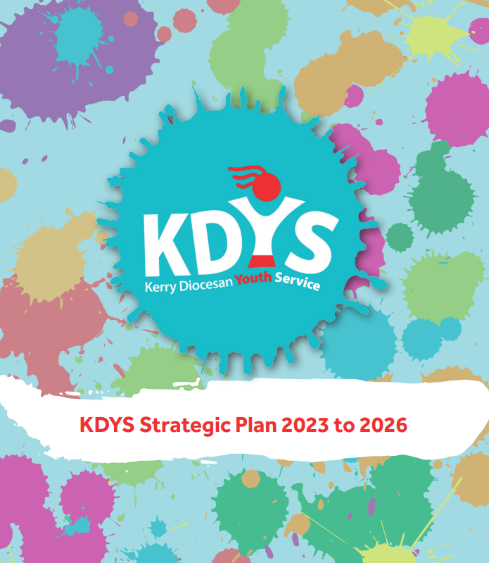
KDYS TRANSFER
PROGRAMME
Anne Murphy, KDYS Youth Information Coordinator.

Slide 2
Navigating the Transition: A Strategy for a Successful Move to Secondary School.
KDYS TRANSFER PROGRAMME.
Youth Work Approach.

Slide 3
You all know that the move to secondary school can be daunting for students. It involves adapting to a new environment, new teaching styles, academic workload, and social dynamics. Understanding these challenges can smooth the way for an easier transition.
KDYS TRANSFER PROGRAMME

Slide 4
The objectives of the
KDYS Transfer programme are:
1. Highlight supports and encourage a positive attitude towards learning.
2. Familiarise students with new subjects, timetables and learning styles.
3. Aid young people in understanding school rules, policies, bullying and cyber safety.
4. Encourage the building of new friendships and social connections.

Slide 5
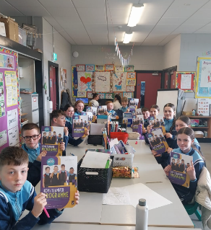
KDYS Transfer Programme creates a support system which takes away the fear for those moving into secondary school.
We all know that students benefit from mentors, teachers, parents, youth workers, all those who can provide
guidance, encouragement and support.

Slide 6
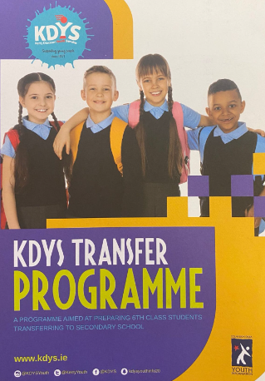
The KDYS Transfer Programme Workbook.
Four Sessions, delivered as follows:
Large class groups: 1 hour session over 4 weeks
Small class groups: 2 hour session over 2 weeks
Very small groups: 4 hour session over 1 day.
Session 1:
Making the Transfer.
Session 2:
New Subjects/Timetables.
Session 3:
Rules, choices, bullying and cyber safety.
Session 4:
Friendship.

Slide 7

FEEDBACK & EVALUATION
RESEARCH & BEST PRACTICE
MOVING
FORWARD
2023
NEW TECHNOLOGY
COLLABORATION
PEER EDUCATION
2022
SIGN POSTING
WHAT MADE A DIFFERENCE?

Slide 8
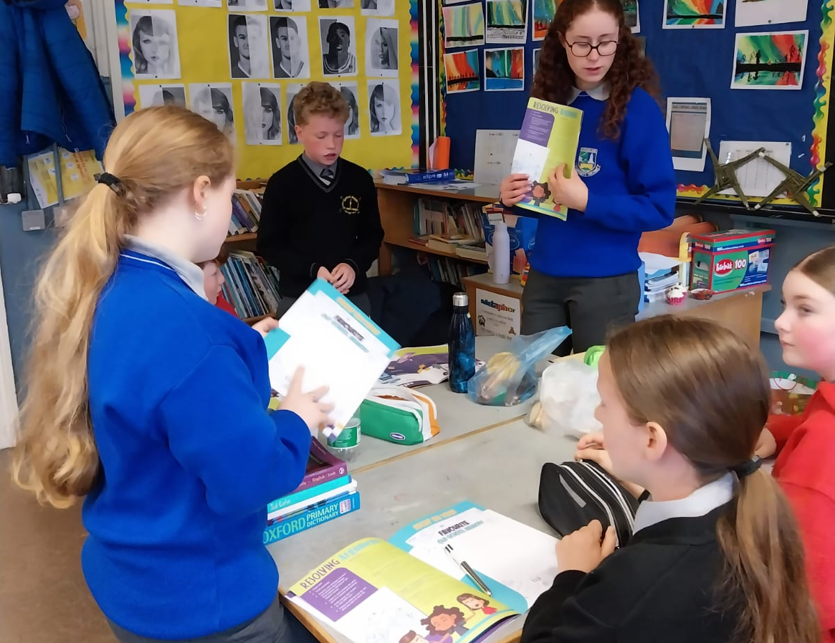
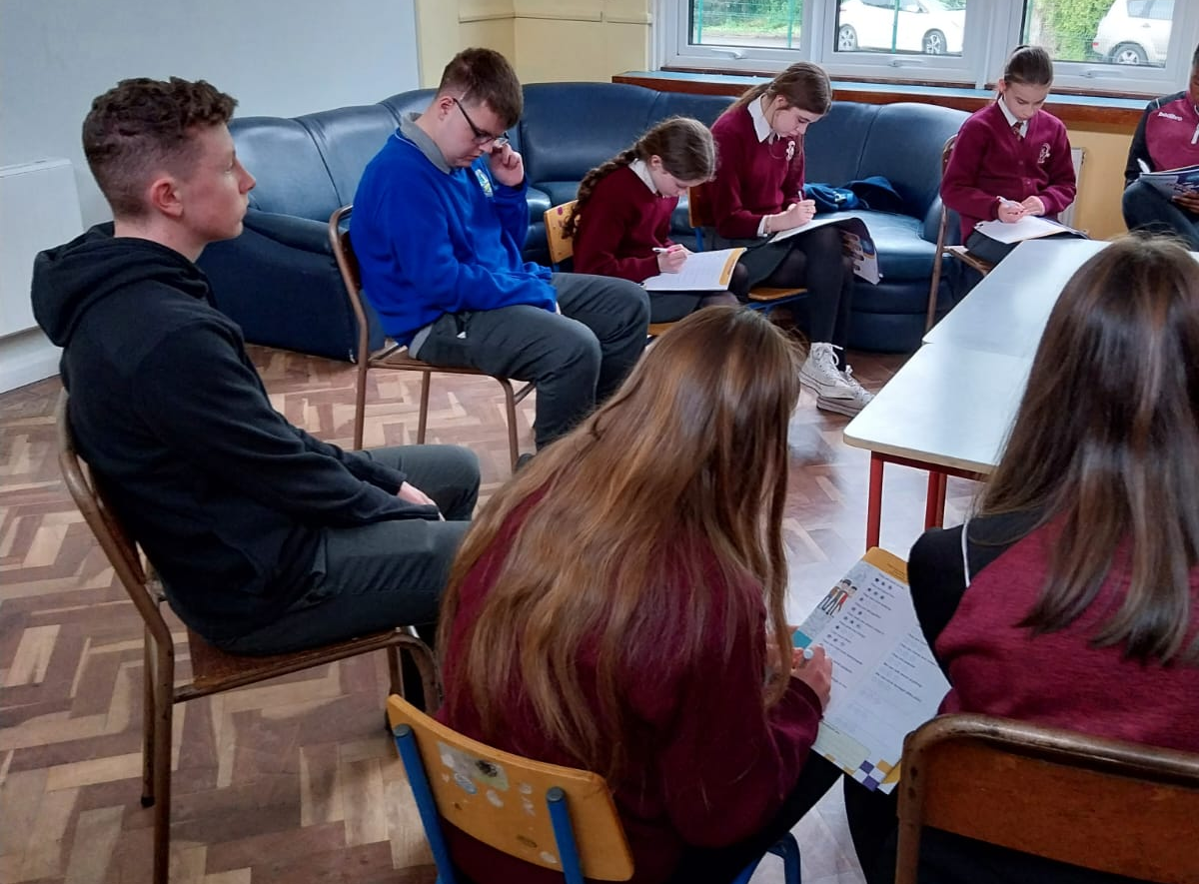
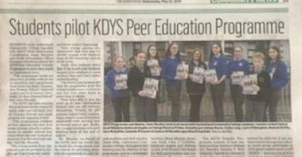
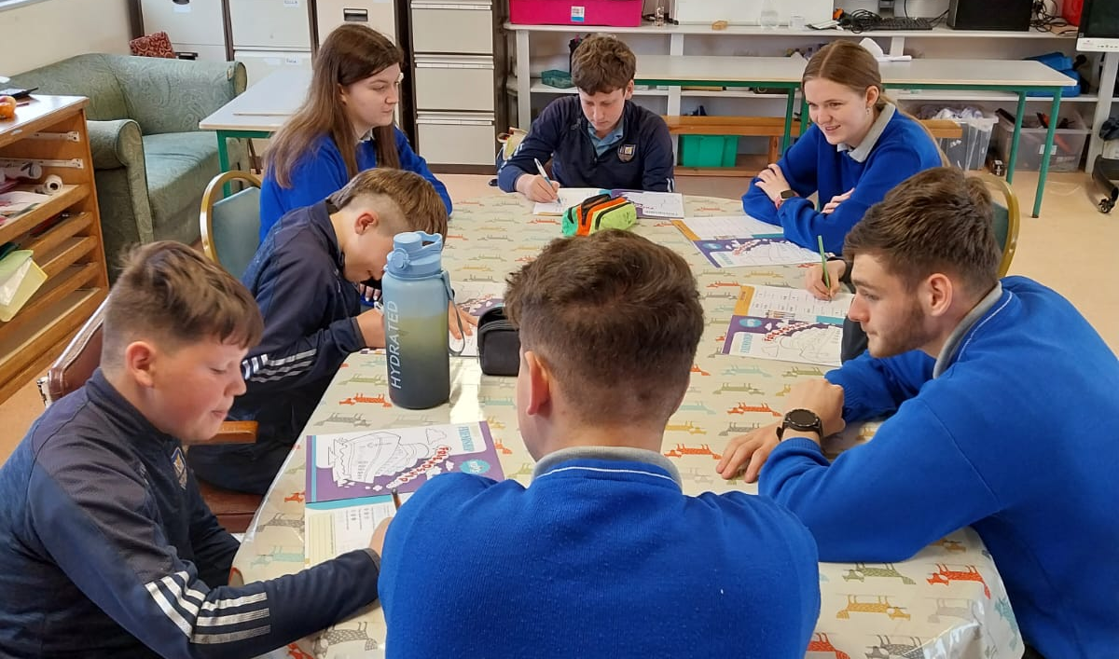
2024
68% increase in the number of schools we engage with since 2021.
(25 – 44)
68% increase in the number of young people.
(506 – 850)

Slide 9
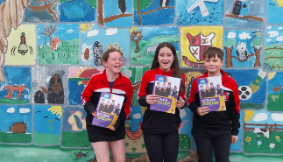

KDYS TRANSFER
PROGRAMME

