Slide 1











YOUTH WORK IN ACTION
ETBI Youth Work Matters 2024
The CYS Youth Information Service - part of the Youth Work team providing supports for young people throughout Clare.

Slide 2
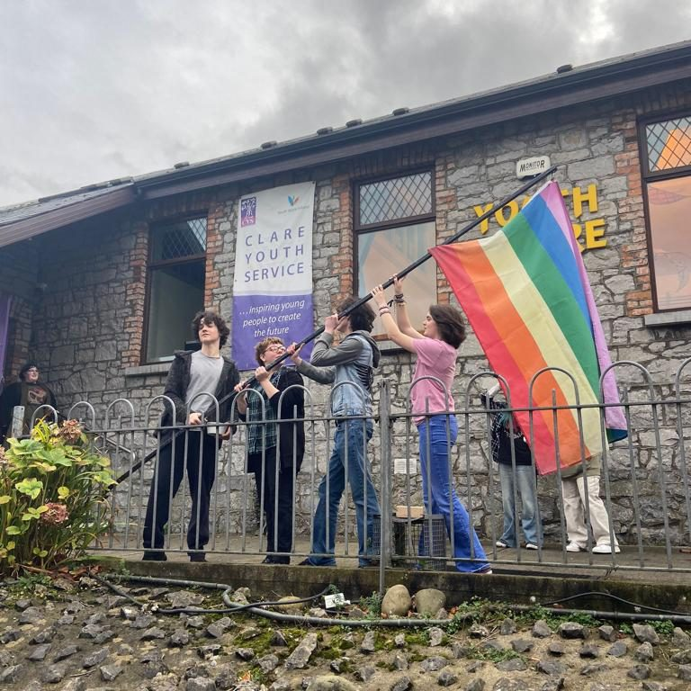
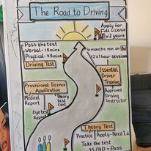
CYS Youth Information Service
Countywide Service
Centre based information provision
Outreach
  Youth Projects, Community spaces, schools and training centers
  22 Remote enabled Digital Screens
  Social Media
  National Youth Chat Service

Slide 3

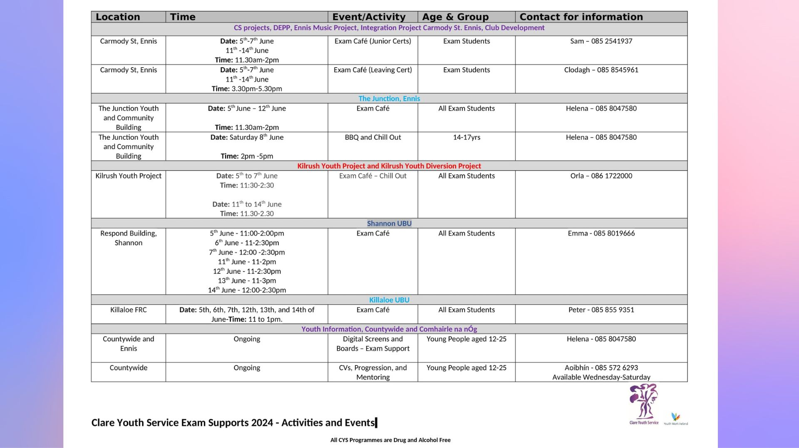





Slide 4
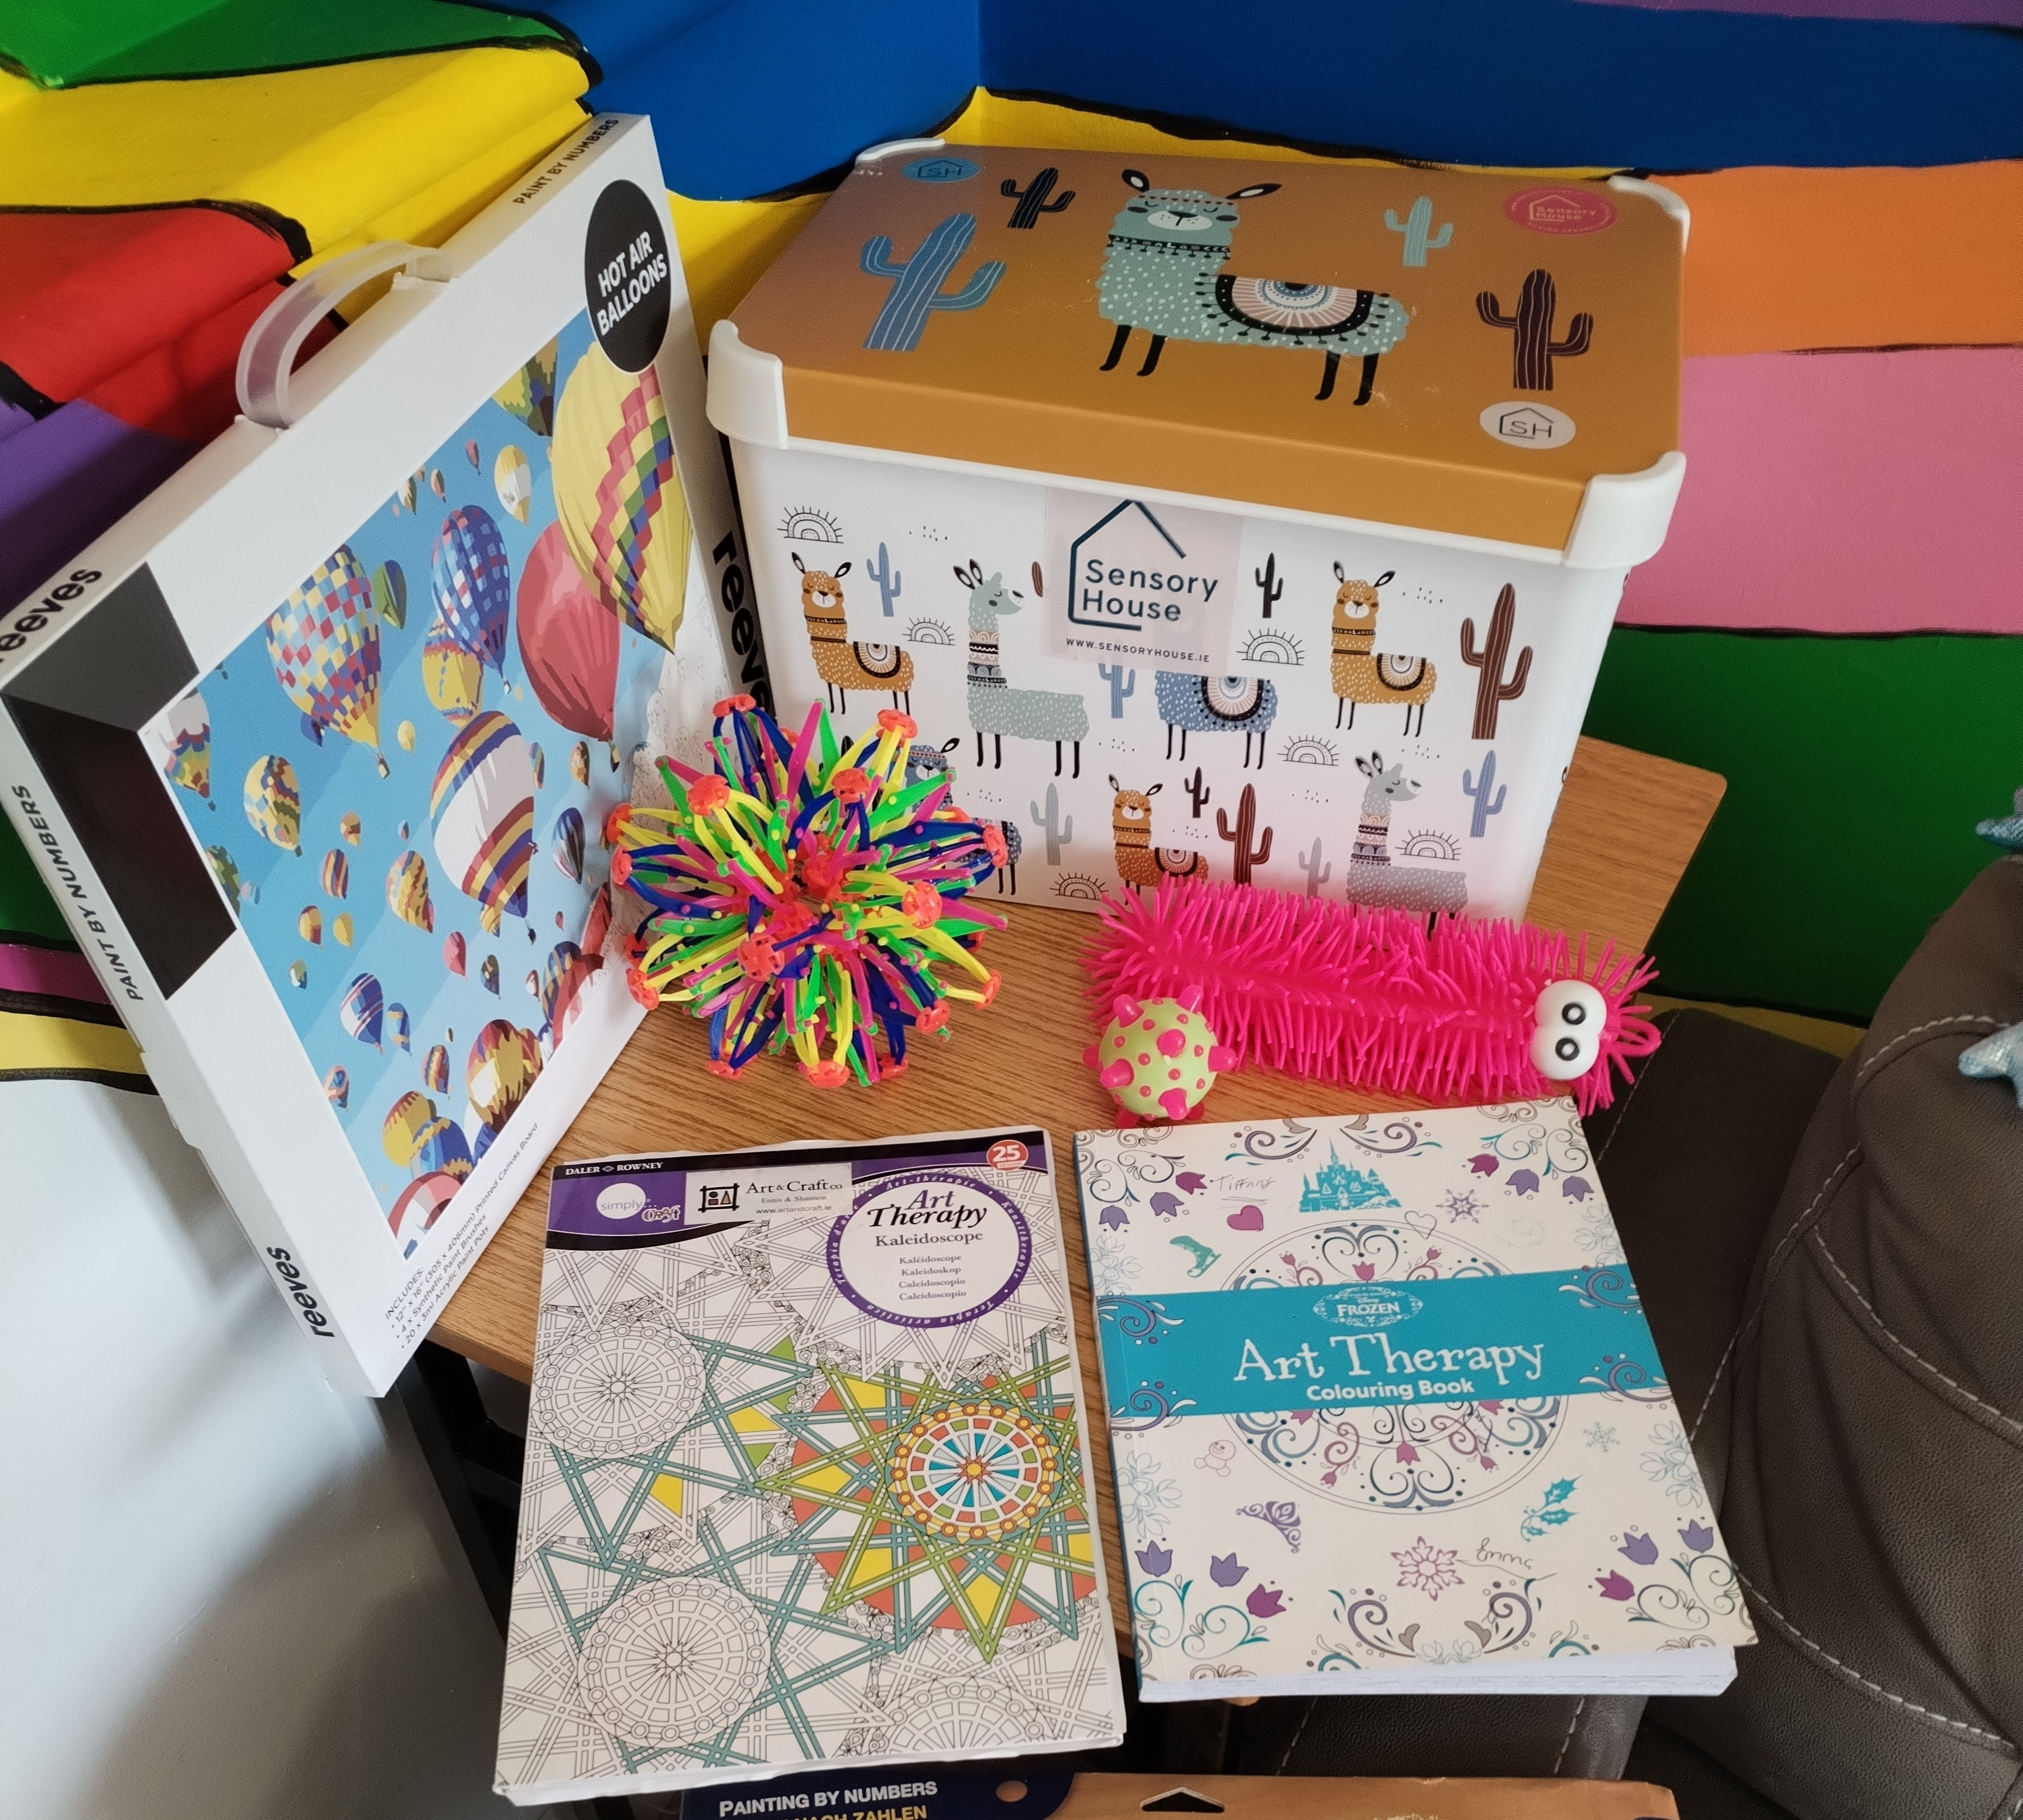
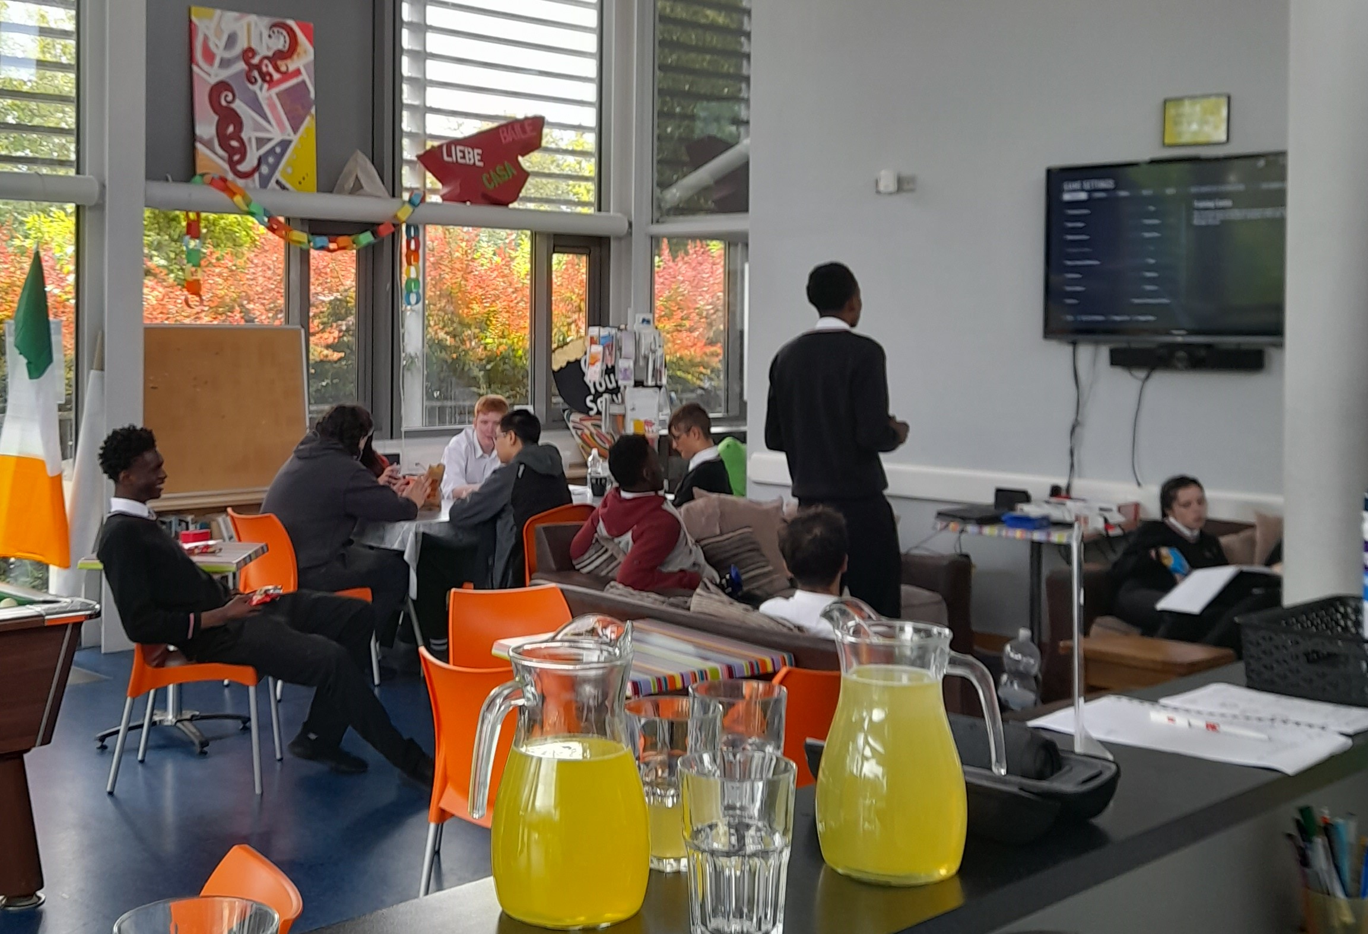
Exam Café’s and Supports
Welcoming, attractive & comfortable space
At a time that’s suitable
Access to Support & Information
Youth workers onsite
Break our spaces
Relationships with others

Slide 5
Thank you for listening
Any questions

