Slide 1

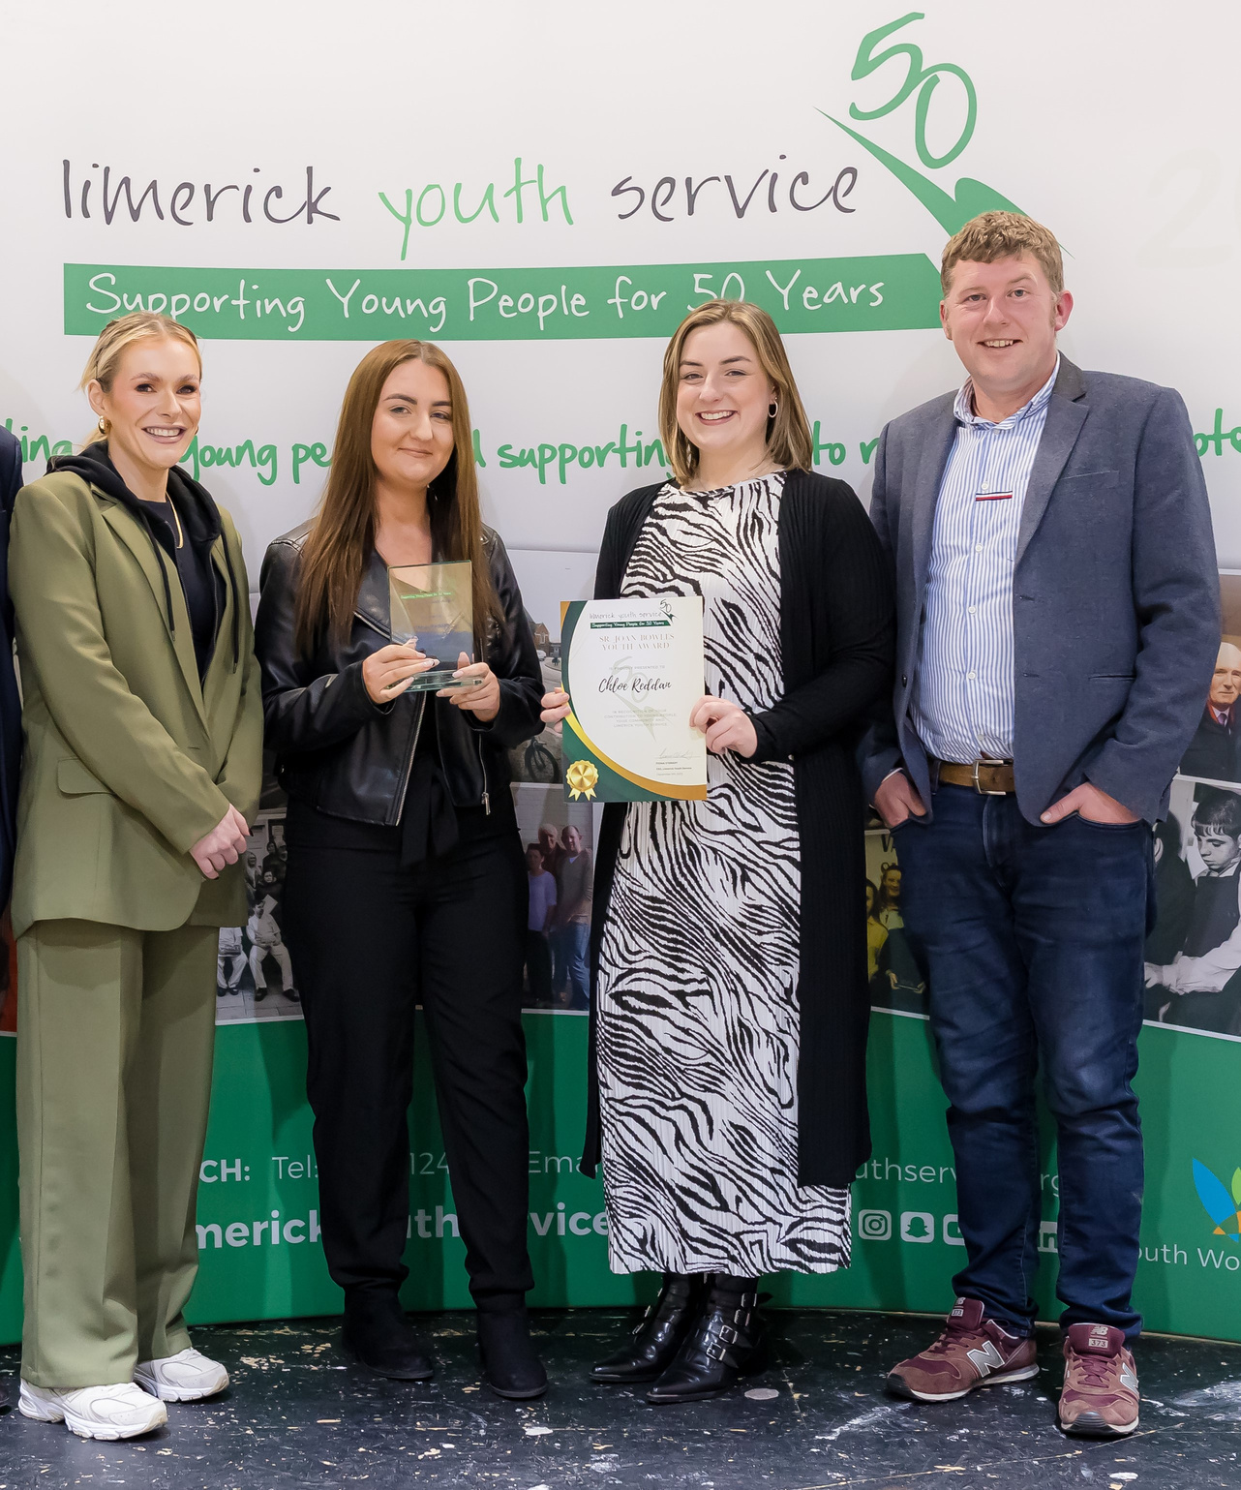

WorkAbility
Project

Slide 2


Who are we?
Who do we work with?
What were the origins and development process of our programme?

Slide 3

Youth Mentor Approach - Key Componants
Relationship Building -
Youth Work Methodology
Role Modeling
Guidance and
Support
Skill Development
Goal Setting and
Achievement
Networking
Opportunities

Slide 4
Benefits of Youth Mentor Approach
Improved Academic
Performance
Increased Career
Readiness
Enhanced Self-Esteem
and Confidence
Positive Behavioral
Changes
Better Social and
Emotional Skills
Long-Term Impact

Slide 5



Types Of Youth Mentoring
One-on-one Mentoring
Group Mentoring
E-Mentoring

Slide 6

WorkAbility is unique/innovative in that we have OT. Occupational therapy (OT) complements our youth work approach, here are some key advantages:
  Skill Development
  Workplace Adaptation
  Building Confidence
  Social Skills Training
  Stress and Anxiety Management
  Promoting Independence
  Support for Employers
  Sustainable Employment
  Enhancing Quality of Life

Slide 7
An integrated youth service approach offers numerous benefits for young people, as it combines various services and resources into a cohesive and collaborative framework. Some key advantages are;
Coordination
and
Continuity
of Care
Enhanced
Support
Networks
Holistic
Support
Improved
Accessibility
Early
Intervention
Increased
Engagement
and
Empowerment
Efficiency
and
Resource
Optimization
Strengthening
Community
Ties
Personalized
Services
Young
Ireland

Slide 8


Sam’s
Story

