Slide 1

Roscommon Youth Service 2
Roscommon LEADER Partnership

Slide 2
Service Aim
Roscommon Youth Service 2, Is a Roscommon Leader Partnership operated targeted UBU youth service funded through the Galway and Roscommon Education and Training Board (GRETB), by the Department of Children, Equality, Disability, Integration and Youth (DECDIY)
The aim of the service is to provide support for young people living in county Roscommon aged 10-24 years who are at risk of not reaching their full potential due to a variety of factors including but not limited to economic disadvantage, marginalisation, rural isolation, social isolation, metal health concerns, disability etc.

Slide 3
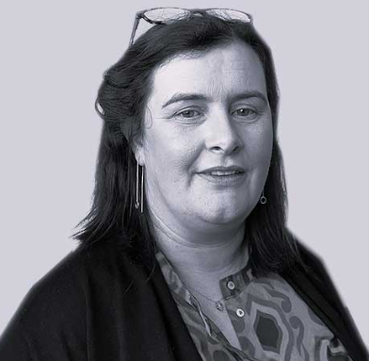
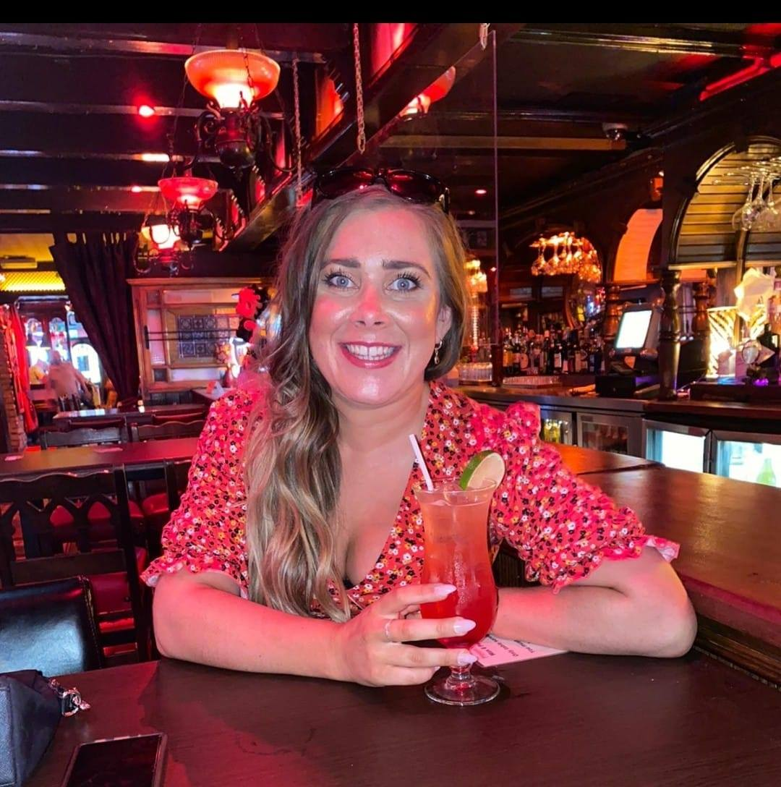
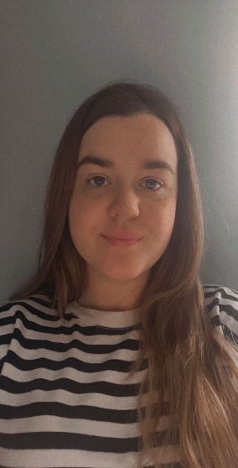
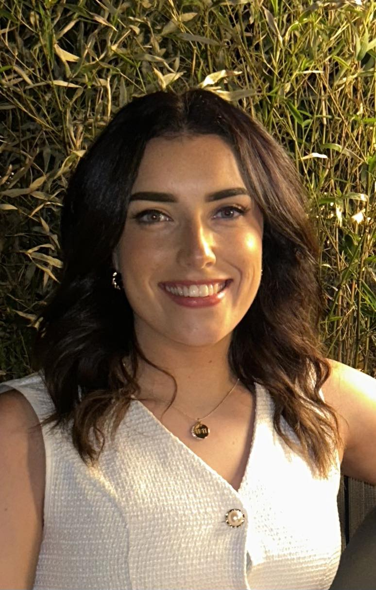
Roscommon Youth Service 2
Lead by Roscommon LEADER Partnership
Mobile Service
3 Youth Service Staff
Line Manager
Linda Davine Line Manager
Aoife Guihen
SYO
Rachel Glynn
Youth Officer
Isla Gartlan
Youth Officer

Slide 4
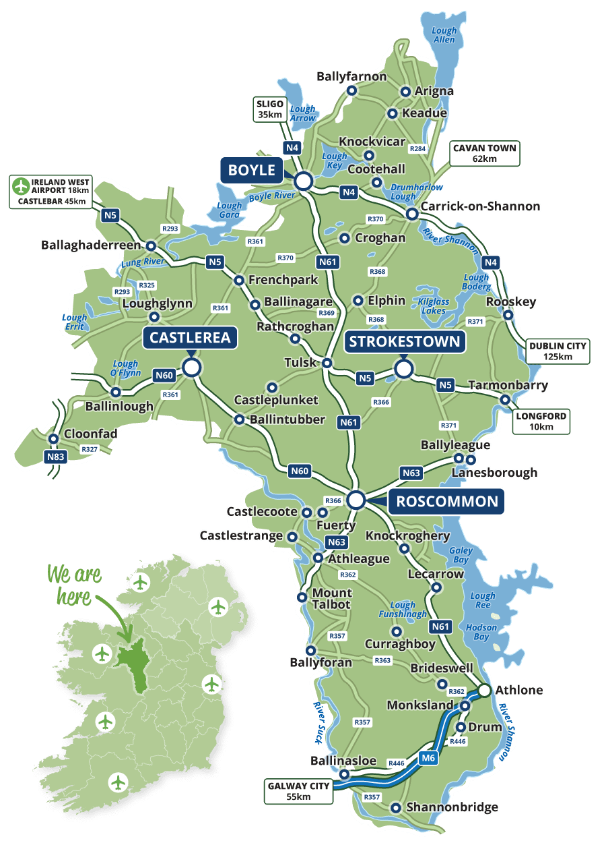
Areas of work
Renting community spaces in each area
Providing an online option for those unable to attend groups
One to One sessions in a safe and comfortable location for the individual

Slide 5
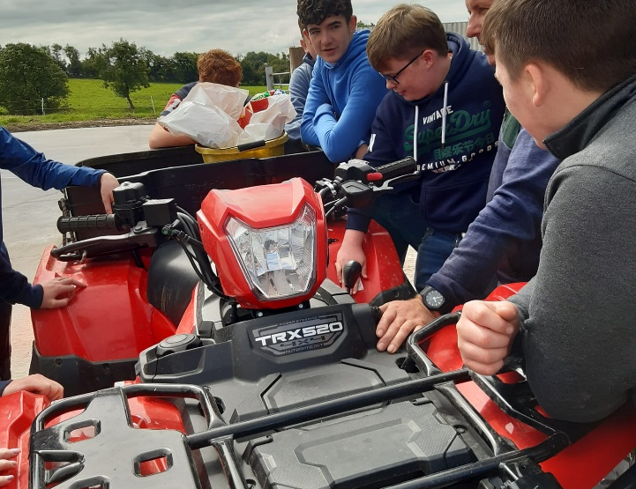
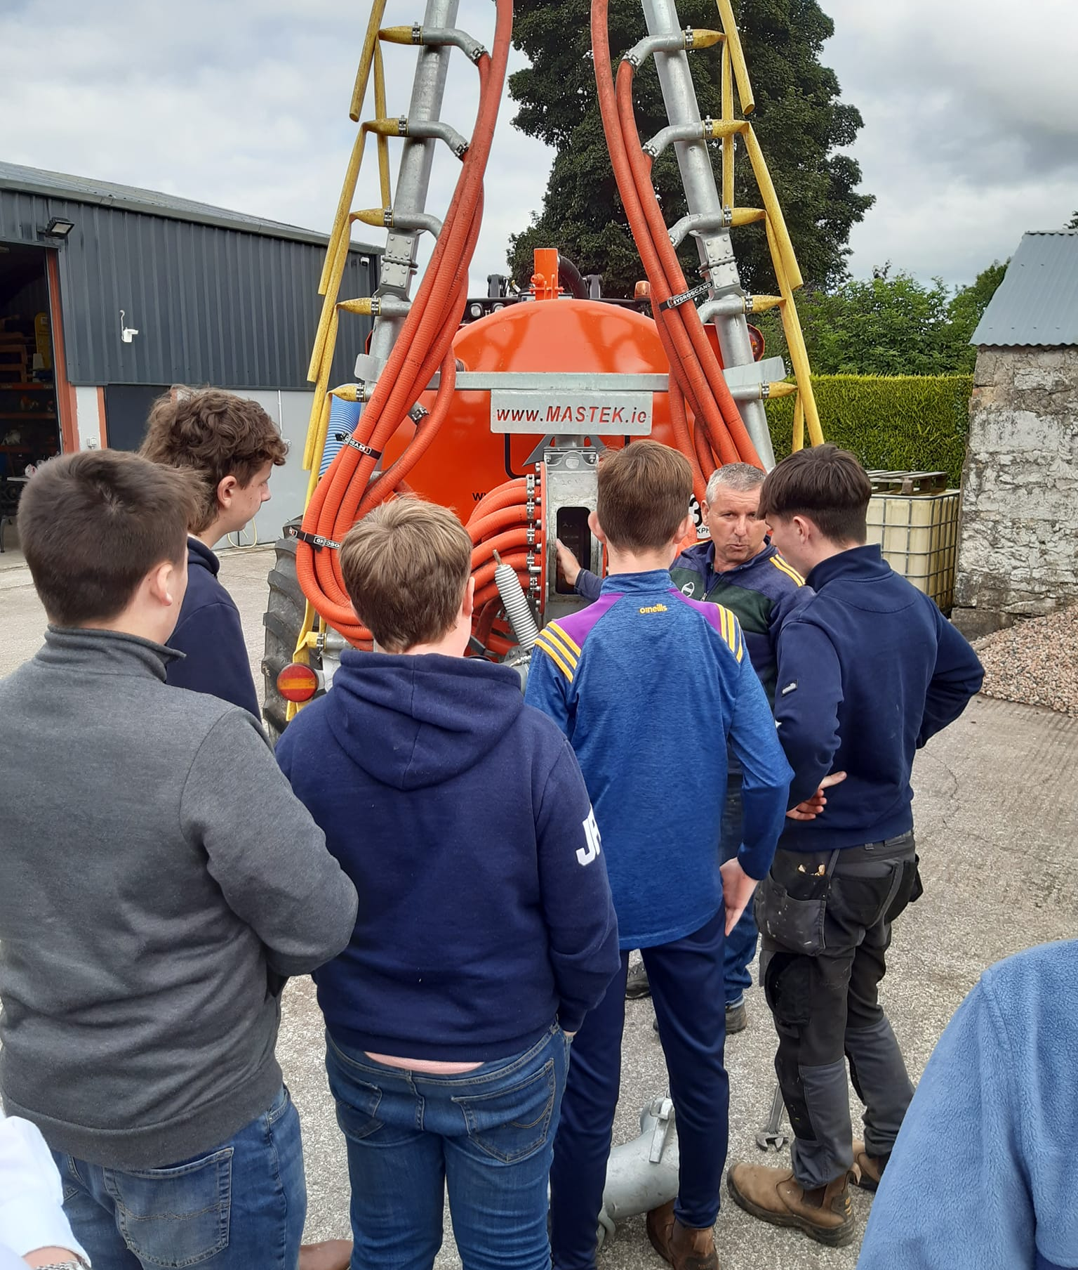
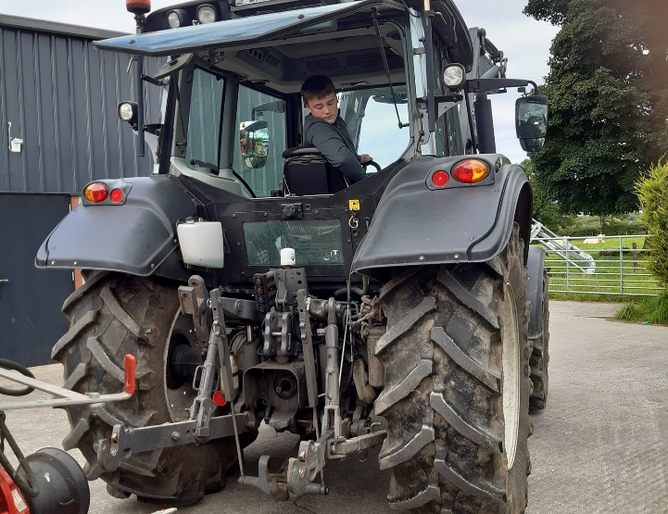
Farm Safety
Farm Safety training,
Quads,
Tractors,
Slurry Tanks,
Sheds,

Slide 6
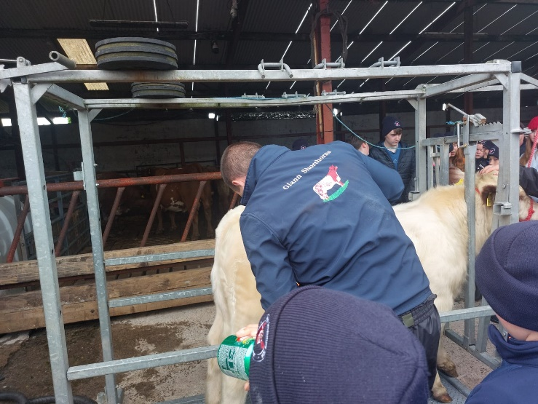
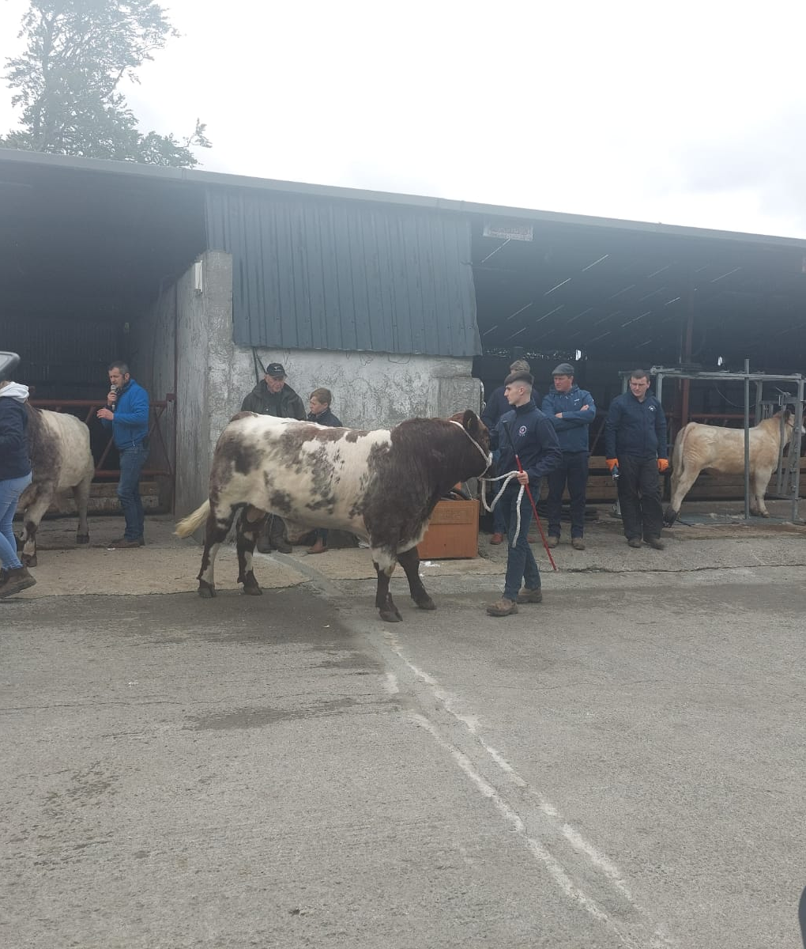
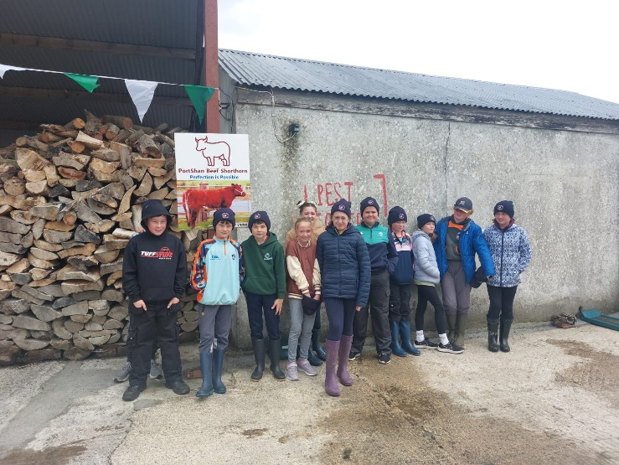
Young Farmers Development Day

Slide 7
Erasmus+ – Youth Mobility
€ 97,732.00
Erasmus key topics – Youth, Employability & Disabilities
The group consists of young people , including those with an Intellectual Disability who are between the ages of 18 and 24 years
Country | Area | Partners
Ireland | Roscommon | Roscommon LEADER Partnership
Greece | Crete | OLOKLIROSI
Spain | Lucena | Amigos de Europa

Slide 8
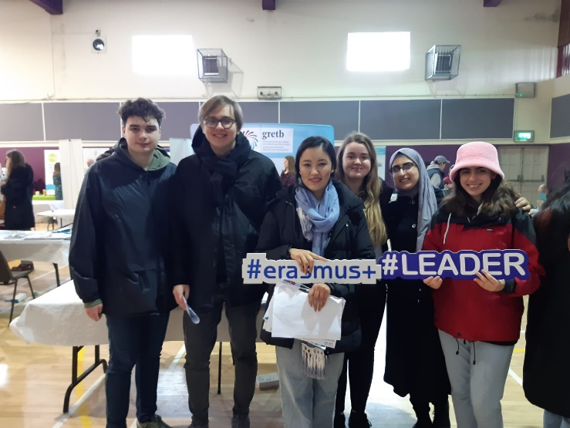
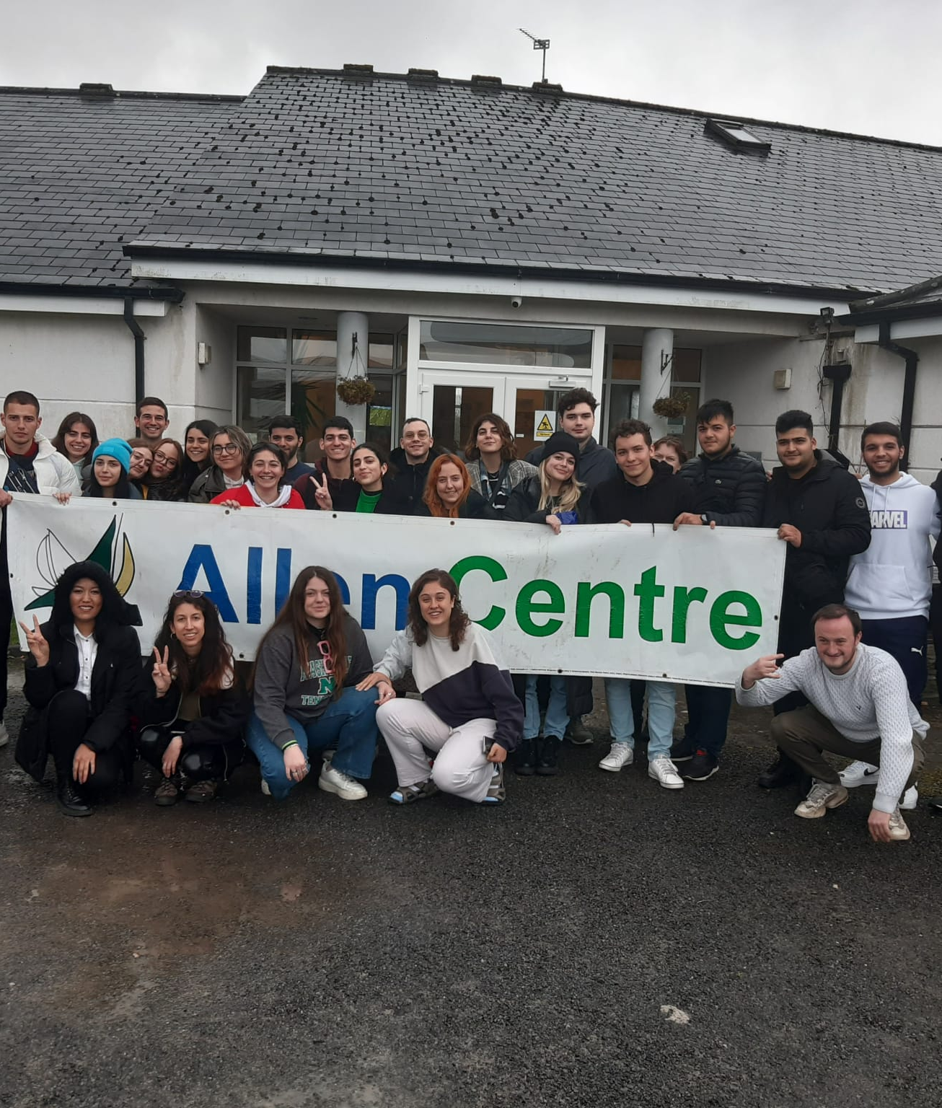
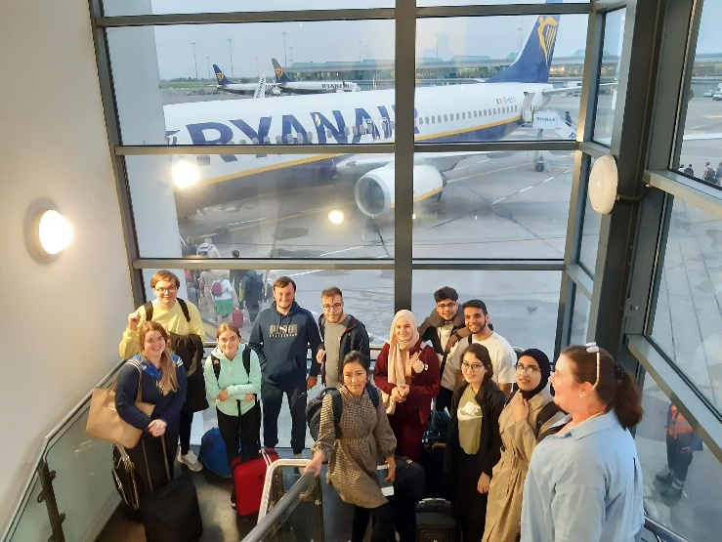
Youth exchange

Slide 9

Erasmus+ – ACORN
€ 250,000 ACORN October 2022 - October 2024
Activating Young Rural Development (ACORN) is a landmark project for European Year of Youth 2022 which will develop a new suite of resources including a transferable mechanism for youth inclusive rural development in Europe.
Championed by partners in four European regions during the lifetime of the project, ACORN will engage, empower and inspire rural young people to become active citizens, co-creators and implementors of rural development initiatives.
Malta, Slovenia, Spain, Denmark and Ireland

Slide 10
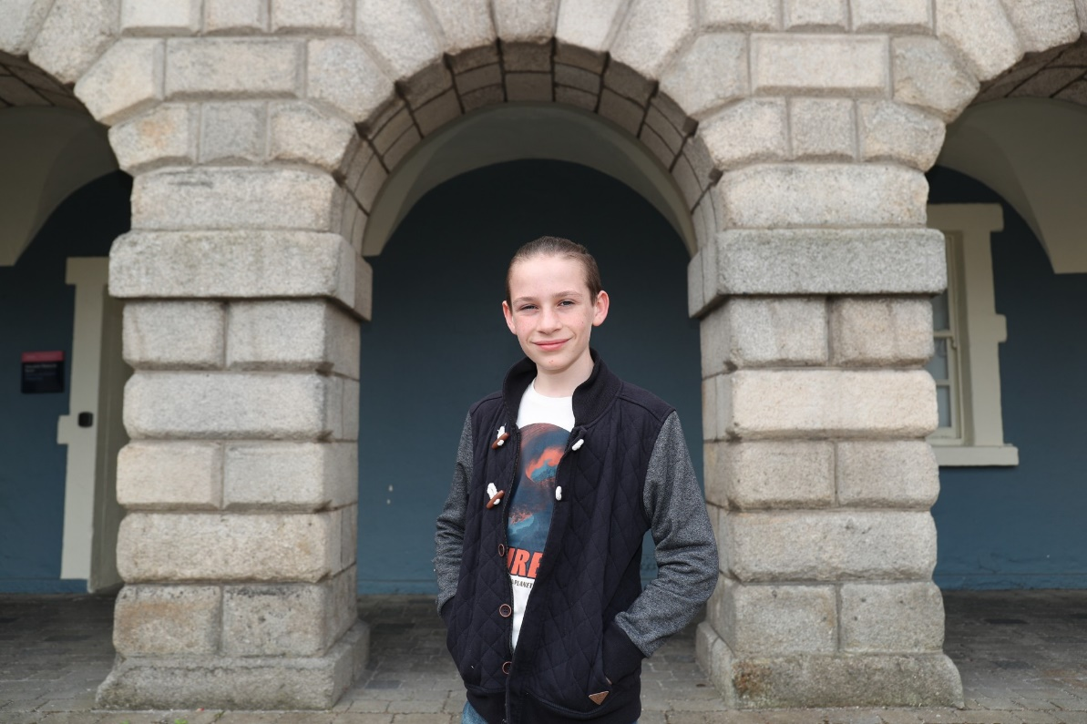
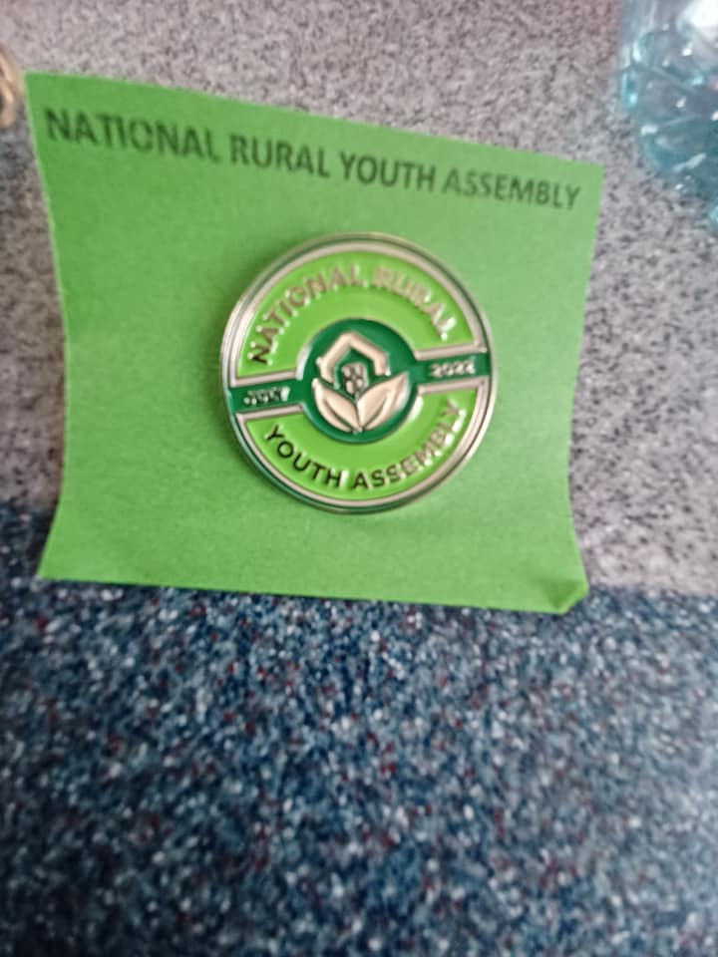
One young people represented the Youth Service at the National Rural Youth Assembly 2024

Slide 11

Erasmus+ – PLANET PULSE
€ 250,000 Planet Pulse May 2024 - May 2026
Project objective is to confront youth climate anxiety, transforming climate-concerned young people into advocates who are equipped to create change in their communities.
Through structured, youth-centred resources and platforms that address emotional well-being, PULSE is committed to turning apprehension into action, converting a generation anxious about their planet's future into the leaders and decision-makers who will positively shape it.
Norway, Germany, Slovenia, Denmark and Ireland

Slide 12
Thank You

