Slide 1






I Feel Like I Am Heard
An exploration of good youth work
practice with young people who are not
in employment, education or training
Jimmy Ryan & Kate Carroll
Foróige, National Youth Development Organisation
Notes:
Partnership with KCETB
Research by South East Technological University
Funded by Kilkenny Leader Partnership and County Carlow Development Partnership

Slide 2

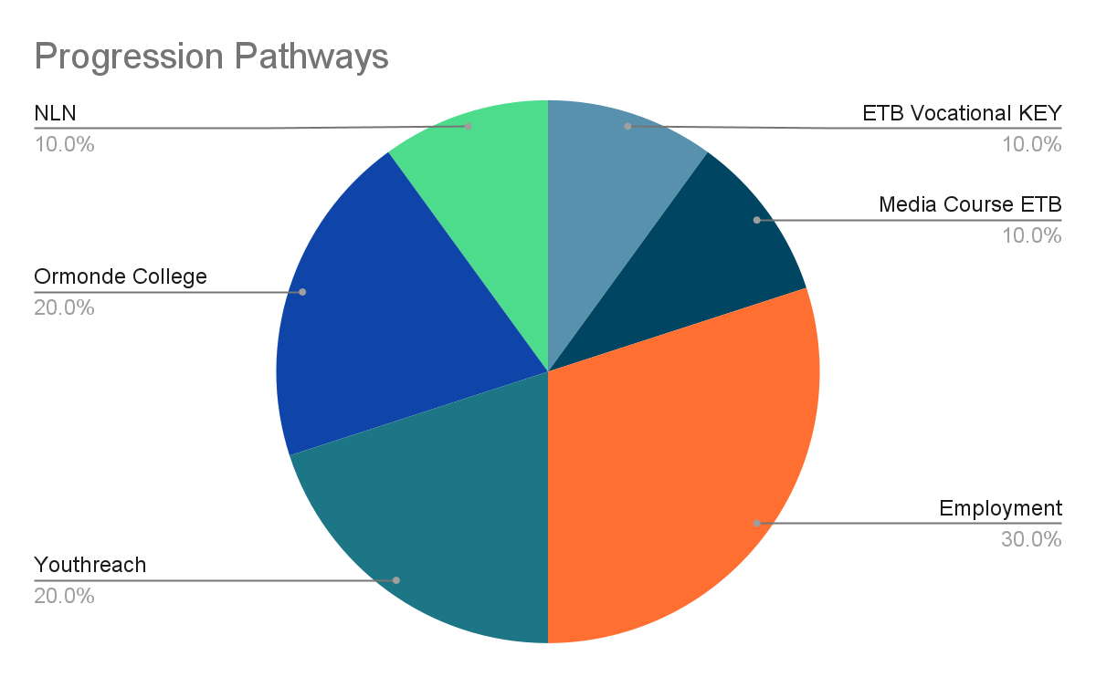
Youth Skills Kilkenny
Funded by DCEDIY through KCETB
NEETs young people ages 15 to 24 years
19 young people
Notes:
Case study was YSK a TYESI funded project in Kilkenny
19 young people engaged
Focus groups and interviews with 10 up
Surveys with youth workers engaged in NEETs work
Interview with Youth Officer involved

Slide 3
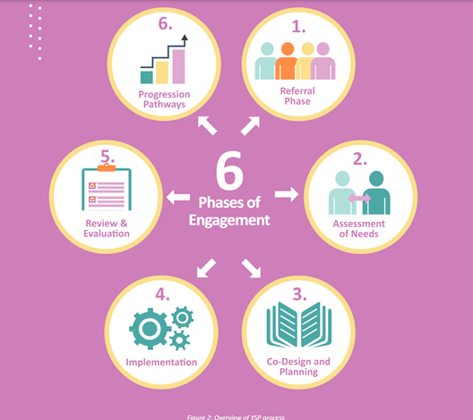
Youth Skills Kilkenny
The Youthskills Model
Notes:
Case study was YSK a TYESI funded project in Kilkenny
19 young people engaged
Focus groups and interviews with 10 up
Surveys with youth workers engaged in NEETs work
Interview with Youth Officer involved

Slide 4
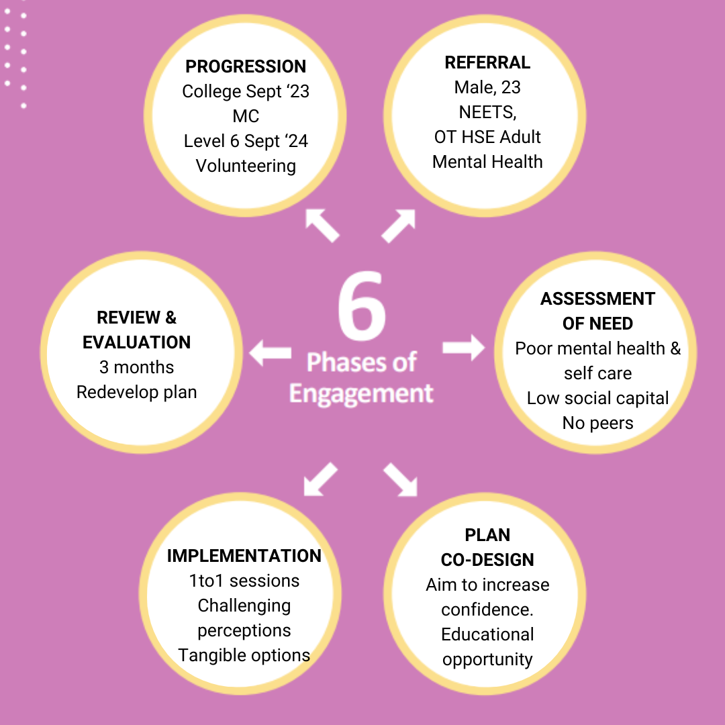
Case Study
“I Feel Like I Am Heard” Research Findings
Unhurried Approach
Relationally Skilled Worker
Structured but Flexible Process
Based on Individual Needs
Voice of Young Person
Outreach, Collaboration, Partnership & Interagency Work
Go the ‘Extra Mile’ to Remove Barriers

Slide 5

Download report at www.kcetb.ie

