Slide 1
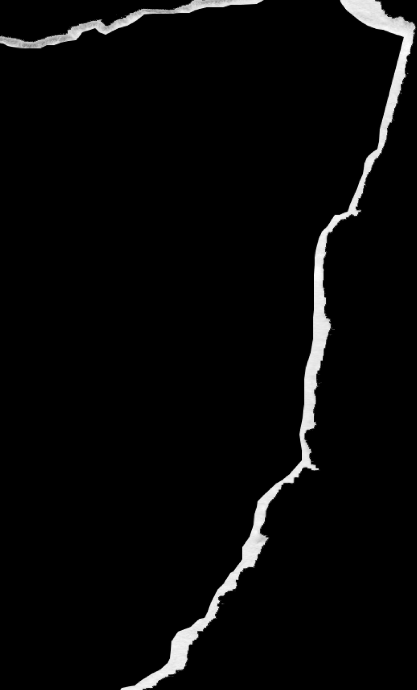
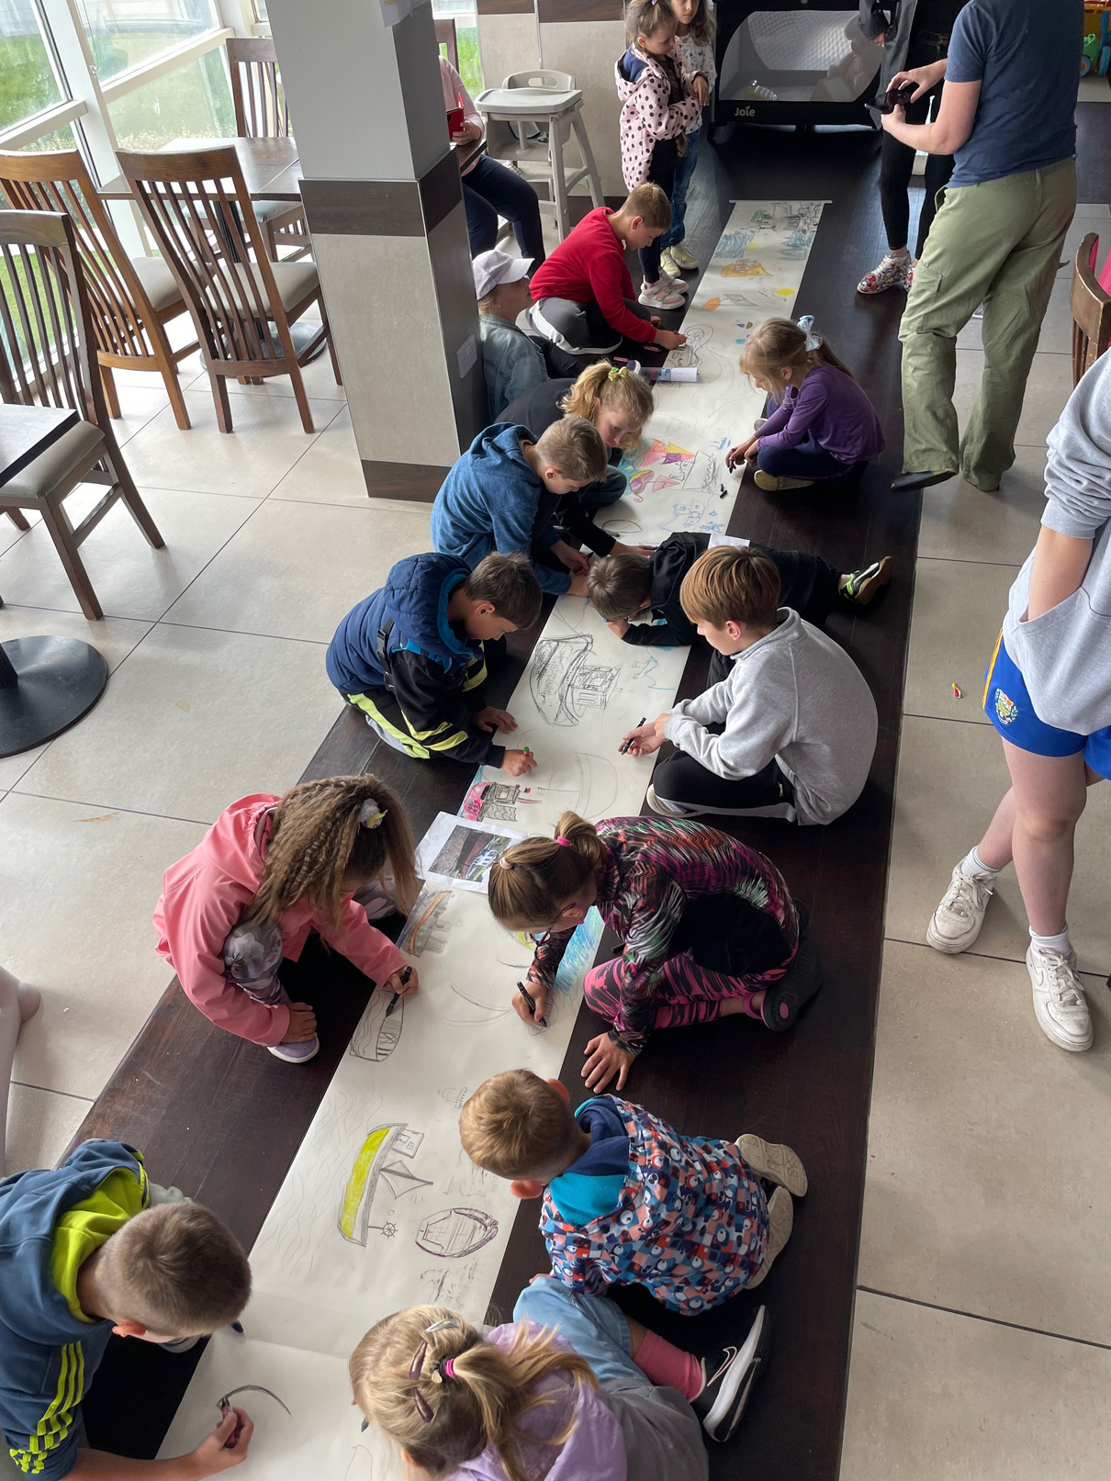
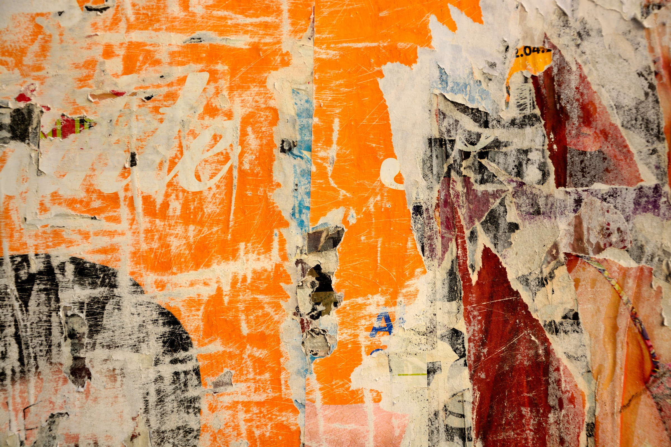
LYCP, CETB, YMCA, FORÓIGE
CONNECTION THROUGH CREATIVITY
MaterReality VR/Art Collaboration
Notes:
Hi there. My name is Emer Barrett, I work at the YMCA Cork as an Integration Youth Worker.
Today I will be talking to you about Connection Through Creativity and looking specifically at an award winning project called Ma-tear-reality. Ma-tear-reality is the brain child of artist and CETB Active Inclusion Support Person, Ann Burns.
Ann is a North Cork based artist who develops creative projects for young people through the mediums of art and virtual reality.

Slide 2
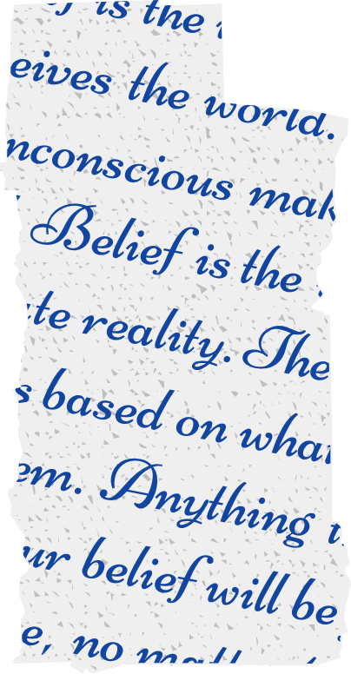
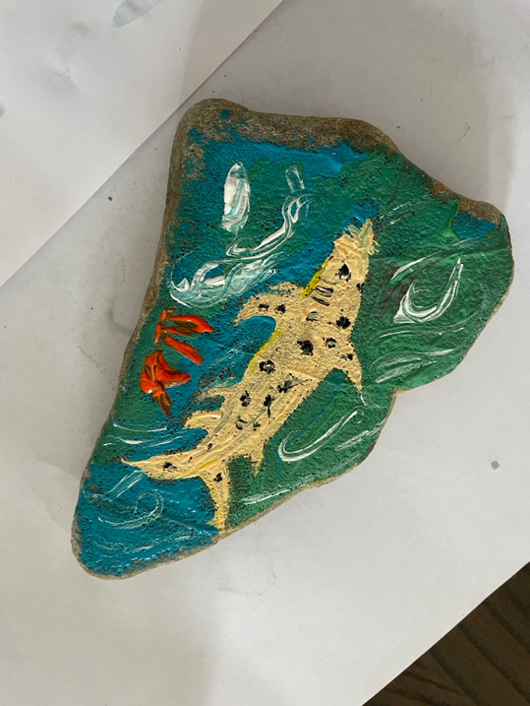
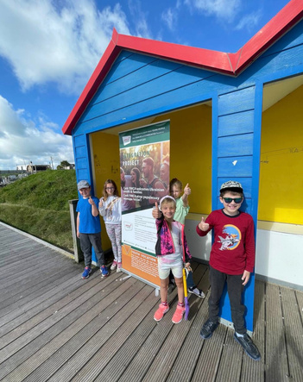
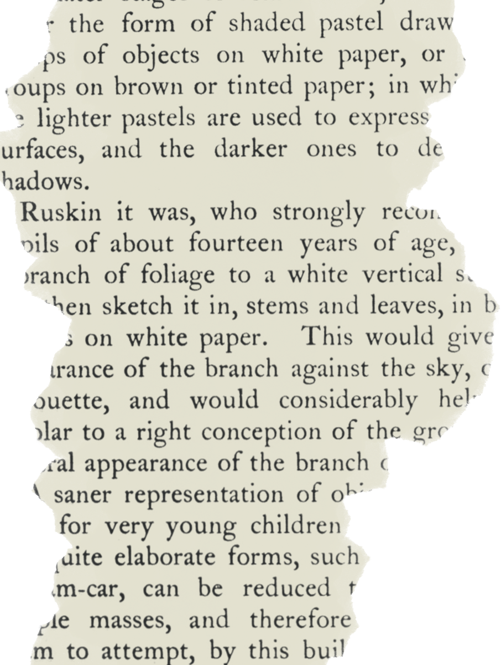
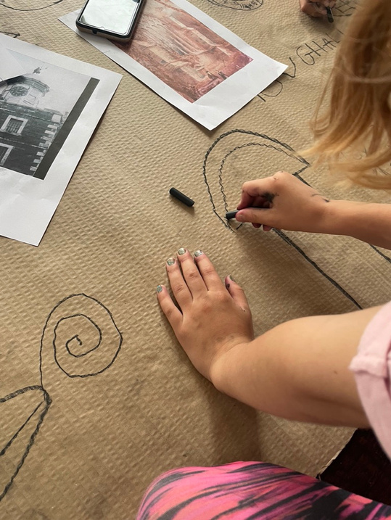
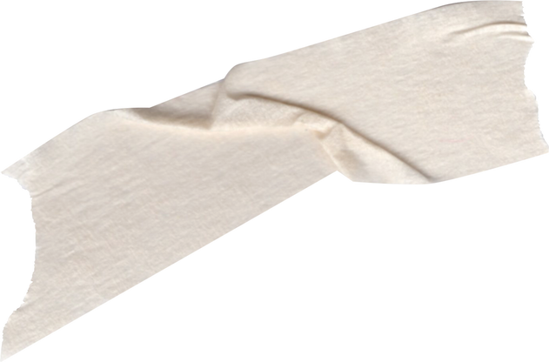
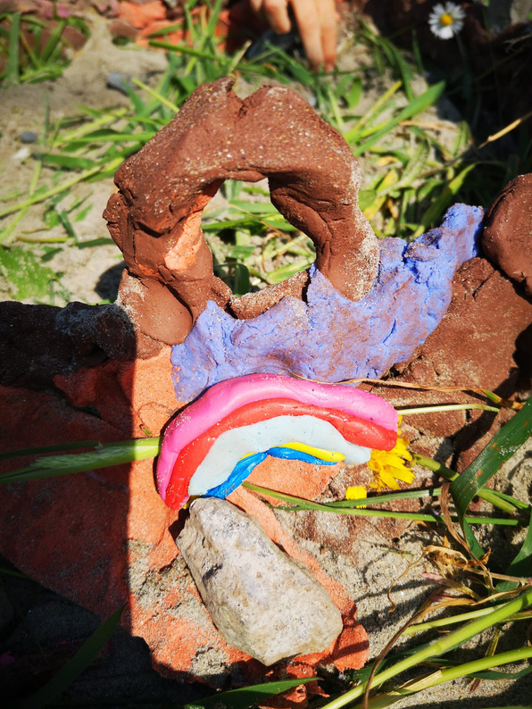
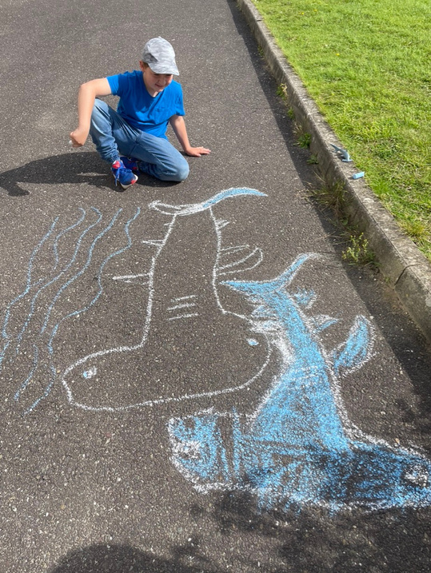
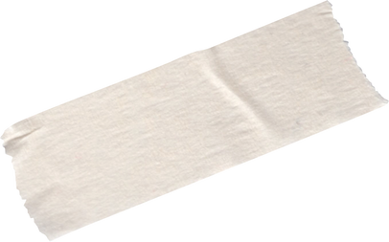
About
art
To give a platform to lesser heard voices within our youth service.
Notes:
Ma-tear-reality is an on going Art and Virtual Reality workshops that invites young people from the seldom heard communities to work collaboratively to make, curate and exhibit their artwork in a virtual reality setting.
They use their natural environments to create artwork that tell their stories and express their creativity. The young people work on curating virtual art spaces that can then be seen by an audience anywhere in the world.
To date Mater/ Reality has run in Sherkin Island and Redbarn, Youghal in Cork in 2023.
The project will continue at the end of this month in Castletownbere working with young people from the local Foroige club There are more linked groups that co-create with the project through a digital platform. Foroige Charleville has also come on board with their digital art experience.

Slide 3
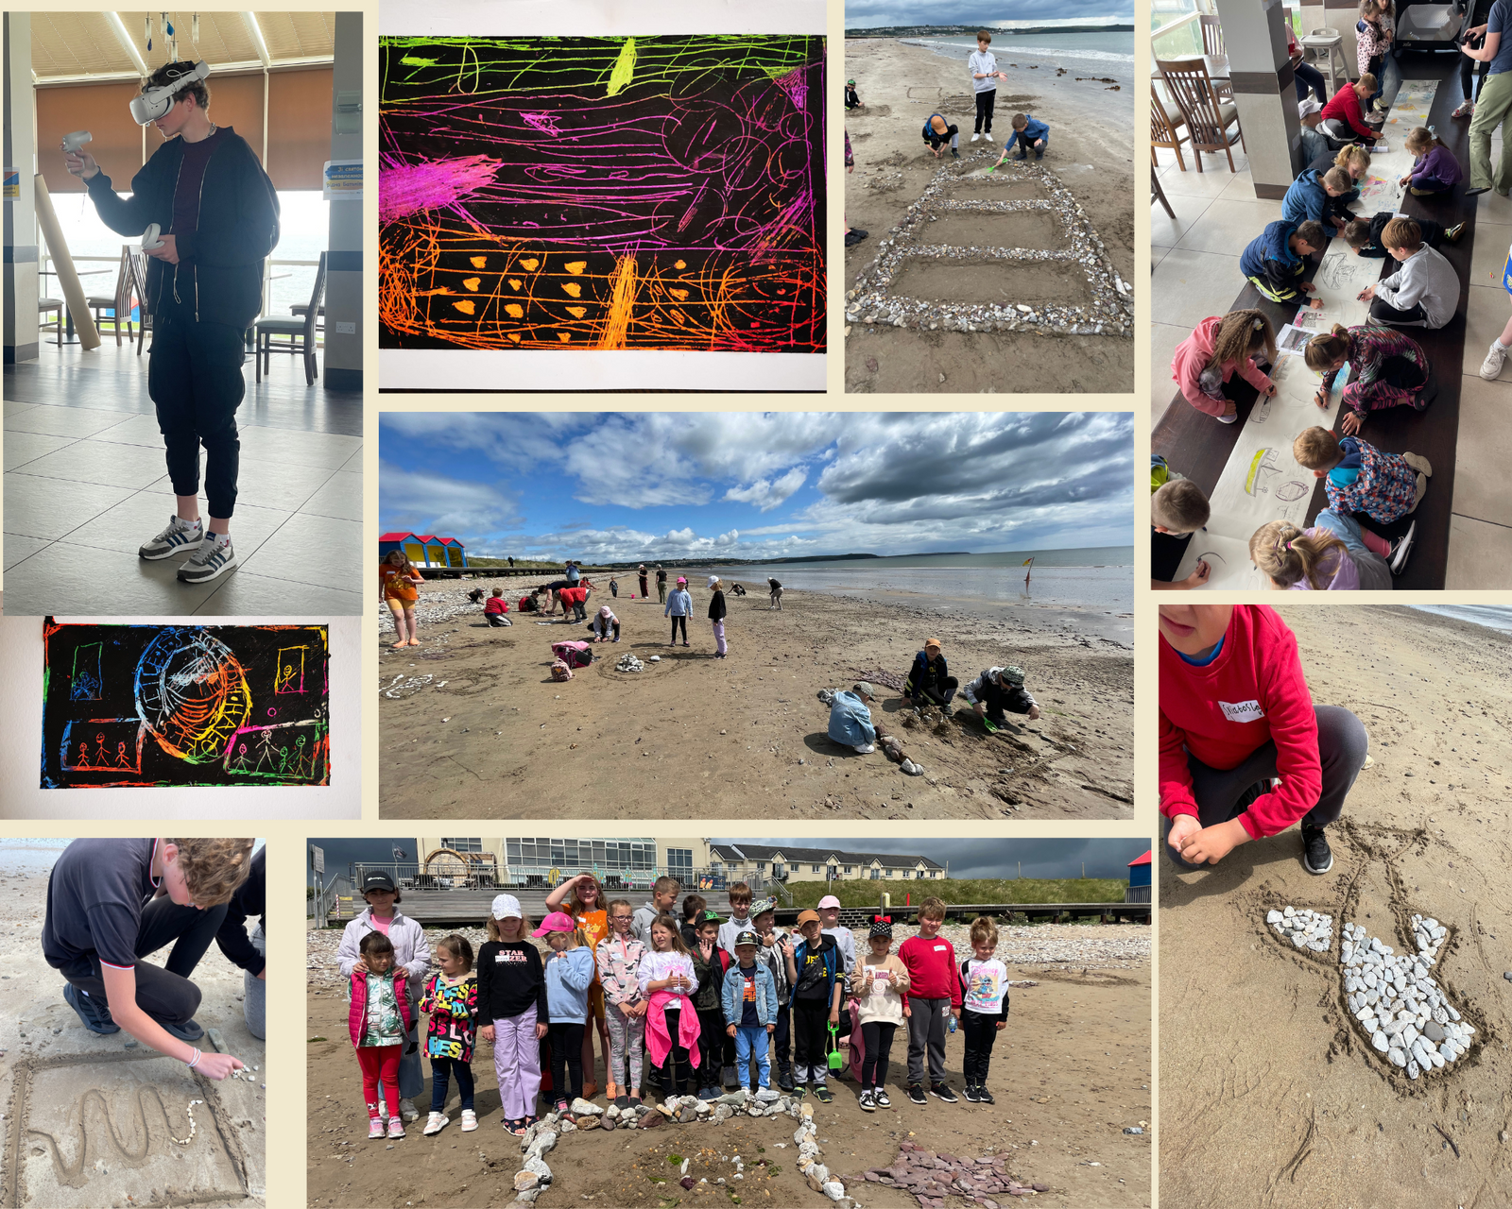
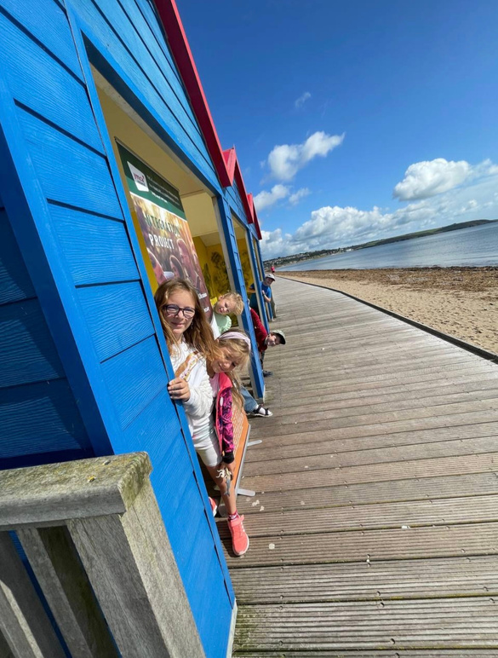
The Project
An environmental & landscape based project that uses sculptures and drawings to express stories by young people from a range of cultural backgrounds.
Notes:
This project was developed as a direct response for youth with seldom heard voices for georgical, economical or social reasons to be listened to and for their work to be fostered.
The idea is that Ann and creative youth workers from various agencies come together to share resources, spitball ideas and allow the project to grow organically as it moves from location to location.

Slide 4
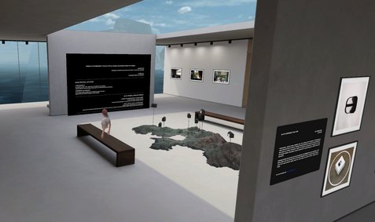
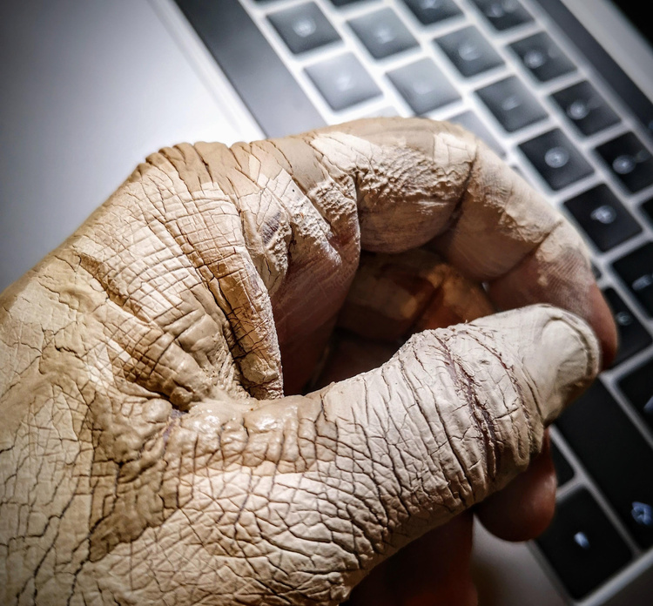

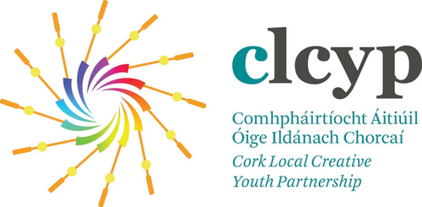
Would you like to take part in a fun & creative virtual reality programme in Youghal?
Use Clay & Drawings to make Your Own Artefacts & Bring them into a Virtual Exhibition
Create your own Gallery in Virtual Reality & Learn to Draw & Sculpt in 3D
Mater-Reality
Location: Redbarn, Youghal, Co. Cork
Dates& Times: July 5,12 & 26ᵗʰ. August 22,23 & 24th
Artist: Ann Burns M.A. www.carriestudios.com
No Experience Necessary
Ages: 5 to 12 / 12- 18
Notes:
Advertising and recruitment is an interagency aspect of the project. As you can see here posters were used to advertise the workshops.
We meet many times, in person and online, before the project starts to discuss, plan, delegate and share resources.
This is a young person centered project. We bring the idea to a community and discuss the vision with the young people. From there they are free to take the project in any direction they like. The project can transform from a sculptural plan to a music based idea or to a drama focused project. The sky is the limit.
What we are offering is a innovative arts perspective.

Slide 5
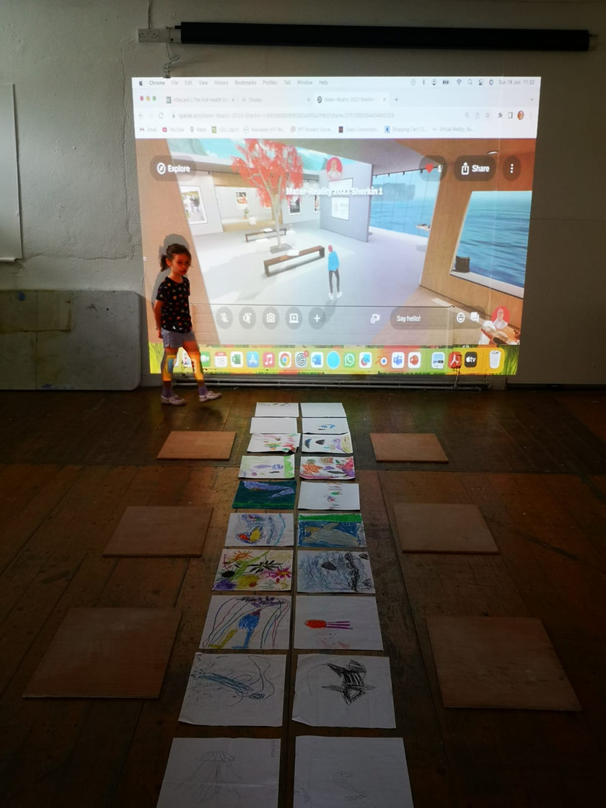
Creative Technology and Digital Skills
Hands on creative projects included drawing, beach work, sculpting, photography and film-making, lidar scanning and virtual reality sculpting.
experiment
Notes:
The young people really enjoyed creating art works from found objects on beaches, green ways and board walks. Even if communication was a barrier they began to tell stories of their lives and interests through drawing, sculpture and painting, outside of language.
The physical artwork is photographed and lidar scanned, then uploaded to the spatial VR platform. The older young people began to curate and experiment with layout, scale and composition creating their bespoke digital exhibition.
As each exhibition is created the hope is that it is accessible through webpages and headset allowing for maximum accessibility.
We felt an important element of the project was that after the art pieces were recorded that the young people could take home their original artwork as part of the creative exchange process.

Slide 6
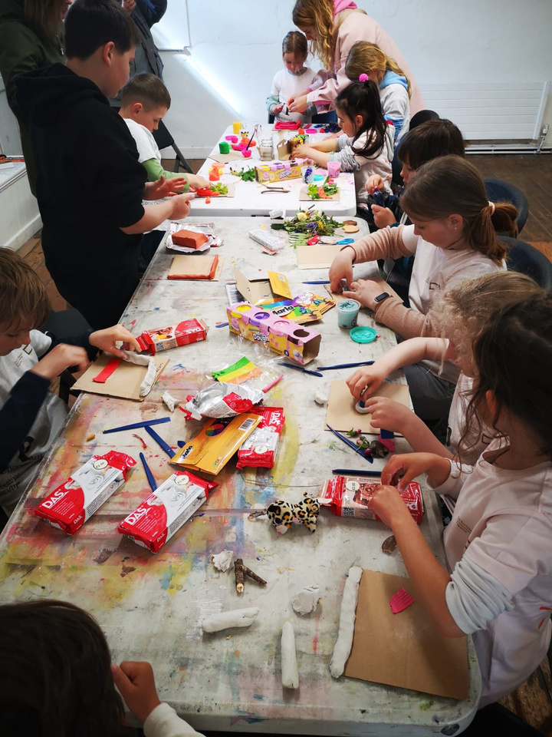
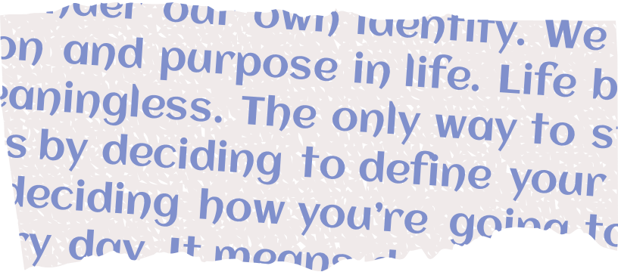
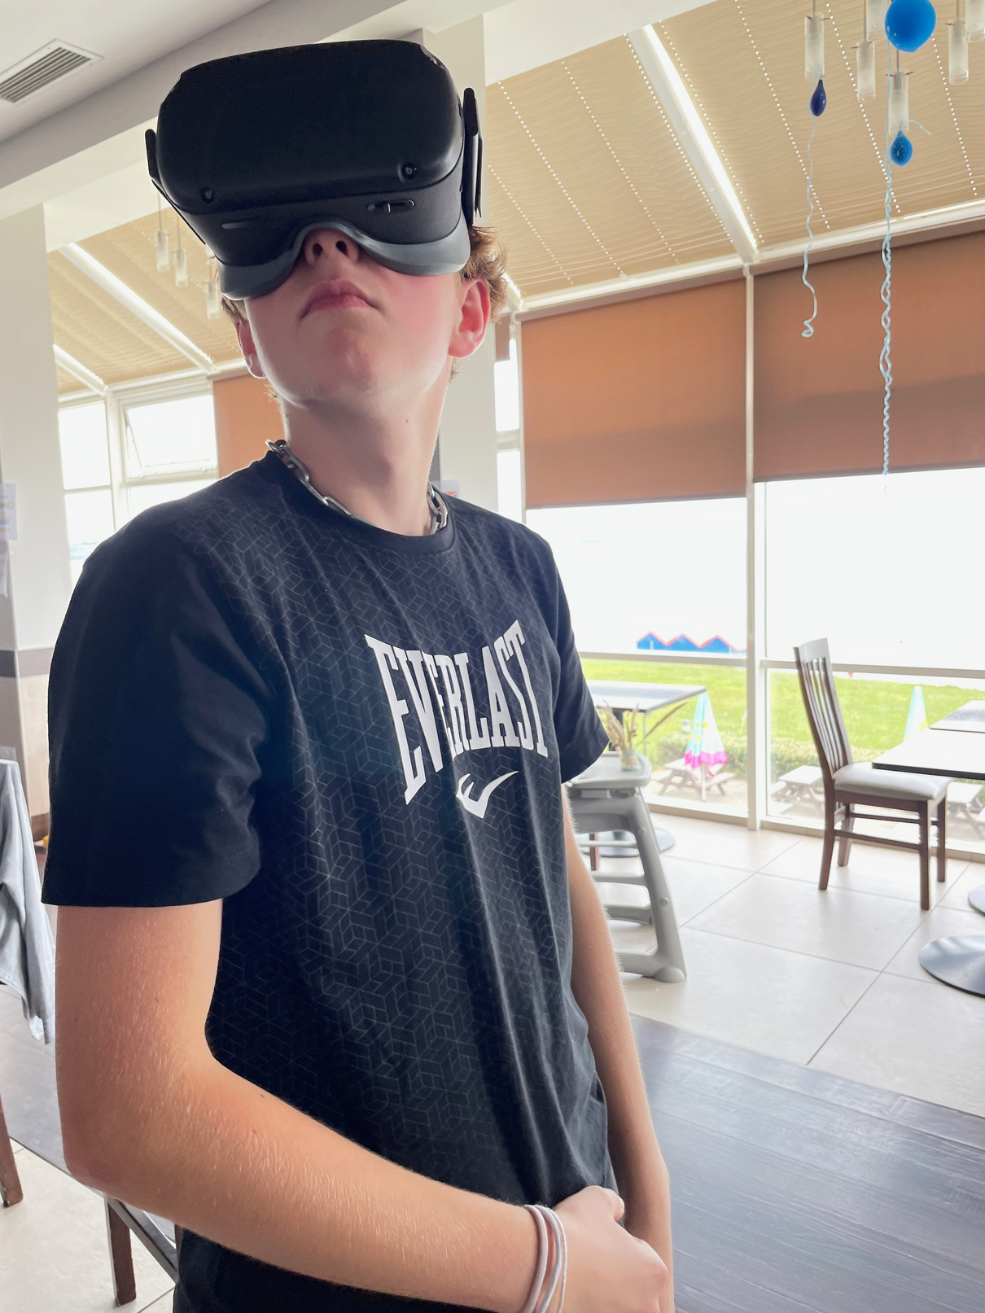
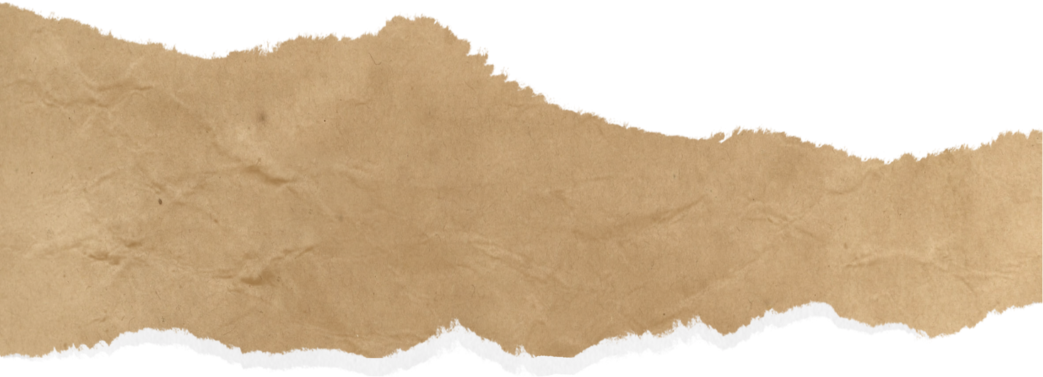
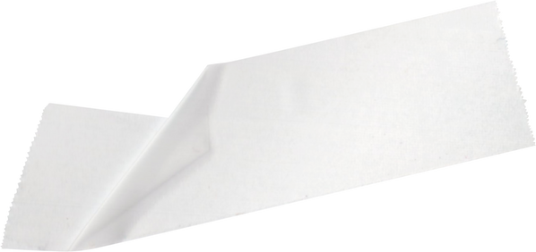
Reaslity
VIRTUAL
Art Skills
PRACTICAL
Notes:
The virtual reality component of the project allows young people to learn digital skills, invent new spaces and show case art created in real time by meeting them where they are at.
We have learned that VR and lidar technology are great tools but it is the practical art produced in these sessions that really showcases their creativity.
Digital technology is never seen as a replacement but as a means to enhance creativity.

Slide 7

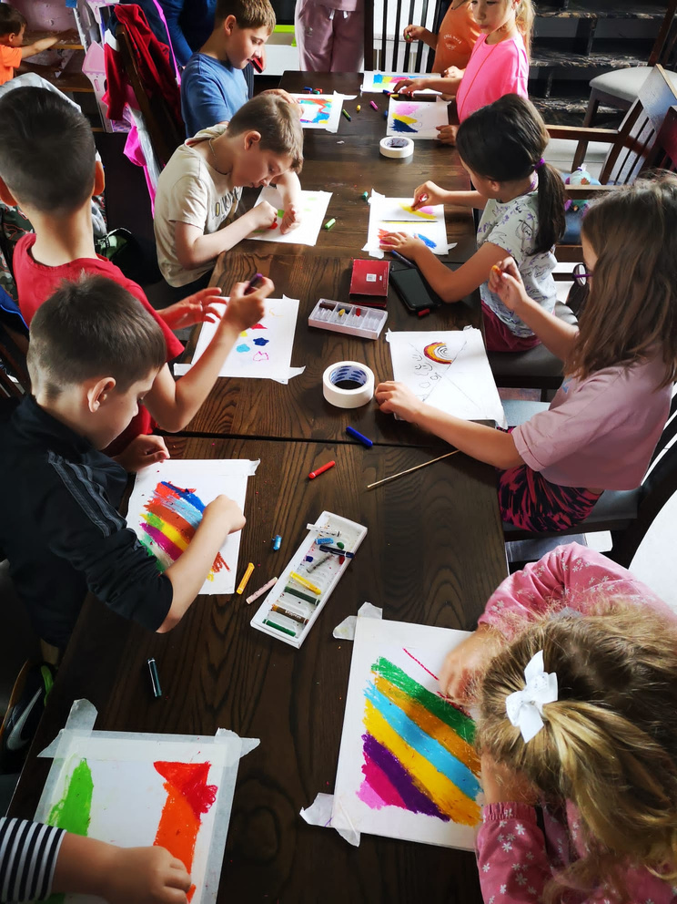
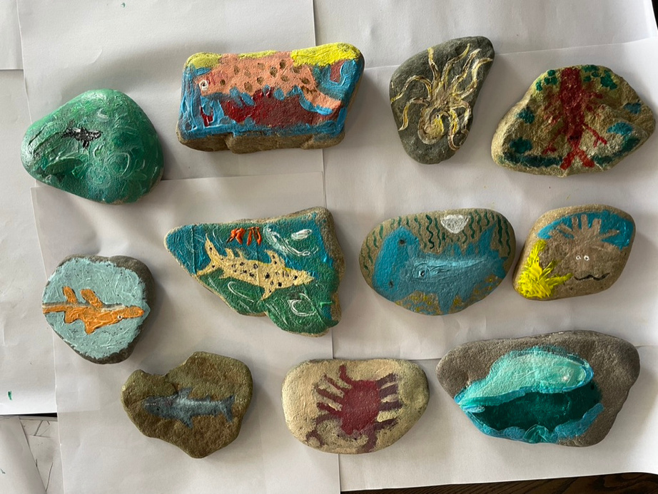
Collaboration
AGENCIES
Bringing together:
LCYP
CETB YOUTH SERVICES
YMCA
FORÓIGE
Notes:
Virtual reality attracts a very broad spectrum of thinkers, and in order to be successful in an educational setting as this one, it requires a myriad of expertise. VR encompasses many transdisciplinary practices. For this reason, we were delighted to have multi agencies on board and plenty of joined up thinking! We needed funders, for sure, but also people with gaming, sound and general digital literacy. Recruitment of staff as well as young people was of the essence, and I guess, we were lucky that both Ann and I had a background in this work, It wouldn't have been possible to train ourselves first, and then the young people.

Slide 8
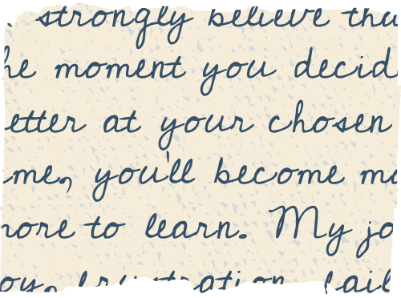
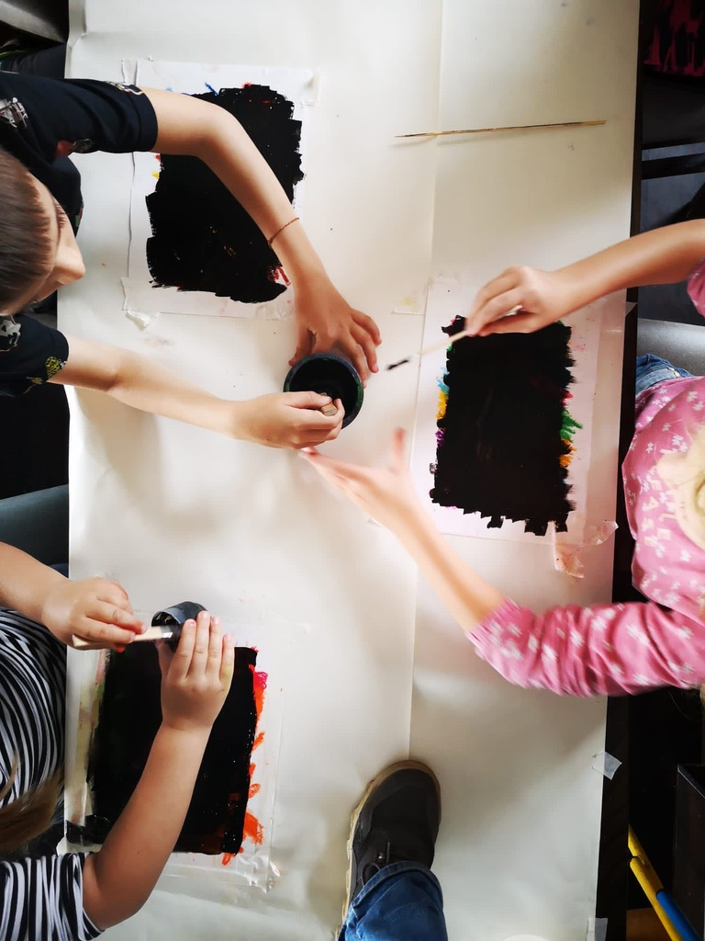
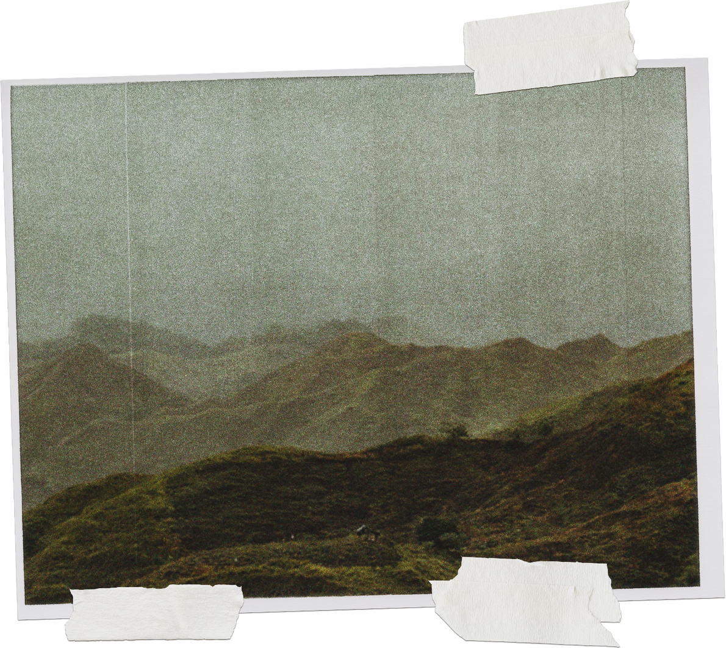
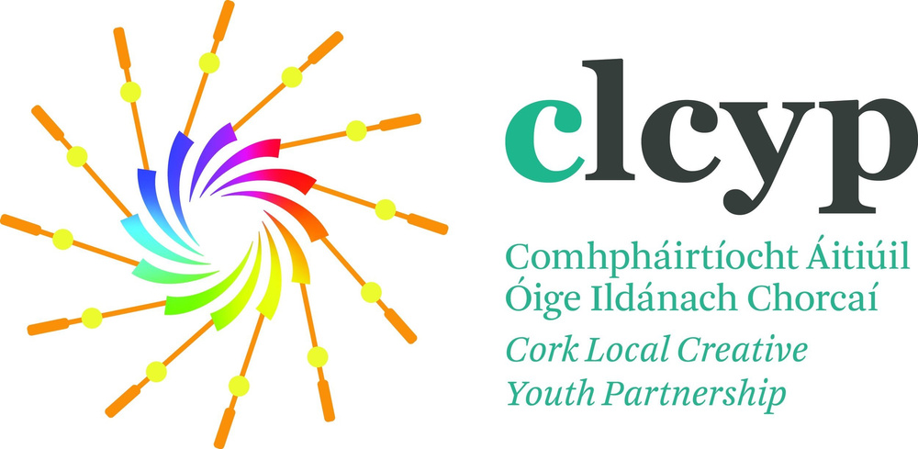
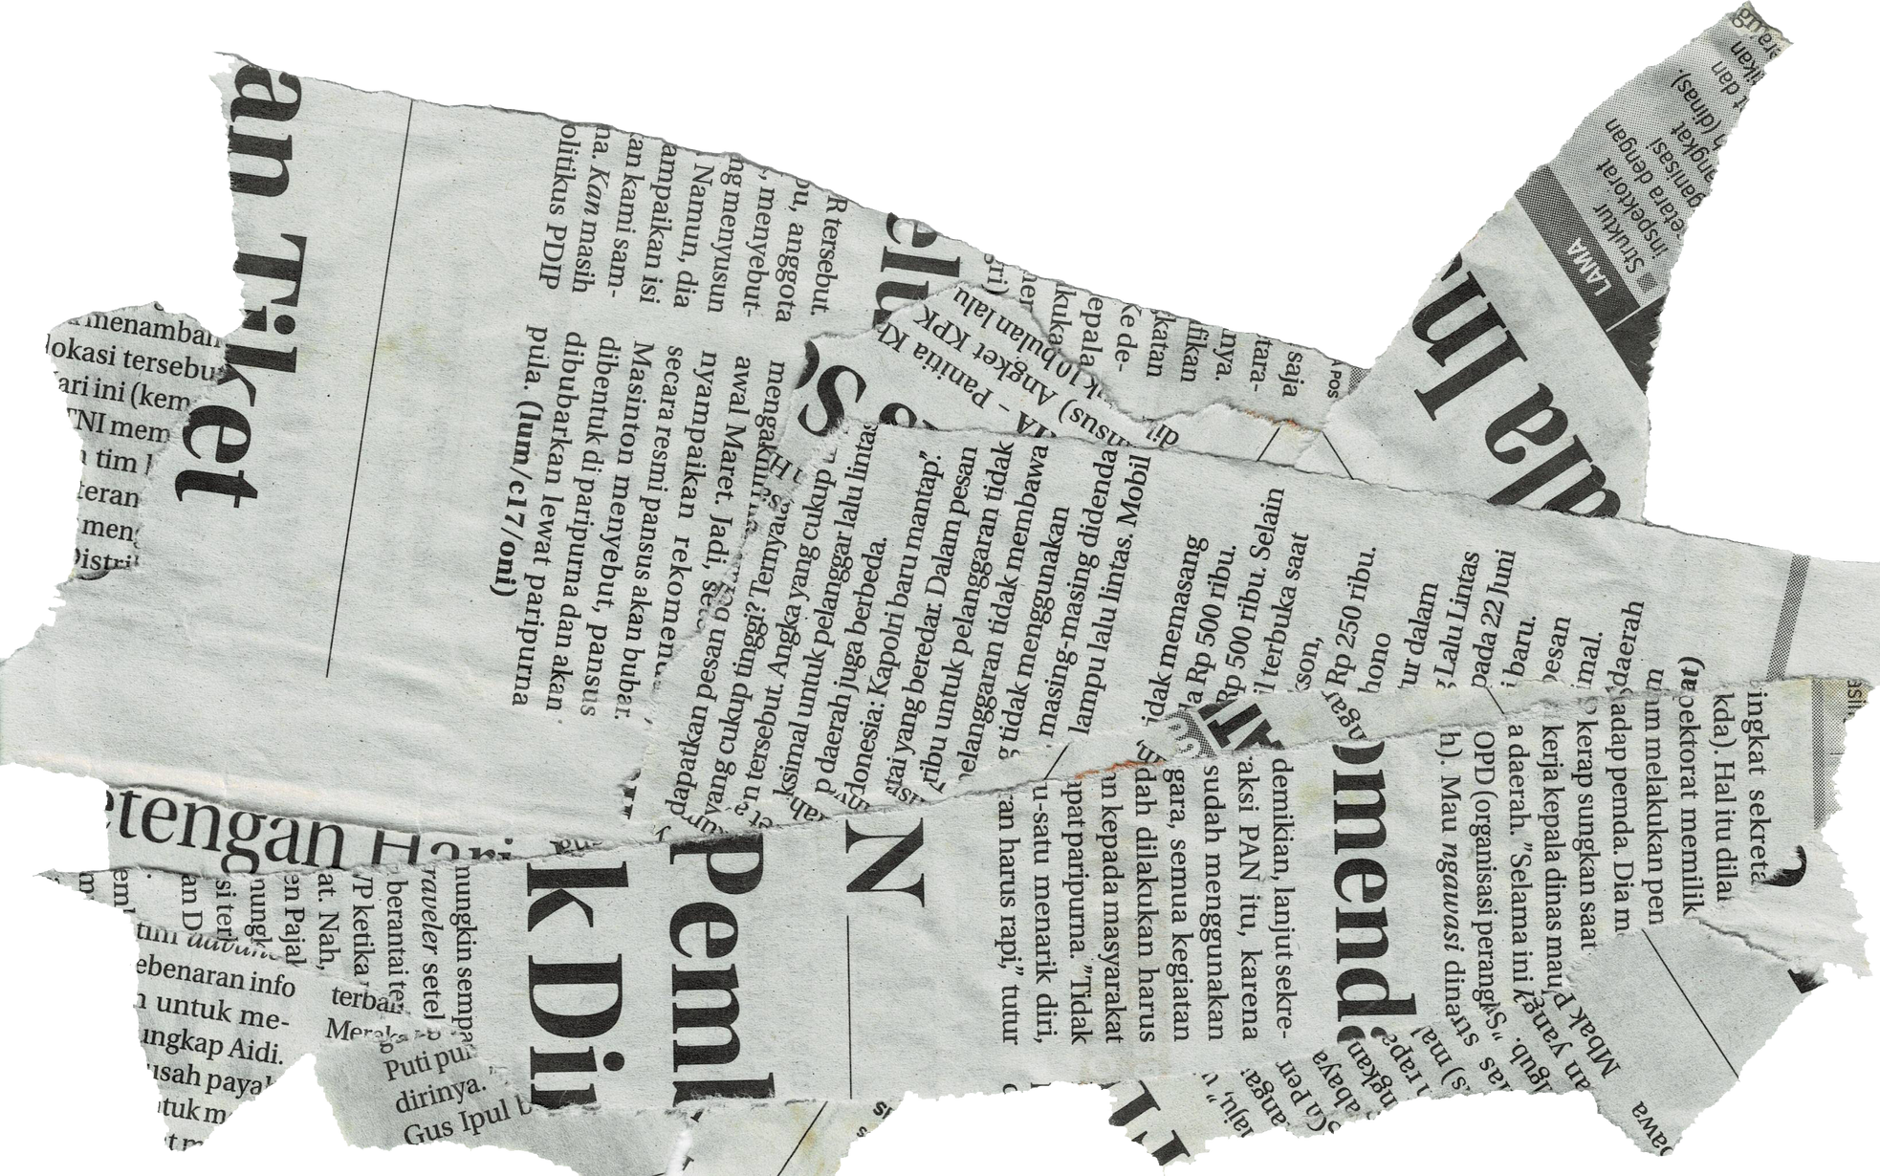
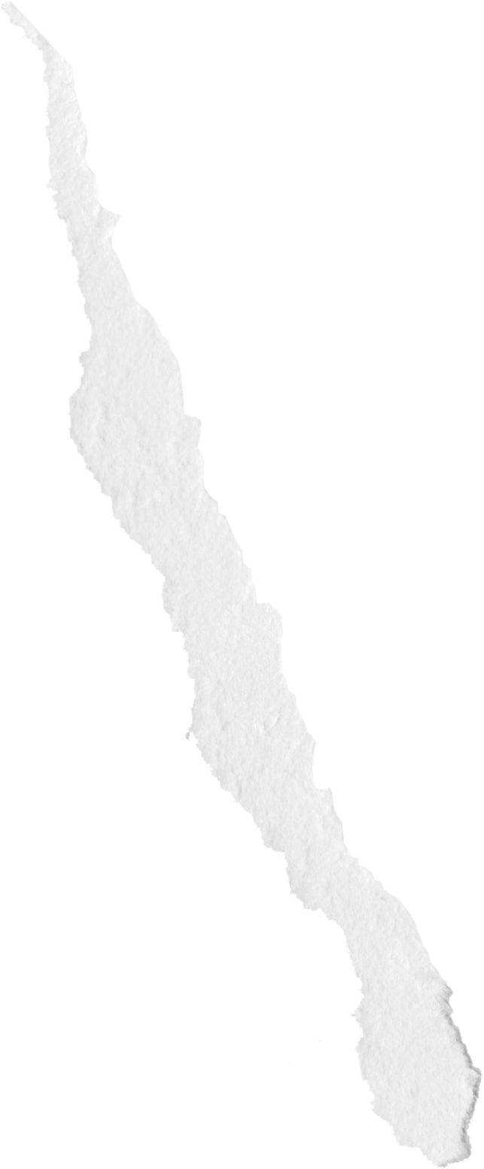
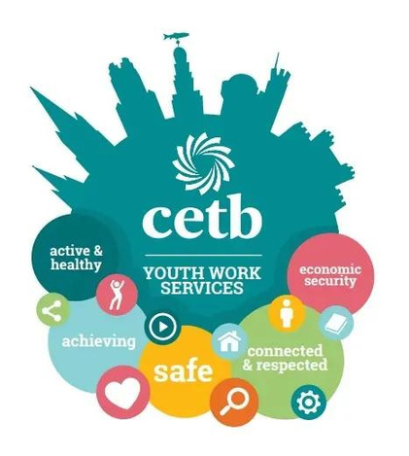

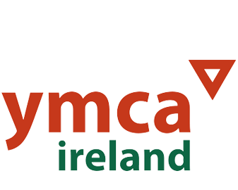
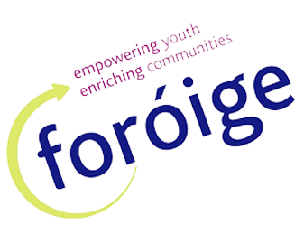
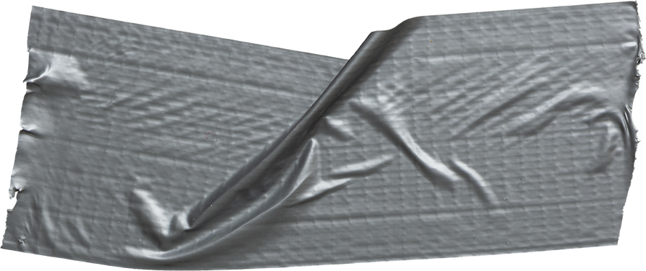
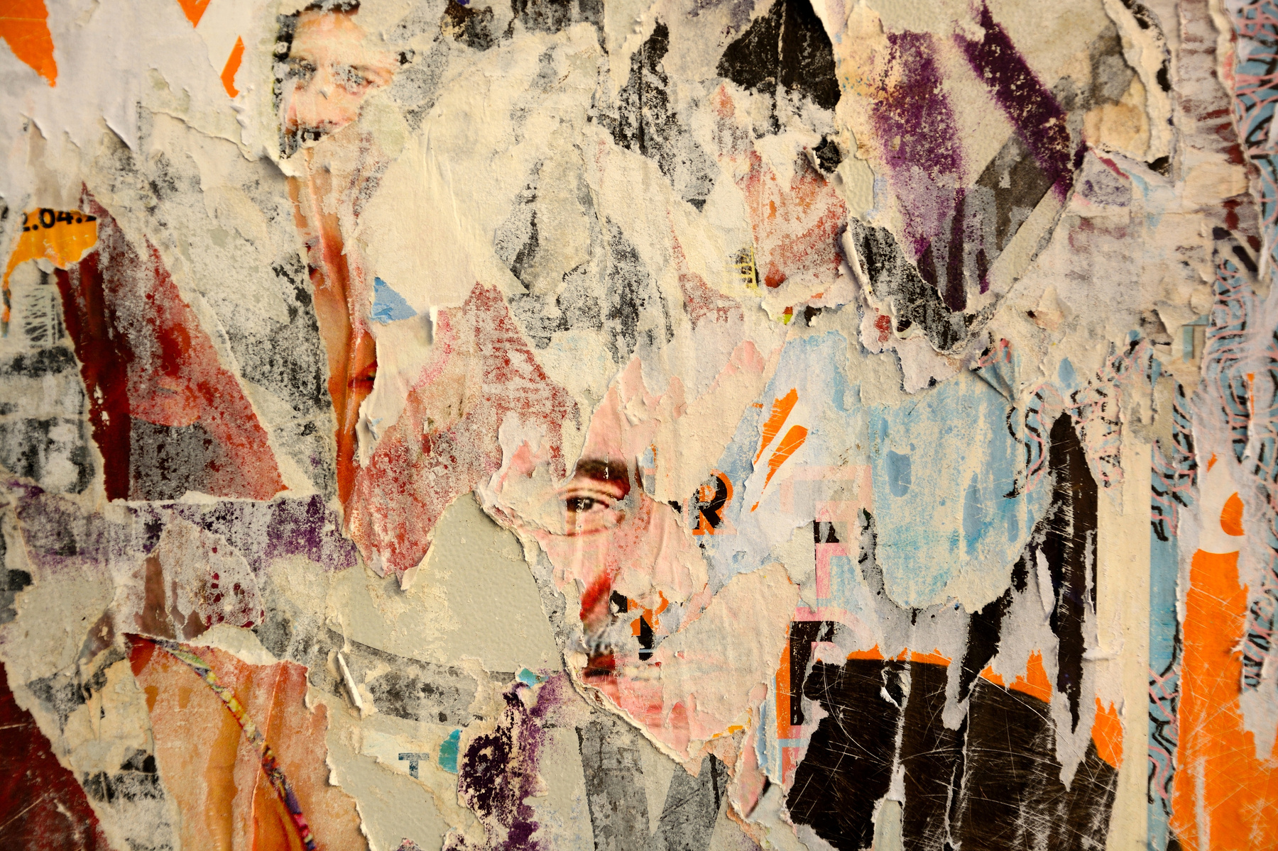
Collaboration
Notes:
It can take time to set up a project with many agencies involved but we were fortunate to find that it added great support, innovative perspective and funding to the project.
Through Anns investigation of VR, in her masters, as both an educational as well as a creative tool, she found, that by pushing this technology beyond the developers original gaming exports, it does sometimes need some 'outside the box' thinking to make more things work! This required many planning meetings and technical tests, only made possible through the collaboration of all involved.

Slide 9
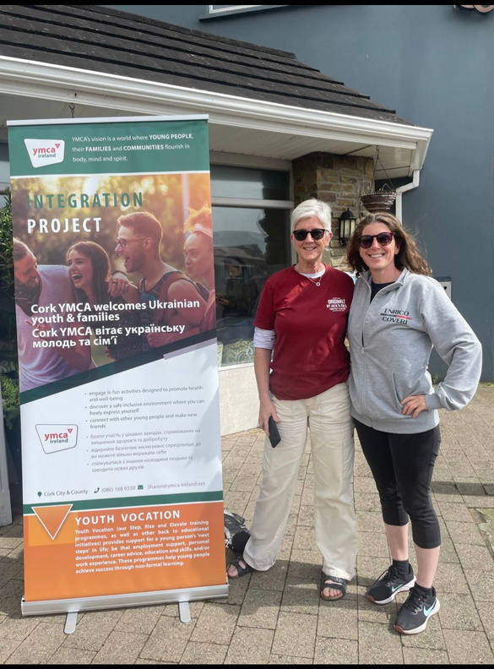
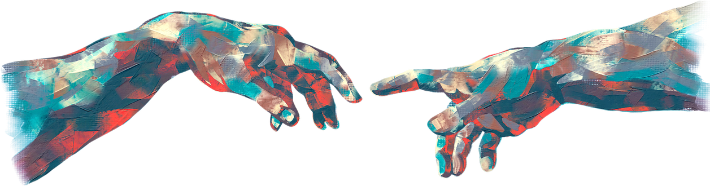
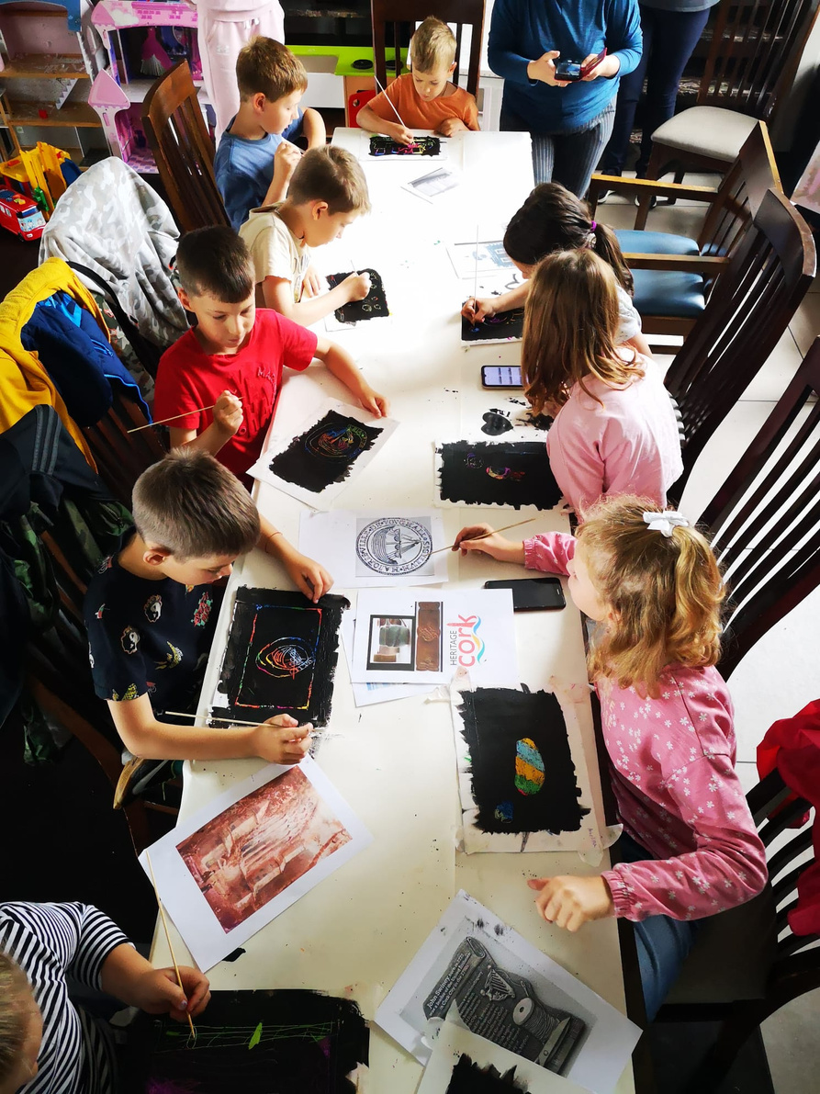
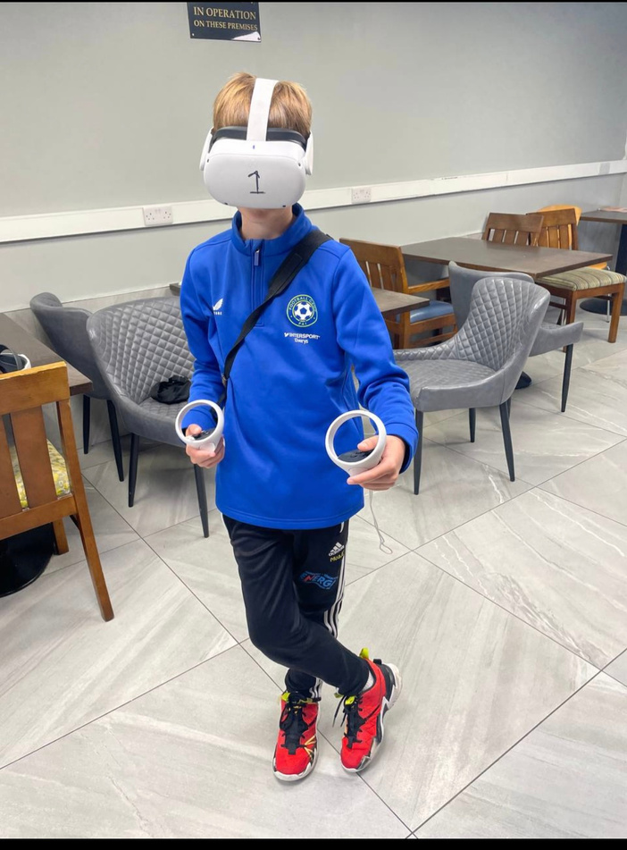
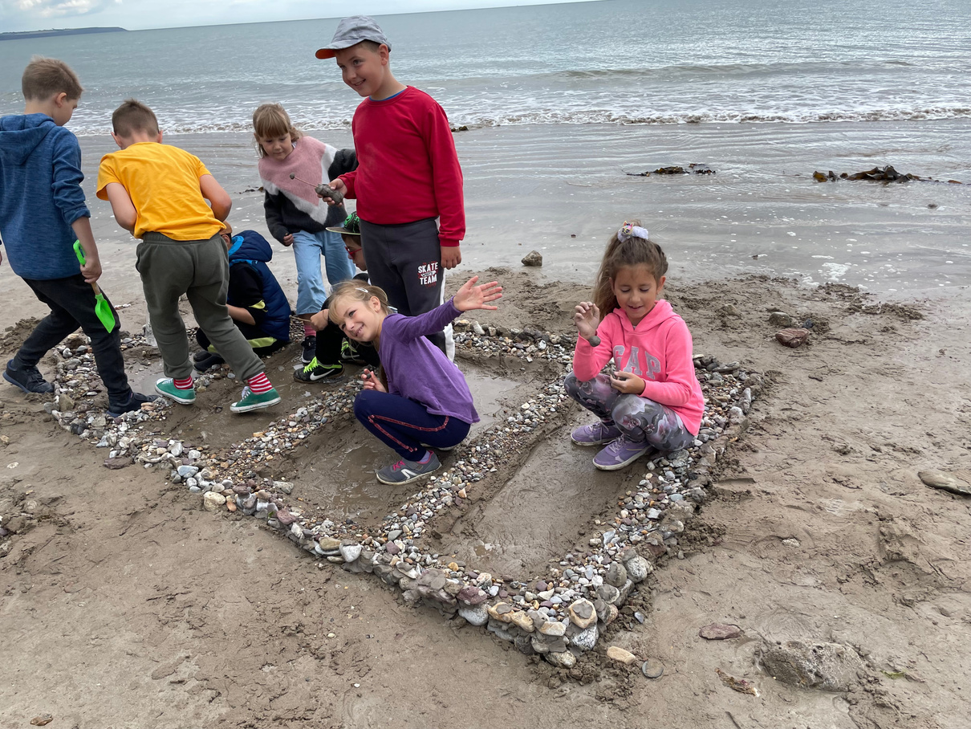
connections
Outcomes
Notes:
I got involved as I have a background as a secondary school and further education Art, Craft and Design teacher and artist. I had made over 17 virtual art exhibitionn during the 2020 lockdown. My line manager at the YMCA was in talks with the CETB about this project and they thought I might be a good fit.
I am so pleased that I came on board for the Youghal Redbarn workshops as not only did I get to collaborate with a great team I was lucky enough to make friends along the way.

Slide 10
Notes:
Ann Burns is now collaborating with the Virtual Worlds Eduverse expert series of talks in collaboration with Erasmus TU Dublin as a result of the success of these projects.
Ann is very happy to talk to anyone about what I have discussed here today.
I’ve popped our contact detail here on this slide for you. Feel free to get in touch if you have any questions or would like to hear more.
Many thanks for your time.
Wishing you all an enjoyable day at the conference.

