Slide 1

Welcome all
Principals and Deputy Principals Conference 1st February 2024
Improving Sustainability & Reducing Energy Use in School Buildings
Karl Fitzmaurice ETBI

Slide 2
“Climate Change is no longer some far-off problem,
it is happening here; it is happening now”.
“We are the first generation to feel the impact of climate change and
the last generation that can do something about it.”
Barack Obama on Climate Change
The main solution is so simple that even a small child can understand it.
- We have to stop the emission of greenhouse gases.”
Greta Thunberg

Slide 3

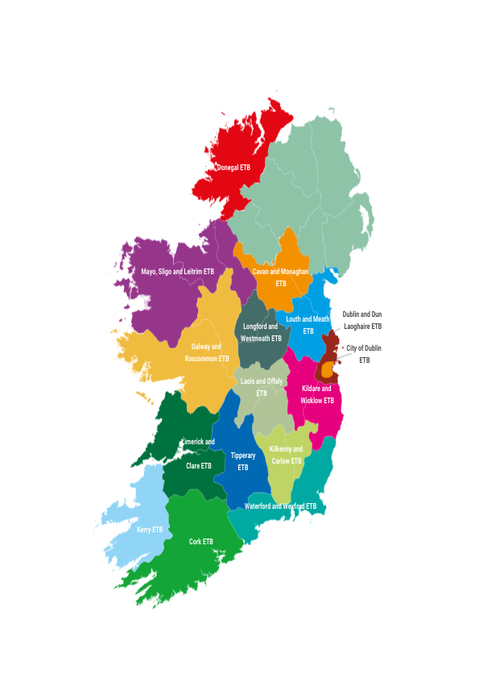
ETBs at a glance
Size of sector: 2.1Bn
Sectoral spend (Supplies/Services) of approx. €203M/yr.
2023 spent on Electricity: €7.3M
2023 spent on Natural Gas: €3.2M

Slide 4
 | Elect 2019 kWh | Thermal 2019 kWh | 2019 Total kWh
ETB Schools | 32,397,304 | 51,981,428 | 84,378,732

Slide 5

National Energy Policy and Targets
Climate Action Plan 2023, Public Sector targets
  51% absolute reduction in CO₂ by 2030
  50% improvement in energy efficiency
Monitoring and Reporting
Public sector bodies are required to report annually to the SEAI on their energy usage and actions taken to reduce consumption – in accordance with Statutory Instrument 426 of 2014.

Slide 6








ETB Energy & Emissions Summary
84,000 MWh
49,170 tCO₂
€10.5m Energy Spend
Final Energy Consumption
2% of PS
2% of PS
95% in Building
20,162 tCO₂ from heat
€3.2million on heat
1% in Transport
29,008 tCO₂ from electricity
€7.3million on electricity

Slide 7
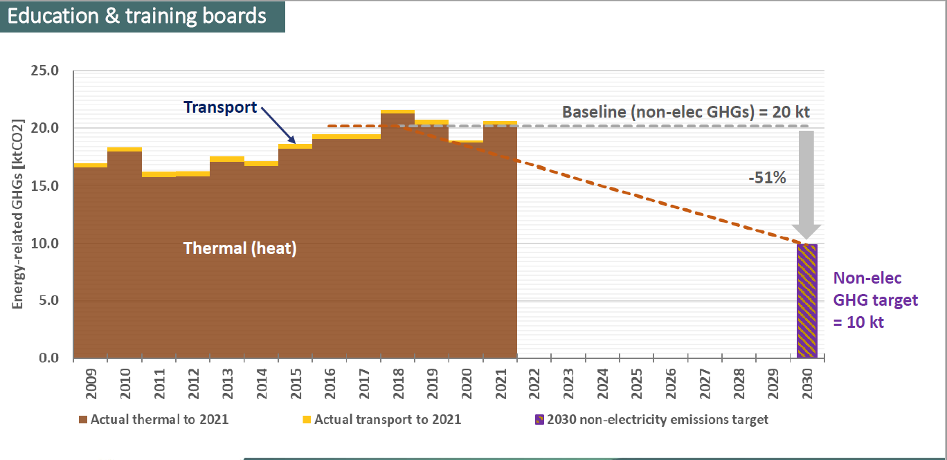

Slide 8
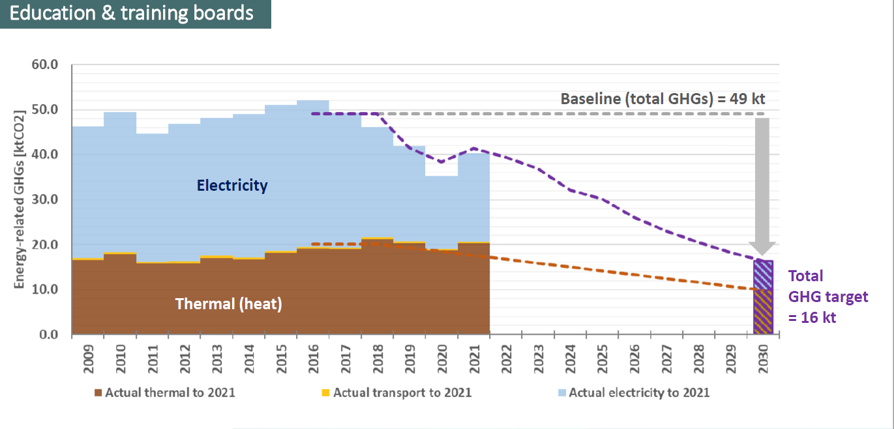

Slide 9



Progress Towards 2030 Targets
Progress towards 2030
Energy performance improved by 30% since 2009
Non-elec emissions
increased by 2% since 2016-2018
Total emissions
reduced by 16% since 2016-2018

Slide 10


Slide 12
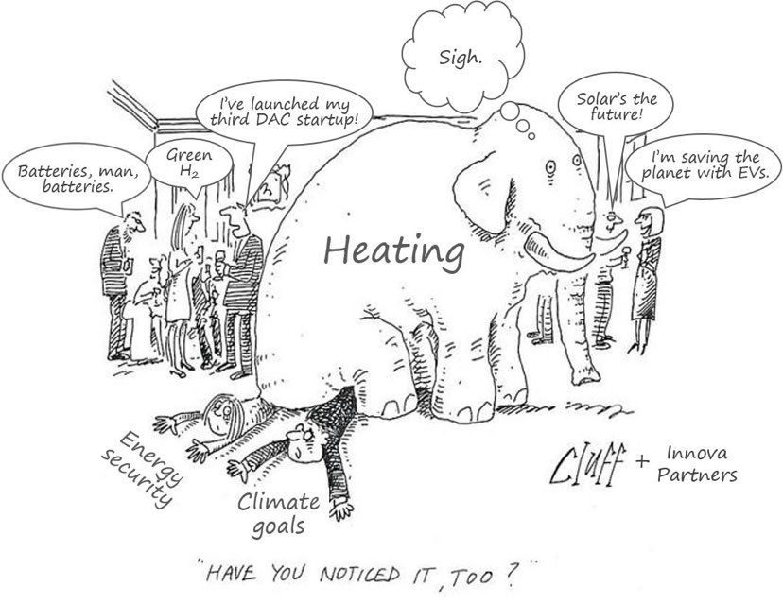

Slide 13
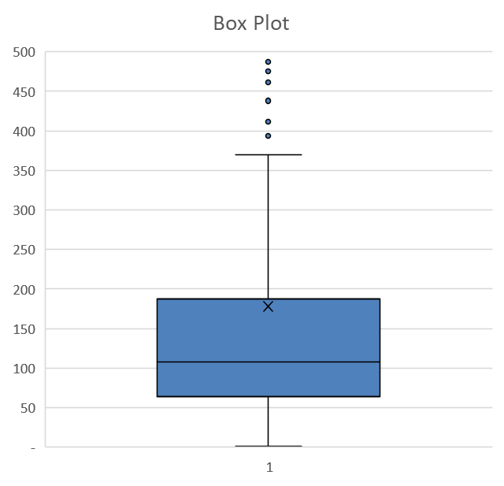
Box Plots Explained
Dots indicate major outliers
Maximum value within the
normal distribution
X indicates the Mean or
average energy use per m²
Middle 50% of schools
are within this range.
Min value within the
normal distribution.

Slide 14
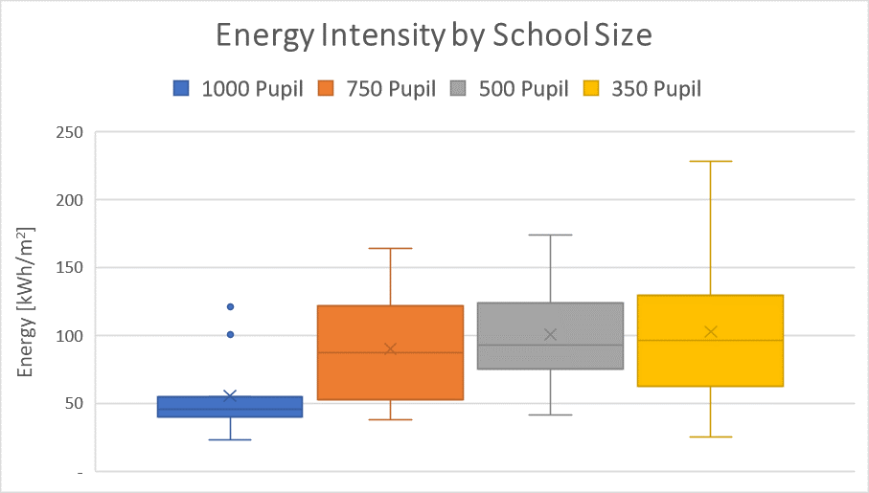
Energy Use by Pupil Numbers
Schools considered to be at capacity.
35 schools sampled
Parameter | 1000 Pupil | 750 Pupil | 500 Pupil | 350 Pupil
Mean Use [kWh/m²] | 55 | 90 | 101 | 102
Usage Range for 50% of Schools [kWh/m²] | 40-54 | 52-121 | 75-124 | 62-129

Slide 15
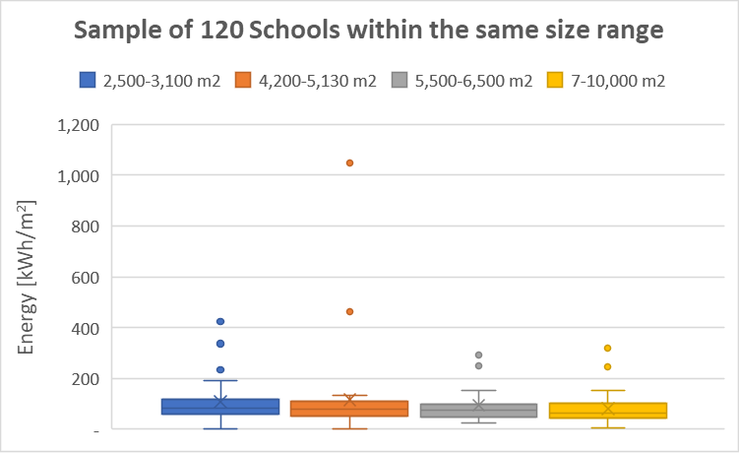
ETB Schools Energy Use Range
Outliers rising as high as >1,000kWh per m²
Parameter | 2,500-3,100m² | 4,200-5,130m² | 5,500-6,500m² | 7,000-10,000m²
Mean Use [kWh/m²] | 108 | 116 | 94 | 79
Usage Range for 50% of Schools [kWh/m²] | 60-116 | 51-109 | 49-98 | 44-100

Slide 16
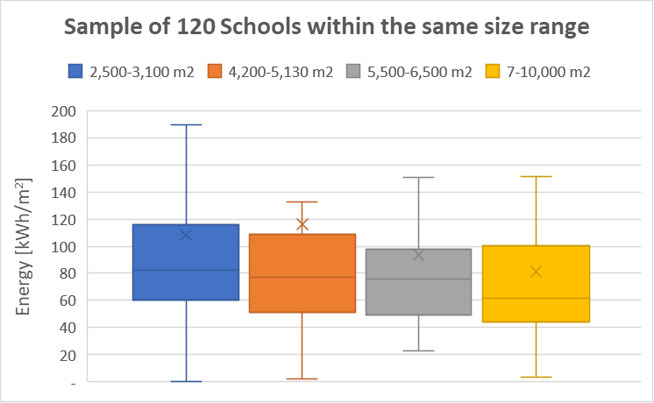
ETB Schools Energy Use Range
Outliers removed from the graph here.
Outliers skewing the Mean value.
Median line should be considered when reviewing your performance.
Parameter | 2,500-3,100m² | 4,200-5,130m² | 5,500-6,500m² | 7,000-10,000m²
Mean Use [kWh/m²] | 108 | 116 | 94 | 79
Usage Range for 50% of Schools [kWh/m²] | 60-116 | 51-109 | 49-98 | 44-100
Median [kWh/m²] | 82 | 77 | 76 | 61

Slide 17
Anyone in the room know where their school lies on this scale?

Slide 18
Proposed Action
Determine your school's consumption levels relative to the ranges shown here.
If you fall within the lower 50% of the scale [below the median line], write down some of the things you have done over the years to manage energy and share them with the group.
If you fall within the higher 50% [above the median line] it is worth carrying out an energy audit to determine why this is so.
Out of hours audits can illustrate the biggest wins.

Slide 19
Out of Hours Energy Audit Steps
1
2
3
Gather a small team of enthusiastic people.
Schedule the audit for an out of hours period such as an evening, weekend, midterm, Summer, Christmas.
Make a plan outlining what will be reviewed and who will review it – lighting, heating, ventilation, IT systems, printers.
Carry out the audit and document any findings.
Keep your ears open – Noise = Energy
Make a plan to reduce out of hours load and implement it.
Schedule the audit but don’t announce it to too many people.
4
5
6
7

Slide 20
Any good examples in the room of how you may have reduced consumption with minimal cost?

Slide 21
Things to Watch Out For
Heating timed off but a pump in manual that triggers the boiler into action.
Immersion heaters left on or timers disconnected.
Lighting sensors malfunctioning resulting in lighting remaining on – particularly outside.
Toilet ventilation running 24/7.
Printers not going into sleep mode.
Desktop computers and screens being left on.
Vending machines being left on at night and weekends – [If turning them off watch out for melting ice if they have been on for a long time].

Slide 22
Other Suggestions
Get your caretake to take monthly gas/oil and electricity readings and record them in a spreadsheet.
Join the SEAI’s Reduce Your Use programme in order to obtain a wide range of tips and resources to reduce your energy use https://www.seai.ie/reduceyouruse/public-bodies/energy-efficiency-campaig/resources/
Checkout the SEAIs Energy Audit Handbook https://www.seai.ie/publications/SEAI-Energy-Audit-Handbook.pdf

Slide 23
ETBs on Energylink
The SEAI have setup a discussion area for ETBs on their Energylink https://energylink.seai.ie/sector/view/13
It is recommended to discuss and present the output of your activities on this page.
Lots of other schools will be experiencing the same issues as you. Sharing on Energylink can help to solve these problems faster.

Slide 24
NOTES
ETBs need to do:-
Decarbonisation needs to be at the core of all building related activities over the coming years. We need to identify the main areas which require focus in order to achieve the 2030 targets including Building Upgrade Requirements, Efficiency Projects, Energy Management Activities and Upskilling at an ETB level.
Robust Energy Management practices across our building stock could improve energy performance by at least 10%, saving >€1m per year. Sufficient resources and training are required to achieve this.
Upskilling may be required in areas such as Energy Efficient Design, Energy Management, Energy Awareness, Energy Performance Contracting. There is potential to obtain strong support from the SEAI for these activities.

Slide 25

Energy Management for ETBs
ETBI is collaborating with SEAI to provide a comprehensive and coordinated energy management initiative, delivered through training courses, site visits, support for ETBI Management, staff, principals, teachers and caretakers.
This is a pathway to engaging with SEAI on the journey towards improved energy performance and substantial savings. The model is tailored around the needs of ETBs and is most successful when the CE and Senior Management fully support it.

Slide 26






SEAI Partnership and Energy Management for ETBs
ETBI is collaborating with SEAI to provide a comprehensive and coordinated energy management initiative, delivered through training courses, site visits, support for ETBI Management, staff, principals, teachers and caretakers.
This model is tailored around the needs of ETBs and is most successful when the CE and senior management fully support it.
The delivery model has three sequential phases:
1
2
3
CE of ETB signs Partnership Agreement with SEAI
ETB selects and trains an Energy Team in Energy MAP and joins the ETB Energy Bureau
ETB Energy Team organises Energy in Education Training for schools and training centres
Energy MAP for ETBs course starts 24th February, email rjermyn@mco.ie to sign up
432-23P0062
Notes:
Note that all references to “[your sector]” in the speaker’s notes in the subsequent 5 slides refer to the specific sub-sector named on this slide, not to the entire public sector.
Left-hand side
Total energy consumption in [your sector] in 2021
Expressed as final energy consumption
Breakdown shows biggest end users in [your sector]
Middle
Total energy-related GHG emissions from [your sector] in 2021.
Heat & transport emissions = emissions from burning fossil fuels in boilers, vehicle engines, etc.
Right-hand side
Progress of [your sector] (in aggregate) towards the 50%-by-2030 energy efficiency target. Tracked against original EE baseline (typically 2009).
Progress of [your sector] (in aggregate) towards the target to reduce non-electricity (i.e. heat & transport) emissions by 51% by 2030. Tracked against baseline of 2016-18 (average).

Slide 27
Benefits of a Partnership Agreement
At no charge to the ETB, a team of SEAI Project Support Managers PSMs, coordinated by a dedicated Partnership Support Manager, will:
Mentor your organization towards exemplar energy management alongside peer organisations in the Public Sector.
Provide training to your core management team in HO and to schools and training centres in your portfolio.
Carry-out building energy assessments to identify the ways to cut energy costs, often with little or no capital investment required.
Highlight your achievements through promotional activities carried out by SEAI.

Slide 28
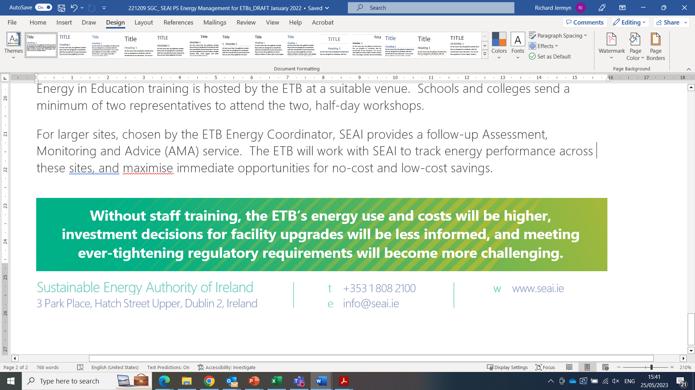
Energy in Education
The Energy in Education programme offers a range of supports developed by the Sustainable Energy Authority of Ireland (SEAI) in partnership with the Department of Education designed to help schools to improve energy management practices, reduce school operating costs and protect the environment.
Energy in Education training is hosted by the ETB at a suitable venue. Schools and colleges send a minimum of two representatives to attend the two, half-day workshops.
For larger sites, chosen by the ETB Energy Coordinator, SEAI provides a follow-up Assessment, Monitoring and Advice (AMA) service. The ETB will work with SEAI to track energy performance across these sites, and maximise immediate opportunities for no-cost and low-cost savings.

Slide 29
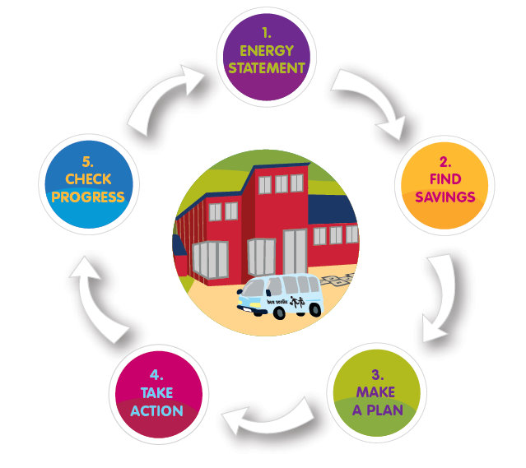
Energy in Education training for schools and Centres
Energy Co-Ordinator and PSM arrange Energy in Education Training
Support includes:
  Website www.energyineducation.ie
  Energy Management Workshops
  Guides and workbooks
  Assessment, Advice and Mentoring service
  Energy Link online forum
  Teaching Materials on www.energyineducation.ie website

Slide 30

Steps to Energy Management
Notes:
This course is designed to take you through the 5 STEPS to a successful Energy Management Programme and is based on a number of ACTIONS linked to each STEP.
Steps involved are developing an Energy Statement, Finding Saving, Making a Plan, Taking Action and Checking Progress.

Slide 31


Why manage school energy use?
Benefits
  Save money
  Take climate action, reduce carbon footprint
  Supports Green Flag activities
  Develops student awareness on environmental issues
  Practical steps to take on energy use
The youth of Ireland talking about Climate Change
Security of Supply reduce reliance on imports
Environmental Drivers National Targets, International Obligations
Notes:
Introduce the Main Drivers here. Show the video of young people involved in SEAIs One Good Idea project talking about climate change and the need for action.
NOTE: the ONE Good Idea is now finished
Engage the audience: Ask the question about the cost impact and discuss briefly.

Slide 32

Where to Start
Assign the role to a competent Staff Member
Partake in SEAIs Information Seminars and Energy MAP Training
Developed Energy Policy
Developed Energy Strategy and Action Plan
Launch a Climate Action and Energy Awareness Campaign

Slide 33
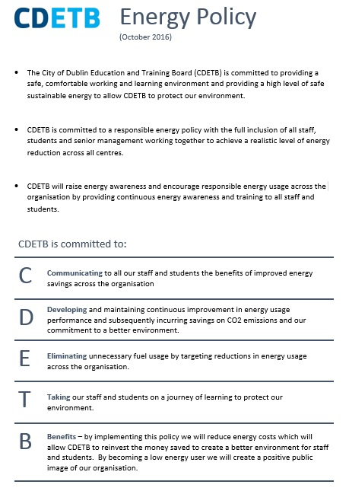

Slide 34
City of Dublin ETB : 2018
“SEAI set up workshops for our heads of centres and porters. SEAI then reviewed energy management at 20 of our highest using centres, and identified improvement action plans. Between 2009 and 2018, we saved over €350,000 on energy costs across 60 centres”.

Slide 35


Ashbourne Community School
€54,000 spend, 25% estimated saving
Regular electricity and gas meter readings
Formed student energy committee
Energy awareness campaign
‘Switch It Off’ policy
Install more energy efficient lights (Replace T8 with LED fixtures)
Better utilisation of natural light
Install 7-Day time-clocks on vending machines
Reduce boiler operating times appropriately
Notes:
Feedback is great!

Slide 36

School case
Savings potential:
  5% - good house keeping
  10% - modest building improvements
  25% - medium costs capital investments
What will drive your campaign?
Notes:
How do you get this commitment from management – Principal, Board of Management, teachers, caretakers, pupils, non-teaching staff. Click
What would incentivise you to be involved?
FLIPCHART – Buzz groups get them talking.
For those of you who know annual energy spend you can use your own figure but for the sake of this exercise we will use the example of €50,000. Click
%5 – from good house keeping Click
10% - few building improvements i.e. Light blub changes Click
25% - insulation, sensors etc Click
Buzz Groups – in 3s, – Hands up and point to the person who is going to speak
Why would your school bother to try and save energy? E.g. To save money
What would drive your campaign?
Students
Teachers
Office
Principal
FLIPCHART

Slide 37
Building fabric, heating and hot water

Slide 38
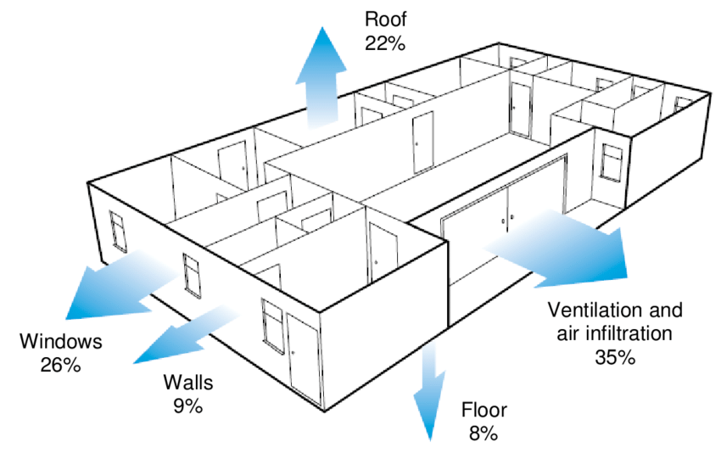
Heat loss from a typical building Source: Carbon Trust

Slide 39
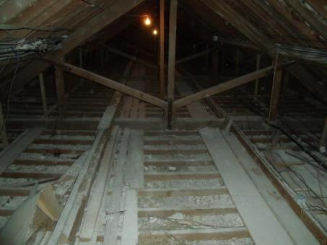
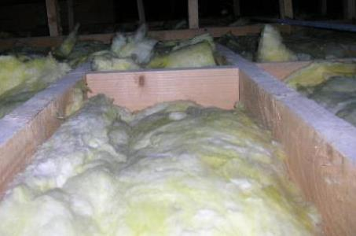
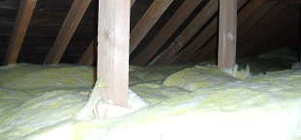
Building fabric - Insulation of roof spaces
Attic insulation - Insulating any attic spaces in a building could reduce heat loss by 25%, providing a payback as short as 3-5 years, and is most beneficial if your school has no attic insulation.
Note: Must maintain through ventilation in attic to avoid condensation
Poor
Very Poor
Good
Notes:
Ask what problem is with first picture
Then step thru’ others to illustrate Poor and Good insulation
If attic has little or no insulation, have it topped up. 300 mm is recommended.
Over 20% of heat in a building may be lost through the roof. Improving insulation levels in this area can often be cost effective, particularly with pitched roofs. Installing attic insulation in an un-insulated attic is likely to be the single most cost-effective way to improve the efficiency in the building, offering paybacks as short as 3-5 years.

Slide 40
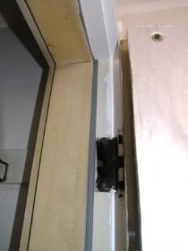
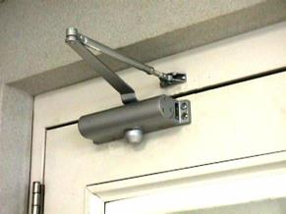
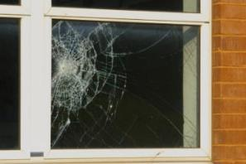
Building Fabric- Windows and Doors
Check door/window closers operate correctly
Weather-strip doors
Repair broken windows – if replacing, use units double glazed to current standards (less heat loss)
Download the factsheet: Heat Loss from School Buildings
Notes:
The very best double glazing can be more than twice as efficient as the double glazing installed 20 years ago. It is important to note that payback periods can be 50 years or more.

Slide 41
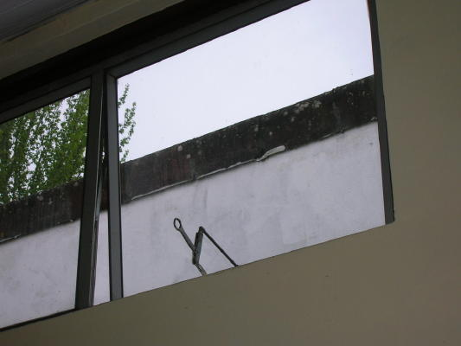
What’s wrong here?
Maintain window closers
And close all windows at night

Slide 42
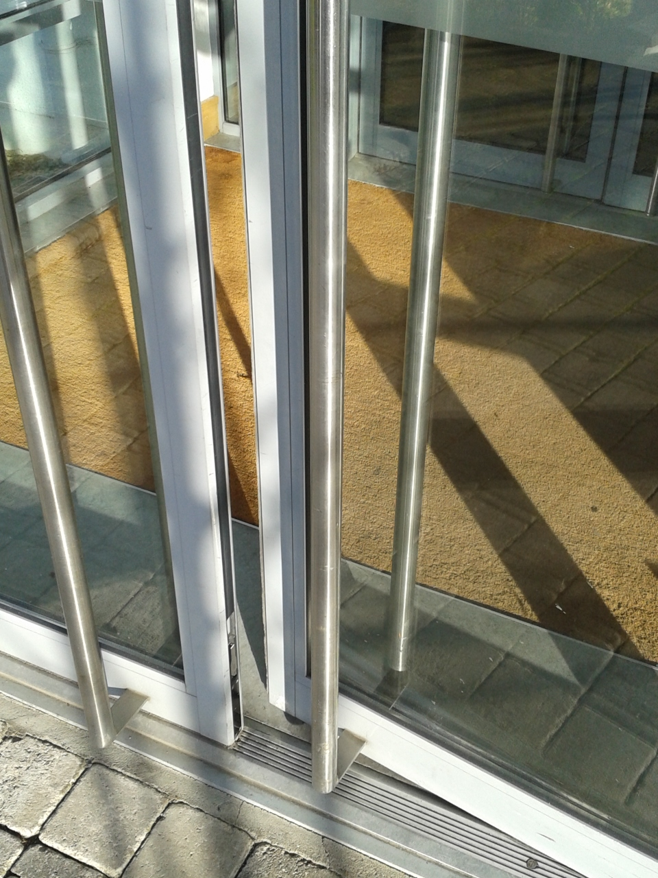
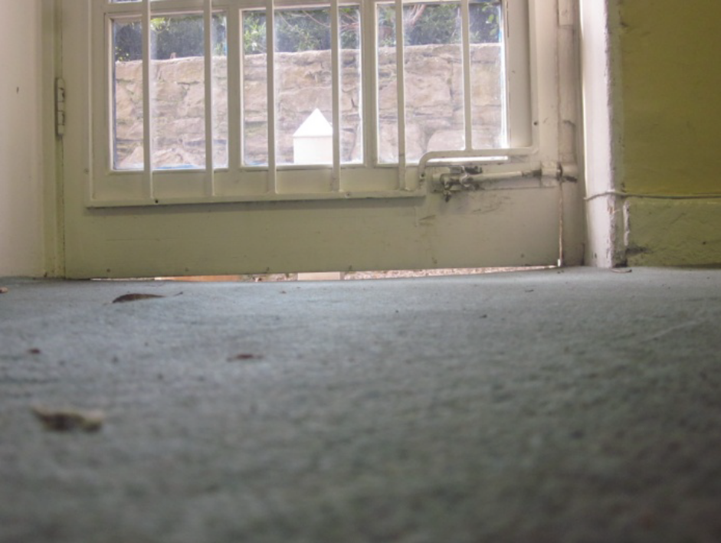
Maintain external door alignment and draughtstrips

Slide 43
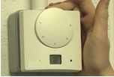
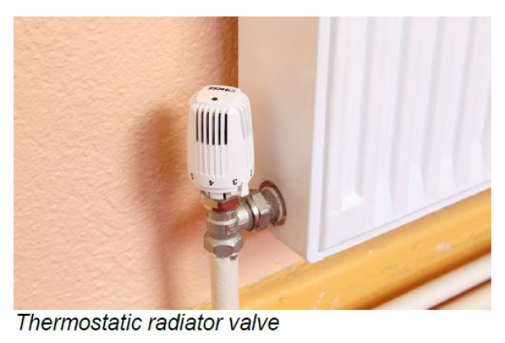

Space heating & boilers
Are thermostats fitted, working and set to 18ºC for classrooms? Are TRVs used appropriately?
Experiment with switch-on/off times for heating to see if later start and earlier stop times are possible.
Turn down the radiators in the corridors and toilets to allow setting or set associated thermostats to a lower level than classrooms.
Ensure boiler and controls are routinely serviced
  Ask for efficiency report; ‘as found’ and ‘after‘ service
  especially “weather compensation” controls.
  Ask your plumber to explain “weather compensation” controls to you.
Notes:
Between 50-70% of the energy use in schools is for space heating.

Slide 44
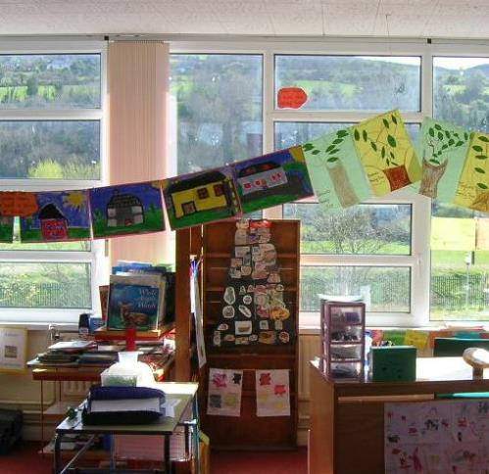
What’s wrong here?
Display unit blocks light and heat
Blocked radiator
Notes:
Try not to block radiators and daylight

Slide 45
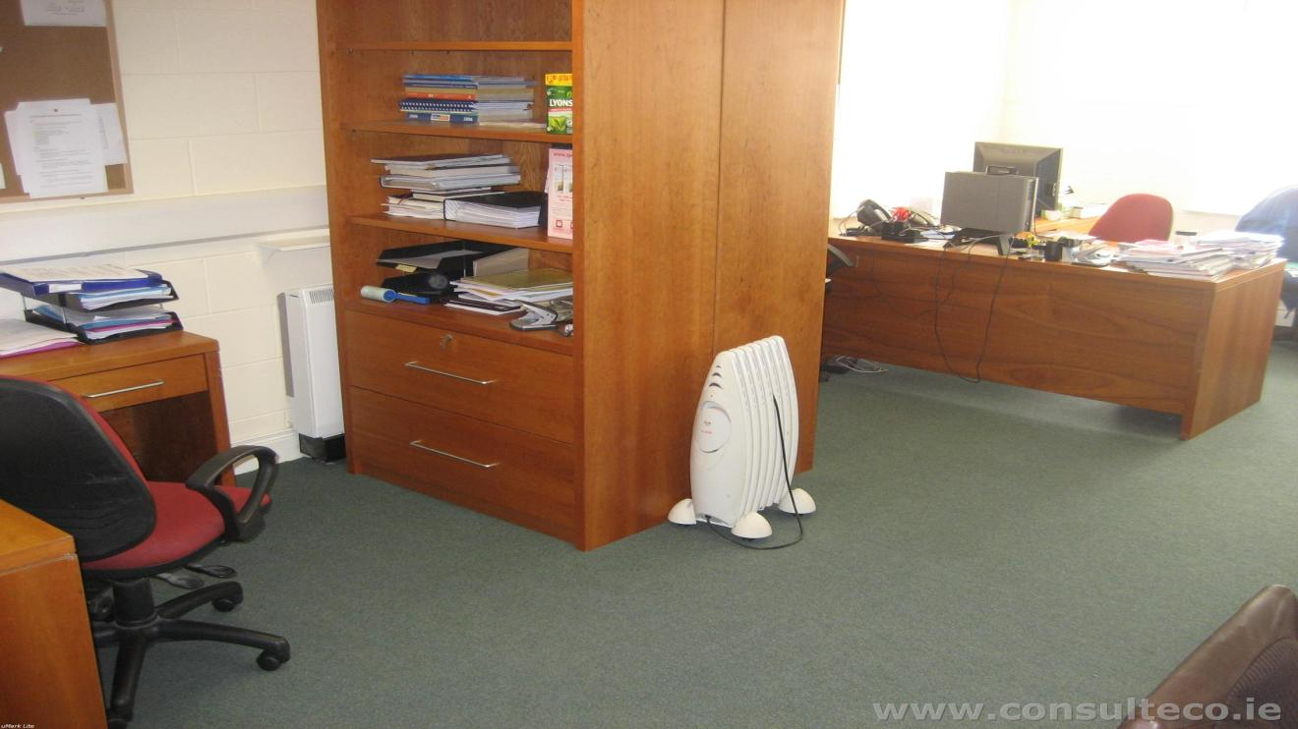
Clear obstructions from radiators

Slide 46
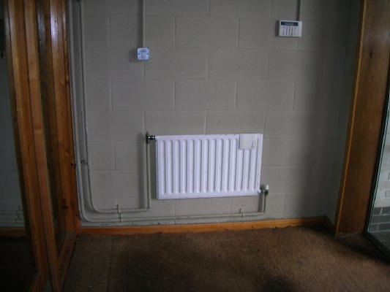
Switch off radiators in lobbies
Outside door
Door mat

Slide 47
Lighting

Slide 48
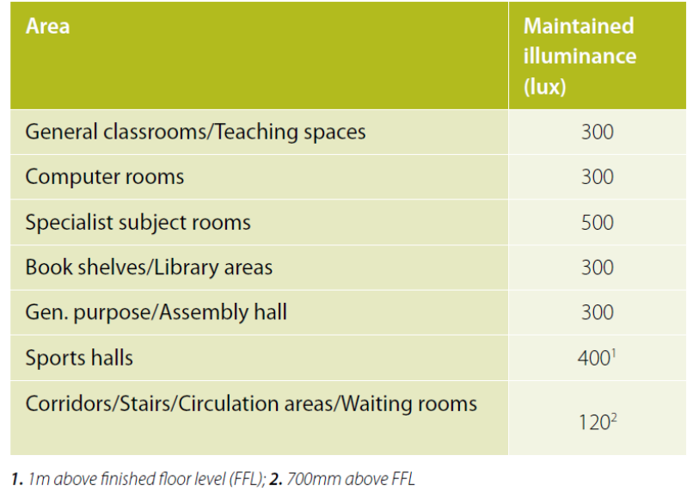
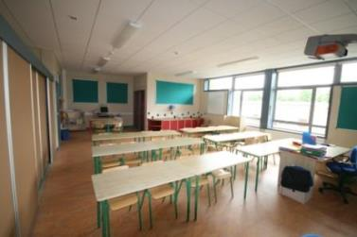
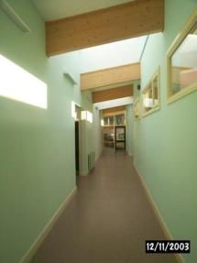
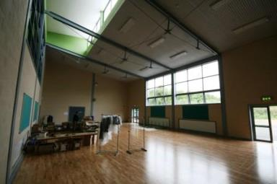
Lighting
Classroom=300 lux
GP Hall=300 lux
Corridors =120 lux

Slide 49
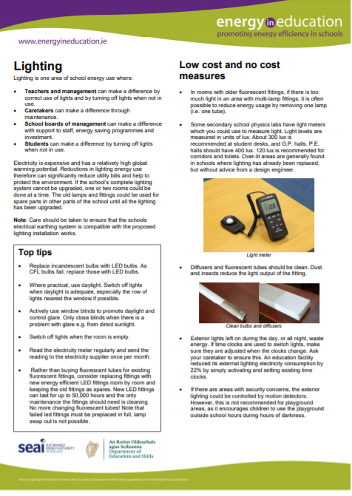
Lighting
Replace incandescent lamps with LED lamps - 80% energy saving.
Replace CFL lamps with LED lamps - 50% energy saving.
LED bulbs last up to 20 times longer. they pay for themselves in replacement costs alone, and the energy savings come free.
Lighting factsheet
Notes:
Most schools have fluorescent light fittings in most areas.
More energy efficient LED fittings are now available. The cost of LED light fittings has reduced in recent times. . Since February 2018, use of LED fittings are promoted in schools where a lighting upgrade project is undertaken that are replacing T8 fittings.

Slide 50
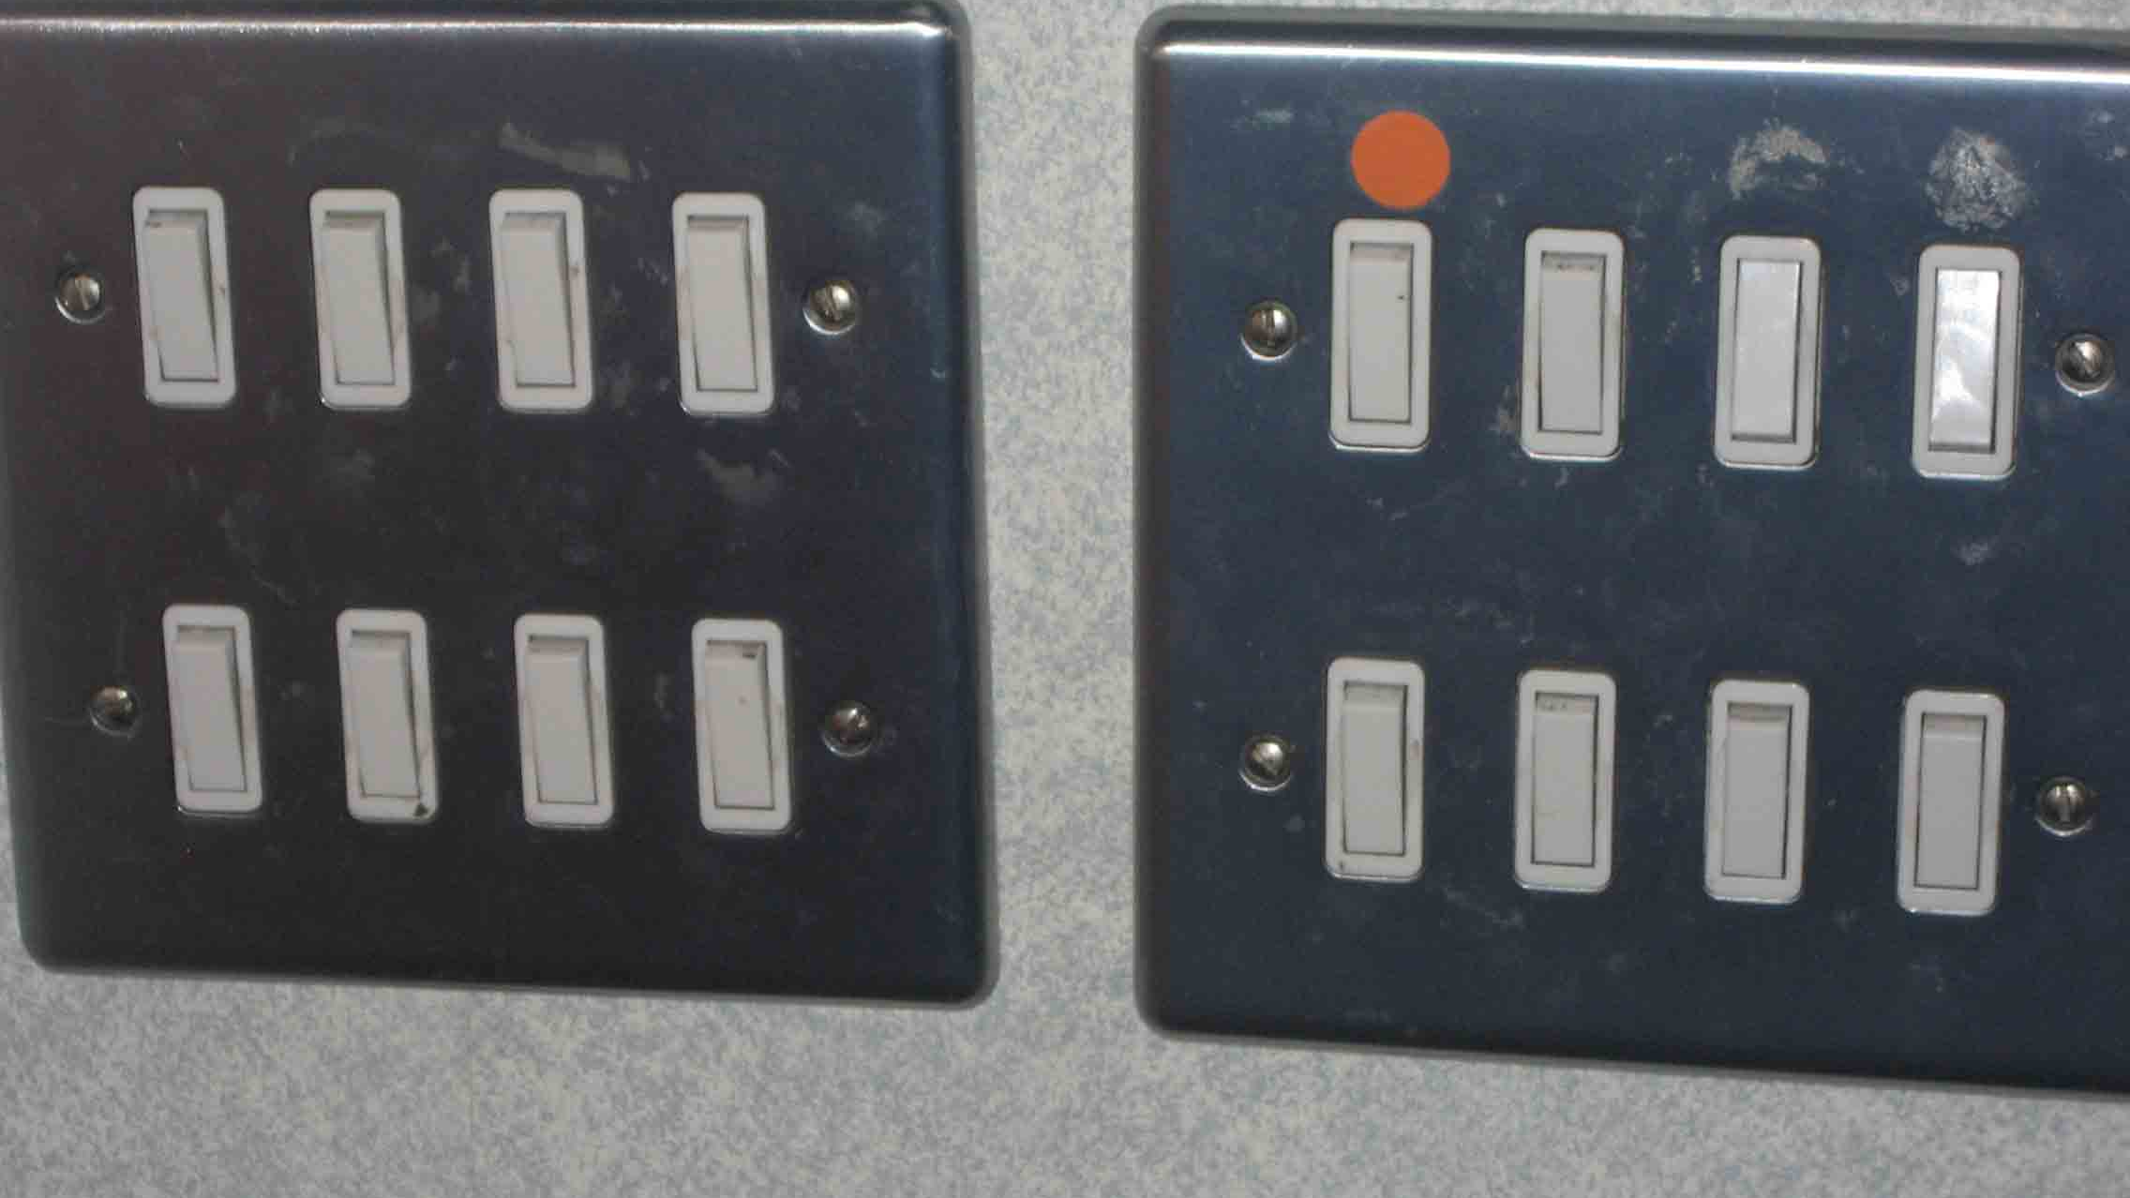
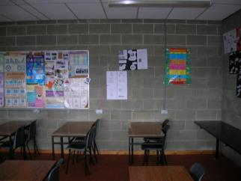
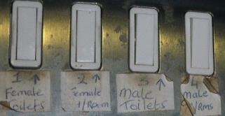
Lighting
Paint unpainted block work
with light coloured paint
  Label light switches
Ensure
  Everyone knows where switches are
  Lights are off, when daylight levels are good
  Unoccupied areas are not lit
Clean dirty light diffusers/ shades

Slide 51
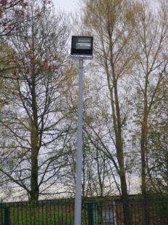
Optimise use of site lighting
Case Study
  >25% of the electricity for site lighting
  Adjusted time switch
  22% immediate savings in electricity
Use time switches
  Adjust time switches
  Make use of public street lighting
If CCTV, use infrared cameras & lights
Notes:
Keeping exterior lights on all night for CCTV cameras can be avoided by using cameras with infrared illuminators. Cameras with built in infrared lamps are available which can “see” up to 20m.

Slide 52
ICT and electrical equipment

Slide 53
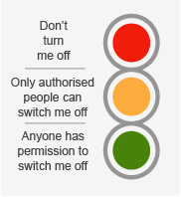
Office equipment applications
Computers
Laptops
Printers
Scanners
Photocopiers
Laminating Machines
Label Makers
Shredders
Only buy SEAI “Triple-E” listed devices. Switch off completely
Use Sleep during idle times during the day but switch computers off at night.
Use Intelligent multi-sockets (extension leads)

Slide 54
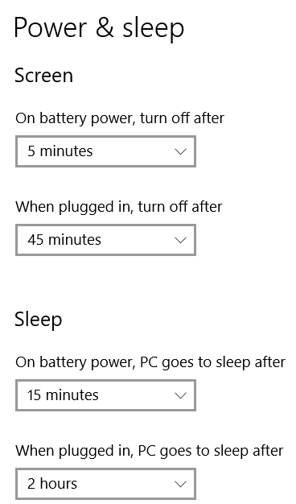
Computers
Switch off when not in use
Make use of the Power & Sleep Settings on a PC.
Put notice up: who is last out today?
    Wasted energy in a poorly managed computer room could cost €600 over the year.
    Screen on all year = 350 kWh
    Screen on school hours = 70 kWh
    Savings = €45/yr
    PC & screen all year = 700 kWh
    PC & screen on school hrs = 140 kWh
    Savings = €90/yr
Notes:
It is best to choose the “Shut Down” option, and when the PC is powered down, to switch it off at the socket. The screen should also be switched off at the socket. Wasted energy in a poorly managed computer room could cost €600 over the year.

Slide 55
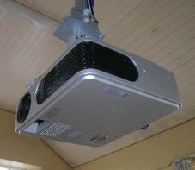

Projectors & smart boards
Read the manuals
Standby is not enough. Switch off.
  10 W * 8000 hrs = 80 kWh
80 kWh x 6 projectors = 480 kWh/yr
  = €80
For guidance on purchasing Interactive whiteboards and digital projectors visit Professional Development Services for Teachers (PDST) website. https://www.pdsttechnologyineducation.ie/en/Technology/Presenting-in-the-Classroom/
Notes:
Overhead projectors and smart boards can use quite a lot of electricity, especially if they are left on when not in use. Switch them off when you can. Do not leave them in standby, especially over weekends and holidays. Switch the projector off at the socket.
Many projectors have an eco-mode which can be used via the menu system on the remote control. Many schools will find that in eco-mode the image on the whiteboard is bright enough. Eco mode uses less electricity, and the bulb may last significantly longer. Eco-mode may also be significantly quieter which can be a significant benefit to some students. The school should experiment with eco-mode and use it in every classroom if possible. Projectors and classrooms vary, so adjust each projector individually.
If replacing old whiteboards consider interactive flat screen with LED technologies, which use less energy than other technologies.

Slide 56
Other electrical equipment
When the school is closed at night, weekends or holidays, switch off at the socket:
Computers and their screens
Servers, switches, routers, and wifi devices
Photocopiers and printers
Scanners, shredders, etc
Projectors, smart boards, and laptops
TVs, DVD players, amplifiers, stereos
Public address systems
Chargers/ adaptors for phones, laptops, speakers etc.
Defrost and switch off fridges, leaving door open
Exhaust fans including those on time switches
Domestic hot water heaters
Do you have it?,
Is it on a checklist?
Notes:
Schools can waste a lot of energy, especially electricity, outside teaching hours. It is important from a cost and environmental point of view to minimise this unnecessary energy use where practical by switching off items. Essential systems such as fire alarm and security must, of course, be left running. Most other items can be switched off at the socket. Not only will this save money, but it will also reduce the risk of fire from faulty electrical equipment
it is important that, when the school is closed at night, weekends and over the holidays, as much of the equipment as practical be fully switched off (at the socket). This includes:
Computers and their screens,
Servers, switches, routers, and WiFi devices,
Photocopiers and printers,
Scanners, shredders, etc.
Projectors, smart boards, and laptops,
TVs, DVD players, amplifiers, stereos,
Public address systems,
Chargers/ adaptors for phones, laptops, speakers etc.
Defrost and switch off fridges, leaving door open,
Exhaust fans including those on time switches,
Domestic hot water heaters,

Slide 57
Low/No Cost Measures Vs Investment Measures
Low Cost/No Cost
  Can begin working on these immediately
  Can be applied to all departments and everyone can take part
  Can yield impressive savings without having to find capital funding
  Can serve as a learning resource for students of all ages
  Good housekeeping can result in improved productivity and comfort
Investment Measures
  Require grants or capital funding from School or Summer Works Programme
  Can have a large impact on reducing energy use
  Requires specialist knowledge and input from third parties
  Without good monitoring and housekeeping from low/no cost measures larger investment projects may not reach their potential. Never underestimate the importance or effectiveness of low and no cost measures and good energy management!

Slide 58

Energy Action Plan
Schools are at the centre of our communities and are where our children learn skills for their future. By ensuring that older schools undertake energy upgrades to become low-energy buildings, we can demonstrate the steps necessary to our children, and the wider community, while critically reducing running costs, emissions, and improving the comfort levels and learning environment in these vital buildings.
  Minister Eamon Ryan
  https://www.education.ie/en/Press-Events/Press-Releases/2021-press-releases/PR21-04-26a.html

Slide 59


www.energyineducation.ie https://forms.office.com/Pages/ResponsePage.aspx?id=RuNk9vvW5UOFuowECBAjVcUKQghXNh1KiVkney0eTFtUMUowSElKMVZONlZFVjU4NFY2RUQwWkxHSy4u
Thank You

