Slide 1

Senior Cycle Redevelopment: the path to a new vision of Senior Cycle – an opportunity born of experience
Dalton Tattan \ Neville Kenny,
Sligo, January 2023
Notes:
Good morning – intro of self
Plan is to tell you nothing new over next 35 to 40 minutes and then get you to give me some answers to some big questions
I say “nothing new” as what I intend to do is offer you some rellections on some of the big decisions that were taken in regard to the Leaving Certificate during the pandemic and then to consider that learning in the context of Senior Cycle redevelopment

Slide 2
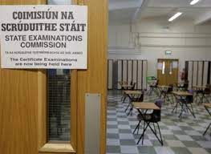
“The Leaving” –
An Irish cultural experience
Who remembers it?
How did it feel?
When was it?
But, do you remember your grades?
Has it changed “since then”?
Have you been through it again since?
Is it (still) ‘fit for purpose’?
Notes:
Snapshot history – 1924/25 through introduction of free second level education; joining of the EU; social and economic “revolution”; the introduction of Transition Year and new subjects demonstrating evolution over time …
Senior Cycle review – the preparatory phases commenced in 2016 – indeed there were previous initiatives or efforts to frame change; and the Leaving Certificate has evolved but we now have a clear vision for change ….
Reference March 29 announcement – “roadmap” and policy direction
We are in the foothills of the implementation phase …. Looking to structure our implementation correctly; learn and apply lessons – domestically but also internationally

Slide 3
“The start” - the known knowns Jan. ‘20
OECD highlights:
Long tradition of high-quality education … committed to adapting system to future challenges
PISA – top performing system and strong emphasis on equity
Irish students feel well supported by teachers yet some\many feel anxious
Variety in assessment needed to reflect breadth of competencies that modern curricula expect
The conversation in Ireland:
Student say LC is a period of intense pressure – why?
Public trust and confidence – why?
Growth in subjects in recent years
Growth in student numbers
Continuation from Junior Cycle
NCCA Review in train
Scrutiny and expectation …
Growing calls for change …
We are the guardians of the positives built up over c. 100 years

Slide 4
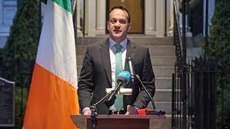
“The shock” - Where were you when it happened…
“This is the right decision at the right time. It is taken in the best interests of our children, our young people, our school and college communities and our wider society. … This is a time where we all need to work together for the best possible outcome for our students. The support of everyone across the sector is vital as we all strive to ensure that this threat is dealt with as effectively as possible. ...”
(Minister, 12/3/20)
Notes:
JFK assination
First landings on the moon
September 11th, 2001
Diana was killed; whatever big event you think of ….
I was in the Clock Tower at a Senior Management Forum – we heard it second-hand as such but immediately we were expected to be part of the national response – “to remain open”
Look at the text highlighted – spoken by the Minister at the time on the day – these would be the guiding principals as we faced the many challenges over the following months.

Slide 5
“The challenge”: Leaving Cert 2020
Immediately: calls for clarity … What is possible?
Advisory Group on State Examinations established – partner voices – became valuable forum
Public Health “picture” – evolving, uncertainty …
Moving at pace … (unprecedented) Oireachtas and media spotlight … communications challenge (to students and teachers in terms of clarity and guidance) … legal position\role of SEC
May 8 announcement on calculated grades
“School profiling” – school historic data – an issue which would be addressed later

Slide 6
“The experience”
September 7: results issued – “the end of the story?”
“Grade inflation” (CAO points increases)
Legal challenges – “out of school” cases; 2019 cases; challenges to standardisation – systemic challenges (concluded March 2021)
“Coding errors” discovered - Review announced
Record number of appeals (until 2022!)
Public health challenges remain … schools open, but …
Lessons learned exercise undertaken
Class of 2021? Early decision made in February 2021

Slide 7
“The Sequel”: Accredited Grades 2021
Schools were closed when the February ‘21 decision was made
Differences to CG 2020 – shows real-time lessons learned
Voice of students very strong \ Role of Advisory Group
Litigation: 1 case
Results issued: September 3
Grade inflation -v- 2020 but again 60,000 progressed …

Slide 8
“The lessons”: What did we learn?
Huge willingness to do the right thing
We can pivot; we can be agile; we can be innovative
Core values - maintaining public trust, fairness for students, being equitable and inclusive in our approaches and acting with integrity.
Remember what was said on March 12th – “work together for the best possible outcome for our students”
Oireachtas Cttee: “…worked under extreme pressure…”

Slide 9
What else did we learn?
Questions do remain – current work reflects these:
How do we return to normal (adjustments made to LC 2023 examinations but LC 2022 was exams only)
No ‘cliff edge’ to grade profile from 2023
OECD Review of LC 20 and 21 arrangements – achieved main goal; demonstrated the strengths and challenges of the LC; Importance society places on LC (publication October).
Biggest single learning point is that change is needed … demanded.

Slide 10
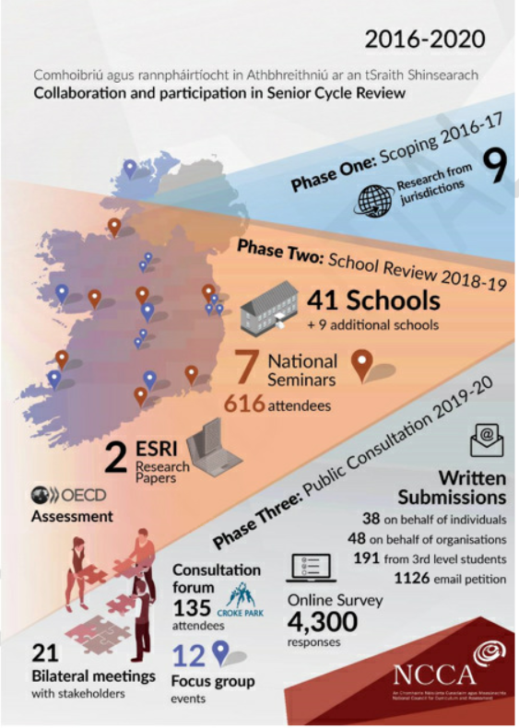
NCCA Senior Cycle Review
2016
Board for Senior Cycle
2017
International perspective
2018 School based Consultation
2019
Public Consultation
2021 Advisory Report
Notes:
We don’t need to dwell on this slide but just to reference the multiple phases to the initial Senior Cycle Review work carried out by the NCCA initially as can be seen – it involved at a local level schools, their students and teachers as well as research at a national and international level.

Slide 11
Vision for Senior Cycle
Minister’s Response
Accepts fully the recommendations of the NCCA Report:
“Clear and welcome direction of travel for evolution of Senior Cycle”
Values the stakeholder engagement and is committed to continuing with that to implement Senior Cycle redevelopment
Values deep engagement with students, in particular
Recognising that demand for change at Senior Cycle has grown the aim is to:
Empower students to meet the challenges of the 21st century
Enrich the student experience and skillset we have in our current system
Embed wellbeing and reduce stress levels for our students
Notes:
The March 2022 announcement is driven by a vision – encapsulated in the 3 Es (Empower, Enrich and Embed) – the vision is predicated on being student focused

Slide 12
Foundations of the Vision
NCCA Advisory Report – supported by research, consultation and analysis
Experience over the period of Covid pandemic and other domestic learning and experience
Growing consensus (and demand for change) - reflecting a more active student voice in the debate – evolving\increasing expectations (and scrutiny)
International experience and perspectives
Notes:
The National Council for Curriculum and Assessment conducted a review of Senior Cycle over a more than four year period from 2016 to 2020. It was based on research and consultation – including work from the OECD and examining a number of international systems.
Before this work could be fully concluded and considered within the Department, the Covid pandemic emerged, which enforced alternative and emergency assessment arrangements to be out in place.
We have seen, over that period in particular, a growing consensus and demand for change. We have seen demands that the system should not simply return to the pre-pandemic norms. In particular, we have seen a more active student voice – not just in terms of our engagement with the National Irish Second Level Students Union but in terms of direct engagements Ministers have had – enabled by social media for example. Participation by students in Parliamentary committee hearings and vocal advocacy for students such as by the Ombudsman for Children.
And, there has been engagement internationally – in terms of accessing expertise here in the OECD but also on a bilateral basis with experts that our Minister has met.

Slide 13
Ingredients for success - the opportunities and challenges
Trust and engagement of all stakeholders
Co-construction and Network schools : opportunity to evaluate
Professional development for teachers and school leaders
Professional time and resourcing generally
Curriculum\Assessment Nexus – cultural evolution
Schedule of Specification revision – September 2023 – roadmap for longer term planning
Notes:
We have mentioned ‘debate’ since the Senior Cycle redevelopment programme was announced. This debate will intensify very shortly as the detail of the subject development work led by the NCCA for the new and revised subjects commences in earnest and also as we go to the school sector inviting schools to become Network Schools.
We know from experience with previous reforms – particularly most recently in regard to Junior Cycle – that we must prepare properly for the work ahead and ensure that we anticipate the concerns of schools – their students, parents, leaders, and teachers – so that we can build and maintain trust in the planned changes.
We recognise critically how significant a change introducing teacher based assessment is; that teachers in particular need to time to build their confidence in the approach and be supported in that regard; and that they must have the time to engage in the preparation for and participation in the new assessment arrangements.
We have used the word evolution deliberately rather than revolution to describe our approach as we are not abandoning the current or ‘old’ system but rather building on it and strengthening it; however the opportunity to evolve across the longer term and the full range of Leaving Certificate subjects (across a period likely to last until th eearly part of the next decade) can only succeed if we meet the challenges we know exist.

Slide 14
SCR: Implementation – Impact of the ‘foundations’
Advisory report reflects the complexity and the breadth of the challenge
Students see alternatives to current, or is it the old, Leaving Certificate?
They expect change …
School leaders and teachers are key and the constant in how the vision is brought to reality
It will take time, but time in a changing world – Jan ‘20; Jan ‘21, Jan ‘22, today?
It will take resources
Are we clear on the journey ahead?
We know where we want to get to – students who can confidently take their place in our society and the world? Isn’t it?
Notes:
The programme for the redevelopment of Senior Cycle announced at the end of March focused on these six areas. In terms of the Above and Beyond project we are looking to focus on the nexus between Curriculum and Assessment and in particular on the recognition that if we are to change what and how students are taught in our schools; their assessment experience – how they are assessed and how they feel their attainment is recognised through assessment will be vital. The next three slides focus on the curriculum, assessment and ingredients for success.

Slide 15
“The Destination” – A Senior Cycle for all
As guardians, what does success look like?
“Education shapes the world we live in by developing the knowledge, skills, attitudes and values on which societies rely, forging social cohesion and preparing people to become and remain competent workers and active citizens. … education systems foster democracy and the transformation to innovation-oriented knowledge societies.” (OECD Building the future of education, 2023)
How do we fulfil this society shaping responsibility – as professional leaders in education and as educators?
Notes:
The National Council for Curriculum and Assessment conducted a review of Senior Cycle over a more than four year period from 2016 to 2020. It was based on research and consultation – including work from the OECD and examining a number of international systems.
Before this work could be fully concluded and considered within the Department, the Covid pandemic emerged, which enforced alternative and emergency assessment arrangements to be out in place.
We have seen, over that period in particular, a growing consensus and demand for change. We have seen demands that the system should not simply return to the pre-pandemic norms. In particular, we have seen a more active student voice – not just in terms of our engagement with the National Irish Second Level Students Union but in terms of direct engagements Ministers have had – enabled by social media for example. Participation by students in Parliamentary committee hearings and vocal advocacy for students such as by the Ombudsman for Children.
And, there has been engagement internationally – in terms of accessing expertise here in the OECD but also on a bilateral basis with experts that our Minister has met.

Slide 16
Group exercise – Strategic questions
(Full questions are in the handout)
(Tables 1,5,9,13,17,21 and 25)
(Tables 2,6,10,14,18,22 and 26)
(Tables 3,7,11,15,19,23 and 27)
(Tables 4,8,12,16,20,24 and 28)
Notes:
Our last slide set out some of the high level ingredients for success for our reform programme. We know we have to create the right environment within which we can achieve the vision we described earlier and meet the associated challenges. The key within this – the litmus test perhaps – will focus on whether we can deliver the cultural evolution which introducing teacher based assessment to the Leaving Certificate represents. We know that ensuring there is continued public trust in and acceptance of the Leaving Certificate is vital – at its most simple the wider public will want to rely on the outcomes students achieve; to know that those achievements are still accepted for entry to work or further study and that the system is fair in terms of how it is administered. Maintaining public trust was a central element in decisions made during the Calculated and Accredited Grades processes which operated during the Covid period.
The reformed system of assessment must make sense to parents and students – it must feel “better” for students; but also teachers must have confidence in it and in their ability to operate it – it must make sense to teachers too and be seen as “better” than the entirely externally marked current system.
But if you worked on our team and you were advising the Minister on how to approach SCR, your views on some strategic questions would be helpful. So, in terms of four strategic questions we have some time for you to consider them and then we can hear back from you.

Slide 17
Group Feedback & Discussion
Go raibh míle maith agaibh
(Thank you)
Notes:
As we said at the start of our presentation we are in the foothills of the implementation mountain for our redevelopment programme but we are anxious to hear from your experience, particularly in how teacher based assessment operates, so that we can realise the opportunities and meet the challenges we outlined when looking at the ingredients for success.

