Slide 1



Kilkenny City Vocational School
Integrated Approach & Alignment of School Provision Mapping/SIP (DEIS)/SSE & LAOS

Slide 2
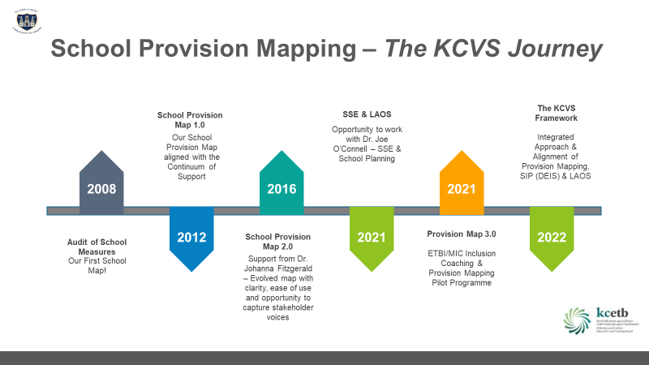



Slide 3
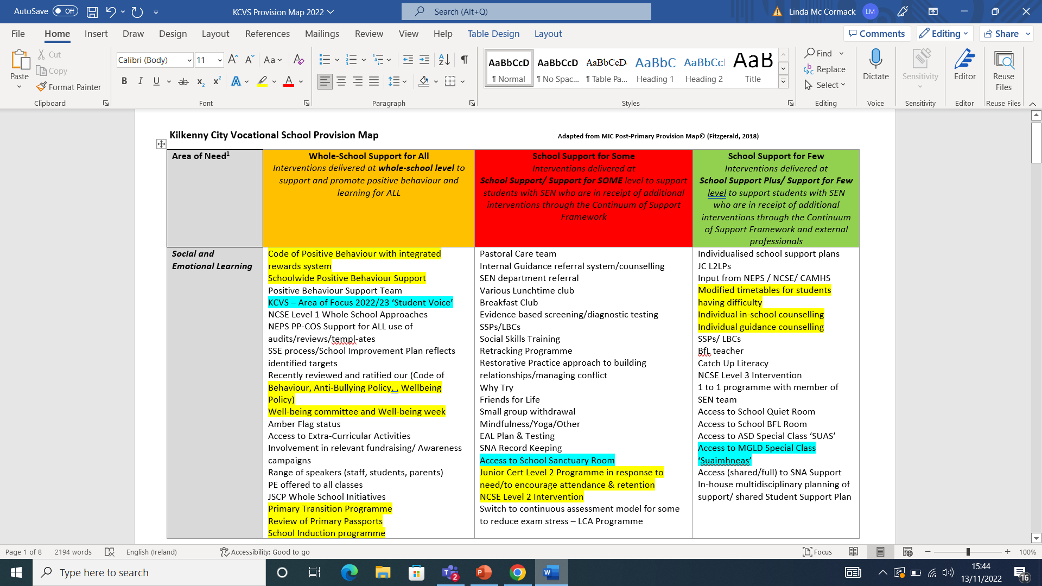
KCVS Provision Map - Present

Slide 4
Our Provision Map & the SSE Process
SSE Process
What are we doing to support All/Some/Few?
Audit
Interventions for students across the continuum
Product
Our PM Document summarising provisions available to support the needs of all students
Where are the strengths?
Where are the gaps?
Aligned with our School Improvement Plan (DEIS)
Audit identifies Teacher Professional Practice requirements
Data Informed – Student/Parent/Teacher Input

Slide 5



Prior to 2021 - Disconnect
School Self Evaluation
Looking at Our Schools
Quality Framework
KCVS School Provision Map
School Improvement Plan (DEIS)
Paper Based Activity Way of Working
Living Breathing Framework

Slide 6
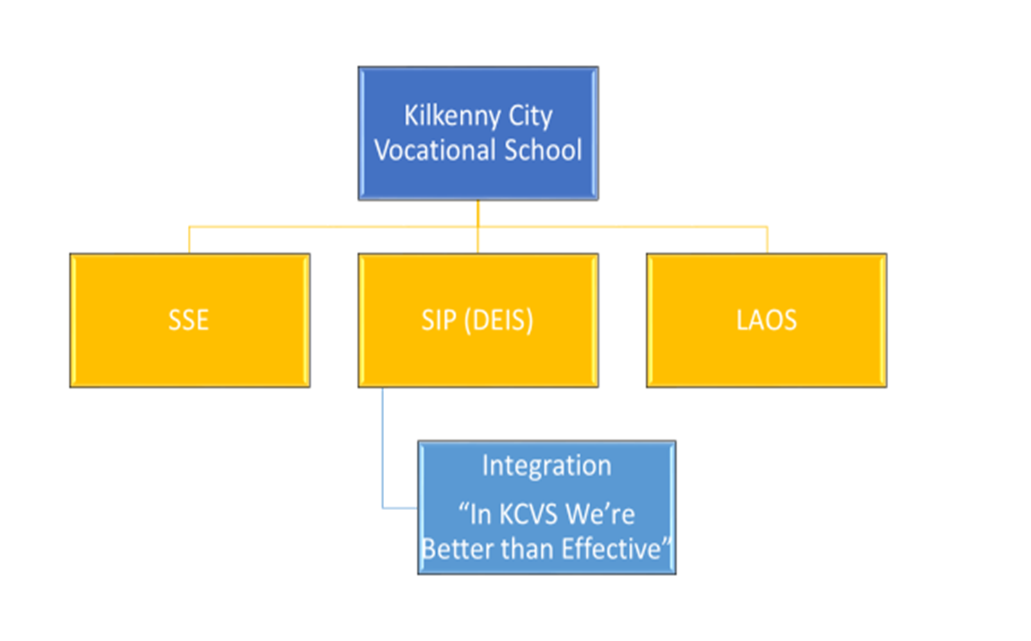
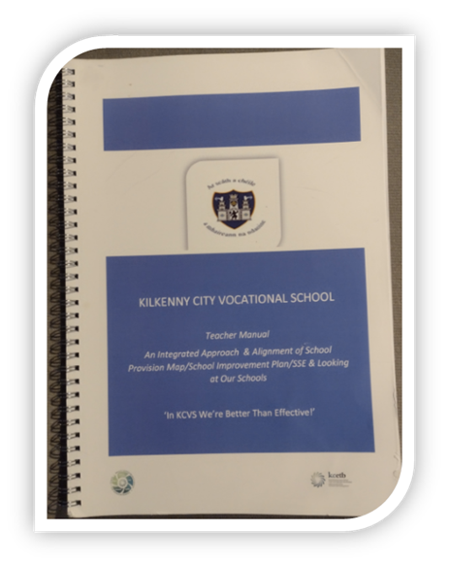
Everything named and mapped in one Handbook
Easy to see the landscape – Where we are, Where we need to be and How are we going to get there

Slide 7
Addressing the Disconnect
Towards Alignment and Integration
Greater Accessibility in terms of presentation of the documents
Increased relevance to our everyday practice
Improved Readability
A Ready Reckoner/One Stop Shop – With all our data, frameworks, circulars cross-referenced
National and Local in one user friendly workbook
Everything named and mapped in one easily accessible handbook making it easy for us to see the landscape
  Where we are
  Where we need to be
  How we are going to get there

Slide 8
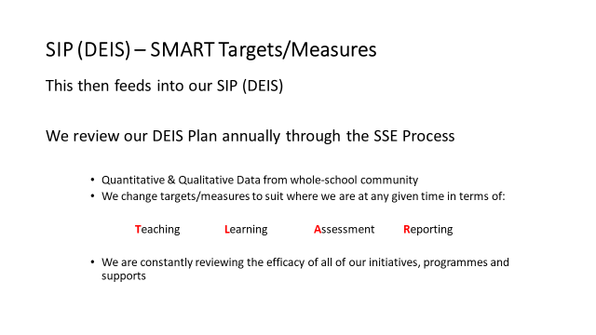
  Provision Map is over-arching source
  of all measures used to support targets in our SIP
  PM/SIP Evaluated Annually (SSE)
  PM/SIP integrated &
  evaluated accordingly

Slide 9
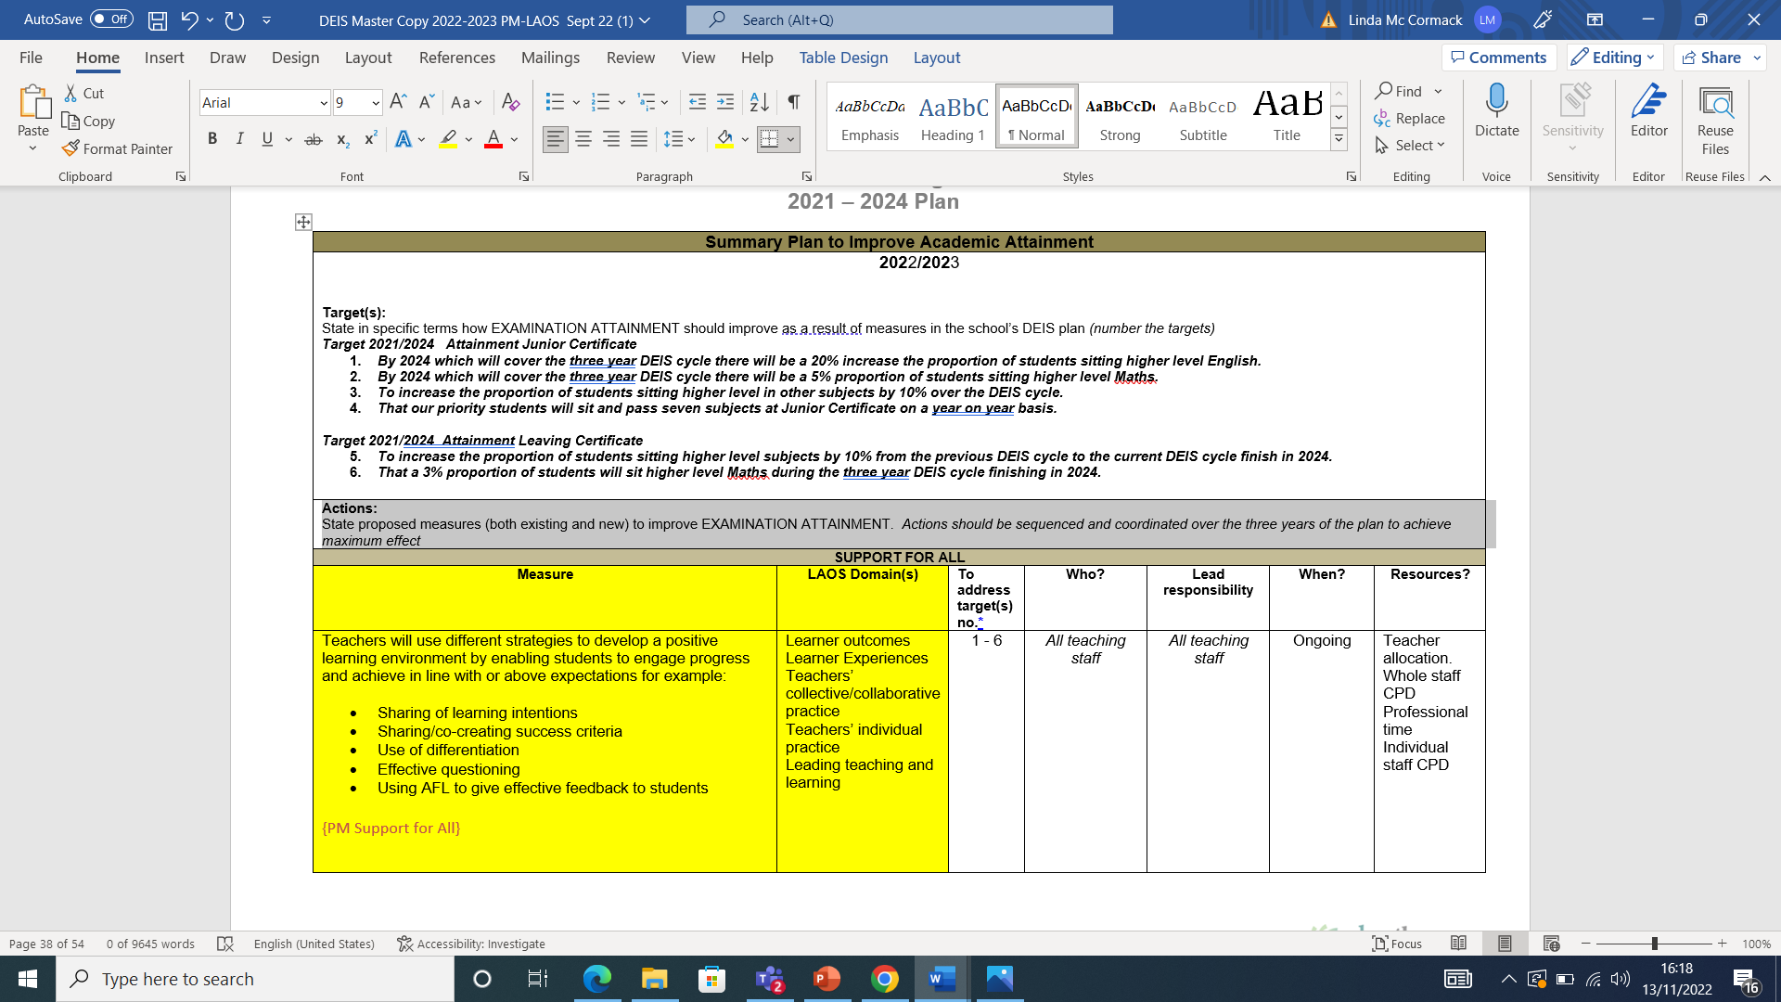
School Improvement Plan (DEIS)

Slide 10
DES Circular 0056/2022
0056/2022 ‘SSE The Next Steps’. (Issued August 2022)
2022-2023
Review Year
Review Post-Covid Landscape & Identify Gaps in Learning
Asks schools to use the SSE to
identify & reflect on the impact of Covid-19 on
Student Educational Experiences
Student Outcomes
Wellbeing
Motivation to Learn
Engagement in Learning
2023/26 -Three Year Plan that enables us to address:
School Priorities related to Teaching, Learning, Equity & Inclusion
(our own area of focus) underpinned by:
National Wellbeing Goals
National Curriculum Goals
Other National Strategies
  Digital Strategy for Schools
  Strategy for Education for Sustainable Development

Slide 11
School Self Evaluation
Local KCVS
Area of Focus
National DES Next Steps 0056/22
2020 – 2021
Post Covid Review Evaluation of Wellbeing Strategies
2021 – 2022
Assessment
2022 – 2023
Student Voice/Participation
Findings (SSE)
reflected & addressed
in SIP (DEIS)
Findings (SSE)
reflected & addressed
in SIP (DEIS)
2022 – 2023
Post Covid Review
Wellbeing Promotion Review
2023 - 2026
3 Year SSE Plan
Addressing Local Areas of Focus
underpinned by National Strategies/Goals

Slide 12
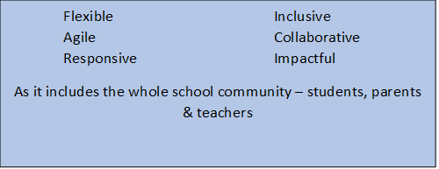
KCVS Integrated Framework – PM/SIP/SSE/LAOS
As a process it is:
Compare Local & National
We highlight our Strengths, Areas for Improvement and Actions

Slide 13
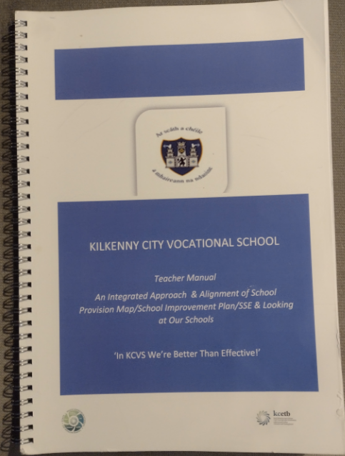
Outcomes
Greater accessibility of data and information
Greater clarity (of context) & Common Language
Fluency in the terminology of evaluation
Increased collaboration and peer learning
Our Handbook is an enabler of Self Reflection and Improvement

Slide 14
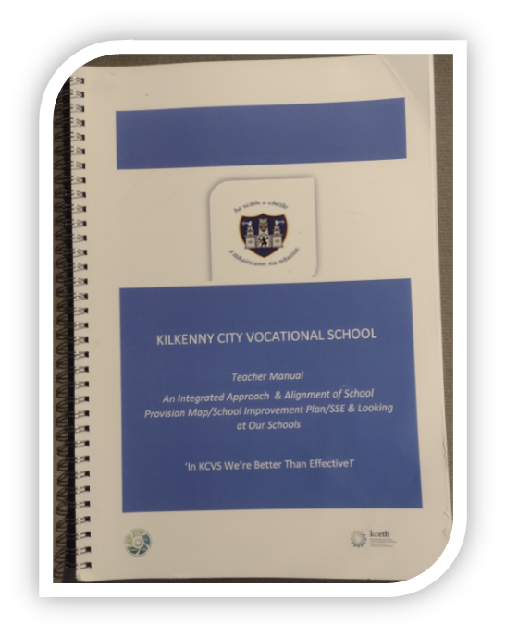
Outcomes
A culture of teamwork, collaboration and innovation
Increased facilitation of student reflection, student voice/participation
Improved Teacher Professional Learning (CPD Consultancy)
Improved Student Outcomes
Disconnect - Integration/Alignment
A living breathing Framework
  *Evidence to date Qualitative
  October 2023 – Quantitative data gathered and collated:
    Attendance
  Retention
  Attainment
  Assessment

Slide 15


Challenges
Time (Data Gathering)
Resources
Student Voice/Participation
Parent Voice/Participation
Whole School Buy In
We are still nourishing and nudging the growth!

Slide 16


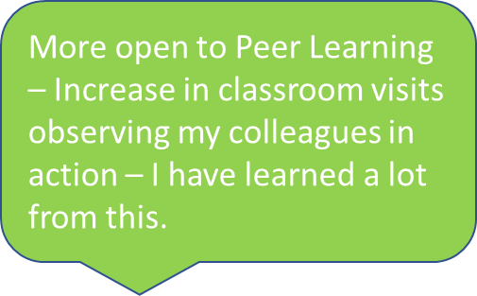
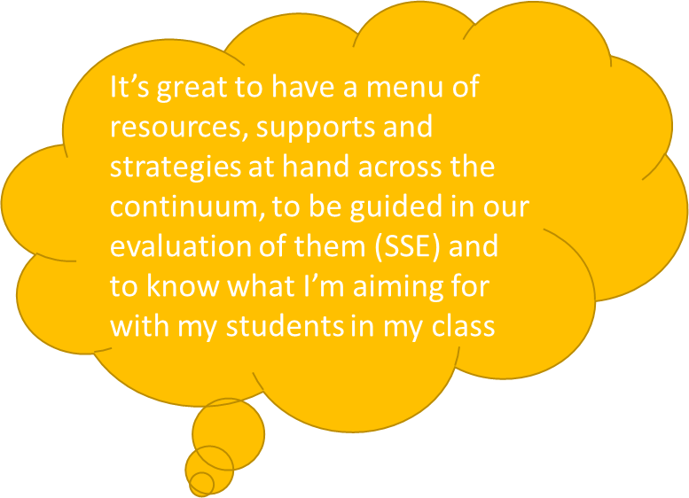
Snr. Staff Member
Jnr. Staff Member
Increased engagement in professional dialogue with colleagues in T&L Strategies & Targets. Fluency in teminology of LAOS.
Academic Practical How does it work in my subject areafor my students? No longer a dusty document, I now use it everyday
Snr. Staff Member
New Teacher to the school

Slide 17
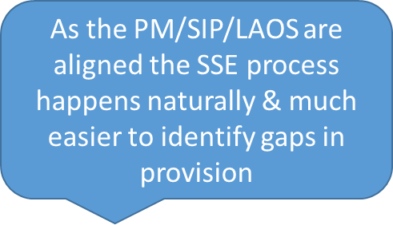
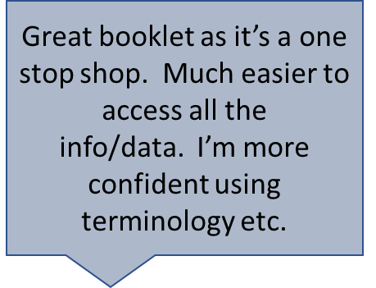

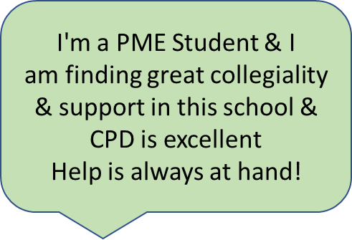
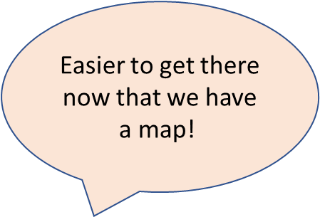

Slide 18
