Slide 1



IT TAKES A VILLAGE TO RAISE A CHILD
DOES PROVISION MAPPING SUPPORT SCHOOLS TO RESPOND COLLECTIVELY TO THE DIVERSE NEEDS OF ALL STUDENTS?
ETBI Annual Principals' & Deputy Principals' Conference: Leading for Learning
January 25th -26th 2023

Slide 2

WELCOME TO OUR PRESENTATION
  Linda Tynan: LOETB
  Cathy McSorley & Linda McCormack: Kilkenny City Vocational School, KCETB
  Liam Walshe & Frances Shannon: Colaiste Pobal Setanta, DDLETB
  Sinead O'Hara: WWETB
  Brian O'Donoghue: Ennis Community College, LCETB
  John Ganley: Mullingar Community College, LWETB
  Dr Pauline Egan: KCETB
  Dr Johanna Fitzgerald: Mary Immaculate College
Notes:
It takes a village to raise a child. I don't think there is anybody here who would disagree with that old adage. But it takes a connected network of villages to support those who are raising the child, especially the child who is most vulnerable in our schools. ETBI, in collaboration with Mary Immaculate College has been cultivating this network to promote outcomes for children and young people with diverse strengths and needs, and to provide support to schools to continue to develop inclusive cultures and practices which recogniss and build on existing good practice across schools and ETBs. This is what Provision mapping is all about.
This morning we have representation from some of those villages to share their experiences of provision mapping in their schools and ETBs.
I want to thank and acknowledge key members of this ETBI village for their involvement in shaping provision mapping over the years. Indeed, it has taken the collective energy, commitment and creativity of this village to hone and refine provision mapping and it has only improved because of the generous inputs from the 14 ETBs, 33 pilot schools- the principals and school champions, the inclusion coaches and Directors of Schools involved in the current pilot initiative. I also want to express gratitude to the ETBI Task Group for Inclusive Education, chaired by the irrepressible Linda Tynan. She has championed this initiative from back in the days when she worked in Tipperary ETB. Finally, none of us would be here today without LCETB taking a chance on this initiative back in 2016. I am forever grateful to LCETB and the LILTA Team for taking this leap of faith and for allowing me to work with your schools to see if provision mapping could achieve what we set out to achieve.

Slide 3


WHAT ARE WE TRYING TO ACHIEVE WITH PROVISION MAPPING?
Systematic & Data-informed Approach
Guide schools in their implementation of school self- evaluation (DES Inspectorate 2016; DE Inspectorate 2022) to develop a school provision map, reflecting current provision for learners with additional and special educational needs across the Continuum of Support (NEPS 2007; 2010).
Capacity Building
Build systematic, collaborative and situated approaches to professional learning and capacity building within and across schools.
SENCO Leadership
Empower and enable SENCOs to co-lead the inclusive education agenda across the school through coaching, mentoring and collaborative opportunities for networking and collegial sharing and support.
Notes:
An outcome hoped for is that we can use school generated data to affirm and acknowledge existing good practice in relation to inclusive and special education in schools.

Slide 4

WHAT IS PROVISION MAPPING?
STRENGTHS- BASED & EVIDENCE-BASED
IT IS A PROCESS
IT IS A PRODUCT
It provides a basis to strategically plan provision, build systems promoting SSE, allocate resources and identify professional learning needs of staff.
A summary document of provisions & interventions currently available in school to support the needs of ALL learners across the Continuum of Support.
It affirms existing EBP, provides a helpful overview and allows the school to identify, monitor and evaluate areas of real strength and areas for development.
Notes:
Provision mapping allows schools to list the provisions and interventions available to learners across the CoS, ranging from provisions for all learners at tiers one to support common needs to specialist interventions at tiers two and three to support distinct needs. In doing so, it provides a basis to strategically cost and plan provision, allocate resources and identify staff professional learning needs.
At a policy level, lack of integration of these interdependent and interrelated frameworks encourages a discrete or ‘siloed’ approach to interpretation and translation in schools and so we attempted to integrate existing frameworks of CoS and SSE to support a 3 step process.

Slide 5

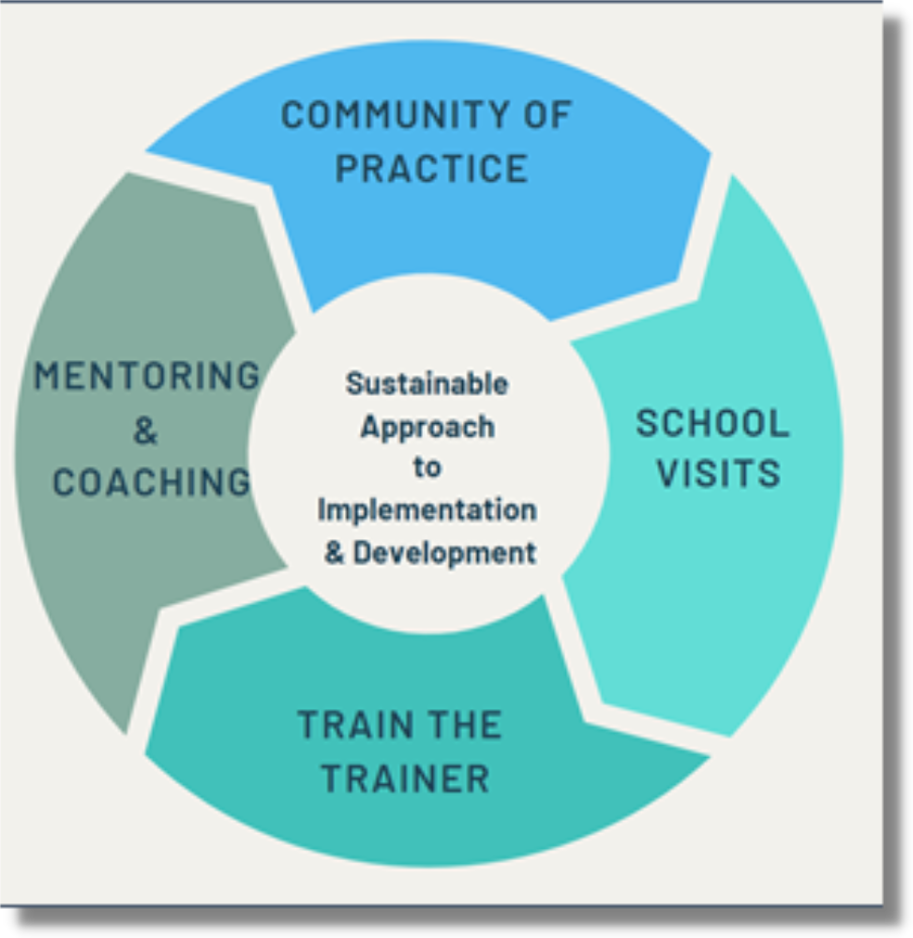
HOW ARE WE SUPPORTING SCHOOLS
The emphasis on research and knowledge exchange involves school personnel in co-constructing new practices in a shared collaborative space (O'Brien and Roberts 2019) and derives from the perspective that policies are not simply implemented but are enacted through processes of interpretation and translation (Skerritt et al. 2021).
Notes:
Implementation and consolidation of any school-wide initiative is linked to sustained support and professional learning. This is especially important when supporting schools with developmental school improvement. A multi-modal approach to embedding provision mapping has been adopted over the past two year and is still ongoing. It involved establishing communities of practice for ETB appointed Inclusion Coaches, who are tasked with leading provision mapping in their ETBs. These Inclusion Coaches have been involved in an online induction programme and continue to meet as part of a community of practice every month and they are supporting the schools to embed provision mapping at a local level. Directors of Schools are also invited to this community of practice and have been instrumental in establishing local communities of practice for SENCOs and also in giving a platform to provision mapping at principal and deputy principal meetings. Online regional and national level seminars and workshops for school principals, school champions leading provision mapping and Directors of Schools have been organised and a suite of resources have been developed for schools. As a developmental pilot project, research and evaluation has been a critical feature and an interim evaluation was published last summer which identified what is working well, what needs further development and where we need to go next. The existing pilot schools are nearing the end of the first cycle of provision mapping and a review will be underway this Spring.
I will finish up now and hand you over to Cathy and Linda in Kilkenny City Vocational School, who will share their provision mapping journey with us. Thank you for being here.

Slide 6

THANK YOU

