Slide 1
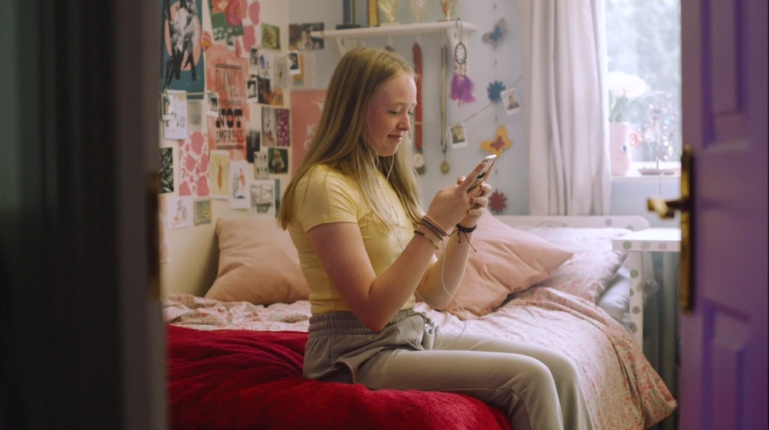




Online safety strategies and resources for schools
Jane McGarrigle
@Webwise_Ireland

Slide 2


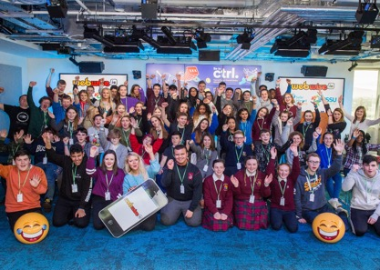
WHAT’S ON THE AGENDA?
Teens digital lives
School Policy
Online Bullying
Training and Resources
Engaging
Parents/Guardians

Slide 3







PROMOTING A SAFER, BETTER INTERNET
EDUCATION
RESOURCES
TRAINING & CPD
LISTENING TO AND
INVOLVING YOUNG PEOPLE
ADVICE & RESOURCES
FOR PARENTS
AWARENESS-RAISING CAMPAIGNS

Slide 4

Lets Discuss in pairs…
What is one area you feel your school is doing well in addressing online safety concerns of your students?
What is one area you think you could improve in your school’s approach to embedding online safety?

Slide 5


CHILDREN’S USE OF THE INTERNET
NACOS REPORT 2021
62%
24%
44% (39%)
26%
19%
Notes:
Im going to share some recent results from a recent online safety survey of parents and children conducted on behalf of the NACOS. I think it’s important to start with the positivies …Most children are positive about the Internet and say there are good elements for their age. 44% say this is very true and 39% say it is fairly true
62% of children and young people, aged 9-17 year, use social media. Unsurprisingly This rises from a quarter of 9–10-year-olds to nearly 90% of 15–17-year-olds
In terms of negative experience… people being nasty to each other (24%) and bullying (22%) stand out as the most mentioned issues that upset young people.
26% have seem harmful online content in the past year including: Hate messages; Gory or violent images; Experiences of taking drugs; Self-harm sites; Sites promoting ways to be thin; relating to suicide.
Importantly - children and their parents or carers have different perceptions of children’s’ experiences. For example, 53% of parents say they help their child when something bothers them on the Internet. This contrasts with 19% of children who report telling a parent about issues that have upset them online – what this tells us is that a lot of children don’t tell their parents when something goes wrong online. And That’s something that we are keen to address.

Slide 6

What do young people think?
“In a heavily digitally dependant world, this generation is arguably the most impacted by the harmful effects of social media and the internet - including young people in conversations such as this talk about digital safety is extremely important - to learn from and act upon our concerns and experiences, and to make the online world safer and more positive."
“There’s a lack of understanding of the positives and the importance of social media in young people’s worlds… it’s easy to say teens are addicted to their phones. But we hardly see anything about how good it is for creativity or how it can broaden our knowledge.”
I think many people, including me, only post certain aspects of their life as it has become almost a culture to only show the best parts of life to others.
“I sometimes feel pressure to post things that make my life seem better and live up to people’s expectations on my life.”
“Solution: Comprehensive curriculum in schools - digital literacy, digital legislation, what happens when you do something wrong online & how to stay safe online. Teaching tolerance from a young age – so kids respect other people’s opinions.”
“Young people now are never disconnected”

Slide 7
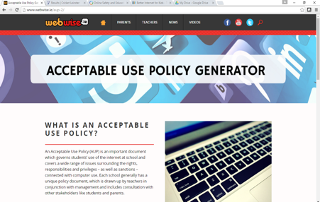
Online Safety and School Policy
Developing a Robust AUP
01
WEBWISE.IE/AUP
02
AUP GUIDELINES, TEMPLATES, AND TOOLS
03
ONLINE POLICY GENERATOR
04
AUP FAQs

Slide 8

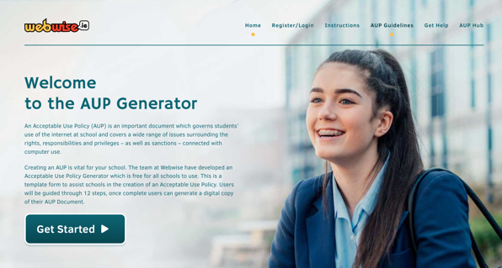
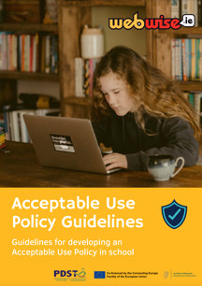
UPDATED SUPPORTS: webwise.ie/AUP-2
AUP GUIDELINES AND TOOL

Slide 9
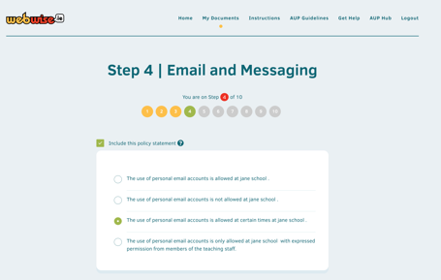
Acceptable Use Policy Generator
Webwise.ie/aup
01
CREATE AN ACCOUNT. SAVE AND
EDIT POLICIES.
02
FILL IN SCHOOL DETAILS. RELEVANT CONTACTS.
03
GET STARTED. SELECT // EDIT ALL RELEVANT SECTIONS IN EACH OF THE 12 STEPS.

Slide 10
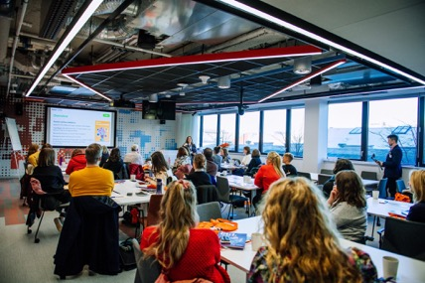
Training and Support: pdst.ie/schoolsupport
pdsttechnologyineducation.ie/onlinecourses/
01
Online Courses: Teaching Digital Citizenship
02
Online Courses: Introducing Internet Safety into the SPHE Classroom
NEW Online Course: Understanding, Preventing, Responding to Cyberbullying
03
04
In-school support via Digital Technologies and Health and Wellbeing teams

Slide 11

TRUE OR FALSE?
UNDERSTANDING CYBERBULLING
Did you know?
One third of children around the world experience bullying
Girls are more likely to experience bullying than boys
True
In Ireland, exclusion online is the most common form of cyberbullying
False
Young people belonging to minority groups (e.g., LGBTQ students, ethnic minority students) are more likely to be the target of cyberbullying.
True
Notes:
Did you know that ? One third of children around the world experience bullying. True - Globally 1 in three children experiences bullying. Unesco, 2019.
Girls are more likely to experience bullying than boys. [TRUE = More girls report experiencing bullying of any kind, either online or offline, than boys (18% for girls compared to 15% of boys). Report of a National Survey of Children, their Parents and Adults regarding Online Safety 2021]
Young people belonging to minority groups (e.g., LGBTQ+ students, ethnic minority students) are more likely to be the target of cyberbullying. TRUE: Children who are perceived to be “different” in any way are more at risk of bullying. Key factors include physical appearance, ethnic, linguistic or cultural background, gender, including not conforming to gender norms and stereotypes; social status and disability. (UNESCO 2019) Some students such as gifted students (Laffan et al.,2019), students with special educational needs (Feijóo et al., 2020) and LJBTQ+ students (Earnshaw et al., 2017) are at an increased risk for being targets of school bullying (Laffan et al., 2019).
In Ireland, exclusion online is the most common form of cyberbullying. False -Having nasty or hurtful messages sent to the young person is the common form of cyberbullying reported. Of those who had reported being cyberbullied, 59% said this happened to them. Being left out or excluded from a group or activity on the internet is the next most common form of bullying behaviour online. 28% of those who reported being bullied online said this happened to them National Survey of Children, their Parents and Adults regarding Online Safety 2021]

Slide 12
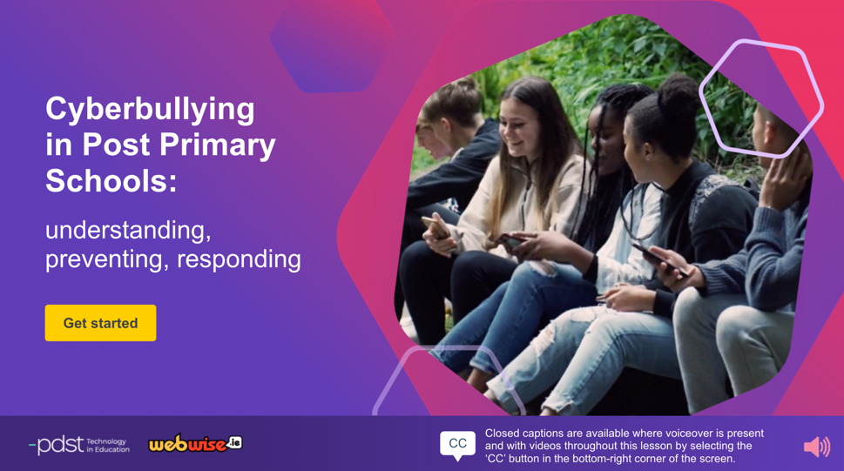

Slide 13
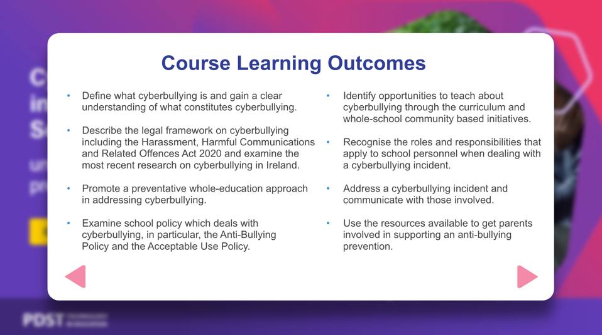
pdsttechnologyineducation.ie

Slide 14

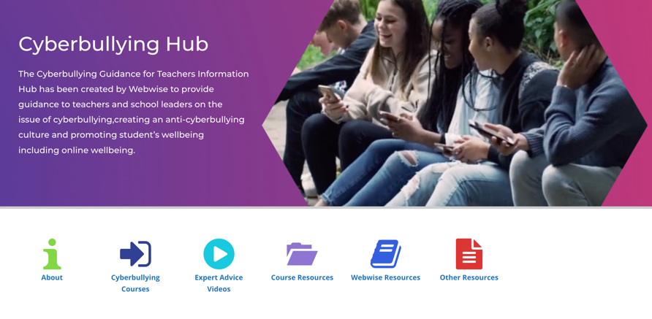
webwise.ie/cyberbullying-guidance

Slide 15
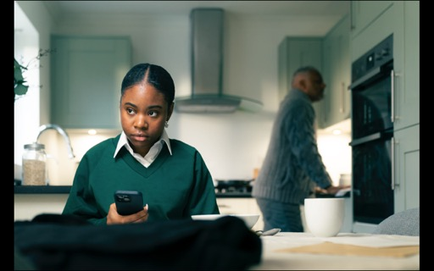
NEW RESOURCES
ADDRESSING ONLINE BULLYING
Silent Witness 3 x Videos Launching February 7th

Slide 16

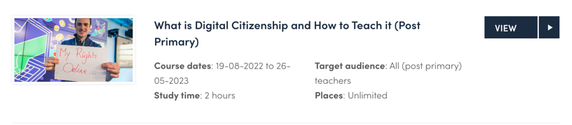
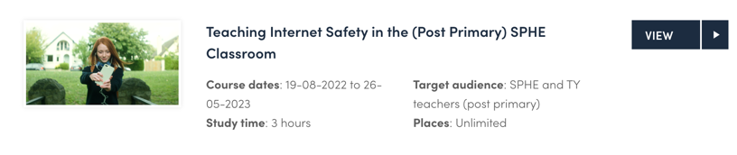

Slide 17
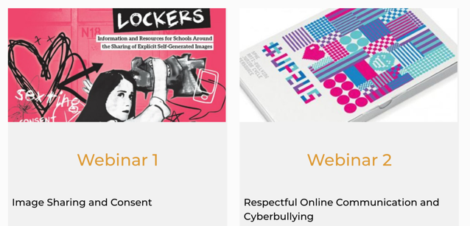
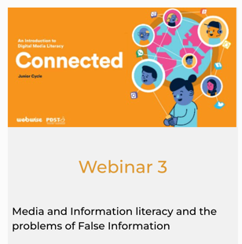
ON DEMAND: WEBINARS

Slide 18
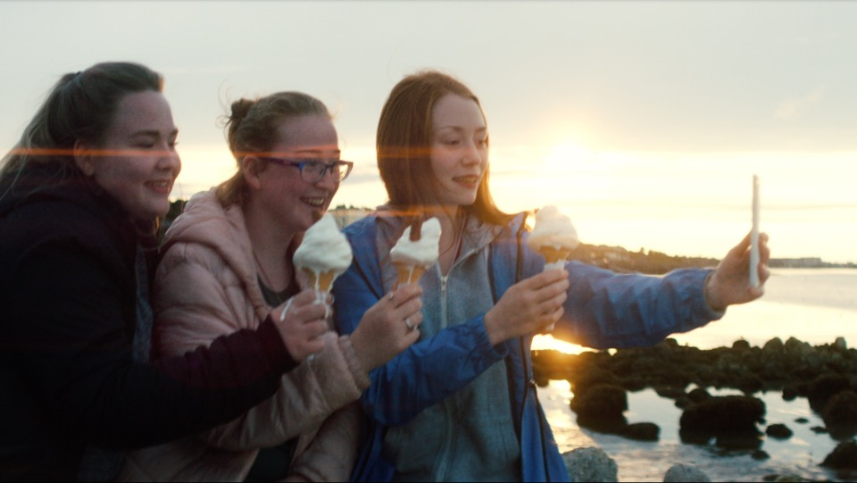
Online Safety Resources

Slide 19
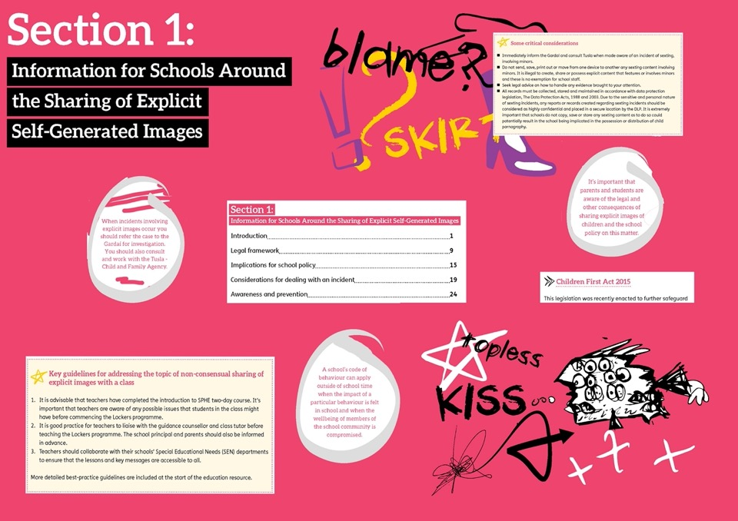


Slide 20
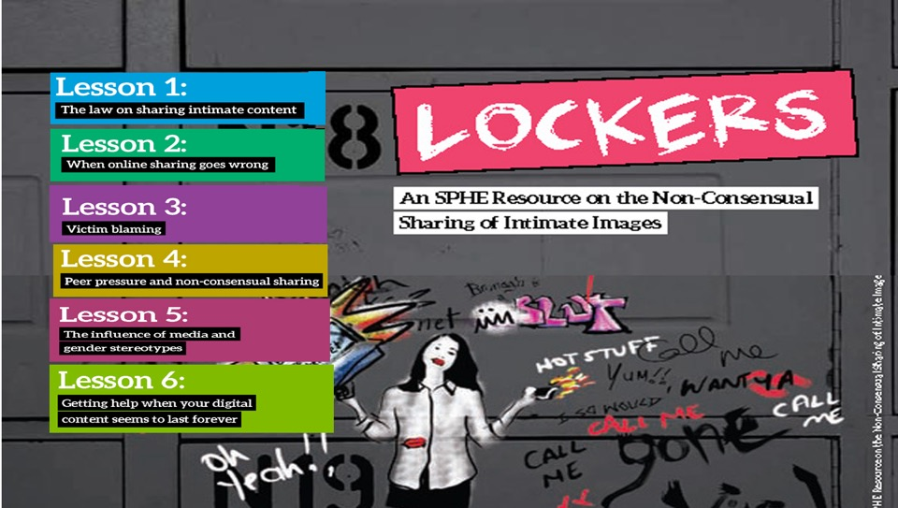

Slide 21
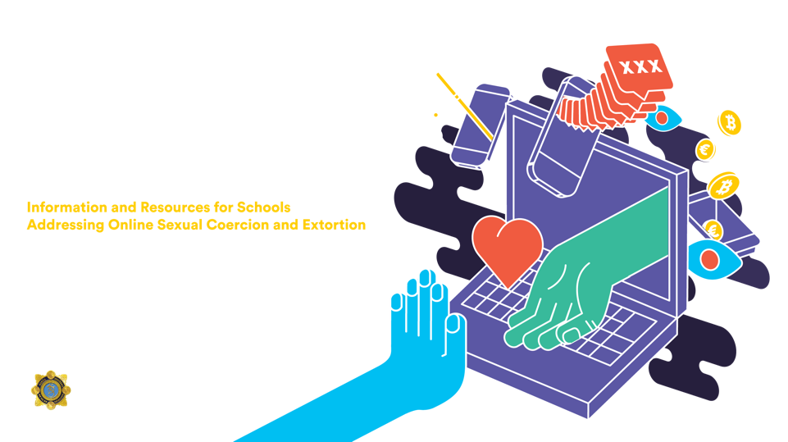

Slide 22

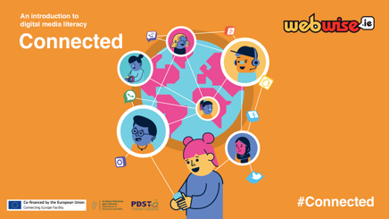
CONNECTED: webwise.ie/connected
DIGITAL MEDIA LITERACY PROGRAMME
01
ONLINE WELLBEING
NEWS, MEDIA AND PROBLEMS OF FALSE INFORMATION
02
03
BIG DATA AND THE DATA ECONOMY
04
MY RIGHTS ONLINE
05
PROJECT BASED ASSESSMENT

Slide 23
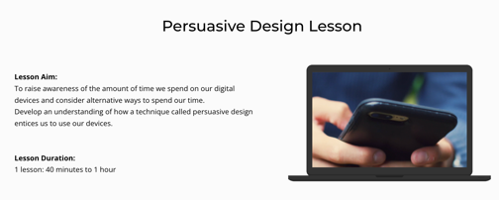
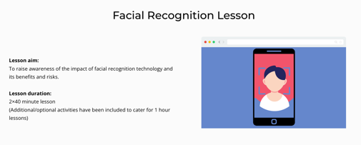
PERSUASIVE DESIGN &
FACIAL RECOGNITION

Slide 24

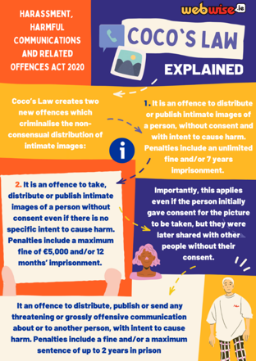
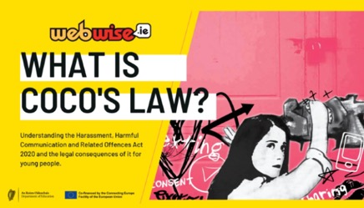

NEW PP RESOURCES: WHAT IS COCO’S LAW?

Slide 25

New Junior Cycle Unit of Learning
Connecting and Communicating Online
New Junior Cycle SPHE Unit of Learning exploring how young people connect, communicate and navigate friendships online
8 lessons supported by 3 videos and the Cyberbullying Teacher’s Information Hub
Explore the opportunities and challenges of the digital world, gain an understanding of the legal implications of online bullying, develop strategies for navigating online friendships and accessing help and support
Aims to develop students' social and emotional literacy in the online environment and to promote critical thinking and responsible digital citizenship.
Give students a safe space to discuss, recognise, explore and challenge abusive and bullying behaviour online.

Slide 26
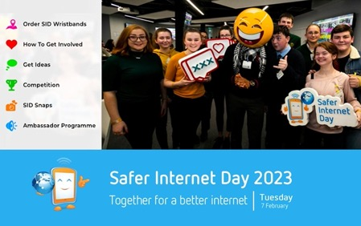

Resources for Safer Internet Day
webwise.ie/saferinternetday/
01
IDEAS & INSPIRATION
02
PLAN YOUR CAMPAIGN
03
FREE RESOURCES
04
FREE SID WRISTBANDS
05
VIDEOS & PRESENTATIONS

Slide 27
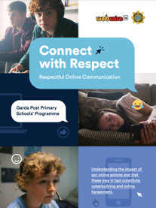
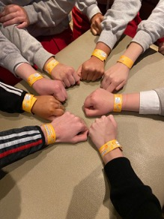
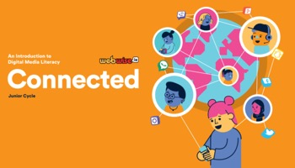
How can schools can get involved in SID 2023
FREE Wristbands
Garda Schools Programme
FREE Classroom resources
Use the FREE Webwise Classroom
resources to lead online safety lessons
Invite Gardai in to deliver a talk
on respectful communication
Order free wristbands for
your school

Slide 28
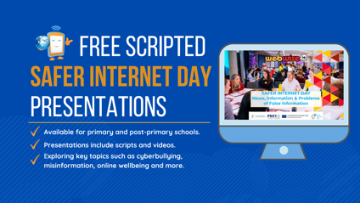
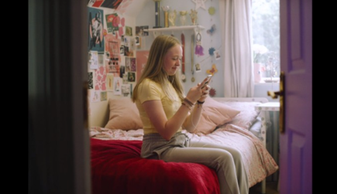

How can schools can get involved in SID 2023
Scripted Online Safety Talks
Classroom Videos
Use the ready-made Webwise Presentations to
promote safe online communication
Explore online advertising, cyberbullying,
false information, photo sharing and more using the Webwise classroom videos

Slide 29


How can schools can get involved in SID 2023
Get Creative
Get Parents Involved
Run a poster competition
Host a parents evening using the Webwise
Parents Talks and resources: webwise.ie/parents

Slide 30
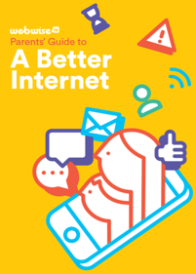
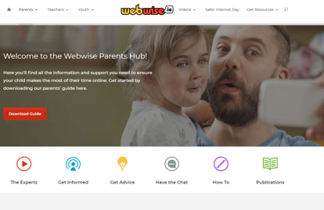
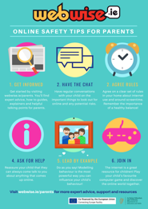

Resources For Parents
Webwise.ie/Parents

Slide 31
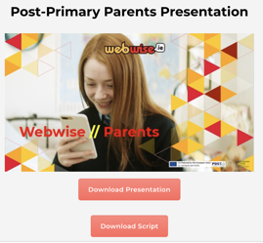
INVOLVING PARENTS
Host a parents evening using the scripted Webwise Online Safety Presentations available here: webwise.ie/internet-safety-talks-for-parents
Distribute copies of the Webwise Parents’ Guide to a Better Internet Booklet to parents. Order for FREE here: webwise.ie/teachers/resources
Share the Webwise Parents Hub on school website, social media and newsletters
Remind them of getting involved in key dates, for example Safer Internet Day
Notes:
The webwise parent hub is a great starting point to help parents support their children online.
Having regular open conversations is one of the most effective ways of supporting your child online. Webwise is encouraging parents and kids to use our topic generator to help them start the conversation.
Topic Generator. This is a brilliant tool to help families come together to discuss life online in a safe, non-judgemental way – that allows for two-way conversation.
Resources for Parents:
Parents' Guide to a Better Internet
This guide gives parents support, advice and information to help their children have a positive experience online. Topics explored in the guide include cyberbullying, screen time, sexting, social media and online pornography. This can be downloaded for free at Webwise.ie/parents

Slide 32
Lets Discuss…
As a result of this talk what is one thing you will incorporate in your school’s approach to addressing online safety?

Slide 33
NEXT STEPS
01
VISIT Webwise.ie/Teachers
Order resources, view advice articles,
Videos.
02
VISIT Webwise.ie/AUP
Review your AUP using the AUP Generator Tool
03
SAFER INTERNET DAY
Add Feb 7 to your school calendar
04
WEBWISE PARENTS
Visit webwise parents online hub. View videos, explainers, download our guide.
05
GET CONNECTED
Sign-up to our newsletter, follow us
On Twitter and Facebook.
Notes:
A whole school approach

Slide 34

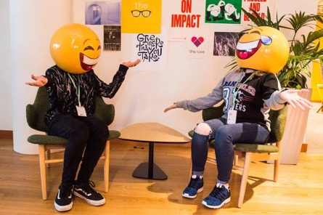

ANY
QUESTIONS?

Slide 35

THANK YOU
FOR JOINING US
internetsafety@pdst.ie
@Webwise_Ireland // Webwise Ireland
This work is made available under the terms of the Creative Commons Attribution Share Alike 3.0 Licence http://creativecommons.org/licenses/by-sa/3.0/ie/. You may use and re-use this material (not including images and logos) free of charge in any format or medium, under the terms of the Creative Commons Attribution Share Alike Licence.

