Slide 1



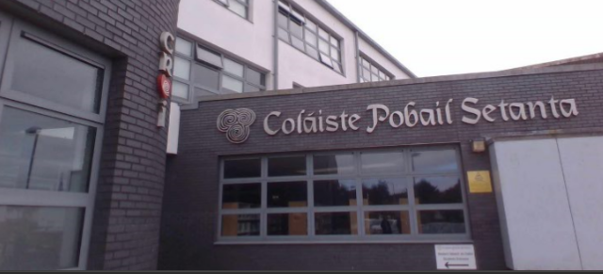
Coláiste Pobail Setanta
It Takes a Village to Raise a Child:
Does Provision Mapping support schools to respond collectively to the diverse needs of all students?’
Liam Walsh (Principal)
Frances Shannon (SENCO)
Notes:
Liam Presenting:
You are all very Welcome to Colaiste Pobail Setanta’s Presentation on our Journey to date engaging with the Provision Mapping Pilot Project.

Slide 2

Aim of Pilot Project
To Guide our School in the implementation of our School Self-Evaluation.
Use the Provision Map to support our School development plan and our model of Provision across the Continuum of Support
Notes:
Liam Presenting:
Guide our School in the implementation of our School Self-Evaluation.
We aim to use our SSE- to support our School development plan and our model of Provision across the Continuum of Support

Slide 3
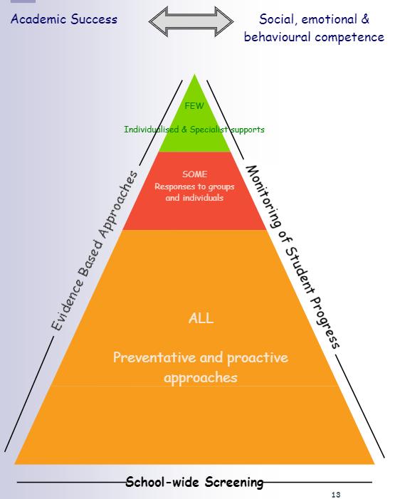
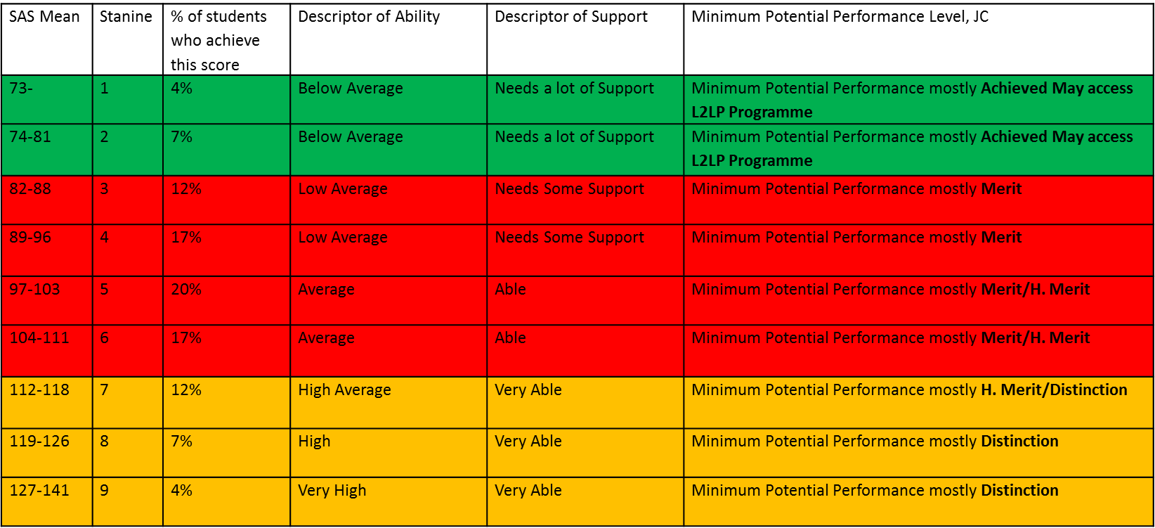
In CPS, we have mapped the relationship between
Cognitive Ability Test results with
Support across COS and Attainment.
Notes:
Liam Presenting:
Over the past 2 Years in Colaiste Pobail Setanta we we have mapped the relationship between
Cognitive Ability Test results with Support across the Continuum of Support and Attainment.
In this Slide we are combing the Continuum of Support with the Mean SAS, Stanine Score, looking at the % of Students who achieve these SAS Scores, matching descriptor ability (Below Av / Av/ Above Av., High Av., High and Very High).
Based on CAT 4 Scores CPS matched up Descriptor as per Continuum of Support –Support for all / some / few – Very able / able / needs some support / needs a lot of support. We colour coded as per COS.
Orange – Support for ALL on COS
Red – Support for Some on COS.
Green – Support for few on COS.

Slide 4
SSE in CPS - Review Year 2022/23
2. Target Setting
1. Ethos Program
3. SEN Provision Mapping
School initiative- all 3rd Years
Developing a Provision Map, reflecting our school post-COVID and resetting provision for students with additional needs and SEN across the Continuum of Support in our school
Notes:
Grainne Gallagher Presenting:
Our SSE Focus during the Review Yr (2022 to 2023) is:
1. Ethos:
The SSE Ethos program is forming the central pillar of our SSE Review Year this Academic year.
It will inform and permeate through our Target Setting initiative and our SEN Provision Mapping.
What is Ethos – Ethos is how we live, work and relate to each other in our school community.
It also relates to shared core values, to the hidden curriculum, to decision making processes and to the relationships that underpin the daily life in our school Colaiste Pobail Setanta.
The SSE Ethos program looks at our 5 Core values across our School:
Excellence in Education / Care / Equality/ Community/ Respect (as outlined by Principal Liam Walsh earlier).
The Ethos programme was piloted last year in DCU and has now been taken on by the ETBI.
Two schools are taking part this year- Colaiste Pobail Setanta and St. Macdaras.
All stakeholders will be surveyed and asked to comment on our SSE journey to date and what we can do to improve it going forward. Their feedback will also allow us to initiate a Wellbeing Promotion Review and begin the development of the next cycle of SSE, beginning in 2023/24.
The SSE Ethos program will inform and permeate through our Target Setting initiative and our SEN Provision Mapping Project.
2. Target Setting:
"Address other areas that they have identified as a priority in accordance with their school context and the needs of the children and young people in their school" Circular 0056/2022
Target setting with 3rd Years falls under this heading- it's an initiative that began in the school last year with 2nd Year Maths students- it has been extended to all subjects in 3rd Year this year (22-23).
All 3rd Yr Students are required to set a target % they wish to achieve in all their subject for all 3 Semester exams across the School Yr.
They will set targets during week 7 of each semester, working closely with their teachers to reflect on their work to date and setting realistic, achievable targets in their subjects.
It is hoped that this will increase the students’ self- efficacy, establish motivation and create a more self-regulated learner.
3. Provision Mapping – in conjunction with Pilot Project with Johanna Fitzgerald and Frances Gibson
Developing a Provision Map, reflecting our school post-COVID and resetting provision for students with additional needs and SEN across the Continuum of Support in our school.

Slide 5
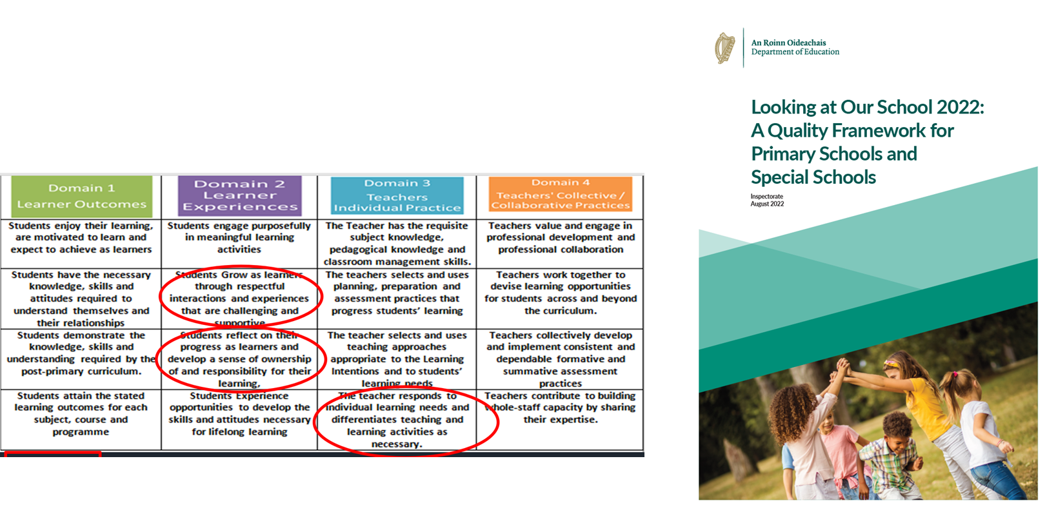

Looking At Our School (2022)
Notes:
Liam Presenting:
LAOS (2016) Sets benchmarks of EFFECTiVE or HIGHLY EFFECTIVE practice in relation to Teaching & Learning and Leadership & Management
Our Target Setting Initiative - SSE Ethos Program – fits in with LAOS (2016)
1 Example – Target Setting – Domain 1 – Learning Outcomes – 1st Column-
Students enjoy their learning, are motivated to learn and expect to achieve as learners.
There are another 3 highlighted in Domain 2-4 that fits the Target Setting SSE .

Slide 6
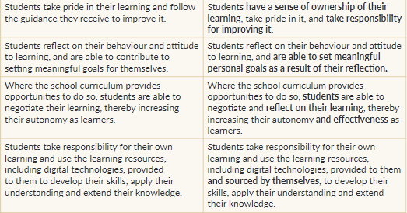
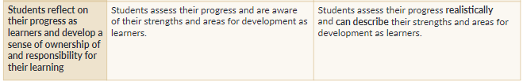
Notes:
Liam Presenting:
Specifically what was the area of focus for CPS? How did SEN Provision Mapping support the process?
How we integrate our 2 focuses in our school
SSE / Ethos Program using Provision Mapping.

Slide 7
How to Integrate Provision Mapping with key steps in SSE
Gather evidence from Staff, Parents and Students.
Analyse the Data and make judgement about strengths and areas of development.
Write up a school self-evaluation report and provision Map.
Devise a 3-Year School Improvement plan which outlines how the educational provision for ALL, SOME and FEW Learners.
Implement and monitor the plan and provision map based on changing profiles of needs, resource allocations and gap in provision.
Notes:
Liam Presenting:

Slide 8

Coláiste Pobail Setanta's
Journey to date with Pilot Project
- Provision Mapping Initiative
Notes:
Frances Presenting:
I am going to track our Journey since getting involved in the Provision Map Pilot Project (Nov 21).

Slide 9

Keys to success
Buy in from Senior Management is Key to the Success of developing and integrating a Provision Map
Whole-school approach to respond collectively to the diverse needs of students according to the Continuum of Support
Notes:
Frances Presenting:
Keys to our success to date has been – buy in from our Senior Leadership Team and in turn a Whole school approach and a desire to fully include our students in every aspect of what we do in our School curriculum in CPS.

Slide 10
School Visit- 3rd March 22 from
Johanna Fitzgerald (MIC),
Frances Gibson & Aoife Smith (Inclusion Coaches)
Tour of School
Planned for Staff Workshop - April 22
Planned for Staff surveys, Student surveys & Parent surveys - May 22
Discussed our plans for SSE in Colaiste Pobail Setanta (22-23)
Discussed our School Context
Discussed Linking SSE to Provision Map in Colaiste Pobail Setanta
Notes:
Frances Presenting:
To kick start our Provision Mapping Pilot Project Process
Johanna Fitzgerald MIC
And Inclusion Coaches Frances Gibson & Aoife Smith visited CPS on 3rd March 22.
We discussed and looked at :
Our School Context – Provision required specific to CPS.
Linking our SSE with LAOS (2022) and our Provision across COS
Steps involved in Provision Mapping (Staff presentation and Staff, Parent and Student surveys) using the Tool Kit provided by Johanna Fitzgerald.

Slide 11

Step One - Set up a working group committee within our school to collaborate with:
Our Inclusion Coach – Frances Gibson SEN Development Officer DDLETB
Senior Leadership Team in CPS
Subject Teachers, Subject Departments and SNA’s
Students across the Continuum of Support
Parents of students across the Continuum of Support
  School Champions in Coláiste Pobail Setanta:
  1. Frances Shannon (SENCO)
  2. Susan O’ Donovan (Guidance Dept. / Year Head)
  3. Grainne Gallagher (Year Head/ SSE Co-Ordinator)
  4. Mairead O’ Rourke (Math’s Teacher/ SET/ Assistant Year Head/CES Co-Ordinator)
Notes:
Frances Presenting: Set up a working group within our school to collaborate with
SLT / staff/ students / parents
4 x School Champions coming from different curricular areas with different areas of expertise within our school community.
Guidance / SEN/ SSE / Maths / Sci/ Geog / Business/ CES etc.

Slide 12
Step 2- April 22 -
Delivered a Whole staff workshop around:
What is Continuum of Support?
Info on
Our Schools Ethos.
INFO ON SCHOOLS SSE FOCUS
for 22-23
What is a Provision Map ?
Notes:
Frances Presenting:
April 22 - Delivered a Whole staff workshop around
What is Continuum of Support?
What is a Provision Map?
What our SSE focus for 22-23 and how we are linking this to LAOS and Provision Map.
Info on Schools Ethos.

Slide 13
Step 3- April 22 –
Surveyed all Staff Using MS Forms during Subject Department Meetings
13 Subject Departments Responded
Notes:
Frances Presenting:
April 22 – whole school Staff meeting – staff went into their Subject Departments and completed the Forms Staff Questionnaire.

Slide 14
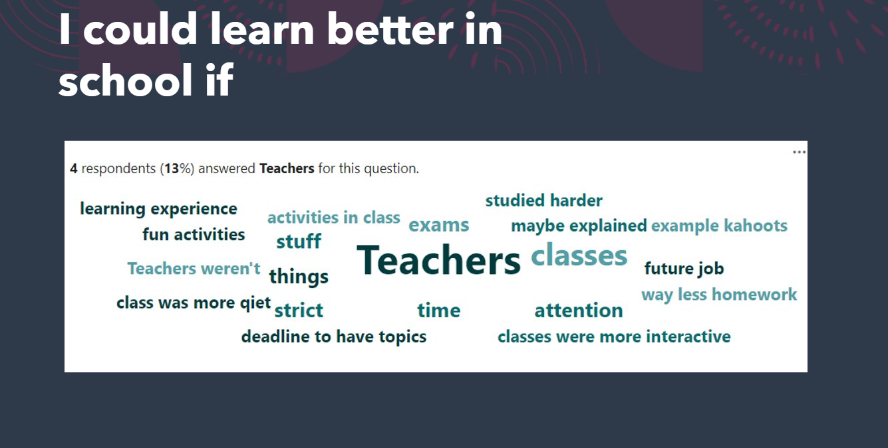
Step 4
May 22
Surveyed Students 1st- 6th Year across the Continuum of Support using MS Forms
Notes:
Frances Presenting:
May 22 – Surveyed Students using MS Forms (1st to 6th Yrs being supported across the COS) - supported by SET in class support / small group withdrawal / 1:1 support using MS Forms

Slide 15
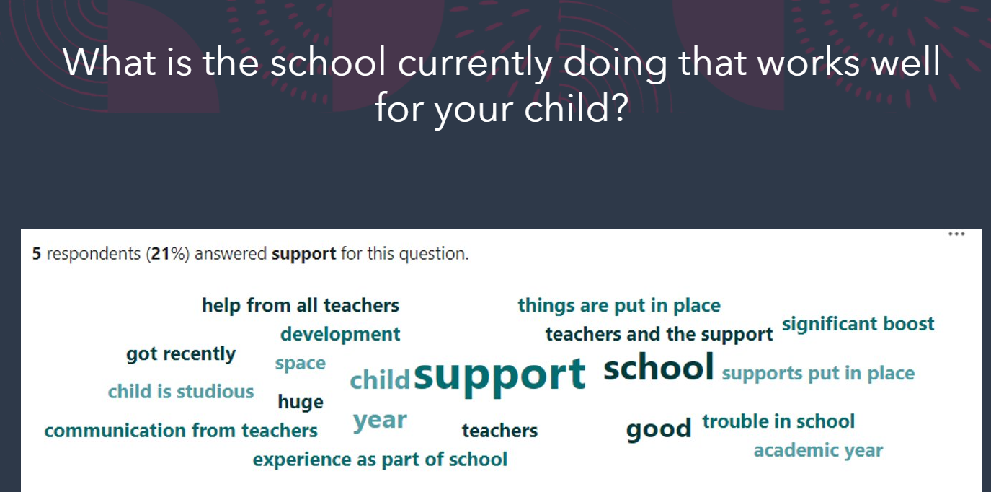
Step 5- MAY 22
Surveyed Parents of Students across the Continuum of Support using MS Forms
Notes:
Frances Presenting:
MAY 22 – Surveyed Parents of Students across the Continuum of Support
using MS Forms - Received 24 Responses

Slide 16
Step 6- Analyse Data
From our Data we were looking for:
How do we identify Learners' additional educational needs?
How do we meet learners' strengths and needs?
How do we monitor, review and report on learner’s progress?
What are our key strengths as a school community?
What areas do we need to focus on developing?
What are the implications for staff professional learning?
How can we use this evidence to inform our SSE plan?
Notes:
Frances Presenting:
Collecting the data highlighted the advantage of completing this project as it facilitated our gathering important information across our school community through the lens of our most vulnerable students.
In this Slide –the 7 Questions we need to answer to go forward and that’s what we are concentrating on this Yr.

Slide 17
Analysing Staff Survey Data –
Thematic Analysis- Braun & Clarke 2006;2020
1. Familiarise ourselves with Staff Survey Data.
2. Colour Code the different Themes that arose
3. Review and Develop the Themes.
4. Look at how prevalent the themes were across all Departments.
5. Later look to see if these Themes crop up in the Student and Parent Data also?
6. From themes / issues identified prioritise a few – meeting the highest needs of our students.
Notes:
Thematic Analysis Approach to analysing our Data,

Slide 18

Collecting the Data was very powerful in this process
Supporting integrated improvement planning - to respond collectively to the diverse needs of students according to the Continuum of Support
Notes:
Frances Presenting:
Collecting the Data was a very powerful process.
Identified Gaps in our current SEN Provision
Identified gaps in teaching resources
Identified gaps in staff CPD
A whole school approach to special and inclusive education
It formed a type of Audit to project needs for the new academic year (22/23)- post Covid- Staff CPD Requirements etc. – A reset

Slide 19
Themes that arose from Staff Survey data:
1. Post-COVID reset
Support Hub
Extracurricular programme initiated
2. Continuum of Support
CPD needed by some
Build on existing resources
3. Student Support Files - Process
Teacher input
Develop an effective System of communication amongst staff
4. L2LP Teacher CPD and Resource development
5. Confirmed Staff commitment to inclusion throughout the school community
Build on existing resources
CPD needed by all Teachers
L2LP Resources- shared on Sharepoint for all staff to acees
Notes:
Frances Presenting:
This is a Summary slide of our Staff feedback – the 5 recurring Themes that cropped up and that we decided to focus on.
Our Teacher Data raised a number of repetitive Themes:
Post Covid Reset – The Surveys identified curricular and extracurricular activities our school provided Pre-Covid that they wanted reintroduced into our Provisions this Academic Yr (22-23).
Continuum of Support – Teachers / Subject Departments identified in their Surveys – not all Teachers and Departments were 100% confident around their knowledge of the Continuum of Support.
A requirement to build on existing resources cropped up also.
3. Student Support Files
The Teacher surveys identified the need for more Teacher Input into SSF’s.
A need to Develop an effective System of communication amongst staff contributing to Student Support Files.
4. The survey identified the need for L2LP Teacher CPD and L2LP Resource Development across all subjects.
Even after survey in May 22 – we now have new needs that require L1LP Programme.
We also now need L1LP Teacher CPD and L1LP Resource Development across all subjects.
Most importantly our Staff Data reaffirmed an area of real strength in our School –
It confirmed our staff commitment to inclusion throughout the School Community

Slide 20
Progress to Date (Nov 21- to date)
Needs in CPS | Progress to date
Focus in on Post Covid Reset | Support Hubs (Semester 1-3 Academic Yr 21/22) - (completed) Revision of key skills in all Subjects – lost out due to Covid Post Covid Reset in CPS: (Sep 22 to date) - (ongoing) School Canteen back at Lunchtime Evening Study back Music / Musical / Shows/ Choir back Sports Clubs back Subject Clubs back Green Schools Committee back Cumas – Supporting the gifted and Talented School looking into reintroducing this – (Plan for Academic (23-24)
Our progress to date:
Our progress to date:
Notes:
Frances Presenting:
What Progress have we made to date in themes identified from our Staff Survey.
Focus in on Post Covid Reset
Some already in place, some being put in place this Academic Yr
Examples include:
1st / 2nd Yrs stay in for Lunch (22-23)- Canteen back open post Covid.
Support Hub (21-22)
All AFL strategies are back in the classroom
Homework Club is back
Maths Club Back – every Tuesday lunchtime
All Extracurricular sports are back
Green School committee is back
Talent Show back – Music Dept.- happening this Thursday in our School.
German Exchange & Erasmus Plus back
All Themed weeks are back across the Academic Calendar 22-23.
Parent Student Teacher Meeting all back face to face 22-23.
Teachers suggested to reintroduce Cumas –
Supporting the gifted and Talented School looking into reintroducing this –
(Plan for Academic (23-24)

Slide 21
Progress to Date (Nov 21- date)
Focusing in on Continuum of Support (COS)
Needs in CPS | Progress to date (Nov 21-date)
CPD on Continuum of Support needed by some. Teacher CPD to support specific Learning Needs across the COS. Build on developing existing resources. Build on Mapping CAT 4 Results with Support across the COS and Attainment. | COS Posters in every classroom in CPS. Whole Staff – Dyslexia CPD –completed Oct 22 Whole Staff – Differentiation (NCSE CPD) –completed Nov 22. All Staff (Teachers / SNA’s) Teaching in ASD Sp. Class - Supporting students with ASD in the Classroom CPD.- Nov 22 / Dec 22 To be completed - ongoing Whole School Staff CPD on above has supported Teachers to build resources around supporting students across COS with Dyslexia / Differentiation / supporting students with Autism - ongoing CAT 4 Test Results colour coded and shared with all staff Late Aug 21 and 22 On SharePoint – completed
Our progress to date:
Our progress to date:
Notes:
Frances Presenting:
Our Survey highlighted we need to keep Focusing in on what is the Continuum of Support and how teachers can support students across the Continuum of Support.
CAT 4 E Test Results are colour coded as per COS and shared on Share point with all staff – this is ongoing every yr now.
The staff data suggested CPD on COS needed by some.
Teachers felt they needed CPD support around differentiating and preparing resources / sourcing resources to meet the needs of students across COS.
We have started the CPD Support for staff since Sep 22:
Whole Staff – Dyslexia CPD –completed in Oct 22
Whole Staff – Differentiation (NCSE CPD) –completed in Nov 22.
All Staff (Teachers / SNA’s) Teaching in ASD Sp. Class Croi are getting CPD around Supporting students with ASD in the Classroom today Nov 15th and later in 8th Dec 22.
This CPD is ongoing.
From the surveys - Teachers felt they needed CPD support around preparing resources / sourcing resources to meet the needs of students across the COS.
Whole School Staff CPD as listed above has supported staff to build resources around supporting students across COS with Dyslexia /how to Differentiate for students across the COS / supporting students with Autism – ongoing CPD (22-23) etc.

Slide 22
Our Progress to Date (Sep 22 to date)
Needs in CPS | Progress to date
3. Reviewing our Student Support Files - Process | SEN Deputy Link / SENCO / Assistant SENCO / SEN Link Teachers (Assistant Yr Heads) / to work on: Student support file document review (ongoing) Teacher collaboration and input into SSF’s (ongoing) Include Teacher Feedback forms to inform SSF Student Target setting and SSF review Process (ongoing) System of communication and sharing SSF info (ongoing)
Our progress to date:
Our progress to date:
Notes:
Frances Presenting:
Teachers / Subject Departments identified in their Surveys the need for more Teacher Input into Student support files.
Following this feedback
This Year we are looking at developing effective communication amongst staff when contributing to a students support file.
We propose to Include information from Teacher Feedback forms to inform Student Target setting and SSF review Process.
We are currently in the process of reviewing our System of communication and sharing SSF info also.

Slide 23
Progress to Date (Nov 21- date)
Needs in CPS | Progress to date
Focus in on our School Ethos Confirmed Staff commitment to inclusion throughout the school community | How we live, work and relate to each other in CPS– Sep 22-23 SLT and SEN Department to Feedback to all staff at next staff meeting (Feb. 23)
Our progress to date:
Our progress to date:
Notes:
Frances Presenting:
From our Teachers Surveys –
The beauty of the data collected– it also highlighted things we are doing well in our School.
One of these were:
Our Staff data- Confirmed commitment to inclusion throughout the school community.
SLT and the SEN Department will Feedback this information to all staff at next whole staff meeting in January 2023.

Slide 24
Future Planning arising from Surveys-
(Sep 22 to June 24)
Needs in CPS | Progress to date
4. CPD and Resource development for L1LP & L2LP Teacher L2LP Resource Development across all subjects. | Differentiation CPD – Training by NCSE- Completed Nov 22. L2LP/ L1LP – Whole Staff CPD - In house Depts to share their experiences around supporting L2LP meet their Learning Outcomes. - ongoing Develop a System of sharing L1LP /L2LP Resources on School Share point – ongoing
Our progress to date:
Our progress to date:
Notes:
Frances Presenting:
Teacher Feedback identified the need for
L1LP and L2LP Teacher CPD and Resource development
To date to support Teachers teach students access the L1LP and L2LP Curriculum in our School we have engaged in a number of whole staff CPD sessions.
Differentiation CPD – Training by Fidelma Downes NCSE- Completed Nov 22.
Over the coming Year we will focus in on supporting staff around L1LP / L2LP CPD.
During our Induction Week – Aug 22 – I the SENCO provided Inhouse Training to all staff around supporting L2LP students meet their PLU Learning outcomes across all subjects. Other Dept’s demonstrated how they meet L2LP PLU learning outcomes in their Subjects.
Through our Staff surveys we learnt the Home Ec Dept had Units of work planned with L2LP learning outcomes in mind.
We propose this Academic Yr In house Depts (like the Home Economics Dept) to share their experiences around supporting L2LP students meet their Learning Outcomes across the 5 L2LP PLU’s.
2nd thing we need to do is to develop a System of communication and sharing
L1LP and L2LP Resources on Share point – this is ongoing also.

Slide 25
What went well to date
Provision Mapping Tool Kit was extremely useful and user friendly.
4 School Champions coming from 4 different curricular areas enhanced Teamwork and supported Data Analysis.
All Staff and Students have MS devices, the use of Microsoft Forms provided a very quick method of collating Data from staff and students.
Looking at COS/ SSE/ LAOS / our Schools Ethos through the same lens - allowed us to avoid initiative overload- supporting our school towards integrated improvement planning.
Notes:
Frances Presenting:
Based on all of this info we reflected on
What went well to date?
We had great Support from Johanna Fitzgerald and Inclusion Coach Frances Gibson
Great Teamwork by all 4 School Champions throughout. Having 4 People on the Project has been invaluable– Split the workload in 4- Tapped into people's different skill sets along the way.
The Provision Mapping Tool Kit was so useful and easy to use. Supported staff presentation, staff, parent and student survey prep.
We are a Microsoft School - All our Staff and students have Microsoft devices and the use of Microsoft Forms provided a very quick way of collating Data from Staff and students. I cannot stress enough how instrumental for us having devices was in this Pilot Project.
The Process was very worthwhile in collating information about how we meet the needs of our students across the Continuum Of Support which will inform planning for the next 3 years.
Engaging in this Pilot Project- We have engaged in a cycle of School Self-Evaluation informed by the
LAOS 22 (Looking At Our Schools) Quality Framework to develop a provision map for Coláiste Pobail Setanta.
This process allowed us to look at the
Continuum of Support /
School Self Evaluation/
LAOS Looking at our Schools
through the same lens.
.

Slide 26

What didn't go well to date in Pilot Project
Few responses from Parents using MS forms.
Language in Questionnaires– ambiguous in parts – may have affected the answers in some questions.
Notes:
Frances Presenting:
We also reflected on what didn’t go well for us during this Pilot Project to date:
Few responses from Parents
Language in the survey was ambiguous in parts – for staff / students and parents – confusion may have interfered with answers given back in surveys.
All teachers are familiar with the Continuum of Support model – the word 'All' may have been taken literally in some depts – if only one teacher was hesitant it may have changed the Dept answer.

Slide 27

Provision Mapping
Is a Process that supported our school to respond collectively to the diverse needs of all our students across the Continuum of Support
Notes:
Frances Presenting:
Provision Mapping provides a helpful overview and allows the school to identify, monitor and evaluate gaps in our provision and identify areas of real strength in our School.
Provision Mapping is supporting identify our focus for SSE / supporting meeting the needs of students as per LAOS 22 and supporting us live out our Ethos Values in CPS.
It provides a basis
To Strategically plan provision,
To allocate resources
To identify staff CPD needs.

Slide 28
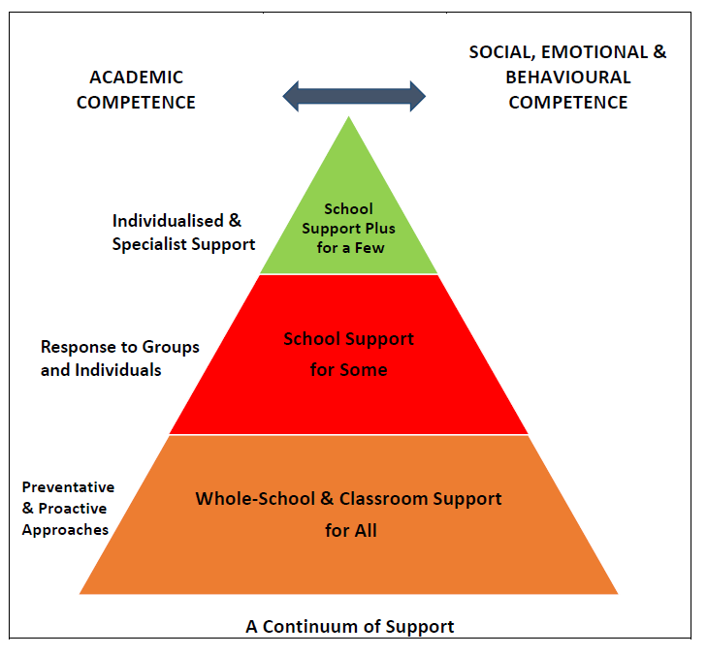
Colaiste Pobail Setanta’s Preventative, Proactive & Solution Focused Whole School Approaches to Inclusive & Special Education (Planning Overview completed to date – Nov 22)
Whole School Teaching and Learning Interventions supporting Academic Competence (e.g.)
Early intervention Screening & Assessment for Intervention.
Teacher CPD/Time for professional dialogue/sharing of best practice/Teaching & Learning Committee .
2 x PSS Psychological Educational Assessments Annually.
Timetabling structures facilitate inclusion
Continuity of staff
Curricular options such as L1LP, L2LP, LCA and TY.
3 X Special Classes - CROÍ
Linking CAT 4 Results to COS- Support
Subject teachers have primary responsibility for provision
Students understand learning outcomes and expectations .
Set Targets for Students.
Areas for improvement identified in SSE plans
Policies are reviewed by all stakeholders.
School Ethos across COS
Key Tasks SEN Team (e.g.)
Review and Update Learning Register / Vsware SEN Tab for all students with AEN across he COS.
Standardised assessments.
Write Student Support Plans, including Care Plans- 1 Child, 1 Plan approach
Parent meetings and reviews
Schoolwide screening assessments- prep & schedule
RACE- parents meeting
RACE- process applications, assessments
CPD- audit, plan and deliver
SLARS- meeting & consultation
SNA allocation and ongoing review of SNA support
Collaboration between SET Co, ASD Co, to optimise use of supports
Student Support Team Weekly meetings
Consultation on overall timetable/mapping needs
 | CPD
Resource Allocation 2021-2022
Whole School Supports for Social/ Emotional & Behavioural Competence
Positive Learning Code of Behaviour and Rewards System.
Rules/Expectations.
Sanctions/ Rewards are clear
Tutor Support / Year Head
Guidance Support.
Clear ladder of referral.
Support for ALL PP-COS guidelines
Robust referral systems, both in-house and external.
Student Support Team- weekly meetings.
School Ethos across COS
CPD Priorities 2022-2023 (e.g.)
Intimate Care Training.
NCSE Differentiation Workshop – All Staff
Dyslexia Workshop
SNA allocation and review training – SENCO / Deputy
ASD Training - staff teaching in Croi
L1LP / L2LP Resource Training
Junior Cycle- full day- all staff
JCT L2LPs- key SETs
Wellbeing curriculum- core staff
JCT / PSS ASD training
SET Stats
SET Total Hours: 195 hrs / week
ASD Special Class : 99 hrs / week
SEN Coordinators: 1
Assistant SEN Coordinator: 1
Sen Link Teaches : 5
ASD Coordinators: 1
SNAs Main: 8 (3.5 NEW SNA’s)
SNAs ASD: 7 (3 new SNA’S)
Refer to School Provision Map for detailed interventions across the 3 stages of the PP-COS
Integrating the Guidelines Appendix 6: Self-Reflective Questionnaire
Integration & Support- Whole School Approach
Post COVID – reset in CPS
Support Hub (21-22)
1st / 2nd Yrs stay in for Lunch (22-23)
All AFL strategies back
All group work back
Homework Club back
Maths Club Back - Tuesdays
All Extracurricular sports back
Green School committee back
Talent Show back – Music Dept.
German Exchange & Erasmus Plus
All Themed weeks back
Parent Student Teacher Meeting back face to face
Step One- IDENTIFY
Tus Maith Program- Gather and analyse data from Primary School Passports-
Gather and Review Professional Reports
Learning Environment Checklists
Consultation with Parents and Students .
Consultation with outside agencies if necessary.
Consultation with NCSE – assistive Technology / SEN transport etc.
First Year Screening Tests
Second Year- Screening Tests
Review of Semester Exams .
Academic Tracking
RACE Testing for JC State Exams -
Teacher referrals/Progress reviews/Subject Teachers survey
Attendance Tracking.
Step Two- MEET NEED
Draw up SSF - outline
Why are You Targeting this Student.
What are the students individual Targets?
What strategies are You using to meet these targets?
Plan and Implement early intervention approaches.
Vary modes of delivery based on needs- individual, small group or co-teaching
Targeted withdrawal for some Evidenced-based interventions (learning and behavioural) VEP, Catch-Up, Friends, ALERT, Toe By Toe, delivered by the most suitable staff.
External Support and/ or referral
Reapply evidenced based assessment (Assessment For Intervention)
Support for all subject teachers on differentiation/suitable teaching approaches
Step Three- MONITOR & RECORD
Review Reports termly (including SSFs/ PPPs).
Record Baseline data and set measurable targets, time-specific.
Continuous assessment data
Engagement in school life
Wellbeing- Student Support Team
Parents Meetings
Assessment for Intervention- retesting and informed planning
Review of outcomes at individual, group, class and whole-school level
Retesting- further referral
Observations- SNA support
VS Ware integration with documents.
Updating Learning Register / SEN Tab on Vsware.
Curricular Options & Timetabling
Wellbeing
SSE/ LAOS aligned with PP-COS Guidelines
SEN Team
Co-Teaching
ASD
Notes:
Frances Presenting:
This is a Planning Overview Document that we are beginning to populate in our school - bespoke to Colaiste Pobail Setanta.
supporting our school towards integrated improvement planning
Helps with Transparency right across our School Community.
Shows our model of Provision across our School.
All staff can see where their work links in to support all / some and few students in our school.
Where our SEN resource allocation is being directed – to improve outcomes for our most vulnerable students across the COS.
How we direct our Provision.
How we are implementing our Ethos.
Those items highlighted in Yellow are items we are working on to improve on this Academic Year and going forward as a result of engaging in the Pilot Project student / staff / parent surveys.
It highlights
CPD put in place.
SSE Focus Etc.
Its bespoke to our school.
A lovely planning document to map all Preventative, Proactive & Solution Focused Whole School Approaches to Inclusive & Special Education in Colaiste Pobail Setanta.

Slide 29
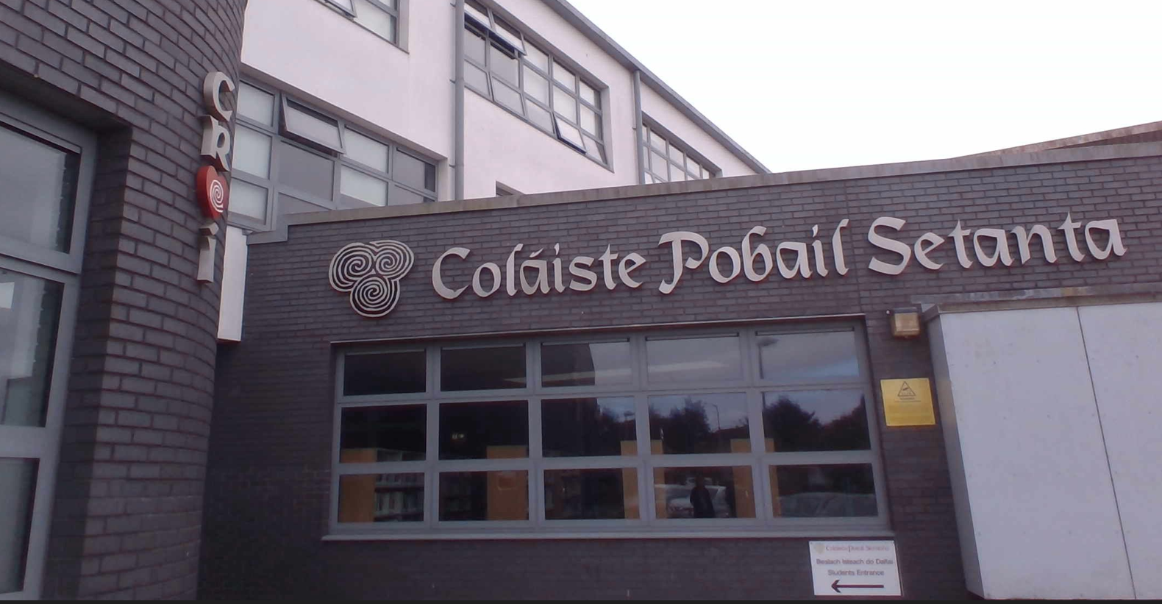
“Inclusive practice is a living and breathing facet that permeates all that we do in Coláiste Pobail Setanta.”
Thank you for the opportunity to share
our Provision Map Pilot Project journey to date.
Notes:
Frances Presenting:
Title of todays presentation:
It Takes a Village to Raise a Child:
Does Provision Mapping support schools to respond collectively to the diverse needs of all students?’
In CPS, We may not be a Village, but we most certainly are a community of Staff / Students and Parents who collectively work together daily to ensure we are delivering Inclusive practice.

