Slide 1

Psychological First Aid
Supporting Students
Leaving Certificate 2020
Notes:
Hello and welcome to this webinar which has been developed for Guidance Counsellors as they prepare to offer support to students from the Leaving Certificate class of 2020 upon the release of their calculated grades on September 7th.
My name is Theresa Tierney and I am a Psychologist in NEPS , Wexford. I am joined today by my colleague David Carroll from the Carlow /Kilkenny team.
We would like to thank the National Centre for Guidance in Education for inviting NEPS to contribute to their recent webinar on the 1st of September entitled Supporting Outgoing students –the class of 2020 . This involvement has led to the development of this webinar.
The aim of this webinar is to introduce the rationale and format of PFA as it can be a useful tool for those offering support in times of crisis.
We are aware that this webinar is designed for Guidance Counsellors, an audience that have a well developed skill set and expertise in working with students. PFA provides a sequenced format that draws upon and utilises many of these skills in a structured way. Aspects of PFA will be familiar to you. We encourage you as you complete this webinar to consider what elements of PFA you already use and what elements you might add to your practice when supporting the Leaving Certificate class of 2020.

Slide 2
Outline of Webinar
Introduction to Psychological First Aid (PFA)
Current Context - COVID 19
- Self Care
Application of PFA - Prepare
- Look
- Listen
- Link
Notes:
We will begin by introducing Psychological First Aid which we will refer to as PFA for the remainder of the webinar
Then we will consider the current context in which the calculated grades will be released and also highlight self care
David will then talk though the steps of one model of PFA prepare . Look , listen and link

Slide 3
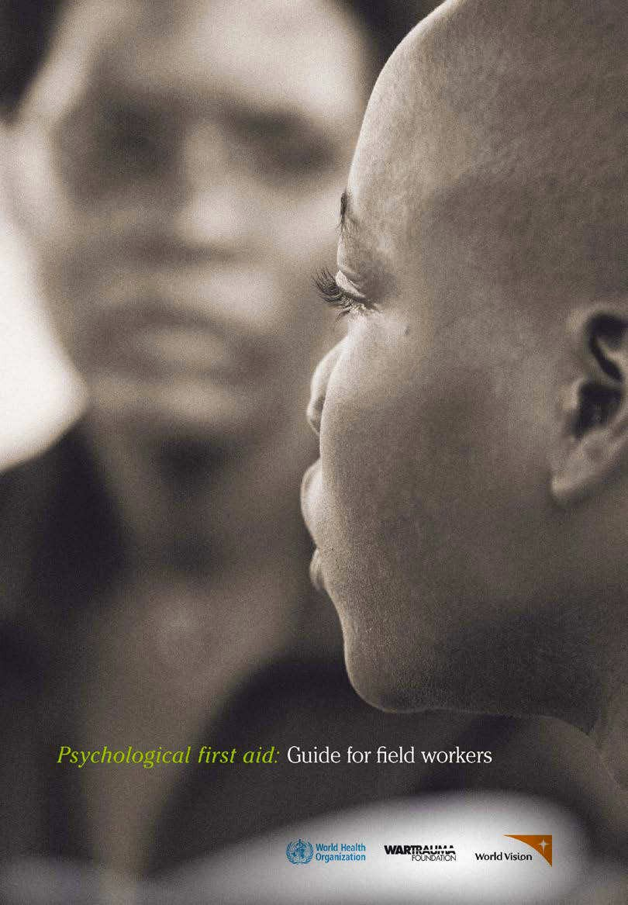



Psychological First Aid
WHO publication h1p://www.who.int/ mental_health/emergencies/en/
Available in numerous languages
Delivered by the HSE Ireland during the COVID 19
Listen, protect, connect, model and teach in NEPS Critical Incident guidelines
Notes:
PFA is a psychosocial response much like physical first aid. it is how you interact with somebody when a crisis occurs ……. While it was initially developed in the aftermath of natural disasters such as flooding , earthquakes it has now been adapted and adopted by many countries including Ireland as the way of supporting psychosocial needs. In the early days of the COVID pandemic the HSE offered training to all front line workers . They also used this model to support front line workers.
IN NEPS we have used the Listen, Protect, Connect, Model and teach model of PFA in responding to critical incidents in schools.

Slide 4
What is PFA?
A safe and humane response to people who are suffering in the context of exposure to a serious stressor. It involves:
Non-intrusive, practical care and support
Ensuring that individuals basic needs are met
Listening, but not pressurising people to talk
Comforting and helping people feel calm
Helping people connect to information, services and supports
Ensuring people’s safety, avoiding self-isolation
Notes:
So what is PFA ? This slide tells us that PFA involves …..read slide

Slide 5
What PFA is NOT...
It is NOT something only professionals can do (though professionals can and do use it)
It is NOT for everyone
It is NOT professional counselling
It is NOT “psychological debriefing”
It is NOT a detailed discussion of the distressing event
It is NOT asking people to analyse events
It is NOT pressurising people to describe their feelings or reactions, though it does try to establish a safe setting to enable people to tell their story
Notes:
It is NOT something only professionals can do (though professionals can and do use it)
It is not for everyone / some people who experience a traumatic event will not need PFA
It is NOT professional counselling
It is NOT “psychological debriefing”. Evidence suggests now that psychological debriefing of itself increases the risk of trauma and therefore is not reccoemended
It is NOT a detailed discussion of the distressing event
It is NOT asking people to analyse events
It is NOT pressurising people to describe their feelings or reactions, though it does try to establish a safe setting to enable people to tell their story

Slide 6
Why PFA?
People do better over the long-term if they….
Feel safe, connected to others, calm & hopeful
Have access to social, physical, emotional and educational
support
Regain a sense of control by being able to help themselves
Notes:
this slide outlines why PFA might be used ….
People do better over the long-term if they….
Feel safe, connected to others, calm & hopeful
Have access to social, physical, emotional and educational
support
Regain a sense of control by being able to help themselves
PFA enable these things to happen

Slide 7
What are steps in PFA? 2 models
Prepare, Look, Listen, Link referred to sometimes as PLLL
Or
2.Listen, Protect, Connect, Model, Teach
Notes:
There are many models of PFA. It is in essence the same wine in different bottles.
The One promoted by the HSE is the Prepare Look Listen and Link sometimes
refereed to as PLLL or P triple L
For the purposes of this webinar we are focusing on the needs of the leaving certificate class of 2020 who have left the school system and whose formal relationship with their school has come to an end. As such the P triple L model is likely to be more appropriate .
The alternative PFA model of Listen Protect Connect Model and Teach is the one adapted by NEPS for use in schools. We suggest that, in your on-going work with your school community, you may want to continue to use that format as it incorporates a learning component, namely the teach step, in supporting students in times of crisis such as a Critical incident..

Slide 8
Current Context
Societal
Leaving Certificate Students
Notes:
While is an overused expression we need to acknowledge that are working in unprecedented times. We are living and working in a time of national crisis. For this Leaving certificate cohort in addition to the public health measures which have restricted all of us , they have not been able to engage in rites of passage such as debs , summer jobs and normal end of school life.
The last six months has seen considerable flux and upheaval for these students with regard to the Leaving Certificate in particular.
Many of the students will not need additional support at this time and will have adequate resilience skills however , given the impact of COVID 19 on the support networks these young people would have traditionally had and the fact that they Leaving Certificate is considered a high stakes exam some will struggle to cope. It is this cohort that might benefit from PFA.

Slide 9
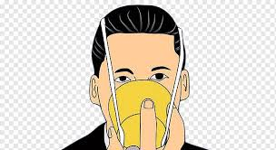



Self Care
What self care practice can I use for
week?
Notes:
We encourage you to consider your own self care for the week of the release of the calculated grades. You will be better able to support students if you are able to put on your own oxygen mask first. However we know that you are likely to be already busy in the reopening of your school and settling students.
We ask you to consider how you might support your own well being for the coming week ? What self care practices could you use this week? What can you control and what cant you control? Are there any aspects of your other work can wait for a week?

Slide 10



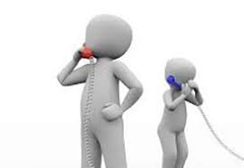
PFA Prepare, Look, Listen, Link
Prepare yourself
-Gov.ie
-Cao.ie
-NPC helpline 1800 265 165
-NCGE.ie
-Third level institutes' websites
-Adult Guidance services etc.
Identify an appropriate space
Find out about local services
Notes:
So the first step is prepare. This is done before you engage with the student
Set out on this slide you will see a number of sources of informationa nd support that you may find helpful when interacting with Leaving Cert 2020 students when they get their results
On Gov.ie there is a dedicated Leaving Certificate 2020 page on which can be found information including the calculated grades systems and tips for well being
Cao.ie is the reference point for third level applications
The National Parents Council have a helpline where the Institute of Guidance Counsellors are providing advice and support to students and parents. This helpline is available at 1800 265 165 from Monday the 7th of September until Saturday the 12th of September
The Natioanl Centre for Guidance in Education has developed a webinar which can be found on their website. This webinar, titled supporting Outgoing students - the class of 2020 - is aimed at giving information and support to Guidance Counsellors in their work at this time. This webinar has information on CAO offers, calculated grades , appeals, informed decisions making , sitting exams in November and other key information for students and parents.
You may also want to familiarise yourself with Third level institutes' websites and local Adult Guidance services
In the prepare stage we suggest that you give some consideration to identifying an appropriate space in the school environs that you can go to with a student that is private and discreet but in line with public health should you decide to provide PFA
You may also wish to ensure that you have up-to-date information and contact details about local services

Slide 11

PFA : Look, Listen, Link
At the Look stage, these are some of the behaviours you may look out for.
Feelings/responses students may have (remember that everyone responds differently to each situation)
*NB Family and Friends
Physical Tiredness Restless Overactive | Emotional Withdrawn Nightmares Lonely Anxious Mood changes
Cognitive Poor concentration Thinking negatively Focusing on the negatives in all situations Thinking about family members that are ill | Behavioural Avoid meeting peers Not talking about LC results at all Crying/Tearful
Notes:
If you are inviting the students into the school you will be able to implement this step . You will look for ……………………
In the current context you might not be in a position to meet up with students and your ability to ‘look’ may be limited. In this situation be cognisant that there is apotential for others to alert you to their concerns about a student for example close friends and family . We advise that in the current context you take note of any concerns and where possible be proactive in following up. You could do this by establishing contact and offering support. Remember as you know already PFA is non intrusive. The students should not feel pressurised to engage. The aim of PFA is for students to know that you are available to listen , comfort and provide information

Slide 12

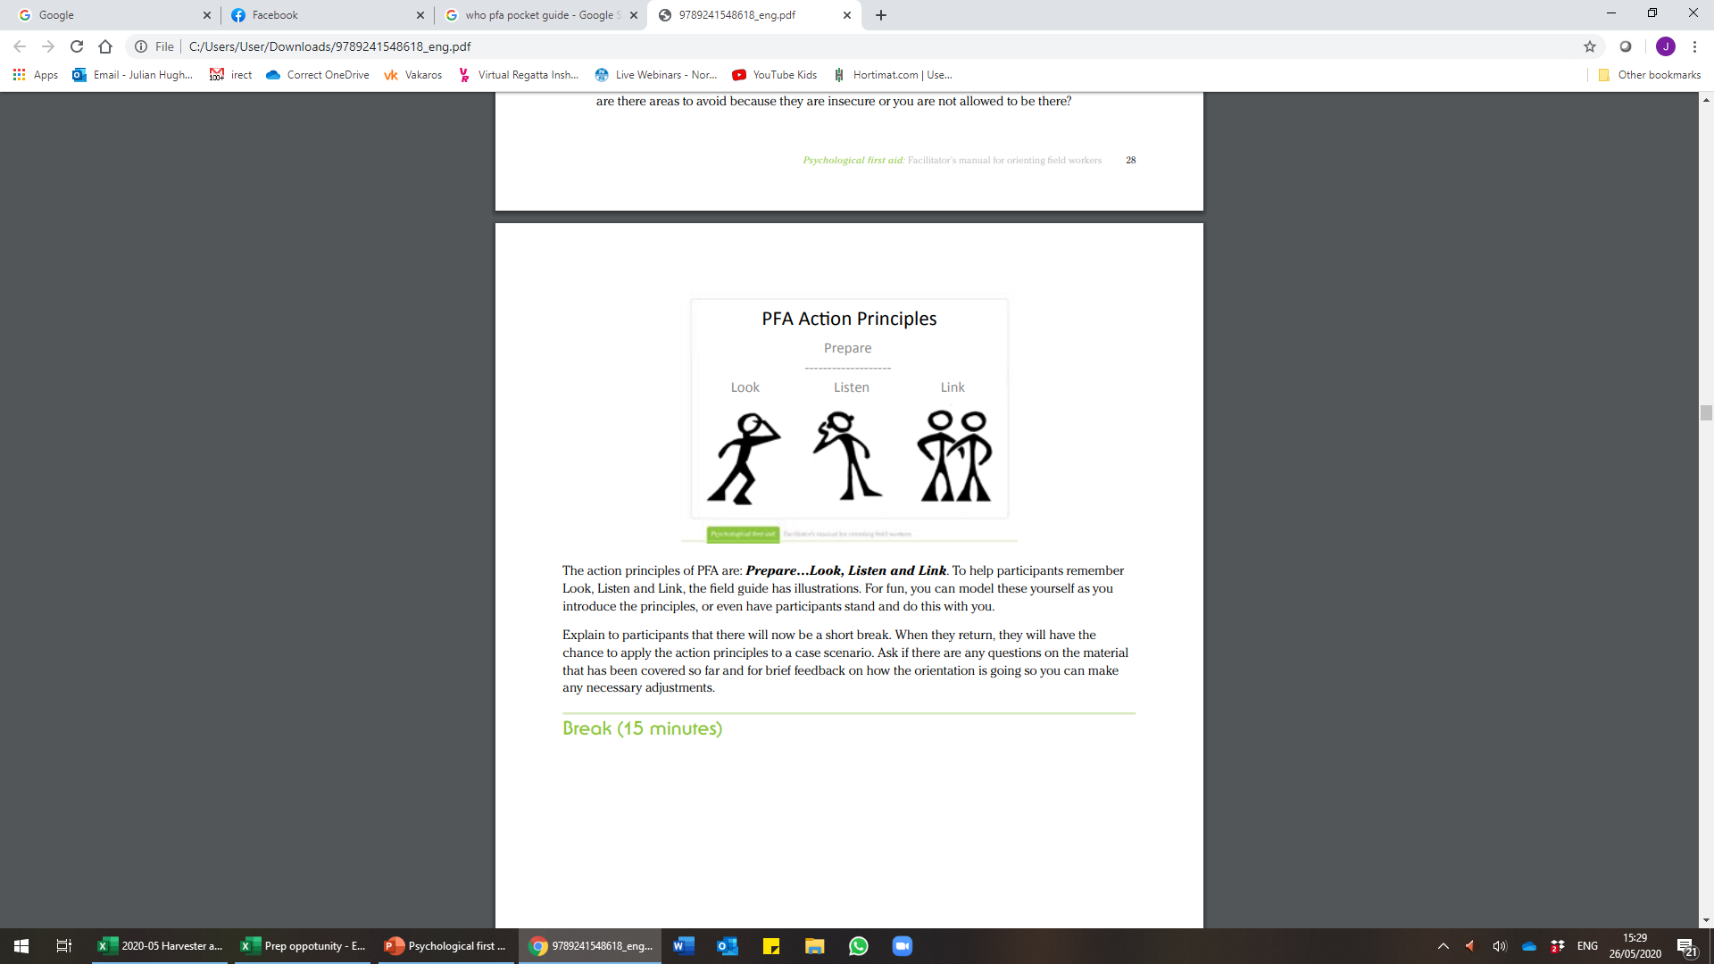
PFA : Look, Listen, Link
Find out what is important to them at that moment, identify priorities.
Engage in active listening.
Provide them with facts (www.ncge.ie) . Be honest with them.
Keep the language simple.
Acknowledge their feelings and explain that all feelings are normal.
Respect their privacy as they may not wish to share their full story with you and that’s ok. Let them know that what they share is private.
Talk to them about their own personal strengths and ways they have shown resilience or helped their own situation.
Do not give your own opinion or pressure them to speak.
Do not make unhelpful comments like “the Leaving Certificate is not that important anyway ”.
Do not tell someone else’s story.
Do not make false promises.
Notes:
In listen we ask about their needs and concerns. As Guidance counsellors you will already have well developed skills in terms of active listening. This is the step where you will use these skills
Find out what is most important to them at that moment, and help them work out what their priorities are.
Listen to them and help them feel calm by keeping your tone of voice calm and soft. Provide them with facts and necessary steps especially those outlined the NCGE webinar which you have watch . Be honest with them.
Keep the language simple.
Acknowledge their feelings and explain that all feelings are normal.
Respect their privacy as they may not wish to share their full story with you and that’s okay. Let them know that what they share is private.
Talk to them about their own personal strengths and ways they have shown resilience or helped their own situation in the past .
Do not give your own opinion or pressure them to speak.
Do not make unhelpful comments in an effort to minimise their distress like “the Leaving Certificate is not that important anyway ”.
At this point do not tell someone else’s story.
Do not make false promises.

Slide 13

PFA: Look, Listen, Link
Advise use of supports: e.g. family, friends and local services and agencies.
Give reminders about times they have felt safe and what enables them to feel safe now.
Keep in contact and arrange a further ‘check in’ meeting.
Encourage those around them to remain as supportive and remind them to monitor conversations.
Try and keep as much of a routine as possible e.g. meeting with friends, engaging in pastimes, going to part time work etc.
Highlight any activities from the NEPS Well being toolkit that you feel might be helpful e.g. relaxation strategies, square breathing etc.
Notes:
This is the main action point. This is where you link them to services or supports
Advise use of supports: e.g. family, friends and local services and agencies.
Give reminders about times they have felt safe and what enables them to feel safe now.
Keep in contact and arrange a further ‘check in’ meeting.
Encourage those around them to remain as supportive and remind them to monitor conversations.
Try and keep as much of a routine as possible e.g. meeting with friends, engaging in pastimes, going to part time work etc.
Highlight any activities from the NEPS Well being toolkit that you feel might be helpful e.g. square breathing ( insert hyperlink)

Slide 14

Sources of additional support
Childline (ISPCC)
Ireland's 24-hour national listening service for young people up to the age of 18.
freephone 1800 666 666 (any time, day or night)
text 50101 (from 10am to 4pm every day)
chat online at www.childline.ie (from 10am to 4pm every day)
Jigsaw
The Jigsaw Support Line is available for free mental health support and advice to young people aged 12 to 25 years old, and parents or concerned adults in Ireland.
freephone 1800 544729 (from 1pm to 5pm Monday to Friday)
text CALL ME to 086 180 3880, giving your preferred day and time for a call (from 9am to 5pm Monday to Friday)
email help@jigsaw.ie (for responses from 9am to 5pm Monday to Friday)
visit www.jigsaw.ie or www.jigsawonline.ie for more information
Barnardos
Barnardos provide a national telephone support service for parents, in response to the challenges they are facing during the COVID-19 pandemic. Freephone 1800 910 123 from 10am to 2pm, Monday to Friday.
SpunOut.ie
SpunOut.ie provides a wide range of articles and information for young people, on many different topics, including mental health.
text SPUNOUT to 086 1800 280 to chat to a trained volunteer (standard message rates may apply)
visit www.spunout.ie for more information
Pieta House
Pieta provides free therapy to those engaging in self-harm, with suicidal ideation, or bereaved by suicide.
visit pieta.ie for more information
call free on 1800 247 247
text help to 51444
Notes:
On this slide which we have taken from the NCGE webinar-Supporting Outgoing Students, which is available at ncge.ie, you will see outlined sources of additional support that are available. You might also want to consider resources such as a local youth or community service which may be offering support at this time

Slide 15
Ending
In order to end PFA you need to consider the student’s needs.
If they seem calm or tell you they feel better then you can decide that no further intervention is needed. Use your best judgement of the situation.
If you feel you need to make contact with the student again this is okay. Arrange a time and date.
Consider your own needs.
Notes:
In order to end PFA you need to consider the student’s needs.
If they seem calm or tell you they feel better then you can decide that no further intervention is needed. Use your best judgement of the situation.
If you feel you need to make contact with the student again this is okay. Arrange a time and date.
Consider your own needs. Do you do need to talk this through with a fellow Guidance Counsellor? What supports are available within your own school? Do you need to access external support

