Slide 1


UBU Your Place Your Space
POEF
Planning & Progress Review Meeting (PPRM)

Slide 2


Welcome

Slide 3
Purpose of the Session
Provide an overview of the Planning & Progress Review Meeting (PPRM) Tool contained in the UBU Performance & Oversight Engagement Framework (POEF)

Slide 4
Session Outline
POEF & PPRM
Purpose of PPRM
Approach & Frequency
Agenda
Steps
Benefits
Required Templates PPRM
Next Steps

Slide 5
The UBU Performance Oversight Engagement Framework (POEF) components work together to provide a shared measurement, monitoring and planning system across the scheme.
POEF components which will be implemented from July 2020:
The Logic Model
Planning & Progress Review Meetings (PPRM)
Unannounced Visits
Indicative Weekly Timetable (Optional)

Slide 6
POEF Component: | Impact Measurement Tool: | Oversight& Monitoring Tool: | Planning Tool: | Optional Tool FO:
Logic Model (LM) | ✓ | ✓ | ✓ | X
Planning & Progress Review Meetings (PPRM) |  | ✓ | ✓ | X
Unannounced visits |  | ✓ |  | X
Indicative Weekly Timetable |  |  | ✓ | ✓

Slide 7
Stakeholder Roles -PPRM
Funded Organisation:
ETB:
Agree with the ETB the schedule of PPRM
Submit to the ETB the Meeting Notification Template attaching updated documentation as required 5 days prior to the meeting.
Adopt a collaborative approach with the ETB Officer to ensure that an accurate note of the meeting is recorded on the PPRM Record Template.
Discuss all agenda items with a focus on identifying what is working, what needs to changed and any issues that may be arising.
Agree and sign the PPRM Meeting Record Template at the end of the meeting and retain a copy to be filed appropriately.
Organise with the Funded Organisation the schedule of PPRM
Review documentation submitted by the Funded Organisation prior to the PPRM
Use the PPRM Record Template to carry out and record all agenda items discussed and decisions made during the meeting.
Engage with the Funded Organisation to problem solve, generate new thinking and identify future capacity building needs.
Agree and sign the PPRM Record Template at the end of the meeting and provide the Funded Organisation with a copy.
Retain the PPRM Record Template and file appropriately.

Slide 8
PPRM Purpose
To discuss the delivery of the service as outlined in the Service Requirement and the Application Form.
The meeting agenda provides an opportunity to discuss progress, issues arising and future planning requirements.

Slide 9
Approach & Frequency
Collaborative effort by stakeholders
Flexible and proactive
Face to face meeting
At least 3 times per year
Align with other processes

Slide 10
Agenda
Review of the RAG Action Plan(s) – progress on action plan, delays explained and recorded and actions to be completed by next PPRM
Review the Logic Model – Discuss progress and agree changes where appropriate
Update on the work with young people and plan for the next reporting period - This agenda item allows for discussion on the Work Report and Work Plan.
Findings of Unannounced Visits – if applicable
Review the Financial Template and Drawdown Form - overall budget v actual spend. Note that Planning and Progress Review Meetings may not fall in line with quarterly financial periods.
A.O. B. Additional items can be discussed here..

Slide 11
Financial/Drawdown Template
Please Note:
Drawdown: An instruction has issued to all Education and Training Boards to invite drawdown requests from successful UBU Your Place Your Space applicants. Once the final Financial Template has been agreed between the Department and the ETBs, a new financial drawdown template will issue.
Recording of Spend: Similar to the above, each Funded Organisation such retain monthly spending records until such time as the final Financial Template has issued by the Department. It is imperative that all third and fourth quarter spending is recorded as UBU Your Place Your Space spend, with the exception of outstanding accrued expenditure from quarter two, which may be attributed to TYFS/RYFS spend.

Slide 12
Steps
Agree Meeting Schedule
Notification Template issued & completed
FO submit completed PPRM Notification Template & documentation including PPRM Work Report & PPRM Work Plan to the ETB 5 working days before the meeting
ETB reviews the submitted documentation
PPRM takes place and PPRM Record Template completed and agreed
FO & ETB retain and file documents

Slide 13
PPRM Potential Benefits:
Provides and opportunity to:
Examine issues, challenges and opportunities
Identify what is working well and what is not
Identify if there is a need for change and initiating the change process
Share thoughts and ideas to progress the work
Understand what is involved in the work
Keep the focus on young people
Review budgets and spending
Enhance planning

Slide 14
PPRM Templates:
Template | Submitted 5 days in advance of meeting | Completed and agreed after the meeting
PPRM Meeting Notification Template | ✓
PPRM Work Report | ✓
PPRM Work Plan | ✓
PPRM Meeting Record Template |  | ✓

Slide 15
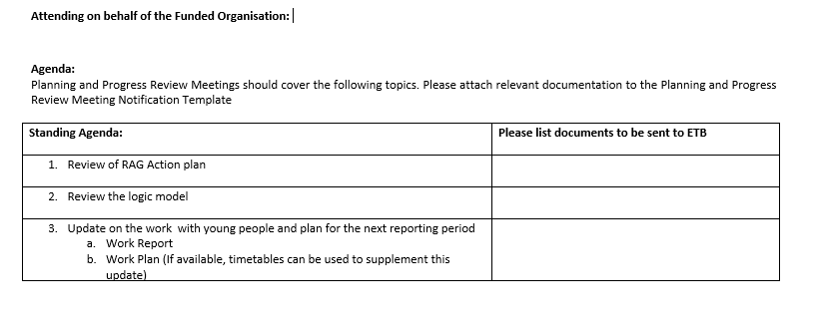
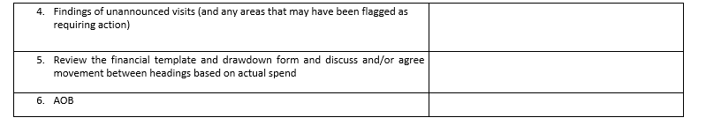
PPRM Notification Template
Please submit to the ETB 5 working days before the scheduled PPRM

Slide 16
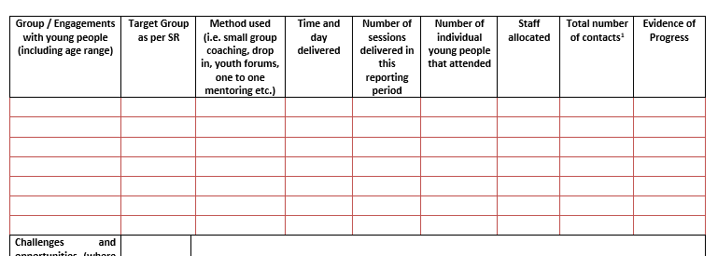
PPRM Work Report Template

Slide 17
The ‘contact’ figure relates to the number of actual attendances and not the number of individual young people attending. To calculate total number of contacts – add the numbers of individual young people attending each session
Example:
Session 1: Attendees - Kate, Liam, Niall = 3 contacts
Session 2: Attendees – Brigid, Kate, Liam, Danny, Stephen, Nuala, Anna = 7 contacts
Session 3: Attendees – Kate, Niall, Brigid, Danny, Stephen = 5 contacts
Number of sessions =3
Number of individual young people attending = 8
Total number of contacts = 15

Slide 18
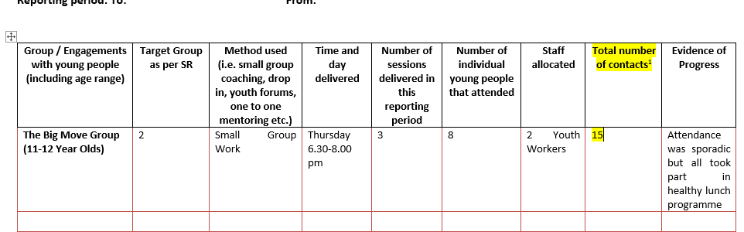

Slide 19
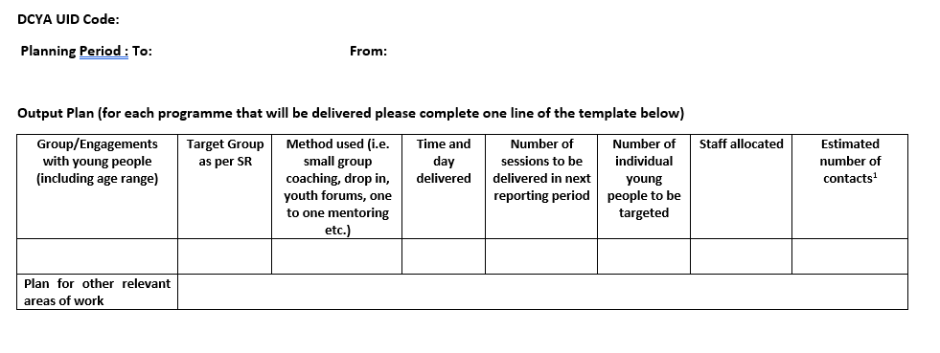
PPRM Work Plan Template

Slide 20
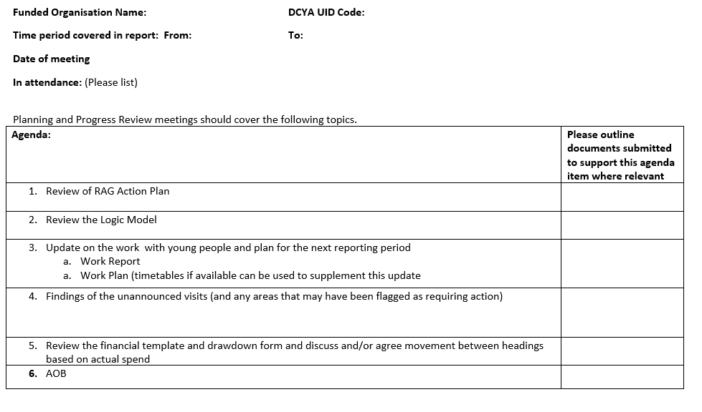
PPRM Record Template

Slide 21
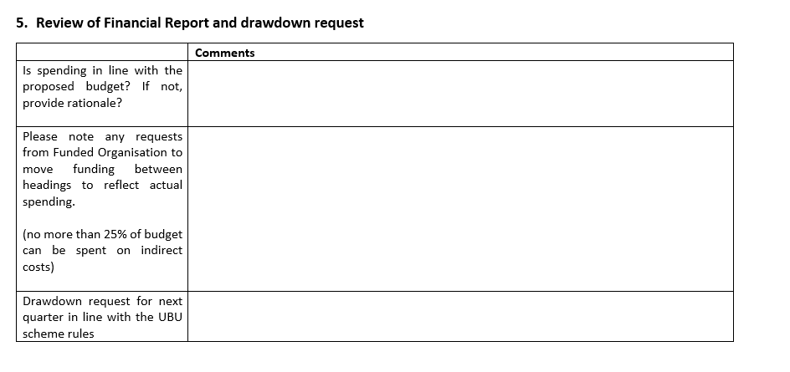
PPRM Record Template – Section 5

Slide 22
Next Steps
Take time & become familiar with PPRM Guidance and Templates provided
Remember for ETBs and youth projects/services the processes and templates are new
The scheme is based on continuous improvement so processes and templates may change over the course of the cycle - please provide feedback
Schedule your 2020 meeting/s

Slide 23
Thank You For Your Time & Attention

