Slide 1


UBU Your Place Your Space
POEF – Logic Model (LM)

Slide 2


Welcome

Slide 3
Purpose of the Session
Provide an overview of the UBU Logic Model (LM) contained with in the UBU Performance Oversight Engagement Framework (POEF)

Slide 4
Session Outline
POEF – tools and how the logic model fits
What is a logic model?
Best Practice Principles, Advantages, challenges,
Getting Started – Problem Statement, Objectives
Outcomes
Components of LM – Inputs, Activities, Outputs
Outputs V Outcomes
Evidence & Monitoring Components
Next Steps
References

Slide 5
The UBU Performance Oversight Engagement Framework (POEF) components work together to provide a shared measurement, monitoring and planning system across the scheme
POEF components which will be implemented from July 2020:
The Logic Model
Planning & Progress Review Meetings (PPRM)
Unannounced Visits
Indicative Weekly Timetable (Optional)

Slide 6
POEF Component: | Impact Measurement Tool: | Oversight& Monitoring Tool: | Planning Tool: | Optional Tool FO:
Logic Model (LM) | ✓ | ✓ | ✓ | X
Planning & Progress Review Meetings (PPRM) |  | ✓ | ✓ | X
Unannounced visits |  | ✓ |  | X
Indicative Weekly Timetable |  |  | ✓ | ✓

Slide 7
Stakeholder Roles -POEF Logic Model
Funded Organisation:
ETB:
Develop the Logic Model to provide a high level visual overview of all work funded under UBU Your Place Your Space
Discuss with your ETB the approach to the development of the Logic Model. It can either reflect the full Scheme Cycle or each re-application period.
Identify key relevant information to inform the Logic Model.
Provide the Logic Model to the ETB
Provide an updated version of the Logic Model on, or following, Planning and Progress Review Meetings as required by the ETB.
Provide guidance and feedback to the Funded Organisation on the development of the Logic Model
Agree an approach with the Funded Organisation regarding the duration of the Logic model
Discuss the content of the Logic Model with the Funded Organisation at Planning and Progress Review Meetings including any amendments required going forward
Retain a copy of the Logic Model and file appropriately

Slide 8
Logic Model – What is it?
“a logic model is a great way to “tell your story”. It describes the resources you need, the activities you plan to carry out, the products of those activities and the resulting impact you intend to achieve. It is often helpful to use the development of a logic model as a programme planning or design tools, as it can help you think through what it will take to achieve the outcomes you have decided on”
(CCF 2010)
Diagram Story:
What are the problems/issues you are most concerned about | What are you going to do to address these | What changes are you hoping to create

Slide 9
So, Why Logic Modelling:
“When programs operate in real communities where influences and forces are beyond your control, evaluation is generally more about documenting a program’s contribution than about proving something. Community based initiatives operate in complex environments where the scientific certainty of “proof” is seldom attainable. This is where logic models can be especially helpful.” (WK Kellogg Foundation 2004)

Slide 10
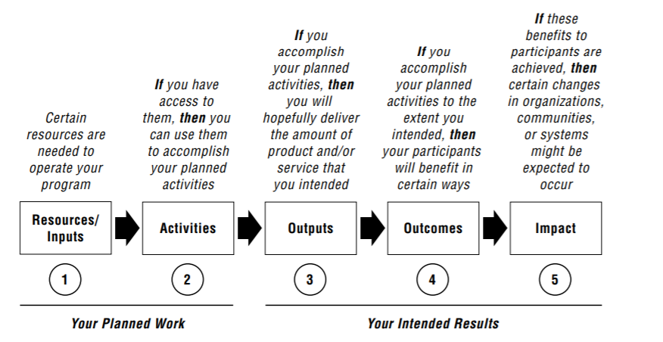
“A program logic model is merely a snapshot of a program at one point in time. A logic model is a work in progress, a working draft that can be refined as the program develops.” (WK Kellogg Foundation2004 )
Classic Logic Model
“If then” approach

Slide 11
Logic Model Best Practice Principles:
Involve stakeholders
LM needs to measure what matters to young people most
Keep it simple
Remember it’s a ‘Snapshot’ - Revisit, reassess, revise
Do not let perfection be the enemy of progress
Each Logic Model will be unique

Slide 12
Logic Model Advantages:
Process can build consensus
Ensures service providers and funders are all on the same page with regard to what is expected to happen
When used effectively, LM can support clarity and provide a positive space for reflection
Visual tool can help project/services to step back and embrace the complexity
Encourage key stakeholders to ask the right questions.
When the model is supported in practice this can result in changes in the way services are provided leading to improved services
Explains clearly why and how an intervention logic should work and allows for an explicit critique of why it may not
The LM can provide a good structure for discussing how the programme can evaluate its outcomes and tell the story of its success.

Slide 13
Logic Model Challenges:
The Logic Model:
LM Process:
is not externally validated and so is less robust than other impact measurement models
does not review the value of the work or provide a method for comparing different programmes or objectives
involves less opportunity to develop a thorough and deep critique of the underlying assumptions and to challenge the evidence base of the work
Different ideas – reaching consensus can be difficult
Division between short- and long-term outcomes and outputs and outcomes can cause confusion
If the right people do not participate i.e. those with the most knowledge of services, then the LM can lose meaning and relevance
Developing a LM requires a time commitment from practitioners and managers

Slide 14
First..
Scope – timeframe for LM &
      - whole service v part of service/programme element
Plan and timeline who will be part of developing your LM e.g. staff, volunteers, young people, management committee, funders etc.

Slide 15
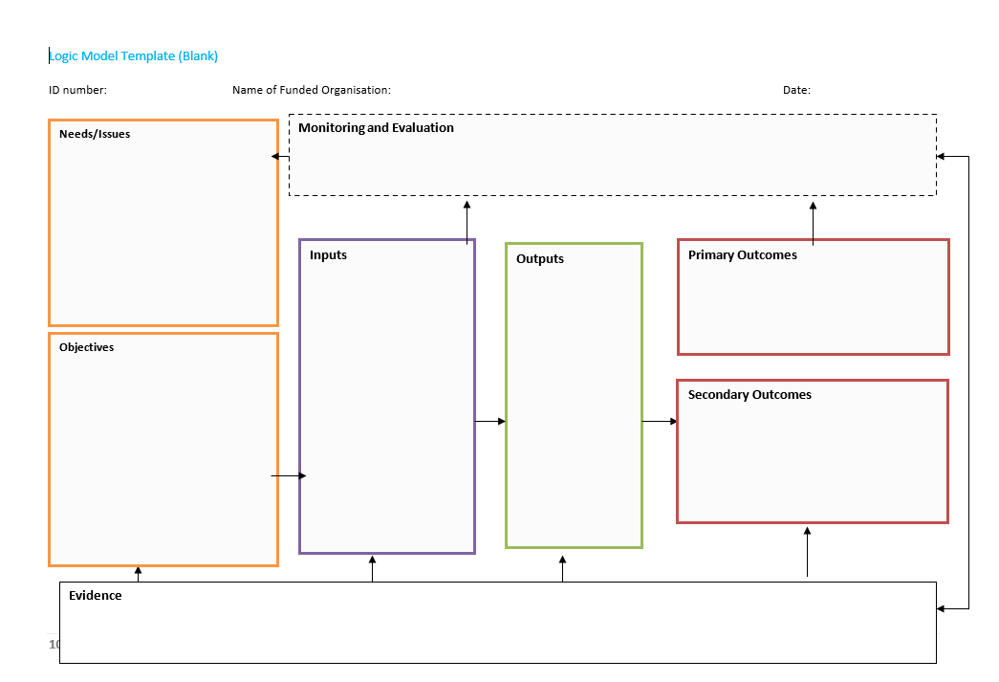
UBU Logic Model Template
READ FROM LEFT TO RIGHT USING ‘IF THEN’

Slide 16
Components of a Logic Model
Problem Statement:
Describes the issue/need that you intend to meet
Answering the questions:
What problem does the project/service seek to address? What do we know about the problem?
Informed by needs assessment, practice knowledge
The target groups are those affected but it is important to note how they are affected.

Slide 17
Components of a Logic Model
Objectives:
Provides and overriding set of goal statements for an aspect of the services activity
SMART – state what will be provided for who and when
Answering the question:
In what ways will the problem/needs be addressed by the project/service ?
Frequently objectives will already be identified through the SLA, application form however during the LM process objectives should be reviewed for clarity and relevance

Slide 18
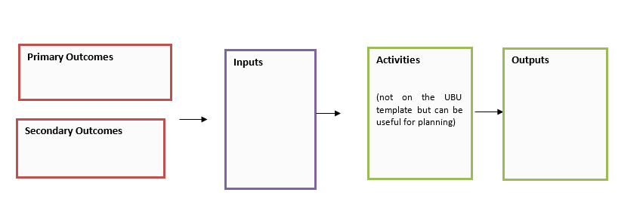
“Do the Outcomes first” is sage advice. (WK Kellogg Foundation 2004)
1. Outcomes
2. Inputs – take stock of your inputs/resources you might have to refine your outcomes
3. Activities- what will you do with the resources available to bring about the outcomes
4. Outputs defines targets, participation

Slide 19
Outcomes
“outcomes are not about what staff do, they are about what has changed as a result of what staff (or service users) did” (Quality Matters, 2013)
Outcomes should be:
Realistic
Specific and measurable
Important
Supported by evidence
Phrased as a change statement

Slide 20
Outcomes
Short = expect to see Awareness Knowledge Skills Opinions Aspirations Easier to measure | Medium = want to see Behaviour Decision making Policies Social action | Long = Impact Conditions Sustainable improvement Often ‘contributory’ and emerge over time 5-7 years Harder to measure

Slide 21
‘So What?’
It can take time for stakeholders to get used to thinking in terms of outcomes rather than the activities
One way to get a group thinking in terms of outcomes is ask the question ‘so what?’
Examples:
So what if there are 2 drop ins on per week: has anything changed for the young people as a result of this?
So what if everyone attended a peer education session: what has changed for the young people?

Slide 22
Inputs Are Your Resources
List the resources that you currently have for your project/service. If you intend to raise additional resources for the project/service timeframe, account for them under activities and outputs.
Types/categories:
Human resources: staff & volunteers etc
Financial resources: Be specific about these resources, but do not spend a lot of time developing a detailed list of all actual or anticipated expenditure
Space: Office and other facilities
Technology: Computer etc
Other Equipment: Office machinery (printers, copiers) and equipment specific to the programmes or the project
Materials/Other: training materials, insurance

Slide 23
Activities
Two Key Questions:
“What will you do with the resources available to bring about the outcomes?”
“What Programmes/actions will you undertake to achieve the objectives?”
Activities should be:
Concrete & Specific
Linked to problem statement/objectives ,the resources available and the desired outcomes.

Slide 24
Outputs
Things you can measure while you are actually doing your activity
Outputs = quantitative information that describes what happened or what staff did
Clearly defines targets, participation etc
Generally countable and are
Engagement/attendance is an output not an outcome
“Outputs are quantitative records of what has happened, such as: the number of programmes run, places filled, care plans undertaken, volunteers placed, houses found etc. Outputs can be counted easily and can be considered as the record of what staff have done” (Quality Matters 2013)

Slide 25
Outputs V Outcomes
Outputs – Doing (tangible completion of the activity)
Outcomes – effect of the output
Example:
Billy's 5th birthday party. You go to local bakery and order a Spiderman-themed cake for the party.
What is the outcome of this transaction?

Slide 26
Billy's Birthday Cake
most people will answer that the outcome is the birthday cake
That is not correct.
the cake is the output provided by the bakery.
The outcome of this will be a delighted birthday boy and a group of happy, cake-filled 5-year-olds.
If the cake had not been tasty, or if the bakery had delivered a fairy-themed cake instead of the desired Spiderman, then the desired outcome—happy kids—would, in all probability, not have been achieved.

Slide 27
Evidence Informing the Model
Rationale/ assumptions
Look for strong rationale based on “best practice” research that connects what you plan to do with why your approach will succeed. Find evidence that supports why you propose the solutions you do.
It’s a good idea to relate your approach to similar change strategies that have proven effective in communities like yours.
Reviewing literature and past evaluation reports from other projects/services (or your own work) will provide you with ample information to construct your rationale

Slide 28
Monitoring & Evaluation
Tools & Processes to collect information
Often, as a result of undertaking the LM, organisations identify new ways of working as well as new ways of capturing information
Outcomes for young people you will need to find ways to record/measure ‘distance travelled’ e.g. Outcome Star1
No UBU specific output and/or outcome measurement tools prescribed in 2020. Youth work projects/services will continue to utilise their bespoke approaches.

Slide 29
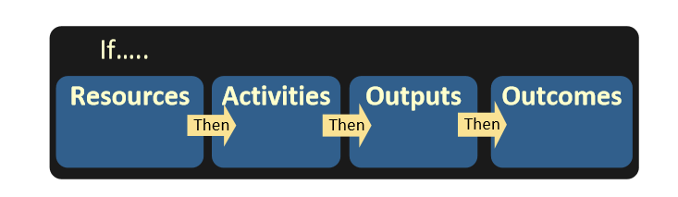
3 R’s - Revisit, Reassess, Revise
Key Questions:
Does it make sense?
Is it clear about links?
www.innonet.org

Slide 30
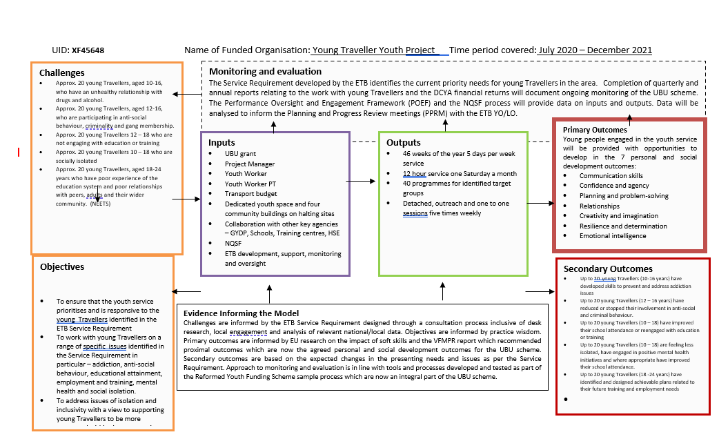

Slide 31
Next Steps
Now that you have created a logic model, put it to work!
• Use it to build clarity and consensus with colleagues, volunteers, young people, families and the wider community about intended outcomes.
• Use it to communicate with funders about accomplishments and resource needs.
• Use it to tell your story to young people, the wider community and media.
• Use it to evaluate your work – a sound logic model is the foundation of effective evaluation.

Slide 32
Thank You For Your Time & Attention

Slide 33
Resources Referenced:
Compassion Capital Fund National Resource Centre (CCF), (2010), Strengthening Nonprofits: A Capacity Builders Resource Library, Measuring Outcomes. www.strenghtennonprofits.org
WK Kellogg Foundation, (2004), Logic Model Development Guide. www.wkkf.org
Gardner, C., Dermody, A, Quigley, M., (2013), Impact Measurement: An Introductory Guide for Irish Social Enterprises & Charities on using LM, Theory of Change & Social Return on Investment to Measure Impact. Quality Matters. www.qualitymatters.ie
www.innonet.org

