Slide 1
Governance Training Programme: Finance Committee Chairs
Hugh Sullivan (Manager, Consulting)
4 December 2020

Slide 2
VC Etiquette
  Please leave your camera on if possible – to show your colleagues that you are engaged and interested
  Please introduce yourself each time you speak – especially if there is a large attendance
  Please mute when not speaking – to reduce background noise
  Use the chat function or ‘raise hand’ button to indicate that you would like to contribute

Slide 3
Agenda & Objectives
Topic | Objective | Timing
Introduction | Background and Context Brief Tour de Table | 10 mins
Supporting Good Governance | The Code Provisions and Responsibilities Key Messages | 30 mins
Workshop Session 1 | The Finance Committee within the ETB Governance Framework | 40 mins
Workshop Session 2 | Relationship with the Board / Executive | 40 mins
Workshop Session 3 | Managing Finance Committee Performance | 30 mins
Summary and Conclusion | Brief Recap Further Discussion and Queries Take-Home Messages and Objectives | 30 mins

Slide 4
Introduction

Slide 5




  Established in 1941, Crowe is the 8th largest professional services firm in Ireland, with over 130 staff in our Dublin office.
  A member of the wider global Crowe network, with over 750 offices in over 130 countries.
  We provide advisory services for:
    Governance and Board Effectiveness
    Stakeholder Relations
    Corporate Planning
    Leadership and Strategic Oversight
  Review, evaluation and training for:

Slide 6


Background and Context
  Education and Training Boards Ireland (ETBI) appointed Crowe in August 2019 to provide: “training on Good Governance Practices to the Education and Training Boards (ETBs) Sector in conjunction with the roll-out of Circular 02/2019 Department of Education & Skills (DES)”
  Workshops and resources on implementation of the Code to:
    Chief Executives (18/11/19) ☑
    Chairpersons (29/02/20) ☑
    ETB Directors (x3: 18/12/19 – 15/01/20 – 16/01/20) ☑
    COVID-19 Interruption
    Audit and Risk Committee Chairs (26/11/20) ☑
    Finance Committee Chairs (6/12/20)
    Board members (up to Dec 20)

Slide 7
Brief Tour du Table…
  Introduce yourself, your role and your ETB
  How long have you been in post?
  How would you rate your relationship with the Board (out of five)?
  How would you rate your Committee’s familiarity with its governance responsibilities (out of five)?

Slide 8
Finance in ETBs
Legal and Regulatory Context

Slide 9
ETB Act 2013 Section 45
(1) An education and training board shall establish —
a committee to examine and report to that board on financial matters relating to the board
a committee to assist the board in discharging its internal audit functions
(2) The Minister may by direction make provision in respect of all or any of the following matters concerning a committee established under this section—
procedures governing the number, appointment and removal of members (including the chairperson) of the committee,
the holding of meetings, including the frequency and conduct of those meetings, and
the preparation of reports by the committee and the furnishing of those reports to other specified persons.
(3) A committee established under this section shall report to the education and training board which established it not less than 4 times in each year.
(4) A member of staff of an education and training board, or a chief executive of that board, shall not be a member of a committee established under this section.
(5) Subject to subsection (6), a chief executive or a member of staff of an education and training board shall, when requested to do so by a committee of that board established under this section, attend at a meeting of that committee.
(6) A chief executive or member of staff referred to in subsection (5) shall not attend the meeting referred to in that subsection where the chief executive or member of staff concerned believes that attendance by him or her is inconsistent with the due performance of his or her functions as chief executive or member of staff, as the case may be.
(7) An education and training board shall determine what action, if any, it should take as a result of the findings of a report of a committee established under this section.

Slide 10
Summary of legal basis
  The Committee is there to supplement the skills and capabilities of the Board in relation to financial matters, including but not limited to:
    Expenditure limits;
    Annual Service Plan;
    Deposits;
    Borrowing;
    Fees;
    Accounts;
    Audit; and
    Acquisition, holding or disposal of land.
The Minister issues information, guidance and instruction in relation to these matters
The Code constitutes such guidance for the Committee

Slide 11
The Code of Practice
Finance Committee

Slide 12
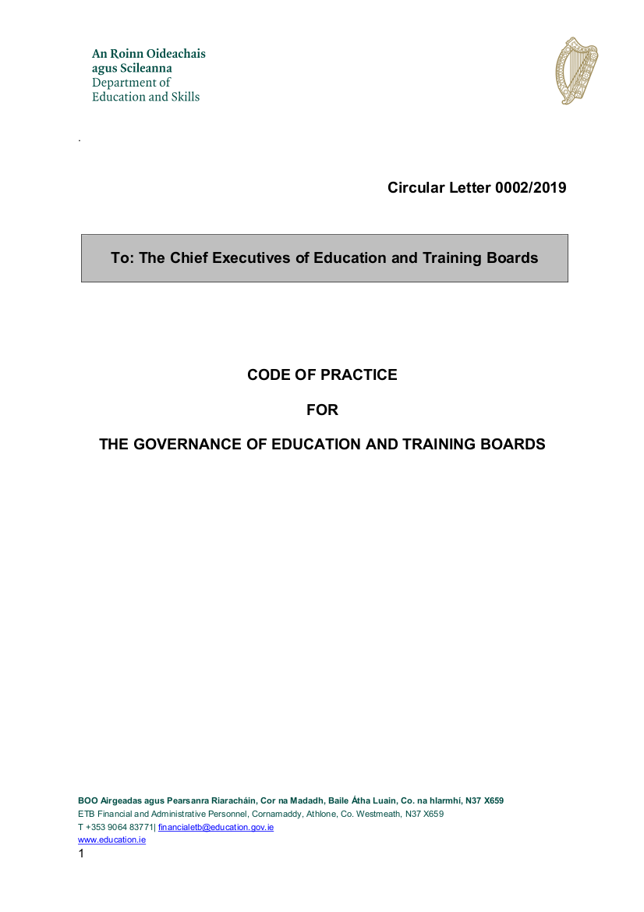
The Code of Practice
  Covers:
    Role and responsibilities of ETB Board
    Role and responsibilities of ETB Board Chairperson
    Roles and responsibilities of ETB Board Members
    Codes of Conduct, Ethics in Public Office, Disclosures
    Board Effectiveness
    Business and Financial Reporting
    Risk Management, Internal Controls, Internal Audit, etc.
    Relations with the Oireachtas, Minister and Department
    Remuneration and Superannuation
    Quality Customer Service

Slide 13
Development of ETB Governance
  Compared with the 2015 Code:
    Alignment with the 2016 DPER Code of Practice for the Governance of State Bodies
    Clear governance framework (reporting, oversight etc.)
    More on specific roles and responsibilities
  The 2019 Code:
    Is still quite new
    Has some technical gaps and inconsistencies
    Is principles-based
  Finance Committee & ARC role
  Review of effectiveness of internal control
  Clear articulation of role in support to the Board
  Enhanced consideration of the skills and capabilities of the committee
  Key points for interpreting the Code:
  In the event of a contradiction or doubt, the legislation takes precedence
  This means that when leading the committee, your role and authority derives from the 2013 Act which sets out the functions of the committee
  The Code contains guidance about how to go about delivering on your role

Slide 14
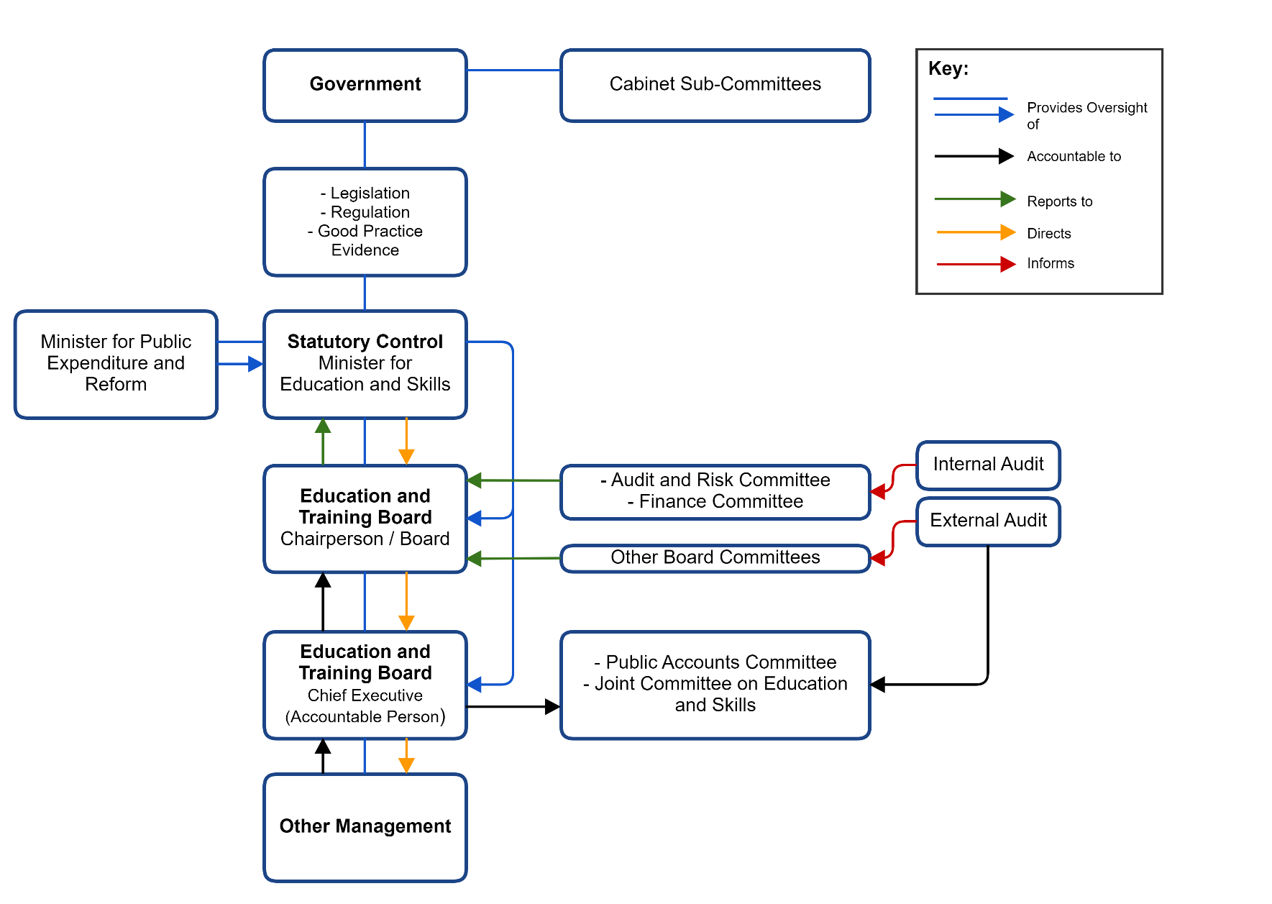
ETB Governance Framework
  This may be subject to change (new ministerial reporting lines)
  This depiction does not separate the two-fold role of the Board.
  FC role is to:
    Report to the Board
    Assist with the discharge of the Board’s functions
    Be informed by internal / external audit

Slide 15
Reserved Functions (ETB Act 2013|12(2))
# | Function | Act Ref | Ministerial Consent Required
a | Request name change | 9(3) | Yes
b | Appointment of CE | 14 | Yes
c | Suspension of CE | 17 | Yes
d | Establishment of a scholarship | 24 | Yes
e | Giving opinions on, and adoption of a strategy statement | 27 | No
f | Adoption of annual report | 28 | No
g | Acceptance of gifts or being constituted as a trustee | 29 | Yes
h | Authorise event attendance (by a Member) | 38 | No*
i (i) | Establishment/dissolution of committee | 44 | No*
i (ii) | Determination of the terms of reference of a committee | 44 | No*
# | Function | Act Ref | Ministerial Consent Required
i (iii) | Appointment/removal from office of a member of committee | 44 | No*
i (iv) | Confirmation of an act of a committee | 44 | No*
j | Adoption of annual service plan | 47 | No
k | Power to borrow money | 49 | Yes
l | Keeping of accounts | 51 | No
m (i) | Establishment of Finance and Audit and Risk Committees | 45 | No*
m (ii) | Appointment and removal of members of FC and ARC (incl. chair) | 45 | No*
m (iii) | Receipt of report from finance and audit and determination of action | 45 | No*
n | Acquisition, holding and disposal of land | 53 | No*
    * While ministerial consent may not be explicitly required, specific legislative provisions or regulations apply.

Slide 16
ETB Governance – What is unique
  Typical State Board:
  Has general responsibility and delegates / reserves functions
  Determines strategic direction and policy basis
  Education and Training Boards:
  15 reserved functions; explicitly prevented from acting beyond these [ETB Act 2013|12 (6)]
  Strategic direction determined by national funding and policy landscape
  ETB Policies developed and adopted by the executive

Slide 17
What the Code Says… (Finance)
Section 6
Taking account of public accountability and the special considerations which attach to State bodies in relation to their management and operation, the annual report and financial statements, taken as a whole, should be fair, balanced and understandable and provide the information necessary for an assessment of the ETB’s financial performance, financial position, business model and strategy.
A fundamental duty of the Board is to ensure that a balanced, true and fair view of the ETB’s financial performance and financial position is made when preparing the annual report and financial statements of the ETB and when submitting these to the Minister.
The Board should ensure that timely and accurate disclosure is made to the Minister on all material matters regarding the ETB, including the business context, financial performance and position, and governance of the ETB.

Slide 18
What the Code Says cont.…. (Finance Committee)
Examine and report to the Board regarding financial matters (Section 4)
Have written terms of reference
Possess certain skills
Externality
Declare, manage and record conflicts of interest (4.12, 4.13)
Induction, training and development (4.14)
Meet minimum four times annually (4.15)
Invite ‘outsiders’ with relevant experience (4.15)
Query matters within TOR (4.16)
Seek DES approval for external advice (4.16)
Maintain relationships with executive (4.17)
Communicate effectively with the Board (4.18)
Reports (4.19)
Review Draft Financial Statements (4.20)
    Various detailed requirements
Numerous other oblique requirements, provisions and references throughout

Slide 19
What the Code Says… (The Finance Committee’s Responsibilities)
  Appendix 14 – Terms of Reference for the Finance Committee
  Report to the Board as to whether the Service Plan is being implemented within expenditure limits, considering:
    Monthly accounts
    Ad hoc reports and information
  Advise the Board on:
    Accounting policies
    Financial statements
    Annual Report (including financial management and recording processes)
    Levels of error identified
    Management’s letter of representation to external audit
  Review and report on Draft Service Plan
  Advise the Board regarding the acceptance of the accounts and whether they should be signed.
    i.e. Does the information available establish a basis to consider that they are a proper reflection of income and expenditure and the organisation’s state of affairs?
  Make reports to the Board

Slide 20
What the Code Says… (The Finance Committee Cont.)
  Section 4: Finance Committee Provisions
  Members should have (or swiftly acquire) familiarity with:
  What an ETB does, including the special reserved / executive distinction;
  The particular organisational culture and context;
  Who does what, who reports to whom and who oversees whom; and
  The legal and regulatory context.

Slide 21
What the Code Says…. (The Committee Chairperson)
Set the agenda for meetings
Ensure:
    that the Finance Committee is appropriately resourced;
    that reports to the Committee contain relevant information and are provided at the right time in an appropriate format;
    absent Committee members are briefed on meetings and attendance records are maintained and reviewed annually;
    that they report at Board meetings and submit regular written reports to the Board containing relevant information;
    that matters arising are reported on at each subsequent meeting; and
    that they are involved in the appointment of new Committee members
  Committee performance
  Convene additional meetings as required

Slide 22
Discussion:
What is the core purpose of the Finance Committee

Slide 23
Some concerns from the group
The Finance Committee is asked to evaluate both the expenditure limits and the implementation of the service plan – this second component is outside of the competence of the committee.
The Finance Committee notes the draft service plan and approves the expenditure limits, but the practice is for the budget to be amended midway through the year
There is a lack of specificity about the relationship between the ARC and FC
The level of resources required to evaluate and sign off on (for example) the letter of representation, giving the appropriate attention to detail is a challenge.

Slide 24
FC Purpose and Responsibilities
Purpose
Always asking the tough or difficult questions – interrogating the material presented
Independence
Identifying and reporting irregularities brought to their attention (breaches or irregularities in financial reporting)
Responsibilities
Make recommendations to the Board on finance matters
  Accounts, strategic plan, procurement planning

Slide 25
What the Code Means….
Supplement and bolster the Board’s capacity to consider financial matters and execute certain critical reserved functions
Support the ETB Governance Framework through ensuring the interests of the ETB in relation to business, financial reporting and internal control
Provide a quasi-independent space for consideration of key organisational planning tools for the Board – particularly: Is the Service Plan being delivered within expenditure limits?
Maintain key governance relationships

Slide 26
Workshop Sessions

Slide 27
Workshop Session 1:
The Finance Committee within the ETB Governance Framework

Slide 28
ETB Governance Framework
  Reports to the Board
    Crucial support and input on financial considerations
    Specific reports and deliverables
  Informed by Internal / External Audit
    Audit reports
    Also informed by the Exec.

Slide 29
How do you, as Chairperson, engage:
  …with the Board Chairperson / Board?
      Board Chairperson is sometimes a member of the FC
      Make reports to the Board – sometimes verbally There is very little comment / interrogation.
      Formal evaluation of the FC is a responsibility of the Board Chairperson
      Annual attendance at the Board, to present the Accounts is occasionally the practice
  …with the Chief Executive (and other Directors)?
    CE attends for clarifications
    All executive personnel are very open and approachable
  …with ARC?
    Not much formal interaction
    Could be worth having an annual joint meeting to confirm SIC/annual report.
    Agenda – teasing out of responsibilities and where there is overlap
    ARC get a copy of the minutes and vice versa
    Confirm whether FC are entitled to get a copy of external reports?
  …with other stakeholders (Government etc.)?
    Need a tighter relationship with the C&AG
    Reporting on fitness for purpose of systems and processes in the ETBs
    Hihglighting issues as they arise with the department / funders

Slide 30
How do you Interact?
  “Executive members of the organisation should maintain an appropriate relationship with the Finance Committee.” (4.17)
  “The Finance Committee should ensure that it communicates effectively with the Board.”
  (4.18)
  What is the FC Chairperson’s role in maintaining these relationships?
  What does the Board need from the Committee to support these relationships?
  “While the Board has reserved functions in relation to financial matters including the keeping of accounts, the adoption of an annual service plan and the power to borrow money, the Finance Committee has a particular role in supporting the Board in this work by examining and reporting to the Board on financial matters.”
  How do you ensure independence / distance is maintained?
  How can you prevent interference or undue influence?
  The FC can only offer so much – the Board has some responsibilities
  Sending reports as appropriate
  Being kept informed throughout an annual cycle
  Some members are Board Members which is both positive and something to be aware of
  Focusing on oversight and a high-level view
  Showing budget to date and where the organisation is

Slide 31
Workshop Session 2:
Finance Committee Competencies

Slide 32
Code Provisions
Relevant Skills and Experience: The Finance Committee should collectively possess an appropriate range of skills to perform its functions to the required standard. Members should have a thorough understanding of the role of the Finance Committee and financial experience. In this regard, the Finance Committee Chairperson and members should be provided with initial induction and continuing training in relevant matters as appropriate.
Competencies: In addition to the skills outlined above, members should have, or acquire as soon as possible after their appointment, an understanding of;
the functions of an ETB;
organisational culture, objectives and challenges;
organisational structure including key relationships, e.g. the ETB’s relationship with the Minister, the Department of Education and Skills and other funding agencies/Departments; and
relevant legislation and other rules governing the financial operations of the ETB.

Slide 33
The FC Interactions with the Executive
Sufficient Resources and Administrative Support?
Adequate / Timely Information and Appropriate Access?
Access to Skills, Support and Perspectives?
Maintenance of Records?

Slide 34
Composition:
Knowledge, Skill & Competence
  The membership is somewhat prescribed:
  How do you capitalise on the capabilities at the table?
  How do you bolster/supplement this skills mix?
  Some challenges in having the right skills and experience in the committee. Some FCs are more lightweight in terms of financial expertise. A mix of educators and financial expertise is important (+1)
  External members (such as former executives) can be invited so the facility is there to seek particular skills and experience
  Invite people to make presentations to the committee about how certain activities are financially managed (e.g. music generation) – inviting the heads of functions about both interrogating the finances but also about informing the committee about how things work in the ETB.
  Meetings can be rotated throughout the ETB’s geographical area to hear a local flavour
  Procurement expertise (highly complex and one to watch) should be included within the skills mix for the FC and knowledge of systems and processes I.R.O cybersecurity.
  The workload is onerous which could present challenges to recruiting new members

Slide 35
Workshop Session 3:
Managing Committee Performance

Slide 36
Common Sources of Conflict/Frustration
What strategies are there for addressing the following sources of conflict before, during and after meetings?
    FC is generally relatively small, so these kinds of challenges do not tend to arise.
    Some challenge wich do arise include:
    Managing the expectations of the exec / committee
    Avoiding tick-boxes and not missing the elephant in the room
    Ensuring that the main Board do actually take this responsibility seriously and don’t assume that things are handed off
    A lot of the Board are unsure of finance and are happy to jump over the agenda item. Conveying the importance to the Board is critical
    Discerning what the right questions are and when to ask the right question – this is a learned skill
    The Departments need to work with the ETBs to make things clearer I.R.O budgeting
    Accounting principles might be somewhat out of date
    Maintenance and depreciation not adequately provided for

Slide 37
Conflicts of Interest
  Significant Legal Requirements
    Ethics and Standards in Public Office
    Annual Returns & matters arising
  Major source of reputational and operational risk
  Two key guidelines:
    Fiduciary responsibilities always apply
    Until it is declared and appropriately managed, there is no difference between perceived and actual conflicts of interest.
Balance:
Committee Members’ obligations to act in the interests of the ETB
Committee Members’ rights to have private lives, interest and ambitions
Balanced by honest communication, and robust processes.

Slide 38
Summary

Slide 39
Key Take-Home Messages
  In relation to the Code, your role is primarily to ensure that the Finance Committee provides high-quality information to the Board to support financial management decision-making and to provide some confidence in information received.
  Be the eyes and ears of the Board for financial matters
  Bolster the skills and capabilities of the Board
  This programme emphasises that governance is real work
  Your independence and flow of information is crucial to the organisation.
  Helping the Board to make governance a conscious effort

Slide 40
Final Comments or Queries

Slide 41
Final Tour de Table
What are your top takeaways?
Conscious that there is a lot to learn – interrogating the code a bit more is worthwhile
The training is a positive starting point for continuous improvement
It is useful to reflect on how far we have come
Consider adding to competencies at the committee – external and independent personnel with capabilities
Important to maintain the basic levels of trust
What is something you would like to develop further?
Chair to present to the Board annually in person (+1)
Consider the value of an ETBI network for ARC/FC members – for the creation of standardised checklists, agendas etc.
Sharing of minutes between statutory committees
Include procurement in the committee skills mix (+1) – is it a dual role (ARC/FC)?
Support systems for data, systems etc. to be brought up to speed
Partnerships is more than ARC/FC/Board – needs to include C&AG and the 2 Depts.
Introduce international standards into financial accounting practices
Is it possible to do everything required in 4 meetings? (5/6 seems common)

Slide 42

Hugh Sullivan
Manager, Consulting
Hugh.Sullivan@Crowe.ie

