Slide 1


UBU Your Place Your Space
Drawdown Sheet
Financial Template
ETB Familiarisation Session: Thursday, 3rd December 2020.

Slide 2
ETB Familiarisation Session: Purpose
Familiarise ETBs:
UBU Performance & Oversight Engagement Framework Section 6 “Financial Template & Drawdown Sheet”
UBU Drawdown Sheet
UBU Financial Template

Slide 3
ETB Familiarisation Session: Follow Up
Recording of this session
Slide Deck for this session will be made available
2 examples of UBU Drawdown Sheet & Financial Template covering Strand A,B, C will be made available
Please submit any queries/questions you have during the session into the Q&A window or email to celene.dunne@etbi.ie

Slide 4
UBU Performance Oversight & Engagement Framework (POEF)
POEF has been designed to provide stakeholders with a set of standardised tools, templates and guidance
Collecting information consistently across the sector
All tools, templates and guidance provided will be used by all UBU Funded Organisations and ETBs.
Section 6 – “Financial Template & Drawdown Sheet” (page 40-48)

Slide 5
POEF: ETB Role
Provide capacity building to FOs for each of the POEF tools, templates and guidance
Provide ongoing support and guidance to FOs in the use of the POEF tools, templates and guidance
Convene and participate in Planning and Progress Review Meetings with each Funded Organisation
Participate in the trialling and testing of new tools
Provide feedback to the Department in relation to the POEF
Collect and maintain all information gathered appropriately

Slide 6
Planning & Progress Review Meeting (PPRM)
PPRM is located at Section 4 of the POEF
The Planning and Progress Review Meetings are key to the overall governance of the UBU Your Place Your Space scheme
PPRM is a face to face meeting between the ETB and the Funded Organisation that takes place at least three times per year.
Agenda Item 5: Review the Financial Template and Drawdown Sheet - review the overall budget as indicated on the financial template discuss and/or agree movement between headings based on actual spend. Note: that Planning and Progress Review Meetings may not fall in line with quarterly financial periods

Slide 7
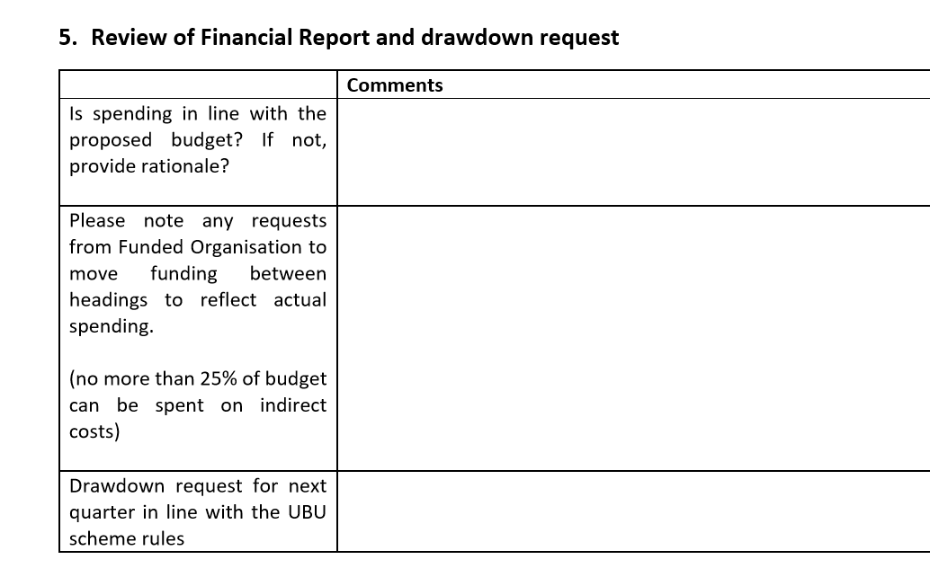
PPRM Report Template:
Provide information on spending & the budget
Record of agreements around moving funding between budget headings as the year progresses.
Discuss drawdown Identify underspends etc

Slide 8
Key Information: UBU Drawdown Sheet & Financial Template
Will be ‘live’ on the UBU website 7th December 2020
For use by all ETBs & UBU FO from 1st January 2021
The Drawdown Sheet and Financial Template are issued using Excel 2016. Each FO should ensure that it has the necessary Microsoft updates to access and save & edit this version of Excel

Slide 9
Purpose:
Drawdown Sheet: The drawdown sheet will allow the ETB to make a grant payment to the FO under Strand A, B and C.
Financial Template: The Financial Template will allow the FO & ETB to monitor spending under direct and indirect cost headings.

Slide 10
Stakeholder Role: DCEDIY
DCEDIY are the grantor of the scheme
Notification of annual UBU allocation by strand to ETBs
Process UBU drawdown requests received from ETBs

Slide 11
Stakeholder Role: ETB Intermediary
Quarterly drawdown requests to DCEDIY
Inform each FO of its annual allocation
Communicate the ETB’s payment schedule to the FOs and advise when they should submit their Drawdown Sheet to the ETB
Review the submitted Drawdown Sheet to ensure completeness and accuracy
Submit the Drawdown Sheet to the appropriate finance section of your ETB for payment
Review the Financial Template to ensure completeness and accuracy
Discuss arising budget and spending issues at the PPRM noting that arising issues may be discussed at any stage
Submit the ‘Quarterly Report’ from the Financial Template for each FO to DCEDIY on a quarterly basis

Slide 12
Stakeholder Role: FO
Download the Drawdown Sheet and Financial Template from the UBU Your Place Your Space website
Fill in the Drawdown Sheet and ensure that the drawdown is signed by the appropriate person
Submit the Drawdown Sheet to ETB on a quarterly basis
Complete the Financial Template for Strand A, B and C as appropriate, on a monthly basis
Ensure that the Financial Template is signed for the appropriate quarter
Submit the Financial Template to your ETB on a quarterly basis
Raise relevant budget issues with your ETB at the PPRM, noting that arising issues may be discussed at any stage

Slide 13
ETB: Steps in the process
Following receipt of the annual DCEDIY allocation letter, the ETB should make a drawdown request to the Department (use the normal drawdown sheet). For quarter one, the ETB may make a drawdown request to the Department based on 25% of the previous year’s allocation, prior to receipt of the DCEDIY allocation letter. For 2021 a notification on this will issue before the end of the year.
The ETB should inform Funded Organisations under its remit of its allocation under each UBU strand. For quarter one 2021, should the ETB still be awaiting the formal DCEDIY allocation notification, the Department can inform you what the appropriate strand amount should be
The ETB should also inform the Funded Organisation of its payment schedule and advise when the Drawdown Sheet should be submitted to the ETB

Slide 14
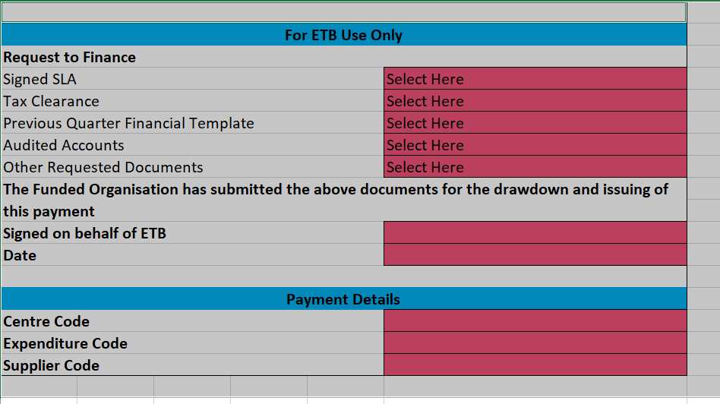
ETB – Drawdown Sheet
‘For ETB Use Only’
Rows 36-51 ‘unhide’
Steps:
Highlight row 35-52
Right Click
Select ‘unhide’

Slide 15
ETB – Financial Template
ETB should ensure that it has been checked for completion and accuracy, and that each FO is in compliance with the UBU Policy and Operating Rules or meeting any Action Plan obligations
Issues should be recorded and communicated to the Funded Organisation at the PPRM meeting. If urgent or of a serious nature, issues should be addressed immediately
ETBs & FOs can track quarterly spend by clicking on the ‘Quarterly Report’ tab. This will show by quarter, if FO has and overspend or underspend. It will also show by quarter, if FO are meeting the 75/25 rule. You can view the Strand B percentage of overall spend.

Slide 16

ETB – Quarterly Report to DCEDIY
Each quarter ETBs send the quarterly report sheet as a PDF to DCEDIY
One Quarterly Report per UBU Unique Identifier
Steps:
On keyboard press Ctrl+P Keys
Under ‘printer’ select: ‘Microsoft Print to PDF
Under settings change ‘portrait orientation to ‘landscape orientation
Under settings change ‘no scaling’ to ‘fit sheet on one page’
Click print to save

Slide 17
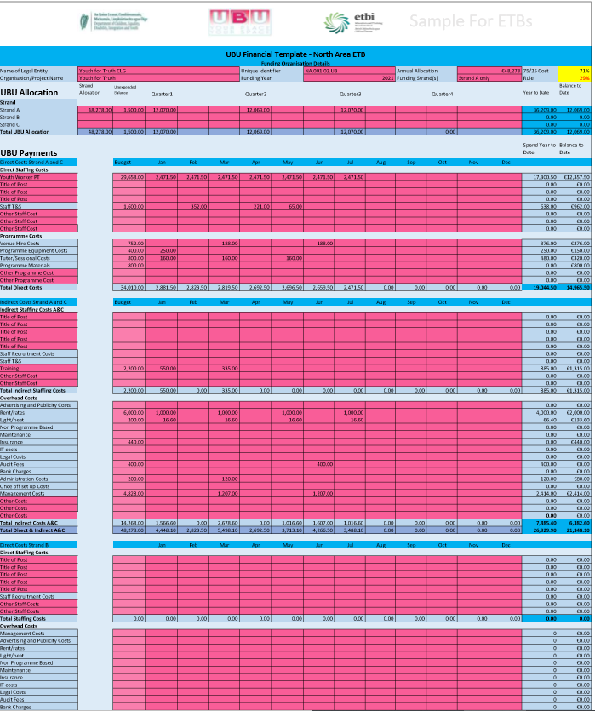
ETB – Quarterly Report to DCEDIY

Slide 18
ETB Quarterly Report Submission:
ETBs submit a ‘Quarterly Report’ per Unique Identifier in a PDF format to
the Compliance Inbox YAUCompliance@equality.gov.ie
Key Dates For ETB Submissions 2021:
Submit Q1 by 31st May 2021
Submit Q2 by 31st August 2021
Submit Q3 by 30th November 2021
Submit Q4 no later than 28th February 2022

Slide 19
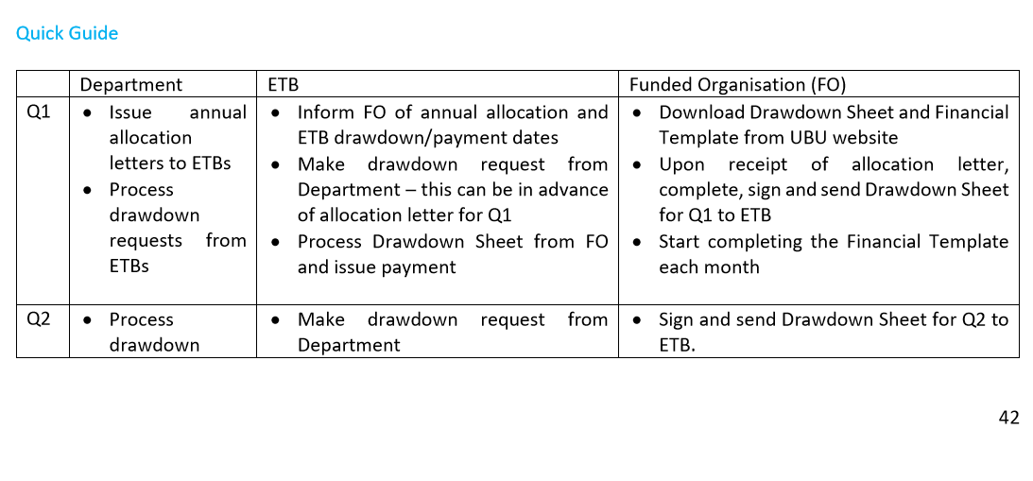
Quick Guide: POEF Document Section 6 p. 42-43

Slide 20
Quick Guide – ETBs
POEF Document Section 6 p. 42-43
Q1 2021– ETB
Inform FO of annual allocation and ETB drawdown/payment dates
Make drawdown request to Department
Process Drawdown Sheet from FO and issue payment
Q2 2021 – ETB
Make drawdown request to Department
Process Q2 Drawdown Sheet from FO and issue payment
Review Q1 Financial Template
Submit Q1 quarterly report to DCEDIY by 31 May
Engage on issues at PPRM or directly

Slide 21
Quick Guide – ETBs (cont.)
Q3 2021 – ETB
Make drawdown request to Department
Process Q3 Drawdown Sheet from FO and issue payment
Review Q2 Financial Template
Submit Q2 quarterly report to DCEDIY by 31 August
Engage on issues at PPRM or directly
Look at underspends or overspends
Q4 2021 – ETB
Make drawdown request to Department
Process Q4 Drawdown Sheet from FO and issue payment
Review Q3 Financial Template
Submit Q3 quarterly report to DCEDIY by 30th November
Engage on issues at PPRM or directly
Q1 2022 – ETB
Send full Financial Template to Department no later than 28 February 2022

Slide 22
ETBs Advise FO
Role of the ETB to advise FO:
Allocation for the period per Strand – this will be in the allocation letter
Schedule of payments & Drawdown Dates
How to make a submission – email address etc.
Additional documents required by the ETB to make the quarterly payment

Slide 23
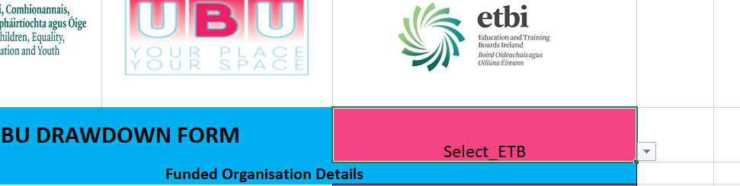
Key Information: FO Sheet & Template
Excel version
Access drawdown sheet & financial template on www.ubu.gov.ie/resources
NOTE: it is important that FO select the correct ETB
Right side of the drawdown sheet & financial template. Arrow will give a drop down of all ETBs in alphabetical order. When ETB is selected the logo will appear.

Slide 24
Key Information: FO Sheet & Template
Guidance - FAQ & Pop up boxes & Section 6 POEF
Fill in the red boxes only
Blue boxes will auto calculate
Cells containing formulas have been locked

Slide 25
What guidance is provided?
POEF Document – Section 6 page 40- 48
Steps in the Process FO section with guidance on filling in the form & template – 41-42
Quick Guide: p. 42-43 last row of the table contains the key information for FO
‘Things to Consider’ p.43
Drawdown Sheet Visual Guide – p.44
Financial Template Visual Guide – p. 45-48

Slide 26
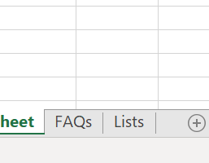
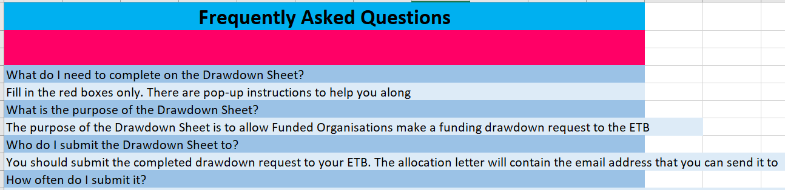
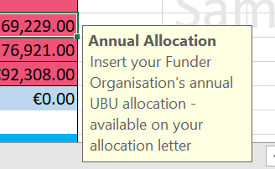
What guidance is provided?
FAQ Tab
Pop Up Boxes

Slide 27
Key Information for FO – Drawdown Sheet
Review allocation letter from ETB and complete RED boxes in the drawdown sheet
Click on RED cells & pop up instructions will help FO understand what needs to be inserted in the cell
Sign, date statement of assurance & submit drawdown sheet
With the exception of Q1, the Drawdown Sheet should be accompanied by the Financial Template & any other documents requested by the ETB

Slide 28
Key Information for FO – Financial Template
The Financial Template must be completed on an ongoing basis and submitted the ETB on a quarterly basis
The Financial Template is an item on the PPRM agenda. It provides an opportunity for the ETB and Funded Organisation to discuss the budget, including issues that may arise throughout the year. You do not have to wait for a PPRM to raise issues with your ETB
Review your Allocation Letter along with Sections 4.2, 4.4 and 4.5 (if necessary) of your 2020 UBU Application Form
Make sure you are on the ‘Financial Template’ tab and then complete all of the RED boxes in the Financial Template

Slide 29
Key Information for FO – Financial Template
Under UBU Allocation insert your annual allocation in column B, rows 13-15.
Once you have received your quarterly payment from your ETB, you should enter the amount received in either column D, G, J or M, rows 13-15, depending on which quarter payment you have received.
Column Q ,rows 13-16 will tell you how much you have left to drawdown
Monies carried forward from the previous year may be entered under the UBU Allocation section in column C. These unexpended monies must be returned to the relevant ETB

Slide 30
Key Information for FO – Financial Template
Under UBU Payments insert your annual budget breakdown in column C – you should refer to your UBU Application Form and pro-rata this with any increases or reductions in your allocation (if changes to your budget has been agreed with your ETB, then these changes should be reflected here)
In columns D to O, insert payments made under each month against your budgeted amount. You will see your overall spend to date and balance remaining in columns P and Q
Your total spend for Strand A & C direct costs, indirect costs and Strand B costs for each month will appear at the end of sections throughout the spreadsheet
Total monthly and annual balances for all strands will appear at the end of the spreadsheet
You must include each staff member on a separate row. Note: if there are insufficient rows to include all of your staff, you can unhide more rows (steps on p. 42)

Slide 31
Key Information for FO – Financial Template
The Statement of Assurance should be signed and dated for each relevant quarter and then the full Financial Template should submitted to the ETB
FO can track quarterly finance by clicking on the ‘Quarterly Report’ sheet. This will show FO, by quarter, if FO have and overspend or underspend. It will also show FO, by quarter, if you are meeting the 75/25 rule. For Strand B, you can view the Strand B percentage of your overall spend.

Slide 32
Questions & Follow Up
Thank You For Your Time & Attention
QUESTIONS:
Please submit any queries/questions you have to celene.dunne@etbi.ie Answers will be provided over coming days
Follow Up:
A recording of this session
Slide deck for this session will be made available
2 examples of UBU Drawdown Sheet & Financial Template covering strand A,B, C will be made available

