Slide 1
Governance Training Programme: Audit and Risk Committee Chairs
Alan Davidson (Associate Director, Consulting)
Hugh Sullivan (Manager, Consulting)
26 November 2020

Slide 2
VC Etiquette
  Please leave your camera on if possible – to show your colleagues that you are engaged and interested
  Please introduce yourself each time you speak – especially if there is a large attendance
  Please mute when not speaking – to reduce background noise
  Use the chat function or ‘raise hand’ button to indicate that you would like to contribute

Slide 3
Agenda & Objectives
Topic | Objective | Timing
Introduction from Crowe | Background and Context | 10 mins
Introduction from Internal Audit | Internal Audit Background and Key Information | 10 mins
Supporting Good Governance | The Code Provisions and Responsibilities Key Messages | 30 mins
Workshop Session 1 | The ARC within the ETB Governance Framework | 40 mins
Workshop Session 2 | Relationship with the Board / Executive | 40 mins
Workshop Session 3 | Managing ARC Performance | 20 mins
Summary and Conclusion | Brief Recap Further Discussion and Queries Take-Home Messages and Objectives | 30 mins

Slide 4
Introduction

Slide 5




  Established in 1941, Crowe is the 8th largest professional services firm in Ireland, with over 130 staff in our Dublin office.
  A member of the wider global Crowe network, with over 750 offices in over 130 countries.
  We provide advisory services for:
    Governance and Board Effectiveness
    Stakeholder Relations
    Corporate Planning
    Leadership and Strategic Oversight
  Review, evaluation and training for:

Slide 6


Background and Context
  Education and Training Boards Ireland (ETBI) appointed Crowe in August 2019 to provide: “training on Good Governance Practices to the Education and Training Boards (ETBs) Sector in conjunction with the roll-out of Circular 02/2019 Department of Education & Skills (DES)
  Workshops and resources on implementation of the Code to:
    Chief Executives (18/11/19) ☑
    ETB Directors (x3: 18/12/19 – 15/01/20 – 16/01/20) ☑
    Chairpersons (29/02/2020) ☑
    COVID-19 Interruption
    Audit and Risk Committee Chairs (today)
    Finance Committee Chairs (4th December)
    Board members (Ongoing to Dec ‘20)

Slide 7
Intro from Internal Audit Unit - ETBs

Slide 8
Audit and Risk Committee Chairs
Information Session
Internal Audit Unit- ETBs
26th November 2020
Michael Mullarkey- Director of IAU-ETBs
Roisin Campbell- Internal Auditor IAU-ETBs

Slide 9
Definition of Internal Audit
“Independent, objective assurance and consulting activity designed to add value and to improve the organisation’s operation. It helps an organisation accomplish its objectives by bringing a systematic, disciplined approach to evaluate and improve the effectiveness of risk management, internal control and governance processes”
Institute of Internal Auditors
&
IAU – ETBs Terms of Reference

Slide 10
Audit Plan
Input from relevant stakeholders
  Audit Committee and Risk Committees
  ETB Management
  Department of Education & Skills (“DES”)
  SOLAS
Risk based audit plan
Process approved by IAU- ETBs Steering Committee
Subject to amendment depending on the needs of individual ETB/ETB sector

Slide 11
2020 Audit activity
30 Audits 2020 Revised Audit Plan
36 Audits pre 2020
2020 Audit Plan Areas
Follow up on previous audit recommendations
Procurement
Policies compliance
Risk Management
Local Training Initiatives
Community Training Centres
SIC Review
DEIS Programme
Health & Safety

Slide 12
IAU –ETBs Steering Committee
Composition
• An independent Chairperson
• 3 nominees of the ETBI Chief Executive Forum
• 3 nominees of ETBI
• The Chief Executive of the ETB in which the IAU-ETBs is based - CMETB.
• 2 nominees of the DES.
• 1 nominee of SOLAS
• 1 nominee of City of Dublin ETB
• 2 x members of ETB staff

Slide 13
Internal Audit Reports –
Reporting Procedures
Findings & Recommendations Report
Opinion Report
Both reports, once finalised, are issued by IAU to Chief Executive and to the Audit Committee Chairperson.
Opinion Report is provided by Chief Executive to the DES and SOLAS for SOLAS funded programmes.

Slide 14
Range of Opinions | Additional action required by Chief Executive
Comprehensive | Opinion Report provided by Chief Executive to DES
Adequate | Opinion Report provided by Chief Executive to DES
Inadequate | Opinion Report provided by Chief Executive to DES
 | Full details of item(s) given rise to this Opinion provided by Chief Executive to DES (and SOLAS for SOLAS funded)

Slide 15
Consulting/“Support”
Appropriate, once
Independence & Objectivity of IAU – Maintained
Responsibility of ETB Management - Respected

Slide 16
IAU- ETBs Resource
1 - Director
1 - Deputy Director - CDETB
2 - Deputy Directors – recruitment process ongoing
6 - Internal Auditors
Supplemented by externally procured resource
Specialist Resource- e.g. Health and Safety, ICT

Slide 17
Thank you for your time
Michael Mullarkey
Director of Internal Audit- ETBs
Michaelmullarkey@iauetbs.ie
087 2328911

Slide 18
Brief Tour de Table…
  In about 90 seconds:
    Introduce yourself
    How long have you been in post?
    How would you rate your relationship with the Board & executive (out of five)?
    How would you rate your Committee’s / Board’s familiarity with its governance responsibilities (out of five)?

Slide 19
Audit and Risk in ETBs
Legal and Regulatory Context

Slide 20
ETB Act 2013 Section 45 (for reference)
(1) An education and training board shall establish —
a committee to examine and report to that board on financial matters relating to the board
a committee to assist the board in discharging its internal audit functions
(2) The Minister may by direction make provision in respect of all or any of the following matters concerning a committee established under this section—
procedures governing the number, appointment and removal of members (including the chairperson) of the committee,
the holding of meetings, including the frequency and conduct of those meetings, and
the preparation of reports by the committee and the furnishing of those reports to other specified persons.
(3) A committee established under this section shall report to the education and training board which established it not less than 4 times in each year.
(4) A member of staff of an education and training board, or a chief executive of that board, shall not be a member of a committee established under this section.
(5) Subject to subsection (6), a chief executive or a member of staff of an education and training board shall, when requested to do so by a committee of that board established under this section, attend at a meeting of that committee.
(6) A chief executive or member of staff referred to in subsection (5) shall not attend the meeting referred to in that subsection where the chief executive or member of staff concerned believes that attendance by him or her is inconsistent with the due performance of his or her functions as chief executive or member of staff, as the case may be.
(7) An education and training board shall determine what action, if any, it should take as a result of the findings of a report of a committee established under this section.

Slide 21
Summary of legal basis
  Referred to as the “audit committee” – ETBI convention is “Audit and Risk Committee”
  Minister may specify membership, meeting and reporting protocol / requirements
  Must meet and report a minimum of four times annually
  Must be exclusive of and separate to the executive
    But you can request their presence (they can refuse)
  Reports are to the Board who decides what action to take
  “assist with internal audit functions”
    As set out in Section 52 of the 2013 Act
52.—(1) An education and training board shall, in respect of internal audit functions, act in accordance with—
guidelines issued and directions given by the Minister, and
any requirements of, or directions given by, the Minister for Public Expenditure and Reform.
(2) An education and training board shall cooperate in full with any other body nominated by the Minister to carry out the internal audit function.
The Code constitutes “guidelines issued and directions given by the Minister”

Slide 22
The Code of Practice
Audit and Risk Committee

Slide 23
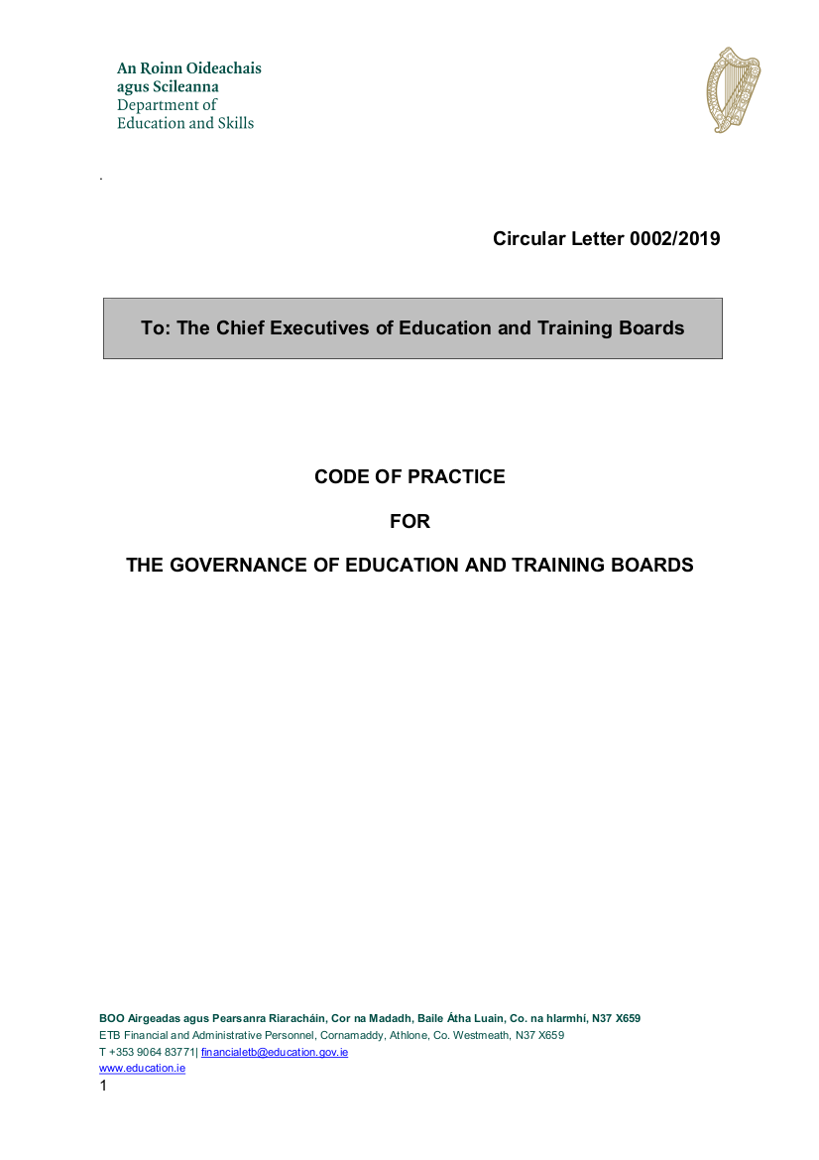
The Code of Practice
  Covers:
    Role and responsibilities of ETB Board
    Role and responsibilities of ETB Board Chairperson
    Roles and responsibilities of ETB Board Members
    Codes of Conduct, Ethics in Public Office, Disclosures
    Board Effectiveness
    Business and Financial Reporting
    Risk Management, Internal Controls, Internal Audit, etc.
    Relations with the Oireachtas, Minister and Department
    Remuneration and Superannuation
    Quality Customer Service

Slide 24
Development of ETB Governance
  Compared with the 2015 Code:
    Alignment with the 2016 DPER Code of Practice for the Governance of State Bodies
    Clear governance framework (reporting, oversight etc.)
    More on specific roles and responsibilities
  The 2019 Code:
    Is still quite new
    Has some technical gaps and inconsistencies
    Is principles-based
  Audit and Risk Committee role enhanced & includes consideration of risk
  Review of effectiveness of internal control
  Clear articulation of role in support to the Board
  Enhanced consideration of the skills and capabilities of the committee
  Key points for interpreting the Code:
  In the event of a contradiction or doubt, the legislation takes precedence
  This means that when leading the committee, your role and authority derives from the 2013 Act which sets out the functions of the committee
  The Code contains guidance about how to go about delivering on your role

Slide 25
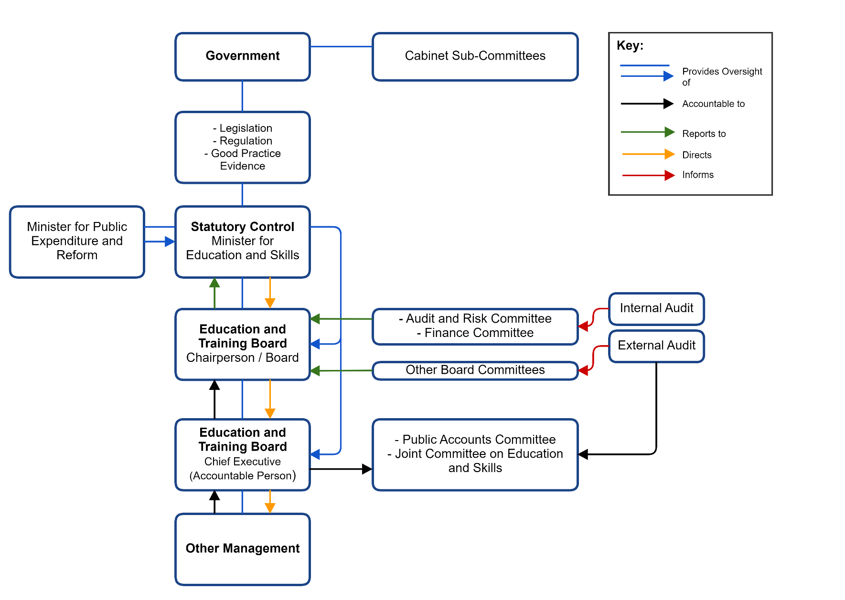
ETB Governance Framework
  This may be subject to change (new ministerial reporting lines)
  This depiction does not separate the two-fold role of the Board.
  ARC’s role is to:
    Report to the Board
    Assist with the discharge of the Board’s functions
    Be informed by internal / external audit

Slide 26
ETB Governance – What is unique
  Typical State Board:
  Has general responsibility and delegates / reserves functions
  Determines strategic direction and policy basis
  Education and Training Boards:
  Limited reserved functions; explicitly prevented from acting beyond these [ETB Act 2013|12 (6)]
  Strategic direction determined by national funding and policy landscape
  ETB Policies developed and adopted by the executive

Slide 27
Reserved Functions (ETB Act 2013|12(2))
# | Function | Act Ref | Ministerial Consent Required
a | Request name change | 9(3) | Yes
b | Appointment of CE | 14 | Yes
c | Suspension of CE | 17 | Yes
d | Establishment of a scholarship | 24 | Yes
e | Giving opinions on, and adoption of a strategy statement | 27 | No
f | Adoption of annual report | 28 | No
g | Acceptance of gifts or being constituted as a trustee | 29 | Yes
h | Authorise event attendance (by a Member) | 38 | No*
i (i) | Establishment/dissolution of committee | 44 | No*
i (ii) | Determination of the terms of reference of a committee | 44 | No*
# | Function | Act Ref | Ministerial Consent Required
i (iii) | Appointment/removal from office of a member of committee | 44 | No*
i (iv) | Confirmation of an act of a committee | 44 | No*
j | Adoption of annual service plan | 47 | No
k | Power to borrow money | 49 | Yes
l | Keeping of accounts | 51 | No
m (i) | Establishment of Finance and Audit and Risk Committees | 45 | No*
m (ii) | Appointment and removal of members of FC and ARC (incl. chair) | 45 | No*
m (iii) | Receipt of report from finance and audit and determination of action | 45 | No*
n | Acquisition, holding and disposal of land | 53 | No*
    * While ministerial consent may not be explicitly required, specific legislative provisions or regulations apply.

Slide 28
What the Code Says… (The ARC)
Section 1.6
“While the Board of an ETB must establish an Audit and Risk Committee to assist with its consideration of issues relating to audit, governance and risk management, the Board of the ETB maintains responsibility for and makes the final decisions on all of these areas.”
Section 7 ARC Principle (pg. 40)
“While the Board has a duty to act in the interests of the ETB, the Audit and Risk Committee has a particular role, acting independently of the management of the ETB, to ensure that the interests of Government and other stakeholders are fully protected in relation to business and financial reporting and internal control.”

Slide 29
What the Code Says cont.…. (The ARC)
Written charter including terms of reference (1.20)
Assist with monitoring and responding to non-compliance (3.3, 7.17)
Support the Board establishing and monitoring internal control and risk management processes (7)
Review risks and help to ensure adequate risk management (7.2)
Review internal controls annually prior to consideration of the accounts by the Finance Committee (7.8)
Ensures the Director of Internal Audit is accountable to the Audit and Risk Committee (7.16)
Review compliance with procurement and disposal procedures (7.16)
Recommend recruitment of additional committee members with key skills (7.19)
Strike a balance at meetings between governance, risk management and internal control (7.21)
Manage conflicts of interest (7.28, 7.29)
Meet at least four times per year (7.31)
Query any matter within the terms of reference (7.32)
Maintain effective relationships with the Board, the executive, Director of Internal Audit, the external auditor and other stakeholders (7.33, 7.34, 7.35, 7.36)
Make an annual report to the Board (7.37)
Consider audit reports
Numerous other oblique requirements, provisions and references throughout

Slide 30
What the Code Says cont.… (The ARC)
Appendix 11 – Template Terms of Reference
Based on established effective practice and covers:
  Membership
  Reporting
  Responsibilities
  Procedures and work programme
    Emphasis on the statement on internal control
  Rights
  Access
  Meetings
  Information Requirements
  Minutes
  “advise the Board on:
  the strategic processes for risk, internal control and governance;
  the management’s letter of representation to the external auditors;
  the planned activity and results of both internal and external audit;
  adequacy of management response to issues identified by audit activity, including external audit’s management letter of representation;
  assurances relating to the management of risk and corporate governance requirements for the State body;
  anti-fraud policies, protected disclosure processes, and arrangements for special investigations;
  the Audit and Risk Committee will also periodically review its own effectiveness and report the results of that review to the Board.”

Slide 31
Internal Control and Risk Management
Internal Control is the complete suite of policies, procedures and protocols which control financial, risk and corporate governance matters. They are designed to ensure:
Compliance with the provisions of the 2013 Act;
That the Board’s risk appetite is not exceeded;
Other legal and regulatory requirements are met;
Public policy obligations and expectations that the assets will be safeguarded are met;
The secure the integrity of transactions and financial management; and
That accurate and reliable records are maintained.
Risk Management – the executive identifies risks, categorised between strategic, operational, financial and compliance / regulatory matters with specific legal and regulatory requirements, and implements appropriate controls to mitigate or manage same.
The ARC provides assistance to the Board in satisfying itself that risks are appropriately managed.
Each year prior to the Finance Committee considering the annual accounts, the ARC will carry out a review of internal control matters for the previous years – by reviewing the minutes of ETB committees – to ensure there are no inconsistencies in these with any assessment of internal control provided to the ARC in internal audit reports.

Slide 32
What the Code Says…. (The ARC Chairperson)
Set the agenda for meetings
Ensure that:
    The committee is appropriately resourced and members are inducted and briefed;
    The committee properly reviews internal audit reports and management responses;
    Actions are followed up, in respect of internal audit reports;
    The committee receives the information it needs in a timely fashion;
    Absent members are briefed;
    Attendance records are maintained and reviewed annually;
    Report at Board meetings and submit regular written reports;
    Report matters arising back to the Committee; and
    They are involved in the appointment of new Committee members.
  Convene additional meetings as required
  Be available to the Director of Internal Audit

Slide 33
Summary of the Code ….
Understand and ensure the execution of the Board’s internal audit and risk responsibilities
Support the ETB Governance Framework through ensuring the interests of the ETB and its stakeholders in relation to business, financial reporting and internal control
Support the Board in establishing, monitoring and providing assurance regarding internal controls and risk management
Assist in the development of the internal audit plan and delivery of the audit work programme
Monitor compliance with legal regulatory and professional obligations
Maintain key governance relationships

Slide 34
Discussion:
What is the core purpose of the ARC?

Slide 35
ARC Purpose and Responsibilities
Purpose
Following from the 2014 C&AG Report and their comments on the role of oversight - Ensure that the ARC can provide accurate information to the Board at the right degree of detail
Ensure positive interaction between various bodies involved in governance (finance committees, Board etc.)
  Develop interactions past formal engagement regarding accounts
Responsibilities
[None noted]

Slide 36
Workshop Sessions

Slide 37
Workshop Session 1:
The ARC within the ETB Governance Framework

Slide 38
ETB Governance Framework (reminder)
  Reports to the Board
    Crucial support and input on internal control and risk
    Critical information for the executive in relation to compliance and accountability
  Informed by Internal / External Audit
    Audit reports

Slide 39
How do you Interact (cont.)?
  …with the Board Chairperson?
  …with the Chief Executive (and other Directors)?
  …with Internal Audit?
  …with other stakeholders (Government etc.)?

Slide 40
How do you Interact?
  “The Board should have formal and transparent arrangements for governance, risk management and internal control and for maintaining an appropriate relationship with the Internal Audit Unit and the Comptroller & Auditor General.”
  What is the ARC Chairperson’s role in maintaining these relationships?
  What does the Board need from the ARC to support these arrangements?
  “While the Board has a duty to act in the interests of the ETB, the Audit and Risk Committee has a particular role, acting independently of the management of the ETB, to ensure that the interests of Government and other stakeholders are fully protected in relation to business and financial reporting and internal control.”
  How do you ensure this independence / distance is maintained?
  How can you prevent interference or undue influence?
  Report to Board and minutes from each meeting
  Annual report to ETB Chair on system of internal control
  Annual informal discussion with ETB Chair
  Annual attendance by C&AG, IAU as requested
  Practical interaction to build rapport – trust in relations, early warning indicators from executive, conflicts
  Good fences make good neighbours
  Appointment of compliance liaison officer
  Appreciation of pain points day-to-day for executive
  In camera discussions before full meetings with exec

Slide 41
Audit and Risk Committee Governance Interactions
 | Board | ARC | Executive | Internal Audit
Internal Control | Responsible for ensuring that a system of internal control is established Annually makes a statement on internal control confirming adequacy | Assists the Board Reviews and monitors the system Satisfies the Board that the system operates effectively (annually) Considers reports | Establishes the system of internal control Corrects and adjusts the system as appropriate Reports to the Board | Evaluates integrity of system indicators Gives opinion to the committee (and by extension to the Board) regarding the efficacy of the system
Risk Management | Considers the risk register Satisfies itself that risk is adequately managed by the executive Establishes a risk policy | Considers risks and the executive’s risk management Gives independent advice to the Board Provides constructive challenge to risk owners on stewardship of risk | Identifies and reports risks within specific categories Establishes the measures for risk management / mitigation Implements the risk policy | Gives opinion periodically to committee / Board on efficacy of risk management.

Slide 42
Workshop Session 2:
Relationship with the Board / Executive

Slide 43
The ARC Interactions with the Executive
Sufficient Resources and Administrative Support
Adequate / Timely Information and Appropriate Access
Access to Skills, Support and Perspectives
Maintenance of Records

Slide 44
The ARC Interactions with the Board
For the following scenarios:
What information should the Board receive?
In the minutes – As commentary – Other?
  A favourable internal audit report?
    Summary of findings and any further suggestions/context from ARC
  An unfavourable internal audit report?
    ‘Unfiltered’ approach – full detail of issues and response/timescale, areas to be reported to Dept(s)
    Do not currently give full copies of reports – these only go to ARCs. Maybe summary doc prepared for Board? Board meetings are public
    Need for transparency between ARC and Board on discharging of roles
    Prior communication between ARC Chair and Board Chair is vital
  Emerging evidence of fraud?
    Dealt with at high level under AOB, pending outcome of investigation (reported to ARC later)
    Timing sensitive and crucial
    ETBI Fraud Response Policy guides approach – fact-finding only, AGS investigates
  Opinion that a risk mitigation implemented by the executive is insufficient (e.g. adequacy of management response to issue identified)?
    Record in minutes where felt that response/actions not sufficient
    Open discussion with executive, in camera discussions in advance

Slide 45
Workshop Session 3:
Managing Committee Performance

Slide 46
Common Sources of Conflict/Frustration
What strategies are there for addressing the following sources of frustration before, during and after meetings?
  Discussion dominated by a small number of people
    ‘Tour de table’ strategy – directly ask all ARC members
    Reports may be long-winded too – not clear/concise
  Refusal to prepare or engage by members or invitees
    Material uploaded on platforms e.g. SharePoint
    Info provided well in advance, good levels of member engagement
    Virtual meetings now the norm – members not always comfortable, can be tech issues but can be more time-effective
  Not enough time to get through the agenda or deviation
    Now guided to min 4 meetings per anum – ideally 6-8 would be needed
    Annual workplan guides agendas for each meeting – calendar of activity

Slide 47
Composition:
Knowledge, Skill & Competence
  The membership is somewhat prescribed:
  How do you capitalise on the capabilities at the table?
  How do you bolster/supplement this skills mix?
  It is unclear the extent to which ARC Chair involved in identifying skill requirements, but specified in Code that can provide recommendations on ARC membership. Board Chair consults ARC Chair on potential appointments to ARC in advance. Could be beneficial to have greater role in selection process. Membership can be affected by wholesale changes in membership, lack of rotation in terms of appointment etc – harms continuity over medium term. Annual review of ARC training requirements

Slide 48
Conflicts of Interest
  Significant Legal Requirements
    Ethics and Standards in Public Office
    Annual Returns & matters arising
  Major source of reputational and operational risk
  Note – your fiduciary responsibilities always apply
  Until it is declared and appropriately managed, there is no difference between perceived and actual conflicts of interest.
Balance:
Committee Members’ obligations to act in the interests of the ETB
Committee Members’ rights to have private lives, interest and ambitions
Balanced by honest communication, and robust processes.

Slide 49
Summary

Slide 50
Key Take-Home Messages
  In relation to the Code, your role is primarily to ensure the ARC provides high-quality information to the Board to support decisions (where it relates to a reserved function) and public / ministerial assurance (where it relates to any executive matter)
  Be the eyes and ears of the Board for risk and implementation of policies and procedures
  This programme emphasises that governance is real work
  Your independence and flow of information is crucial to the organisation.
  Helping the Board to make governance a conscious effort i.r.o consideration of risk

Slide 51
Final Comments or Queries

Slide 52
Final Tour de Table
What are your top takeaways?
Clarity on info flow between ARC/Board
IAU engagement and strengthened role/capacity
Similar issues across ARCs – we are not alone!
Reminder on Anti-Fraud and Corruption Policy
Methods of reporting to Board on difficult issues
What is something you might do differently?
Tighten the ARC workplan
In camera meetings
Standing agenda item for ‘early warning indicators’ from executive
Formalisation of links between ARC and Finance Committee
What is something you would like to develop further?
Better relations with Board Chair, greater rapport and developing connections
C&AG/IAU engagement
Openness in communication channels
Reviews of ARC effectiveness (as distinct from self-reporting on its performance)

Slide 53


Alan Davidson
Associate Director, Consulting
Alan.Davidson@Crowe.ie
Hugh Sullivan
Manager, Consulting
Hugh.Sullivan@Crowe.ie

