Slide 1

Circular 0053/2019
Exemptions from the Study of Irish
The Annual Principals & Deputy Principals Conference 2020
Clayton Whites Hotel, Wexford
Wednesday, 29th January 2020
3.45-5.15pm
Gean Gilger
Education Policy & Development Officer, ETBI

Slide 2
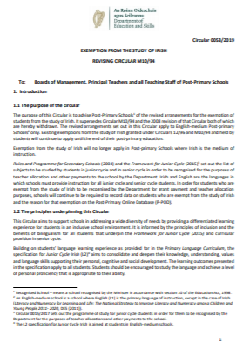
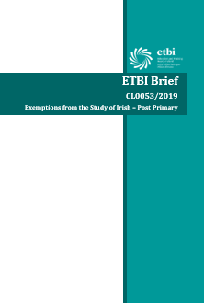
Today’s Workshop
Key points of the circular
Key documents
The application process
The appeals process
On the ground examples
– Group Discussion
FAQs

Slide 3
Key Points of the Circular
There are only three criteria for which exemptions from the study of Irish may be considered. NO OTHER CRITERIA MAY BE CONSIDERED
The decision to grant an exemption is made by the Principal
The appeals process only assesses the procedures followed during the application process

Slide 4
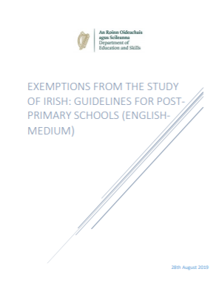
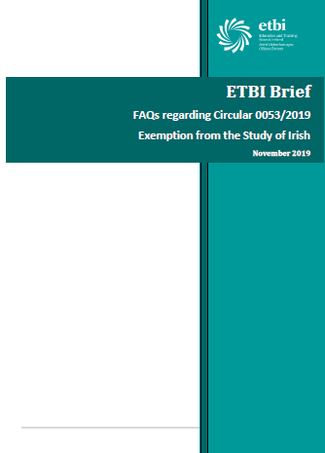
Key Documents
Circular 0053/2019
DES GUIDELINES
ETBI FAQs and Forms
ETBI Brief

Slide 5
Criterion 1
Students whose education up to 12 years of age (or up to and including the final year of their primary education) was received outside the State and where they did not have opportunity to engage in the study of Irish.

Slide 6
Criterion 2
Students who were previously enrolled as recognised students in a primary or post-primary school who are being re-enrolled after a period spent abroad, provided that at least three consecutive years have elapsed since the previous enrolment in the State and are at least 12 years of age on re-enrolment

Slide 7
Criterion 3
Students who present with significant learning difficulties that are persistent despite having had access to a differentiated approach to language and literacy learning
AND
Present with a Standardised Score on a discrete test in either Word Reading, Reading Comprehension or Spelling at/below the 10th percentile.
Documentary evidence to this effect, held by the school, should include Student Support Plans detailing
a) regular reviews of learning needs as part of an ongoing cycle of assessment
b) target-setting
c) evidence-informed intervention and review, including test scores

Slide 8
Procedures for granting an Exemption
Importance of Dates
  Importance of Paper Trail
    Importance of Evidence
      Importance of following the Process

Slide 9
The Application Process
On receiving a written application…
STEP ONE
Record the date the application as received
STEP TWO
Confirm application is relevant to one of 3 criteria outlined in circular
STEP THREE
Acknowledge receipt of application in writing.

Slide 10
The Application Process
STEP FOUR
Consult with parents/guardians, student, school personnel
  In case of criterion 1, review evidence of age and stage of primary education
  In case of criterion 2, review evidence of age, time spent outside state and previous periods of enrolments within the state
  In case of criterion 3, consult with class teacher and SET team. Confirm student has at least reached 2nd class. Review evidence of response to targeted intervention in student support file

Slide 11
The Application Process
STEP FIVE
Inform parents/guardians/student regarding any implication of an exemption from the study of Irish in the future
STEP SIX
Complete the checklist (Appendix 4 of Guidelines – 3 separate checklists)

Slide 12
The Application Process
STEP SEVEN
Inform parents/guardians/student that the outcome will be confirmed in writing within 21 school days of receipt of application.
If exemption is granted, a Certificate of Exemption will be issued.
If exemption is refused, the reason(s) will be shared in writing along details of how to appeal to the Irish Exemptions Appeal Committee.
(An application must be made within 30 calendar days from the date that the school’s decision was shared in writing with the parents/guardians/student)

Slide 13
The APPEALS Procedure
An appeal may be lodged with the Irish Exemptions Appeal Committee.
Appeal Form (See appendix 6 of Guidelines)
Appeal will be confined to review of whether the school adhered to the guidelines for processing application only
NOTE: If unhappy with outcome of appeal, the matter may be referred to the Ombudsman for Children/Ombudsman

Slide 14
Data Retention
All documentation in relation to the application, including application form, supporting documents, correspondence with parents/guardians/student, copy of Certificate of Exemption should be retained in the student’s file in accordance with GDPR and the school’s data protection policy and for inspection by authorised Department Officials

Slide 15
Reporting
Schools will be required to provide the DES with information in relation to number of exemptions granted and grounds for same via Post-Primary Online Database (Ppod)

Slide 16
Useful documents in Guidelines
Appendix 2: Application Form
Appendix 3: Summary of Application Process
Appendix 4: Checklists for Application Process
Appendix 5: Certificate of Exemption
Appendix 6: Appeal Form

Slide 17

Group Discussion
What has your experience been in relation to Circular 0053/2019?
What advice can you share with others?

Slide 18
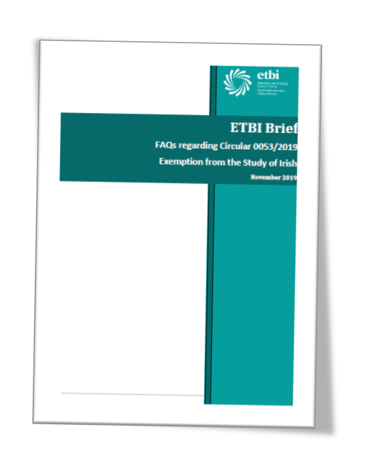
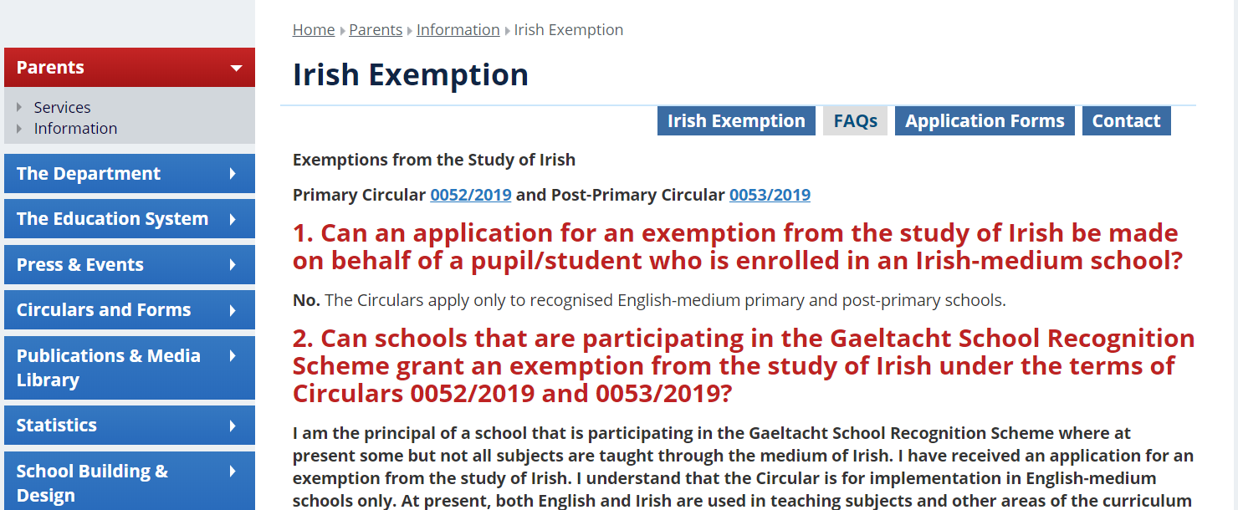
Frequently Asked Questions
Other supports available via Department of Education & Skills website and ETBI
https://www.education.ie/en/Parents/Information/Irish-Exemption/FAQs.html

