Slide 1


Understanding Consent
Empowering and supporting students

Slide 2
Caitriona Freir
Dublin Rape Crisis Centre
Youth Programmes Coordinator

Slide 3


Dublin Rape Crisis Centre
National Sexual Violence Helpline
Support for victims of sexual violence- outreach, advocacy and therapy
DRCC in the community
Education and training
Prevention of sexual violence- resources from programmes

Slide 4
Outline of talk
Understanding consent
The impact of pornography
Sharing of Intimate images
Whole school approach
Training and resources

Slide 5
Consent and young people
More than just age of consent
Teaching young people skills- communication and self awareness
What do young people understand about consent? What do they need to know
School staff may not understand consent
Notes:
Young people often engage in activities without checking how comfortable they really are? Am I comfortable with this ?

Slide 6
Consent and the law

Slide 7
What the law says about consent -The Criminal Law (Sexual Offences) Act 2017
‘A person consents to a sexual act if he or she freely and voluntarily agrees to engage in that act.’
Some circumstances in which there is no consent to a sexual act: if
force is used
there is a threat of force being used against victim or another person
there is a well founded fear of force to self or another
a person is asleep or unconscious
a person is incapable of consenting because of the effect of alcohol or some other drug
a person is suffering from a physical disability which prevents communication of consent
a person is mistaken as to the nature and purpose of the act or
a person is mistaken as to the identity of any other person involved
a person is being unlawfully detained at the time of the act
consent is given by a third party
(4) Consent to a sexual act may be withdrawn at any time
(5) Any failure or omission on the part of a person to offer resistance to an act does not of itself constitute consent to that act.

Slide 8
Impact of pornography and culture
Young people could experience a range of different risks from
unrealistic expectations of body image and performance, which could leave young people questioning their own shape, size and overall appearance
more casual attitudes towards sex and relationships which don't reflect messages about love and consent
more risky or violent sexual behaviour, which if seen without appropriate relationship and sex education might leave a young person with a warped attitude towards the sexual behaviour they expect to experience
unrealistic attitudes towards gender roles and identities in relationships; often showing women as always 'up for it' and men as dominant
Potentially addictive behaviours- rewiring of brain
Notes:
Social Media- sexualised environment
Increasingly, young people are reporting that they are receiving a lot of sex and relationship education from the internet and pornography. This means that young people are developing unrealistic expectations about themselves, their relationships and sex. Pornography provides a readily available and easily accessible model or ‘script’ for how to have sex that may guide young people’s sexual encounters. As young people may not have the opportunity to compare what they see in popular culture and pornography with real life, they may be more susceptible to internalising what they view in pornography and modifying their world view, identity and behaviour accordingly. In addition when young people engage in stimulating or potentially addictive behaviours, such as pornography, there is a surge of dopamine to the brain. With recurring surges of dopamine released into the teen brain, it is rewired to crave the same effect. A young person’s brain is at the peak of dopamine creation and neuroplasticity making it very vulnerable to addiction and rewiring as their brain is not fully developed.
As a result of these factors, pornography appears to have influenced the views of young people and the level of sexual behaviour which is deemed to be appropriate, expected or acceptable. There is a clear need to support youth to develop the competence to distinguish positive and negative models of sexual health and relationships from the pornography that they watch.

Slide 9
Impact of pornography and culture
As pornography does not give a clear message about the necessity of consent, young people can end up confused or misinformed about the importance of this issue.
Influenced the views of young people and the level of sexual behaviour which is deemed to be appropriate, expected or acceptable.
There is a clear need to support youth to develop the competence to distinguish positive and negative models of sexual health and relationships from the pornography that they watch.

Slide 10
Sharing intimate images – issues to consider
Sexting
Sextortion
Common issues within schools variety of ways
Legal issues to consider
Welfare of young people- different levels of need

Slide 11
Impact on young people
Self blame
Shame
Isolation
Anxiety
Dropping out of school
Hopelessness, despair
Constant fear and dread of someone seeing the image
Panic attacks
Anger
Alcohol and substance use
Eating disorders
Suicide

Slide 12
Supporting the Young Person
Listen
Elicit the facts from the confusion
Provide information re asking people to delete, helpline, ISPs etc – act quickly if still containable locally
Give space for the feelings, do not dismiss them
Be actively non-judgemental
Reassure – a seven day wonder
Consider reporting issues, Child Protection, Gardaí
Provide support in planning to tell parents
Encourage to use supports

Slide 13
What the law says
Child Protection obligations- duty to report and duty of care
Under data protection law, individuals have the right not to have their personal data, including their image, collected and published without consent. Anyone who publishes private content online could be seen to be violating data protection laws and could have a civil lawsuit brought against them.
Current data protection laws are not, however, a very robust remedy to, or protection from, the problem of non-consensual sharing of explicit images.

Slide 14
Supports around explicit image sharing
Webwise.ie
Youthinkyouknow.co.uk
Europol & Gardaí
Online sexual coercion
https://www.europol.europa.eu/activities-services/public-awareness-and-prevention-guides/online-sexual-coercion-and-extortion-crime
ISPCC
Hotline.ie- reporting

Slide 15
What should we do in schools- Prevention
Needs assessment before initiating programmes
Youth Involvement
Ensure policy and procedures match the environment
Buy in from parents, community leaders
Create Safe space
Consider cultural dimensions- inclusivity
Interactive- consider learning and physical disabilities
Link to local, national and International events

Slide 16
A Whole School Approach - Prevention
School Communication
Policy , student input and evaluation
Community Partnership
Parental Partnership
Equipping staff- training, values preparation
Youth participation

Slide 17
Working with Parents
Involve parents from the outset
Consider delivering to parents directly in addition to young people
Ensure parents understand rational- use statistics etc if needed
Communicate youth involvement with parents- what young people want
Share resources

Slide 18
Training and resources
Dublin Rape Crisis Centre Programmes
  BodyRight – Training prog for professionals to deliver to young people
  Let’s Get Real
  Ask Consent
Website support
  Webwise.ie
  Youthinkyouknow.co.uk
  Spunout.ie
  Hotline.ie

Slide 19
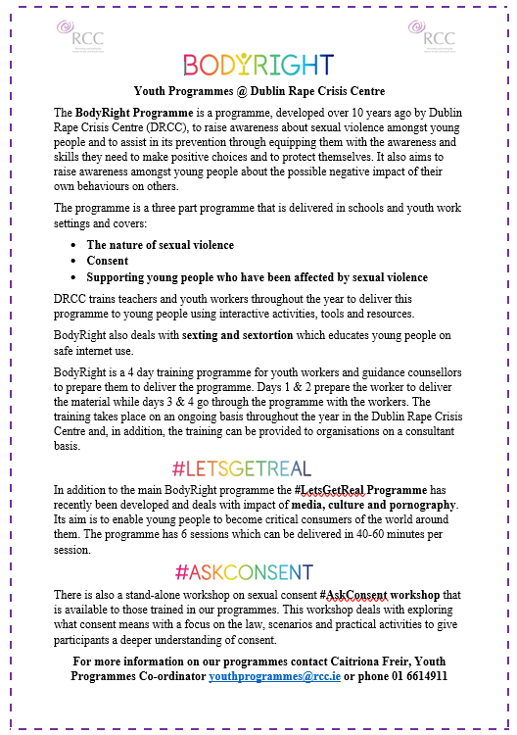
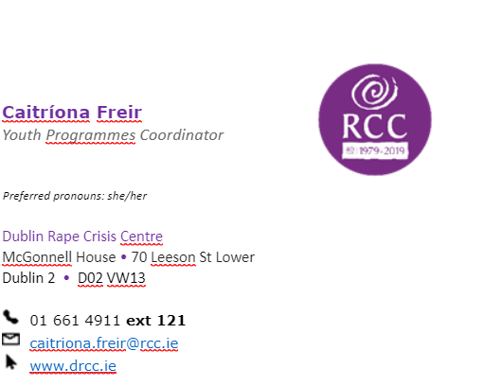

Slide 20

‘

