Slide 1
How Can Schools Best Support Transgender Students
Hannah Solley
Family Support and Education Officer

Slide 2

Transgender Equality Network Ireland
TENI is a non-profit member-driven organisation, founded in 2006 and registered as a company limited by guarantee in February 2010. The governance is provided by a volunteer Board and operations are led by the Chief Executive and staff.

Slide 3

Transgender Equality Network Ireland
Transgender Equality Network Ireland (TENI) seeks to improve conditions and advance the rights and equality of trans people and their families.

Slide 4
Family Support and Education Officer
Provide support to families who have gender diverse children
Provide support and guidance to schools to help them to support gender diverse students
Notes:
Describe what my role within TENI is, taking that initial support call from a parent, signposting to services and support groups. Parents often find it very difficult. Don’t be afraid of asking any questions. It’s ok if you find this difficult or challenging because most parents do as well.
It’s so important to provide support to schools because we want to enable students to remain within the school system – not only to complete their education but to help them build social skills and resilience that will equip them with these skills for life.

Slide 5
Definitions & Language

Slide 6
Sex vs. Gender: What’s The Difference?
Sex
The designation of a person at birth as male or female usually based on their anatomy or biology.
Gender Identity
A person’s deeply-felt identification as male, female, some other gender or no gender.
Gender Expression
The external manifestation of a person’s gender identity.

Slide 7
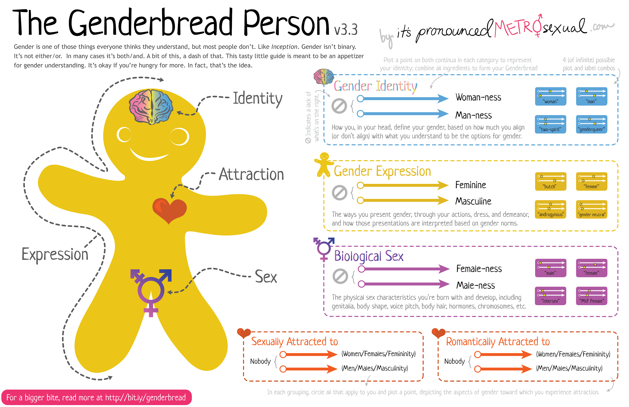
Gender, sex & sexuality

Slide 8
Terminology
Transgender: Someone who identifies with a gender other than that which was assigned to them at birth.
Trans man: A person who was assigned female at birth and identifies as male
Trans woman: A person who was assigned male at birth and identifies as female
Cisgender: Someone who’s gender identity is alligned with the sex they were assigned at birth
Intersex: An Umbrella term used for a variety of conditions where reproductive or sexual anatomy does not fit the typical definition of female or male.
Notes:
The terminology is what can turn people off when they are overwhelmed with all of the different identities. However these identities can be very affirming for people and makes them feel less isolated and misunderstood. A brief overview of intersex conditions.
I talk about Lucas being a very ‘tomboyish’ girl and many children are but not all turn out to be transgender.
When I asked Lucas what it was like to be transgender he asked me to stand in front of a mirror and close my eyes, he said remember that you feel like a woman – like Catherine, now open your eyes – but now you see a beard and a penis – but you still feel like Catherine – like a woman, only now you have to pretend to be a man because that is what everyone else sees. He said you can only keep up this pretence sof so long and that eventually it becomes very stressful, like playing a part in a play where there is no interval, you then have to transition socially in order for your true self to be seen but also to give youself a break from the pretence.

Slide 9
Non-binary identities
  Many people do not identify at one end of the gender spectrum or the other, and may be:
  Somewhere in between
  A bit of both
  Some people feel they are just human beings without any gender identification and describe themselves as non-gender. Levitt & Ippolito (2014)
  Some terms that non-binary people might use are gender neutral, androgynous, gender fluid, demigirl, demiboy.
Notes:
Although this may seem like ‘another trend’ none of this is new, non-binary identities have always been there, they are just more visible now. Many non-binary people prefer neutral pronouns and these can be particularly challenging not least for the school but also for families too. It’s important to feel comfortable when asking a student how they wish to be referred to and to convey to them that it may be challenging and mistakes will be made but that the intention is always to be affirmative and that in time it will get easier.

Slide 10

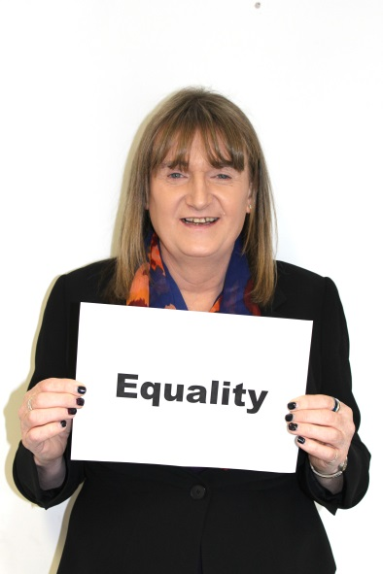
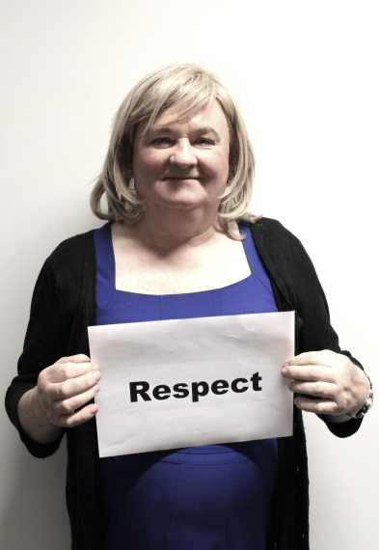

There are more of us than you think!
An estimated 1% of the population will experience some form of gender variance
In an Irish context, this means
45,882 people
Intersex conditions appear in approx. 3 in every 200 births so this would equate to about
75,000 Intersex people in Ireland
Notes:
You may think you don’t know anyone who is transgender or that has an intersex condition – you probably do but they may not have publicly disclosed they are transgender or have an intersex condition.

Slide 11
Transition
The process through which some trans people begin to outwardly live as the gender with which they identify, rather than the one assigned at birth.
Transition might include social, physical or legal changes such as:
  Coming out to family, friends, school, etc.
  Changing physical appearance.
  Changing name, pronoun and sex designation on legal documents.
  Medical assistance (e.g. through hormones or surgery).

Slide 12
What Do You Think Is The Best Way To Support a Social Transition In School?

Slide 13
Supporting a Trans Student and Their Family
If a student discloses it is important to listen, be respectful and don’t panic.
Ask the student what they would like to do. They might not be ready do anything about this immediately.
If they are ready to make a social transition then try and arrange a meeting with the family to discuss how they would like to proceed and what a transition plan might look like.
Remember that parents may be emotional and unsure, they may be experiencing a sense of grief and loss. They may not be ready to accept yet. Compromises might need to be reached.

Slide 14
Transition Plan
Important that the student and staff have a realistic expectation of what this might look like
Name and Pronoun
Uniforms
Bathrooms
PE and changing facilities
Notes:
Transition plans require addressing practical elements – some of which may be difficult depending on individual school policy. Bathrooms and changing facilities can be tricky, as this is not always about policy or law but more about inclusion and acceptance from the other students and may need a bit of delicate negotiation initially. Sometimes the use of the wheelchair accessible toilet may be required at least initially, but as the student becomes more confident and their gender identity is less of an issue with the wider student body, in my experience they will often use the bathroom that matches their gender identity without incident. It is important to note that the accommodations should be used with the intention of inclusion rather than further ’othering’ or excluding the student.

Slide 15
Medical Interventions
Not all trans people embark on medical interventions
School is supporting a social transition only
Not the role of the school to ascertain if this is a phase or not
Notes:
Medical interventions occupy a lot of the media representation of trans people but not all will embark on any and some will engage with only some interventions. If a school looks for a ‘diagnosis’ by way of verifying that this is a ‘real’ thing, they may be encouraging a young person to engage in medical interventions that they may not need at this time or ever.
The school is simply providing pastoral type support and care for a student who needs particular supports at this time in their life, such as accommodations around a name and pronoun, uniforms or bathroom use etc. These supports are provided as a way of enabling this student to remain in the school system.

Slide 16
Informing other Students
Primary objective is to protect the student from bullying and intrusive questions
The transgender student should be consulted prior to speaking with their peers
The transgender student should never be responsible for educating the other students about what it means to be transgender
Notes:
Recent trends would indicate that by the time a student makes a social transition many of the wider student body may already be aware of the students new name and pronoun, sometimes the student may feel it is unnecessary for their class to be informed, however, this is not always the case and it very much depends on the level of social capital the student has within the wider student body. It is important that staff are informed and given clear instructions about what is happening so that they don’t feel ‘caught out’ if a vexing student in the class asks ‘well who is Jack anyway/’ If teachers are not confident and feel unsupported they are reluctant to provide support to the trans student and this can be very damaging for them.

Slide 17
Where do we start? What do we say?
You will not be explaining what gender diversity is
You will be outlining what changes the other students may observe
You will be looking for support from them
You will be setting out what behaviour is and is not acceptable
Notes:
If students are to be informed it is generally the trans’ students core class or group, it is usually done by a member of staff – sometimes the year head, school counsellor or whoever might feel confident to do it. It is not meant to be an education about what being trans is but more about what changes the student will observe in their fellow student, e.g. name, pronoun, uniform, bathroom etc. We provide a sample dialogue so that the teacher know where to start the conversation, the whole thing takes about 10 mins.

Slide 18
How can we prevent Bullying?
Ensure that students know that it is rude to ask anyone about surgery or hormones
Acknowledge that a change of name and pronoun will be challenging for everyone, but repeated and purposeful mis-pronouning and using the birth name will be deemed bullying
Is there a teacher (or two) who can be approached with any questions that students might have?

Slide 19
Effect of puberty
Female identified developing in a male form: facial hair, voice, muscle, bone structure etc.
Male identified developing in a female form: breasts, menstruation, voice etc.
Brings huge psychological stress, risk of self harm/suicide is much higher in gender incongruent people
Additional stressors: bullying, family rejection
Notes:
Can be very stressful for all concerned, trans males may be binding their chests and experiencing a lot of distress around menstruation, trans females often avoid speaking too much for fear that their voice might break, many limit their intake of food in an attempt to control their body shape.

Slide 20
Common Issues
Co-occurring mental health issues
Self harm often plays a significant part
Heightened risk of suicidality (Mayock et al. 2009, Mc Neill et al 2013)
Over a quarter of those who identified as Transgender indicated that they had attempted suicide at least once (Mayock et al. 2009, Mc Neill et al, 2013)
Notes:
It is not uncommon for adolescents from our wider community to engage in self-harm but the rates of self-harm within the trans community is especially high, and social anxiety plays a significant role and can be extremely debilitating.

Slide 21
Is it something that the school must act on?
Yes !
Protected by Equal Status Acts 2000-2015
Protected by Employment and Equality Acts 1998-2015
Protected on both the gender and disability ground
Notes:
If a student and their family want to progress with a social transition the school cannot legally ignore this, trans students are protected on two of the nine grounds of the Equality Acts 2000-2015

Slide 22
What is the Gender Ground?
Established by the Court of Justice of the EU
A person cannot be subject to less favourable treatment because of their gender identity than someone who is not transgender

Slide 23
What is the Disability Ground?
In this context includes a range of physical and psychological conditions
Gender dysphoria is a recognised medical condition
Obligation for service provider to provide reasonable accommodations
Not the function of the school to ascertain whether or not the student is transgender

Slide 24
Gender Recognition Legislation
The Gender Recognition Certificate (GRC) can be used to obtain a new birth certificate
People who have a GRC have a new legal gender status ‘for all purposes’
It is not necessary to have had any medical treatment to be granted a GRC if over 18
16 & 17 year olds can obtain a GRC with the support of their parents
Under 16s are not recognised in the Act
Notes:
Whilst the Gender Recognition Act is rather good here in Ireland, remember that it is merely a piece of paper and does not always afford a trans student social acceptance. If a school is refusing the student to take part in activities or use facilities congruent with their gender identity – this can sometimes force a family to embark on changing their child’s birth certificate in order to obtain these rights but that does not always solve the problem of social acceptance and inclusion, so it is important to remember that this is about support rather than policy or legislation.

Slide 25
Frequently asked Questions
Is it necessary to inform the entire school?
Is it not more advisable to move to a co-educational school?
What about overnight trips?
What if the parents are divorced or separated and not in agreement?
What supports will be needed for non-binary students?
Is a Deed Poll necessary to facilitate a name change?
Notes:
Not necessary to inform the whole school, having a discussion about a student in this way (although necessary) can leave the student and their family feeling extremely vulnerable.
Moving school can be very stressful and difficult, as can making a social transition, doing the two together seldom works well, some students will make their transition and then move on after a year or so to a co-ed, but it depends on their age and individual circumstances.
If parents are not in agreement, as per usual educational policy, the parent with the most responsibility for the child’s education has the most say, but it is still important to try and get both parents on board if at all possible.
Non-binary students may need different types of supports such as neutral pronouns but not all so it is important to clarify what is needed with the student.
Deed Poll is not necessary to change the name, schools can change the name by manipulating the VS-Ware on their local system. A Deed Poll is required to change the official name within the Dept, Education on the P-POD system. The preferred name can be used when the school is applying for the student to sit the leaving cert but it is also very simple to change the name on an existing leaving cert even several years later by making a special case to the State Examinations Commission.

Slide 26
Frequently asked Questions
How can we support the siblings of a transgender student?
What if a parent of another student makes a complaint?
Does the school have a duty to inform the parents of other students if it is not widely known that a student is transgender?
Notes:
Siblings very often get forgotten so it may be necessary to ask how they feel and if they are ready for this social transition, they may be asked a lot of questions that they are not comfortable answering, their class or peer group may need to be informed about what is going on also.
If the parent of another student makes a complaint it is important to stress that this is not about the school encouraging transgender identities, the school is merely providing pastoral type support and care for a student who needs it at this particular time in their life. Do not engage in conversations about medical interventions.
The school cannot inform anyone without the explicit permission of the student in question, many students do not disclose their trans status publically and may have come from a different school/town/country.
School trips and sleepovers can often be tricky but it is important to have respectful conversations with both the student and their family before assuming that someone needs to know that they are transgender.

Slide 27


Slide 28
How to contact us
Hannah Solley, Family Support & Education Officer
087 063 7933
hannah@teni.ie
office@teni.ie

