Slide 1

Towards Finalising a Patron’s Framework for ETB Schools
Séamus Conboy & Aisling Kirwan, ETBI
Dr Orla McCormack & Dr Joanne O’Flaherty, University of Limerick

Slide 2
Question & Comments Wall

Slide 3
Aims of the Presentation
The aims of today’s presentation are to:
Recap on the rationale for a Patron's Framework and the journey so far
Outline understandings of the core values identified in the review
Provide an opportunity to apply these values to your own school context
Outline next steps

Slide 4
Rationale for the Patron's Framework
Education Act (1998) - Identified ETBs as Patrons – requirement for Patrons to define its characteristic spirit
Increased calls from the sector and others for clarity
Circulars on religion in ETB schools (13/18 and 62/18)
Admissions Act (2018)

Slide 5
What has happened so far?
John Marcus O'Sullivan Conferences
UL Research
Core Values Review

Slide 6
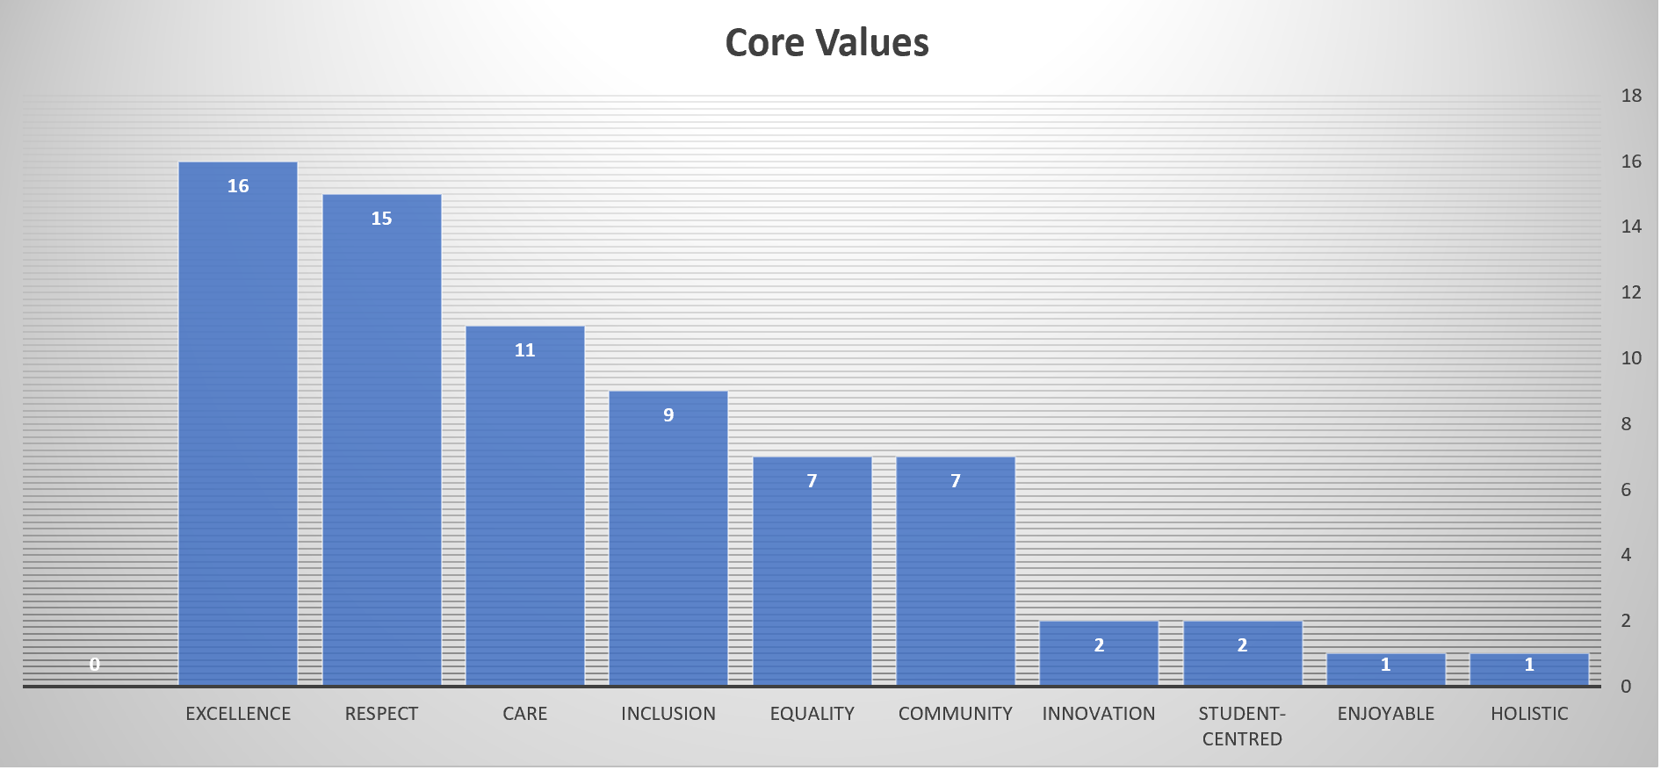
Core Values Identified

Slide 7


Which of the following values are already present in your school?
Go to Menti.com and put in the following code
55 64 42

Slide 8
Ethos/Characteristic spirit - Bottom-Up or Top-Down?
The Education Act (1998) gives significant governance responsibilities to patrons, particularly in relation to characteristic spirit
Boards of Management are accountable to the Patron for upholding the Characteristic Spirit
Irish Education System has a paternalistic and custodial vision of ethos where patron act as the guarantor of values in their schools (Norman, 2003)
However, many theorists argue for a more organic ‘bottom-up’ approach to values which emerge from social interaction and processes(Donnelly, 2000)

Slide 9
The Patron's Framework - a Top-Down or Bottom-Up Endeavour?
Patrons’ Days – Discussing a sectoral position on key questions e.g. the place of Religions and Beliefs in Non-Designated ETB Schools
Feedback
from Principals’ Forum
Translating the Patrons’ Framework into local contexts
Liaising with Irish Episcopal Conference about Religious Education and Ethos in Designated Community
Colleges
Bottom Up
Presentation at P&DP Conference 2019 – Feedback
ETBI will provide CPD to enable school leaders and teachers to engage with the school community on values in action
Top Down
Development of Patrons’ Framework
Core Values Review – 2 workshops across all ETBs with Ps and DPs
UL Research – Engaged with principals, teachers and students

Slide 10
Tensions between Policy and Practice
Widely argued that there can be significant inconsistencies between official policies on values and practices in schools
Imperative to ensure that the values espoused in mission and vision statements are evident across the whole school
A Whole-School approach is necessary for values to have a meaningful impact

Slide 11
Which of the following values are already present in your school?
Go to Menti.com and put in the following code
55 64 42

Slide 12
Methodology
Systematic reviews provide a comprehensive up-to-date compilation of literature relevant to a particular research topic (Corcoran, O’Flaherty, Xie & Cheung, 2019; O’Flaherty & Beal, 2018; O’Flaherty & Liddy, 2017).
    Part 1: A review of literature relating to the five core values
    Part 2: A review of Irish legislation, circulars, policies and curricula
    Part 3: A review of the literature regarding suitable terms the sector could consider in describing its pluralist approach.

Slide 13
Part 1: A review of literature relating to the five core values
Electronic Database Searches
(n= 3,994 records)
Identification
922 articles screened for inclusion
Screening and Eligibility
128 full-text articles included for analysis
Included
Notes:
Electronic Database searches: Science Direct, JSTOR, ERIC, EBSCO, Psych INFO, and Dissertation Abstracts
(n = 3,994 records)
Records after duplicates removed
(n = 3,605)
Titles/Abstracts screened
(n = 3,605)
Full-text articles assessed for eligibility (n = 924)
Excluded (n = 3,320) not relevant population, higher education institutions, special needs population, books
Excluded (n = 43) full text article not available – authors contacted (n = 753) full text assessed and not relevant
Full-text articles assessed and included looking at core values in education (n = 128)

Slide 14
Part 2: A review of Irish legislation, policies, circulars and curricula
Focus | Number reviewed
Active circulars | 179
Archived circulars | 249
Policies | 49
Legislation | 39
Specifications/curriculum | 100
Total | 616

Slide 15
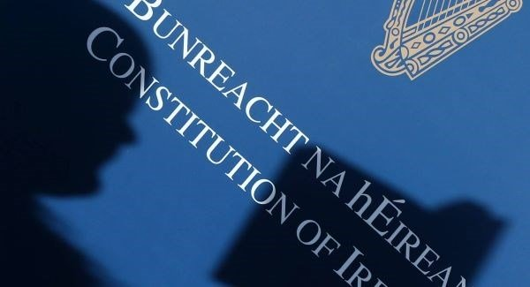
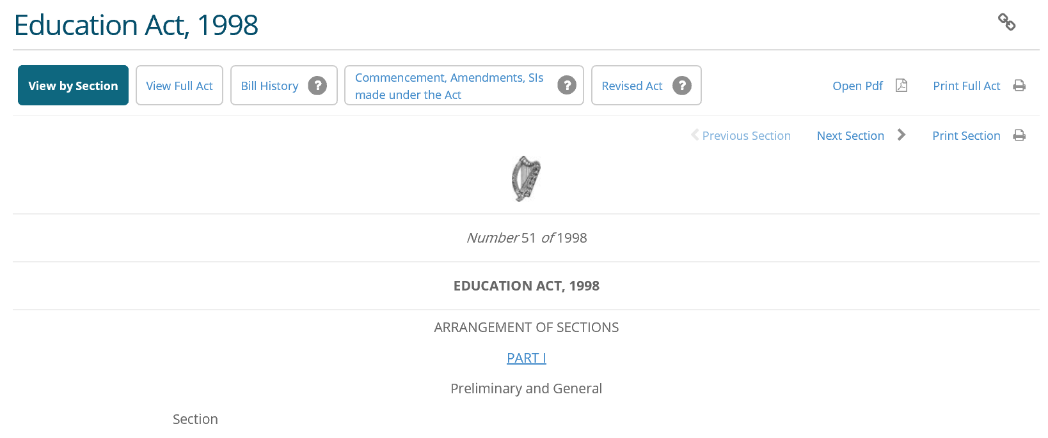
Place of (Core) Values
Notes:
Education (Admissions to schools Act) 2018
Equal Status Act
Values
Active circulars (n=179)
12
(7%)
Archived circulars (n=249)
4(2%)
Legislation (n=39)
5 (13%)
Policies
(n=49)
19
(39%)
Curriculum specification
(n= 100)
50
(50%)
Total
91

Slide 16
Core Value | Part 1: Research literature (n=128) | Part 2: Legislation, circulars, Curriculum, Policies (n= 616)
Community | 11 | 176
Equality | 55 | 112
Respect | 18 | 82
Care | 9 | 78
(Academic) Excellence in Education | 35 | 54
Notes:
Some conclusions we can draw from this

Slide 17


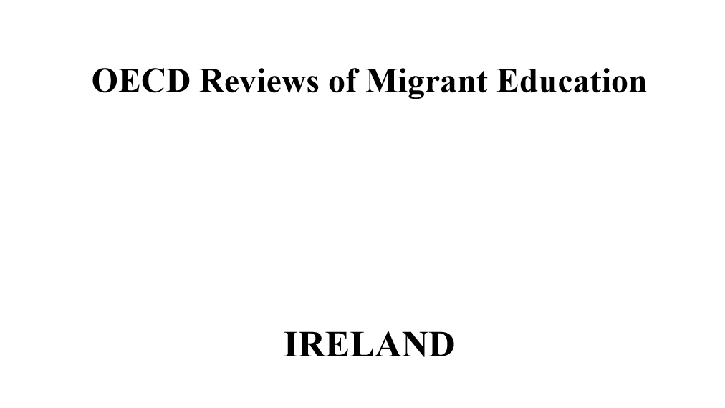
(Academic) Excellence in Education
Understandings of (Academic) Excellence in Education
Student Outcomes
Ways of supporting academic achievement
Monitoring academic achievement
Preventing selection/comparison based on academic achievement
Notes:
Wellbeing policy,
OECD Thematic review of migrant education – country report for Ireland
Literacy and numeracy for life
DEIS plan 2017
Supporting academic achievement (0010/2013’ 20/98; 11/95; M29/95; M02/95; Youth Work Act 1997; 2001; Education Act 1998)
Monitoring academic achievement/standards (0056/2011; 0077/2007; 0075/2008
Preventing selection/comparisons based on academic achievement (M51/93; student support act 2000; Education Miscellaneous Provisions Act 2015; Admissions to Schools Act 2018; Education Act 1998)
Posts of responsibility/academic role: 06/97; P17/00; P07/03
Relationship between physical fitness/health and academic achievement (0013/2016; 0051/2015
SEN students: mixed ability teaching/academic ability: sped24/03; SPED02/05

Slide 18
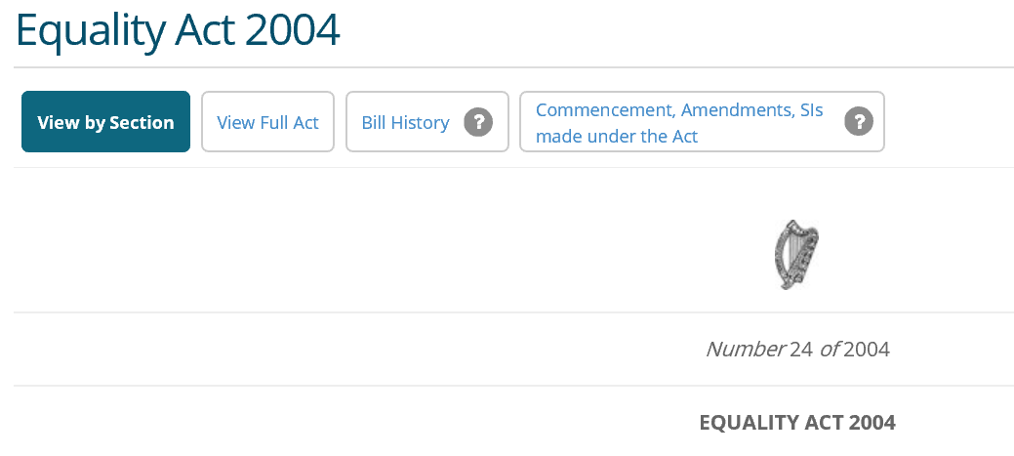
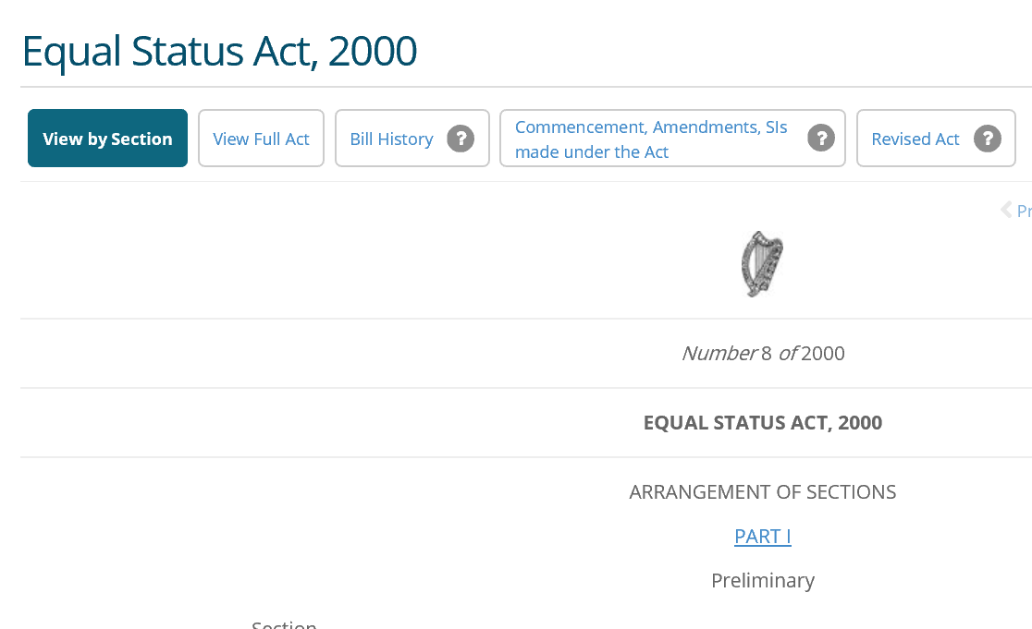
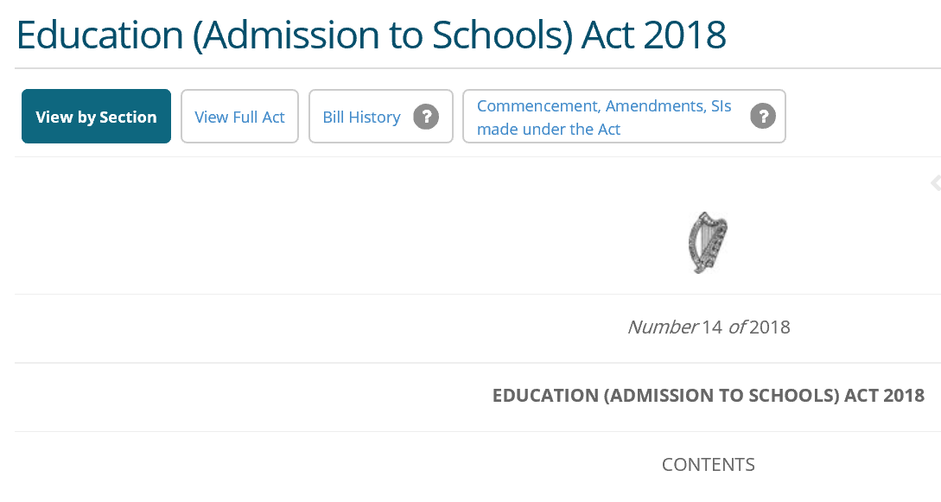
Equality
Understandings of Equality
From the perspective of achievement gaps and diversity of student population (research)
Emphasis placed on equality of opportunity (DEIS programme)
Versus Equality of access, equality of participation and equality of treatment
Equality in votes of board/representation etc
Gender equality
Equality Legislation

Slide 19

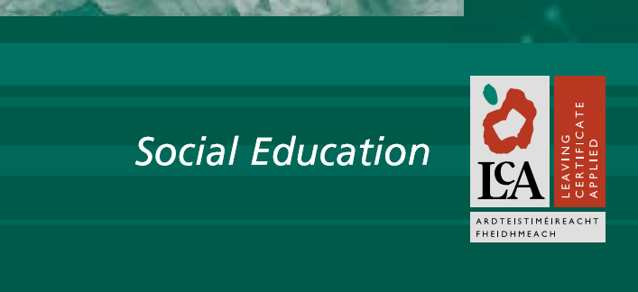

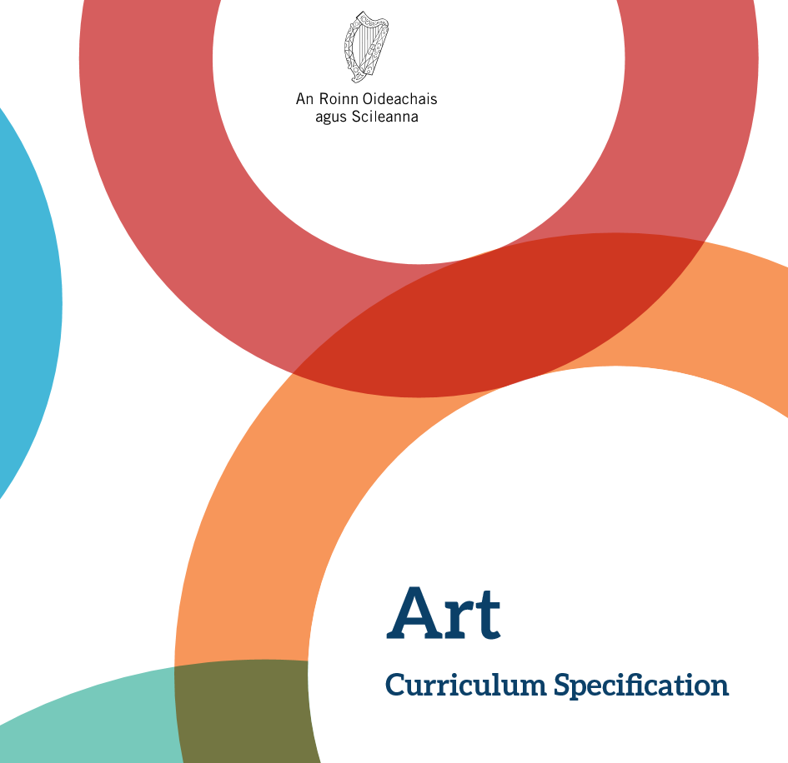
Respect
Understandings of Respect
Respect for others
Respect for oneself
Mutual respect
Respecting the school characteristic spirit/culture
Respect for difference & diversity
Respect for environment
Notes:
PE, Politics and Society, RE,
(nCur (n18 articles focusing on respect; Overlapped with equality (11 articles focused on both)
How respect can be taught in schools; often from a curriculum perspective
Respect
Active circulars (n=179)
6
(3%)
Archived circulars (n=249)
8
(3%)
Legislation (n=39)
3
(8%)
Policies
(n=49)
16
(33%)
Curriculum specification
(n= 100)
49
(49%)
Total
82

Slide 20
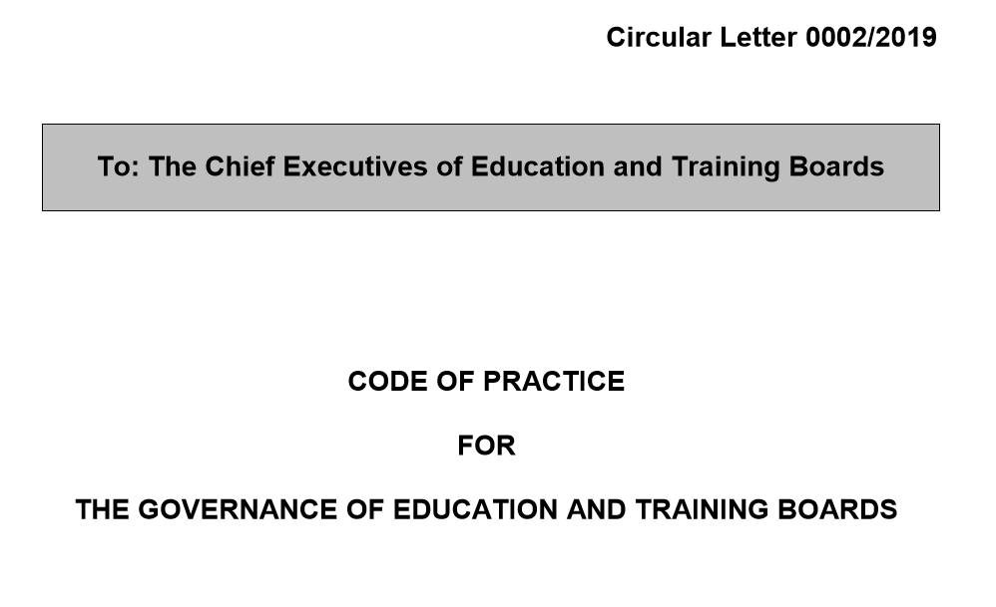

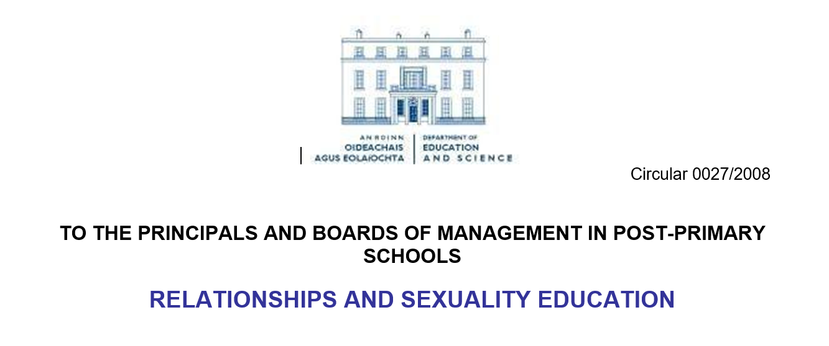
Care
Understandings of Care
Intertwined with other values (research literature)
Care for child/ Duty of care to the child
Care in duties of the board
Care needs/supports/teams
Pastoral care
Whole school approach
Notes:
Least well evident in general

Slide 21
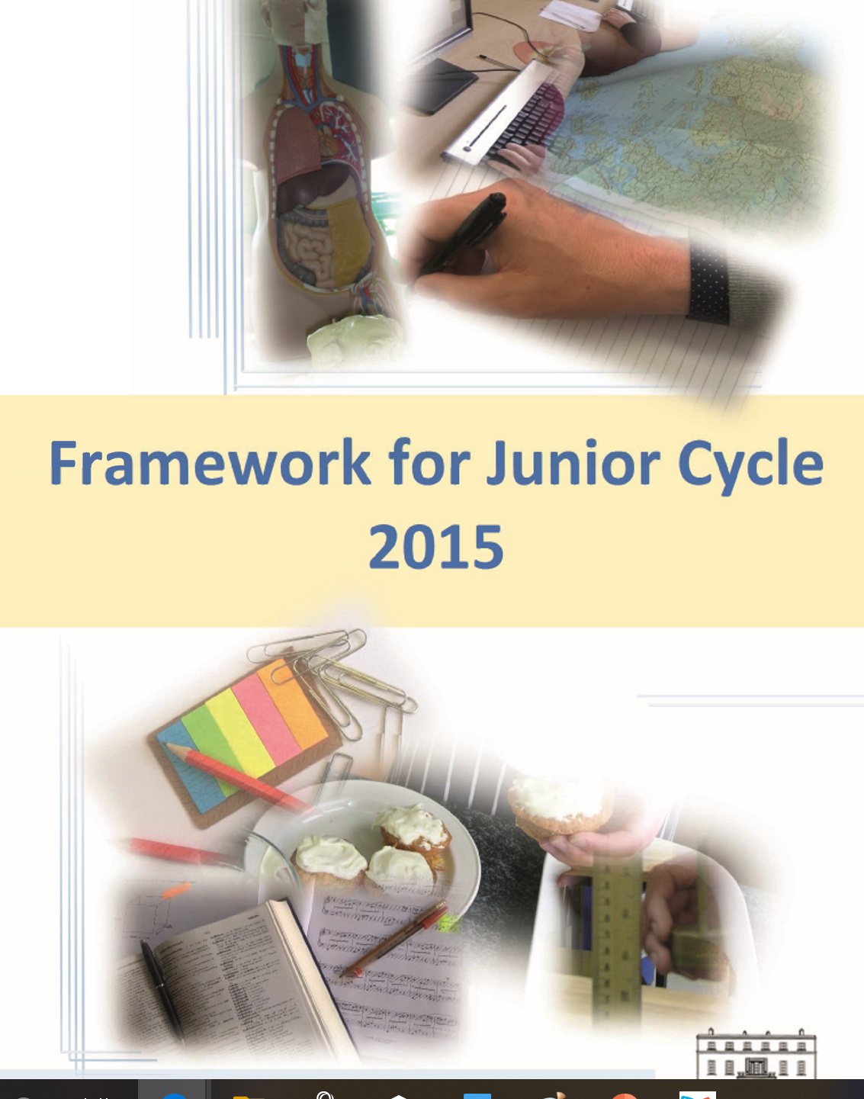


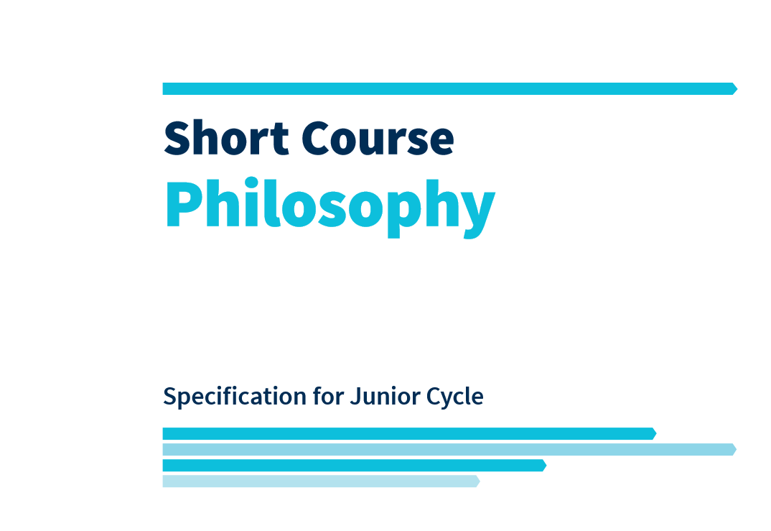
Community
Understandings of community
How the community can support student outcomes (research literature)
Consulting and communicating with community
Membership of board
Specific communities
Community as a learning resource
Notes:
Philosophy, music, RE, CSPE
Consult with/communicate with school community (0061/2019’ 0002/2019; 0043/2018; 0038/2018; 0080/2017; 0059/2017; 0034/2017; 0033/2017; 0032/2017; 0009/2017; 0056/2011; 18/02; F11/05; 0058/2013; 0018/2015; 0034/2011; 0016/2014; 0067/2017; 0039/2012; 0040/2012; Education and Training Act 1999; Education Act 1998;)
Membership of boards (0057/2019; 0064/2011; Education and Training Act 1999’ Vocation Education (Amendment) Act 2001; ETB Acts 2013
Travelling Community (0051/2019; 0002/2019; 0018/2015; 0023/2016; (Youth Work Act 1997; 2001; Admissions to Schools Act; equality Act 2004)
Awareness of/in community/school-community links: 0016/2019; 0050/2018; 0048/2018; 0003/2018; 0027/2012 0025/2012; 0056/2011; M18/15’ PRIM16/05; 18/02; M01/00; M18/99; M51/93; M33/91/ P20/90; 0058/2013’ 0063/2017; 0070/2018
Ethos as a sense of community: M33/91/ P20/90
School as community: 0038/2018; 0003/2018; 0034/2017; 0013/2016; 0051/2015; 0030/2014; 0010/2013; 0056/2011; M33/91
Support and educate community: 0016/2019; 0009/2012; 0058/2013
Partnership (0016/2019; 0058/2013)
Involve community in school/T&L/as a resource: PPT 12/05; 0058/2013; number of curriculum and policies to go here
HSCL: 0058/2013; 0001/2016; 0002/2016; 0012/2017; 0009/20180
Irish language community (Education Act)

Slide 22
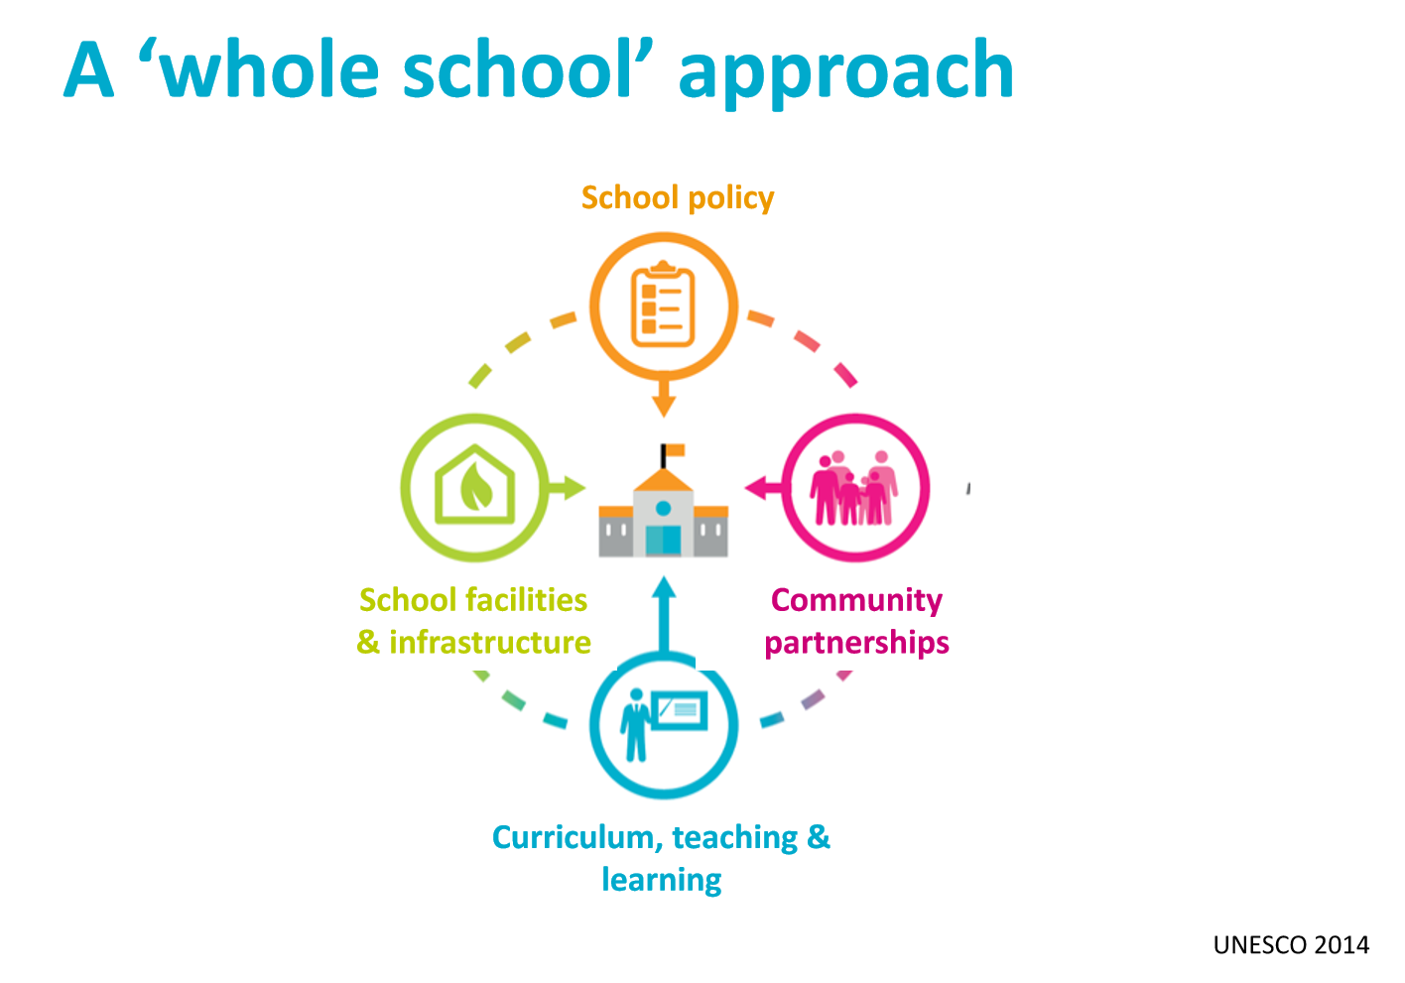
Task 1
Each table will be allocated one ‘Core Value’
Using the UNESCO Whole School Approach Framework consider how this core value is/can be lived out within school life?
Identify other aspects of school life within which this core value needs to be considered?

Slide 23
Aspect of Framework | Description
Curriculum, teaching and learning | Pedagogical approaches; approaches to assessment; skills, attitudes; content taught/not taught; participation of students……
School policy | Leadership, admissions policy, discipline policy, bullying policy……
School facilities and infrastructure | School buildings; use of school facilities; allocation of resources; outside space; transport….. Timetabling; Student Council……..
Community partnerships and relationships | Interaction and integration with local community; involvement of parents; school celebrations cooperation with local partners…….

Slide 24
Value | Table number(s)
Community | 1 – 7
Respect | 8 – 15
Equality | 16 – 22
Care | 23 – 29
Academic Excellence | 30 – 36

Slide 25


Slide 26
Part 3: A review of the literature regarding suitable terms the sector could consider in describing its pluralist approach.
Search Term (s) | Number of articles | Articles Screened
Secular | 11 | 11
Pluralism / Pluralist / Plural | 13 | 13
Non-denominational / nondenominational | 3 | 3
Progressive pluralism | 0 | 0
Multi-denominational / multi-denominational | 0 | 0
Non-secular / nonsecular | 0 | 0

Slide 27
‘Definitions’ of ‘secular’
“ …. the separation of religion and state and promotes secularism as the best means to create a society in which people of all religions or none can live together fairly and cohesively” (The National Secular Society http://www.secularism.org.uk)
“secularism—deﬁned as a commitment to doctrinal non-establishment and, thus, the survival of multiple interpretations of faith (what some have chosen to call “toleration” or a commitment to doctrinal “relativism” (Nelson, 2011)
Notes:
Pros and Cons ….
The demand for stronger faith/secular partnerships and commitments.
secularism alone can safeguard the public freedom of religious belief
schools should be encouraged to provide a modern religious education in ways that illuminate what might be described as the mutually constitutive relationship between “the development of religious ideas and the rise of the modern secular state” (Andreescu, 2011)
‘secular schools that ‘maintain a deafening silence about spiritual or antimaterialist values’ (Brighouse, 2005, p. 85).
The lack of stillness is recognised as a deficit in the avidly secular educational systems of the US: “Silence, stillness, and solitude have been almost eliminated from the lives of children and from U.S. culture in general.” (Kessler 2000, 37). A position supported by Williams (2003) – who notes that the loss of stillness is damaging.
“In this [secular] sector religious and heritage education is characterized by its secular ideological roots. Students are taught about religion, the history of religion, religion as a part of culture, and religious tradition and folklore from the spiritual and humanistic point of view” (Katz, 2017).
Other definitions:
‘...promote and establish a secular society; promote the provision of secular education; promote, provide and develop Humanist ceremonies; extend the contributions made by Humanists to a wide range of social, civic and health care provision … ‘ (Humanist Society Scotland http://www.humanismscotland.org.uk )
“Secularism is a way of thinking that appreciates the need for change, relativism, and thus tolerance. It also involves a true legal contract that gives people the “right to control and manage their own social and political life according to their will, through social consensus in a civil society” (Andreescu, 2011).
“”secularisation, ‘believing without belonging”’ (Davie 1994)
“an enduring presence of theology within modern secular culture,” theology meaning “speculative engagement with an abstract notion of transcendent divinity, not faith or a religious belief in any simple sense” (Wexler, 2011).
“We agree that more thoughtful consideration of religion in education is much needed and that it must be grounded in a deep respect both for the essence of secular values and of the human quest for religious understanding, not to speak of religious identities. We also see a paramount role for the dimensions of secularism that demand protection of religious freedom and of religious minorities” (Marshall, 2011) .
Education needs to “begin with an acknowledgment of the ways in which religion, secularity, and especially the ﬂux within them already overlap” (Nelson, 2011).

Slide 28
Definitions of ‘pluralism’
“liberal goals are achieved not by banishing religion from the public realm but by supporting religious pluralism in the public realm.” Thus we have a chance to rethink education, “not as transmission or reproduction, but as a creative force” (Wexler, 2011).
Pluralism, therefore, brings us face to face with (1) the issue of value diversity, (2) the conflict between different values, or between different perspectives, or cases of diverse realization of the same value and (3) the challenge of understanding and finding a solution (Alvarez, 2009, 127).
Notes:
Pros … Cons …
Indeed, pluralism itself is not possible without agreement on values such as justice, honesty, civility, democratic process, and a respect for truth. (Lickona, 1991, p. 20)
Conyer (2009, p. 164)) argues that if teachers are to ‘effectively implement pluralistic education practices, they must first have a clear theory of what is a pluralistic education (McFarland 1999; Sleeter and Grant 2003; Banks 2005)’.
Conyer (2009) explores how teachers understand and enact pluralism as a core value within the context of Jewish Community Schools ‘and the pedagogical implications of their understandings’ (p. 160). Interestingly two of his four case-study teachers (all of whom are affiliated with carious Jewish denominations – conservation, orthodox, ultra orthodx) suggest that ‘their primary reason for affiliating with a denomination is to be part of its community, not because of its beliefs’ (Shaul and David p. 162).
giving pupils opportunities to learn about other religions and beliefs, and to celebrate other religious festivals in schools.
“In a pluralistic world where education is part of life and culture and is relevant for politics, concepts of family and community, literature and history, knowledge about religions is not an option; it is essential. The question is how that knowledge can be part of education in ways that are respectful and thoughtful” (Marshall, 2011).
Other definitions
“‘respecting the otherness of others” (Faas, Darmody & Sokolowska, 2016)
religious toleration regarding the diversity of religious belief systems co-existing in society (Beneke 2007)
“Pluralism is an ambiguous term that is easily applied to almost any field. At a philosophical level, it usually refers to a rejection of monism (Watson 1990). At a sociological level, it often refers to an ideology that responds in some way to ethno-cultural diversity, such as cultural pluralism (Kallen 1924). At a religious level, it acknowledges diversity between and within religious traditions (Veverka 2004; Hartman 2001). For educators, it most often refers to the social, economic, racial, cultural, religious, and linguistic diversity of every student, and the challenges that that diversity raises (Sleeter and Grant 2003; Gollnick and Chinn 2002)” (Conyer, 2009, 159) .

Slide 29
Definitions of ‘non-denominational’
non-denominational system is one that accommodates "the changing
nature of society" (Brown, 1993).
“not restricted to a particular religious denomination”
“open or acceptable to people of any Christian denomination”
Notes:
Pros … Cons …
Interface with the beliefs and values of school personnel/staff or parents/guardians
Confusion as to ‘acts of worship’ (Younger, 2018).
“If society is becoming more diverse and pluralistic, it is difficult to see how a non-denominational system better accommodates, this diversity. First, it, by definition, eliminates the diversity of the denominations by homogenizing the system. Second, it can only accommodate the diversity of other beliefs and religious convictions by ceasing to be a system based on the Christian tradition. That is, this system would, as it tried to accommodate diversity, retreat further and further from the Christian culture (Brown, 1993, p. 81).

Slide 30
Definitions of ‘inter-denominational’
“A school under the patronage or trusteeship of more than one religious faith community. Such a school provides for a variety of religious education opportunities” (DES, 2019 www.education.ie ).

Slide 31
Definitions of ‘multi-denominational’
All students are given equal opportunities for enrolment in line with the Admissions to School Act (2018). In all aspects of school life all members of our school communities are treated equitably regardless of their race, gender, religion/belief, age, family status, civil status, membership of the Traveller community, sexual orientation or ability. Multidenominational schools promote a fully inclusive education that recognises the plurality of identities, beliefs and values held by students, parents and staff (CNS Interim Patrons Framework).
Students of all religions and beliefs are treated equally. The school environment acknowledges and facilitates students of all religions and beliefs and does not privilege any particular group over another. Religious Education caters for students of all religious and non-religious beliefs (CNS Interim Patrons Framework).
Notes:
- a growing demand for these schools, as the proportion of the population who do not belong to the Catholic faith has increased (Hyland, 1989)

Slide 32
Definitions of Denominational
Denominational schools provide religious education according to traditions, practices and beliefs of the specified religious community (DES, 2019 www.education.ie)
In denominational schools celebrations for school events are based on one particular religion. Religious education is delivered through a particular lens. Symbols and images displayed are from one particular belief system. (O’Higgins Norman, 2003; McCormack O’Flaherty et al, 2016)

Slide 33
Interesting observations thus far ….
Across much of the literature reviewed, when discussing various ‘state education’ sectors authors describe them as secular (US, England, Turkey, Israel etc.)
Scottish public schools are referred to as denominational or non-denominational throughout the literature
DES describes schools as ‘multi-denominational’ or ‘inter-denominational’
An Foras Pátrúnachta offers a choice of three ethos’s to parents: and describes these as Catholic characteristic spirit; Interdenominational characteristic spirit and Multi-denominational characteristic spirit …

Slide 34
Prompts for consideration …
How schools can prepare citizens to live and thrive in communities that respect religious diversity and understand religion and what religion has to do with the fundamental challenge of integrating worthy core values into educational curricula.
Impact on curricula (for example a ‘secularized curricula’, pedagogy, structures, strategies etc.
Role and position of Religious Education … promotion of ‘religious literacy’…
Scope of schools to broaden the range of partners who support Religious and Moral Education to give children and young people broader insights into the range of religious and secular beliefs which are part of our society.
Children in early school settings often engage in learning which encourages them to share beliefs and family traditions.
Religious Education is often central to the life and work of the school as a community.
Education Scotland (2014); Marshall (2011)
Notes:
Offering children and young people opportunities to develop their own beliefs and values through learning about a range of religions and other beliefs.
Children and young people increasingly engage in learning about religions and beliefs relevant to their local community
RE as offered in Scotland is unique because two distinct and separate curricula are offered: one with a ‘secular’ and neo-confessional slant for non-denominational schools called ‘RME’ and the other with a neo-confessional slant but typically faith based by its intention for Catholic schools called ‘RE’ (Rodger 2003). All other faith-based schools follow the non-denominational curriculum (Matemba 2011; Grant & Matemba, 2013).
Coates (2011) notes the key positionality of parents as supporting the development of curriculum and resources of Jewish Montessori schools.
Interesting point:
Across much of the literature reviewed authors when discussing various ‘state education’ sectors describe them as secular (US, UK, Turkey, Israel etc.)
Scottish public schools are referred to as denominational or non-denominational in the literature
DES describes schools as ‘multi-denominational’ or ‘inter-denominational’
An Foras Pátrúnachta is the only Patron body to offer a choice of three ethos’s to parents: Catholic, Multidenominational & Interdenominational and describes these as Catholic characteristic spirit; Interdenominational characteristic spirit and Multi-denominational characteristic spirit

Slide 35
Designated or Non-Designated?
A designated school is where the management of the school is governed by a specific agreement (Model Agreement) between the ETB and a ‘Trustee Partner’ – the local diocese and/or a religious congregation or other recognised school patron. As well as giving the ‘Trustee Partner’ a role in the management of the school the Model Agreement gives the ‘Trustee Partner’ a role in determining the school’s characteristic spirit. While Model Agreement (Designated) Colleges involve a ‘Trustee Partner’, the ETB is the patron. (ETBI, 2015 p.6-7)
A non-designated school is under the sole patronage and management of the ETB.

Slide 36

Task 2
With these definitions in mind please log on to www.tinyurl.com/corevalues2020 and complete the survey on where you schools are now and where you think they should be.

Slide 37

Next Steps – Pilot Project – Rolling out the Framework
Rolling out in 2020/21 academic year
Action Research Model
School teams of 3-4 to include one member of SMT
One 2 day conference to facilitate development of school action plan (Nov 2020)
Clusters of schools collaborating, reflecting, sharing learning throughout the year
Cluster support days (Feb/March 2021)
Minimum of 2 hours Croke Park ringfenced for whole school implementation

Slide 38

The Big Question???
Review of your schools characteristic spirit using the Core Values Framework
Affirming good practices in your school
Individualised school support from the CNS and Patronage Directorate in ETBI
Building leadership capacity in your staff
Teacher Professional Learning in line with Teaching Council Cosán Framework
Positive publicity and recognition supported locally and across national platforms in relation to the work being undertaken in your school
Accreditation for your school on completion of the programme
Application forms will be in schools in May – limited spaces

Slide 39
Contact Details
Orla.McCormack - Orla.McCormack@ul.ie
Joanne.O'Flaherty - Joanne.OFlaherty@ul.ie
Séamus Conboy - seamus.conboy@etbi.ie
Aisling Kirwan - aisling.kirwan@etbi.ie

