Slide 1

Cosán – The National Framework for Teachers’ Learning
Tomás Ó Ruairc, Carmel Kearns and Barry Kenny
ETBI Principals and Deputy Principals Conference
Wexford
29 January 2020

Slide 2
Outline
11.20 – 11.40 Bringing Our Learning Home
11.40 – 12.00 Cosán and the Development Process
12.00 – 12.20 Group activity 1 and feedback
12:20 – 12:40 Developing reflective cultures
12.40 – 12.55 Group activity 2 and feedback
12.55 – 1.00 Next steps and conclusion
Notes:
Explain timings and roles:
Barry will act as facillitator for both group activities
We’ll use Mentimeter to keep a record.
We will take some oral feedback but unfortunately due to time this may be only 2-3 groups per task – but we’ll have all of your responses on Mentimeter.

Slide 3
Making the implicit Explicit:
Bringing our Learning Home
Tomás Ó Ruairc, Director, The Teaching Council ETBI Principals and Deputy Principals Conference
29 January 2020

Slide 4
Cosán – The National Framework for Teachers’ Learning
Carmel Kearns
Head of Teachers’ Learning and Research
The Teaching Council
ETBI Principals and Deputy Principals Conference
29 January 2020

Slide 5
Cosán: Three Key Points
Your Professional Learning
Flexibility
Collaborative Reflection
Notes:
Your Professional Learning: Cosán recognises that teachers continue to develop professionally in their contexts throughout their careers
Flexibility: Cosán is a flexible framework which recognises the many ways in which teachers learn
Collaborative Reflection: Collaborative, meaningful reflection can enhance teachers’ professional learning, in turn enhancing students’ learning

Slide 6
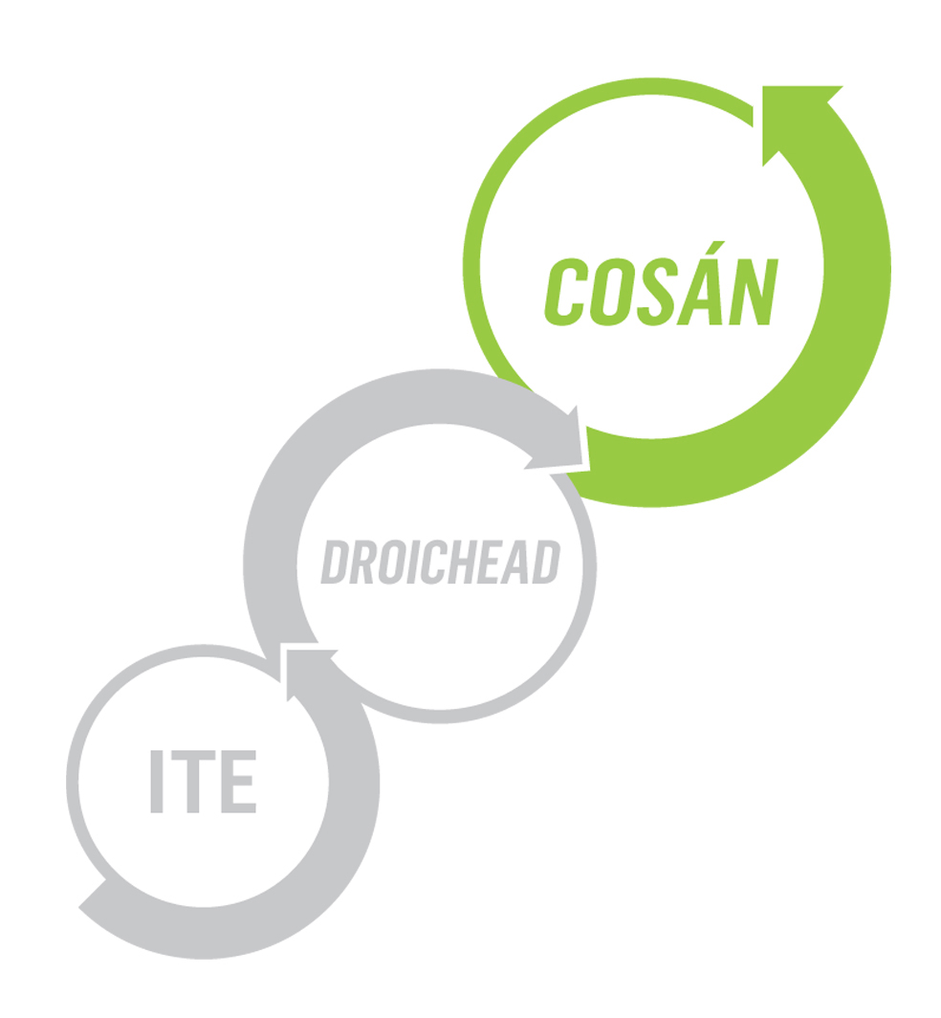
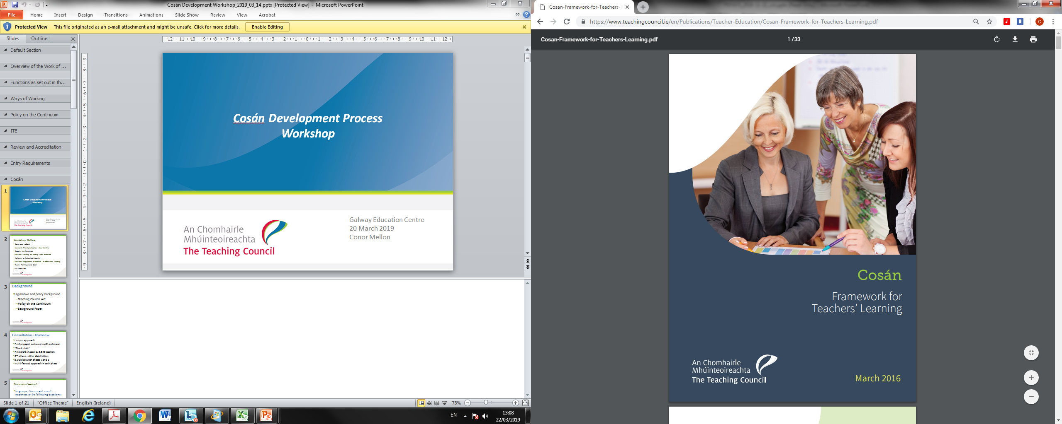
Overview of Cosán
Cosán – pathway
Flexible framework for teachers’ learning
Developed following extensive literature review and consultation
Recognises & values the variety of learning processes that teachers engage in
Sets out 6 learning areas
Development phase

Slide 7
“Teachers need an outlet to showcase what they have achieved. Schools are good at celebrating the successes of their students, but are still reticent about applauding the successes of teachers …”
Notes:
Suggest hide – time constraints?

Slide 8
“Let us see a celebration of what we have achieved. Let it feel prestigious and let it hold value. Let us find ways to link up research projects across the country and expand the dialogue … Creative professional development deserves to be acknowledged and applauded.”
Notes:
Suggest hide – time constraints?

Slide 9
Consultation - Overview
Unique approach
First engaged exclusively with profession
“Blank slate”
First draft shaped by 3,349 teachers
2nd phase - other stakeholders
5,000 between phases 1 and 2
Multi-faceted approach in each phase
Notes:
We went out to the profession with a blank slate, and asked some very high level questions – what’s been your experience of professional learning to date? What works for you? What would you like to see in a framework? In essence, what does the profession think about professional learning? We asked only the profession in the first phase of consultation, because we are a professionally-led body, and we felt it was important that the profession would develop the first draft. In later stages of consultation, we went to other stakeholders.
And if we asked the questions, they certainly weren’t found wanting in the quality of their engagement. They gave us lots of feedback. At workshops, in written submissions, through the online survey. 500,000 words of feedback in fact. The profession left us with a range of key messages that have shaped the framework – and these are readily observable in the underpinning principles.

Slide 10
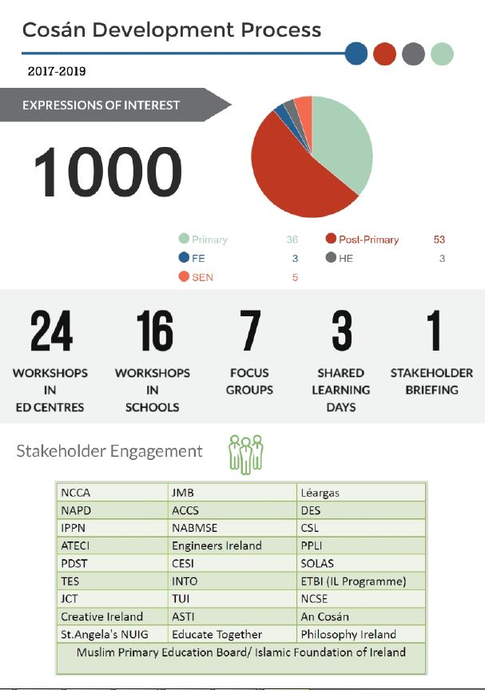
Cosán – Development Process (to date)
Notes:
Suggest hide – time constraints

Slide 11
Cosán – Development Process (to date)
Notes:
Suggest hide – time constraints

Slide 12
Cosán – Core Principles
Professional Autonomy/ Responsibility
Flexibility
Accessibility
Acknowledgement
Relevance & Quality
Impact
Core Principles
Notes:
Teachers told us that professional autonomy around their learning was vital, and we know from the literature that autonomy in professional learning is crucial in fostering active engagement, and ensuring that learning is relevant for teachers. Professional responsibility is also here, and this reflects the Council’s policy on the continuum where engagement in learning for teachers, is both a right i.e. teachers should have access to quality relevant learning opportunities, and a responsibility, where they should be expected to continue to engage in professional learning for professional growth.
Teachers also told us that flexibility was important - where they could engage in varying forms of learning, or at different times in their career. They do not want a one-size-fits all. Likewise, as mentioned, they needed access to quality learning, that was relevant to their context and career stage. They also wanted to be acknowledged for their continued engagement in learning – this framework publicly acknowledges the rich terrain of teachers’ ongoing learning and, in time, the Council will also have a role in formally accrediting programmes, thereby further acknowledging teachers’ learning.
Finally, the impact of professional learning was widely debated during the consultation process . It is agreed that professional learning should have an impact on practice –on the teaching and learning that goes on in our classrooms – but of course teachers are best placed to directly observe and determine this impact.

Slide 13
Standards to guide learning and reflection
As learning professionals, teachers demonstrate a commitment to:
Quality teaching and learning for their students and themselves
Commitment to quality teaching and learning
and,
continued professional growth
Notes:
Cosán offers two overarching standards. This was based on feedback from teachers in the consultation process, that they wanted Cosán to be an accessible, practical document. It is also based on the principle of flexibility that I outlined earlier. In other words, the standards are set at a high level, so that teachers can interpret and apply them in their own unique contexts. So we see within these the emphasis on considering our professional learning in line with quality teaching and learning in our classrooms, and importantly professional learning that impacts our students. Likewise, in engaging in professional learning teachers demonstrate professional growth and enhanced practice – again there are clear connections here around the impact of the learning on us as professionals and our practice. And finally, the importance of ensuring this is all sustainable. The latter point was particularly highlighted by teachers in their feedback. Teachers are busy people, and they need to have a framework that will work, a framework that is real - that can be applied by them in the reality of our daily working lives.

Slide 14
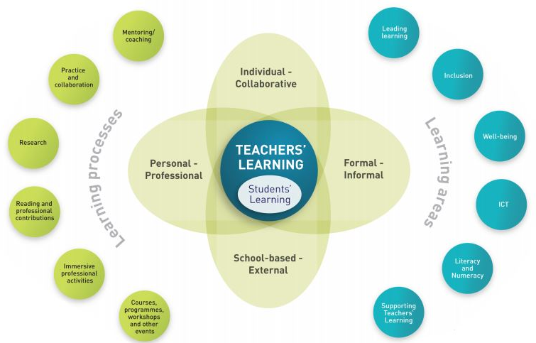
Key Elements in Cosán
Commitment to quality teaching and learning
Ability to sustain professional practice
Ability to sustain professional practice
Commitment to continued professional growth
Notes:
These key elements in Cosán reflect what teachers said in the consultation process i.e. that they learned in a myriad ways – whether through mentoring, practice and collaboration, research, their own reading, or of course attendance at workshops and programmes. Likewise, a number of learning areas were highlighted, and these are defined very broadly in the framework e.g. inclusion, well-being, literacy and numeracy, and leading learning. And of course, all of this learning may happen individually, collaboratively, formally or informally. It may also happen in school or external to school, and Cosán recognises all of this! But in echoing the standards I just mentioned, at the heart of teachers’ learning is an emphasis on student learning i.e. that our professional learning has a direct link, and indeed, impact on what happens in our schools and classrooms. And this notion of impact is not simply about standardised test results, but within Cosán, impact is defined in a much broader way – referring to e.g. engagement, motivation, enjoyment etc. And within the framework, all of these learning processes take place in a context where teachers are reflective practitioners, who reflect on their learning, and on their practice, and on the connections between their learning and their practice.

Slide 15
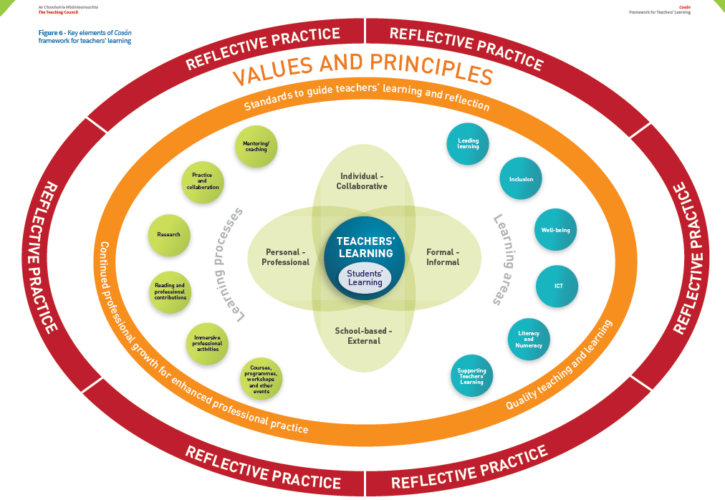
Overview of Framework
Notes:
So reflection is absolutely key to Cosán. In reflecting on their practice, whether individually or collaboratively, teachers can identify opportunities for development and engagement in professional learning. And of course, it’s crucial to continue to reflect on our professional learning, and explore the impact this is having on practice – so essentially it’s a cyclical process.
But if this is what the framework looks like on paper, what will it look like in practice?

Slide 16
Group Activity 1
Barry Kenny
Teaching Council Associate
ETBI Principals and Deputy Principals Conference
29 January 2020

Slide 17


Group Activity 1: Professional Learning
A. Think, Pair and Share:
What does professional learning look like in our context?
Notes:
Question 1 is Think, pair and share activity
With those comments in mind….consider question 2, discuss with colleaqgues and plase share feedback using mentimeter
Before we go any further we’d like you to consider:
What professional learning looks like in your context?
Why and how, in your context, do teachers engage in professional learning?
What do you think it does for them?
We’d also like you to begin to explore the framework in more detail, to explore the learning processes, the areas, dimensions, the emphasis on reflection, etc., and consider professional learning in your own context - does the description of your own setting align with the framework? And how can you, as school leaders, continue to support your colleagues on their learning journeys?

Slide 18
Group Activity 1: Professional Learning
B. Group Discussion
How can we as school leaders continue to support meaningful professional learning?
Feedback via menti.com
code: 84 08 32
Notes:
With the previous activity having acted as a solid warm up, please now engage with colleagues and discuss the following.
We would appreciate your feedback via menti.com - see code – which we will take into consideration as we work together to move the Cosán development process forward.

Slide 19
Cosán Development Process
Evidence-based approach
Collaborative exploration of teachers’ engagement in professional learning, and reflection on professional learning.
Notes:
Just to echo Barry's thanks for all of that feedback. And we’ve been engaging with teachers the length and breadth of the country to ask them to consider similar questions. Because that's what the Cosán Development Process is all about. That's the phase we're currently in terms of the ongoing evolution of Cosán.
We're working with the profession, and we're asking them to explore their engagement in professional learning and their reflection on their professional learning, in the context of Cosán.

Slide 20
Lesson No. 1
Although Cosán acknowledges the wealth of professional learning that teachers are already engaged in – it is also about culture change, in terms of critical reflection on that learning.

Slide 21
Developing Reflective Cultures
Reflective School Culture
Vision Creation
Collaborative Inquiry
Professional Learning
Relationships
Student Learning
Reflective questioning
(Barnett and O’Mahony 2006)
Notes:
So we've started to have a look at some of the literature about reflective cultures.
Barnett and O’Mahony outline a range of characteristics of, and measures to work toward, a reflective school culture. They talk about the importance of relationships and, specifically, team culture, where, for example, roles, responsibilities , norms and expectations are clear and agreed by all. They also talk about the commonplace use of reflective questioning in schools. Barnett and O’Mahony explicitly reference how leaders should model this type of questioning in their interactions with teachers:
Reflective questioning is a technique in which one person prepares and asks questions that are designed to provide opportunities for the respondent to explore his or her knowledge, skills, experiences, attitudes, and values. … Reflective questioning encourages the respondent to explore his or her own thinking; it is not intended to direct the respondent to a conclusion pre-determined by the questioner. For questioning to be truly reflective, the questioner must respect the respondent’s statements, suspend judgment, and avoid attempts to manipulate his or her thinking. (Lee & Barnett, 1994, p. 17, emphasis in original)
They also talk about the varying ways that school communities can co-create a common vision. For example, asking those reflective questions, or being more direct and asking:
Whom do we serve?
● What do we do?
● When do we do it?
● Where do we want to go with our efforts?
● Why are we focusing on this work and these goals?
● How do we put the above into operation?
They talk about infusing a culture of collaborative inquiry through teachers’ practice, possibly through action research, where they reflect on, and question, particular practices and gather evidence to answer questions about this practice.
Finally, they talk about professional learning as a direct means to supporting reflective cultures. By drilling down into professional learning and exploring its impact on practices, on the teaching and learning that’s happening in our classrooms, and ultimately on our students, we can ask and answer critical questions.

Slide 22
Case Study 1: Bray Institute of Further Education
3 collaborative learning sessions
First engagement with FESS
Offered teachers a choice of different workshops
Opportunity to reflect at the end using “What? So What? Now What?” model.

Slide 23
Experimentation
"It all went really well. People were interested and were introduced to new ways of thinking. They had to move from room to room for each workshop and this seemed to create a positive atmosphere. We had never participated in anything that way before.”

Slide 24
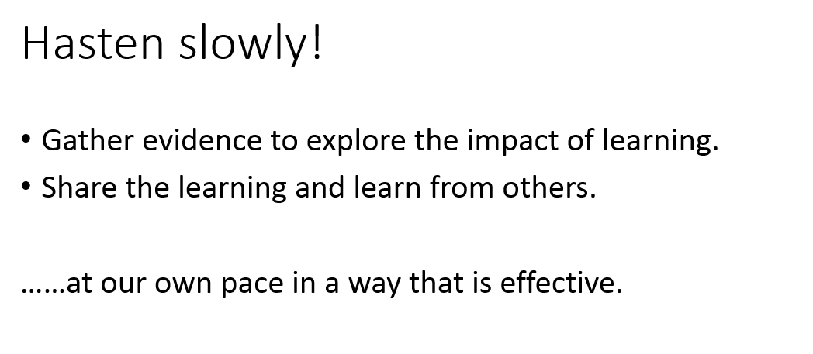
Evidence-gathering

Slide 25
Tentative, incremental steps
“It’s a start…it was a success in terms positive engagement and participation… In terms of generating good feeling and collegiality it was a real success.”

Slide 26
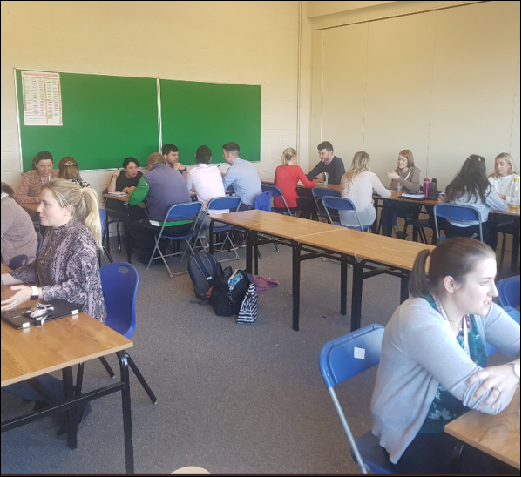
Case Study 2: Athy College

Slide 27
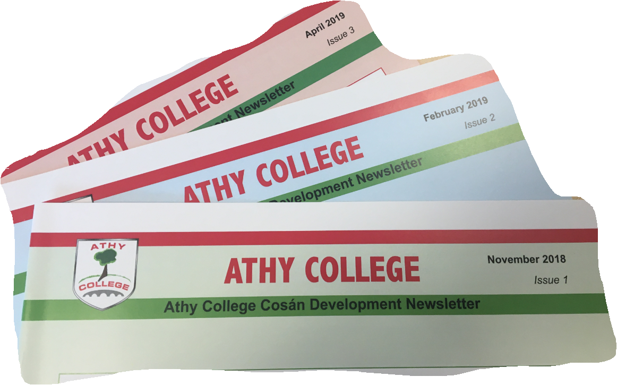
Shared Learning and Reflection

Slide 28
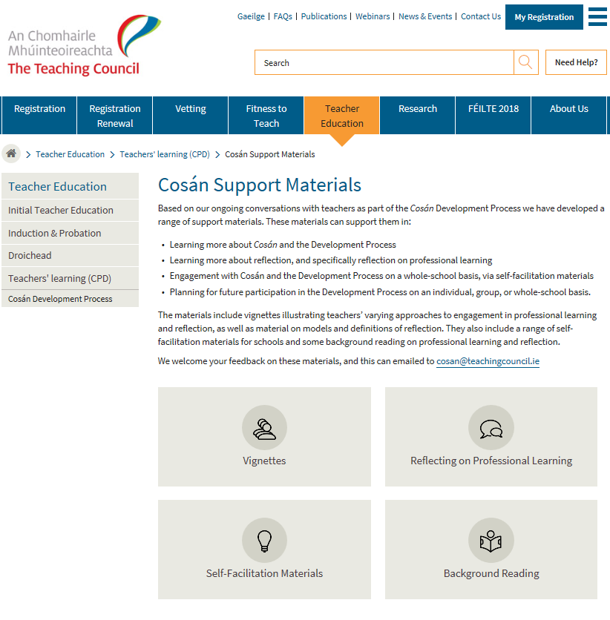
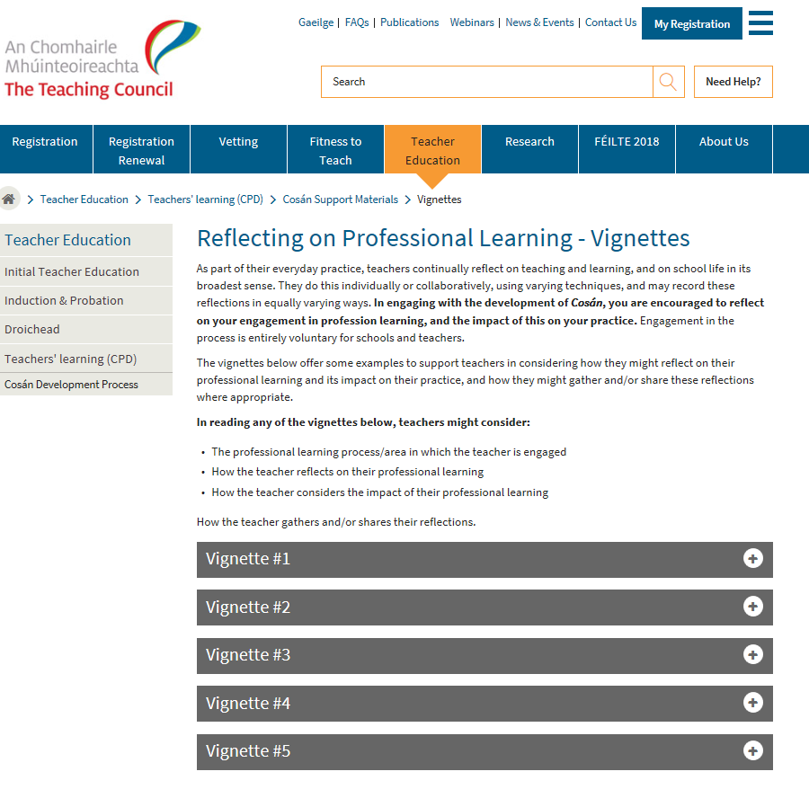
Supporting teachers in reflecting
Notes:
Duplicate slide – suggest delete
The Council is attempting to support teachers on their reflective journey –through the publication of a number of resources on our website. These include…

Slide 29




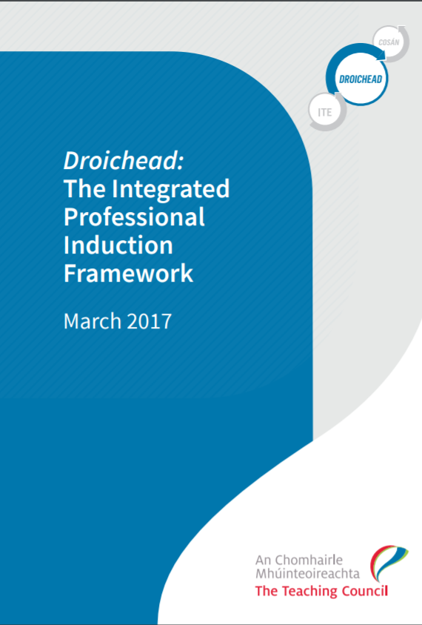
Reflection:
Common Ground in a Crowded Space?
Notes:
And it makes sense that we continue to do this, given that reflection is a crucial element of Cosán.
But, based on a comparative analysis of a range of national policies, it’s not just relevant in the context of Cosán. There are lots of national policies where, reflection is key to them and we’ve looked at these in some detail in a paper on our website – Common Ground in a Crowded Space. And we could equally talk about collaboration, and agency, because they’re equally emerging as common themes, but for the purposes of today, we’re focusing on reflection.
And we know that reflection is a central focus in the Junior Cycle Framework, in terms of the students’ ability to reflect on their learning, but also, more and more, it’s asking teachers to engage in reflection on their practice, through the SLAR process, and we see a similar emphasis in the revised SEN allocation model.
Reflection also key to Droichead, both in terms of the NQT’s reflection through their Taisce, but also through reflection on learning and practice in collaboration with his or her PST.
And it’s also a central feature of the Looking at Our School quality framework and the School Self-Evaluation Process, and is referenced extensively throughout it.

Slide 30
Reflective Tools
Visual
Discursive
Textual
Cognitive
Notes:
Through our reading and conversations with teachers we see that they typically reflect on their learning in varying ways, or indeed, use a range of reflective tools:
Cognitively – many teachers told us that reflection is mostly an exercise they do in their own head – a thought process and that this is how they reflect on their professional learning.
But we were also interested in how these reflections might be drawn out, either through discussion or through other forms. And they told us that they sometimes reflect:
Discursively – many teachers have told us that they engaged in professional conversations about their learning – as a form of reflection.
Textually – some teachers have told us that they use writing when reflecting - for example, as part of their Cúntas Miosúil , or as part of a journal or as part of their ongoing planning.
Visually – some teachers have told us that they use images, specifically photographs when reflecting – using visual ethnography – but this is less common.
And some of them have told us that they do a combination of these – hence why they’re overlapping here.

Slide 31




Reflective Tools
Portfolio-based Learning
Digital - Physical
Blogs
Journals
Vlogs
Forums
Social Media
Mapping
Planning/ Reporting
Photographs
ETC…
Professional Dialogue
Notes:
From initial teacher education and induction we can see the use of even more specific textual and visual tools to help teachers reflect e.g. Blogs, Journals, Vlogs etc. And these can be in digital or physical form. From the literature we know that each tool has its own challenges and opportunities. For example, journaling is very popular for initial teacher education students but while some research says that it can give them scope to really delve into their own practice and learning in a critical way, the fact that it may be graded is potentially problematic as they may merely produce reflections for a purpose beyond the benefit of their practice i.e. to “make the grade”. Likewise, some research has demonstrated how Twitter or other online forums can be used to draw out reflections on professional learning, but in order to use such mechanisms, strict protocols around data and sustainability are necessary. And we’re not saying that one tool is better than another, but teachers and schools should explore which tools or a combination thereof might work for them.
You’ll also note here how we’ve kept Professional Dialogue as overlapping, because from our conversations, and importantly in the research, we note that professional dialogue appears to bring these other tools to life. Even if someone posts a static blog as a reflection, it’s the back and forth about elements of their reflection and the dialogue that helps them make real sense of it. And professional dialogue is absolutely vital for visual tools like photographing, where an accompanying narrative with the photo gives us a real sense of the teacher’s learning journey.
I’ve mentioned one further element here - portfolio-based learning – which without wanting to confuse anyone, as a process or product can include any of these elements. In engaging in portfolio-based learning we can call on any of these tools, whether writing reflectively, contributing to online forums, using photographs, diagramming etc. But as I mentioned before, this is all brought to life by the dialogue around this portfolio.

Slide 32
Group Activity 2
Barry Kenny
Teaching Council Associate
ETBI Principals and Deputy Principals Conference
29 January 2020

Slide 33
Group Activity 2: Moving Forward Together
A. Think, Pair and Share
How/when does reflection happen in our schools?
Notes:
Allow time to read
Having explored the framework and the tools, we might now begin to think about how we can continue to support teachers in actively reflecting on their learning, what you can do as school leaders in this regard, and where we might find avenues for synergy, collaboration and the sharing of a common language.
Question 1 is Think, pair and share activity

Slide 34
Group Activity 2: Moving Forward Together
B. Group Discussion
How can we as school leaders continue to lead and support cultures of reflection?
Feedback via menti.com
code: 84 08 32
Notes:
With the previous activity having acted as a solid warm up activity, please now engage with colleagues and discuss the following.
We would appreciate your feedback via menti.com - see code – which we will take into consideration as we work together to move the Cosán development process forward.
I’d ask you to use record your responses to this question on Mentimeter.

Slide 35
Possible Next Steps
Carmel Kearns
Head of Teachers’ Learning and Research
The Teaching Council
ETBI Principals and Deputy Principals Conference
29 January 2020

Slide 36
www.teachingcouncil.ie
cosan@teachingcouncil.ie
Notes:
One possible next step that you might choose to take, is to check out at the resources on our website that I mentioned earlier. These seek to support you in embedding reflective learning cultures in your schools.
The Council is attempting to support teachers on their reflective journey –through for example, as I’ve mentioned, the publication of a number of resources on our website, which schools can use to facilitate ongoing discussions. These include some of the models we mentioned earlier, but broken down into specific questions that teachers might ask when engaging with them, as well as vignettes illustrating potential uses for some of the reflective tools we looked at earlier.

Slide 37

Workshop-based professional learning
In collaboration with ESCI
Series of 3, with school-based activities and online support
3 participants per school, including one senior leader
Facilitated by practising teachers
Currently in Clare, Limerick, Donegal, Cork, Navan, Kilkenny and Dublin West
A further 6 education centres in 2020/21
cosan@teachingcouncil.ie
Notes:
You might also choose to engage, with two colleagues from your school, in our workshop programme that we're currently supporting in collaboration with ESCI.

Slide 38
Thank You

